Slide 1
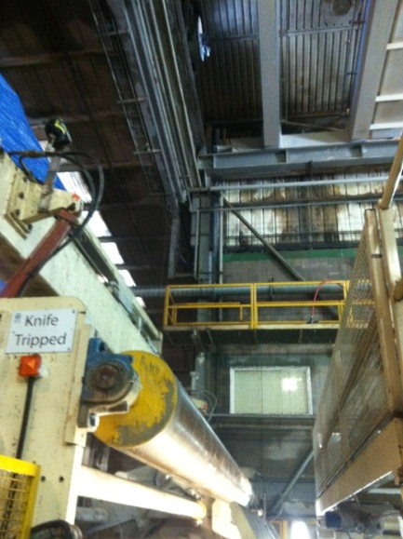
Fire at Oakenholt PM2 – 27/02/2015
Description: Operator saw small flames in a corner of PM2 building. The fire was extinguished by the site fire team, and the external fire & recue service were called in to check the roof void as a precaution. They also carried out thermal imaging, to help identify any hot spots.
No injuries were sustained during fire fighting operations.
Damage: Water damage to 10t of paper.
Water damage to wrapper motors.
Causes: Investigation commenced / ongoing.
Actions: Paper machine shut down for clean up – 6 hours.
Affected area inspected to ensure safety.
Work started to repair water damaged wrapper motors.
Fire seen in this area

