Slide 1
Salmon For Tomorrow - Clywedog
Photo Survey
Fish Passage Improvement and Weir Removal Scheme
TO BE SENT TO: permitreceiptcentre@naturalresourceswales.gov.uk
Reference: https://naturalresources.wales/permits-and-permissions/water-abstraction-and-impoundment/hydropower/geomorphology-photo-surveys-for-hydropower-developments/?lang=en

Slide 2
Basic Site Information
River Name: River Clywedog
Address or Location: SN94432 85506
Key Elevations:
Existing Fish pass weir crest: 170.783 mAOD
Existing weir crest: 171.928 mAOD
Length and Bed slope of the existing channel: 1:110 over 145m
Length and Bed slope of the proposed channel: 1:110 over 145m
Refer to geomorphology assessment 277161 - ARP - 10 - XX - RP - XX - 1001

Slide 3
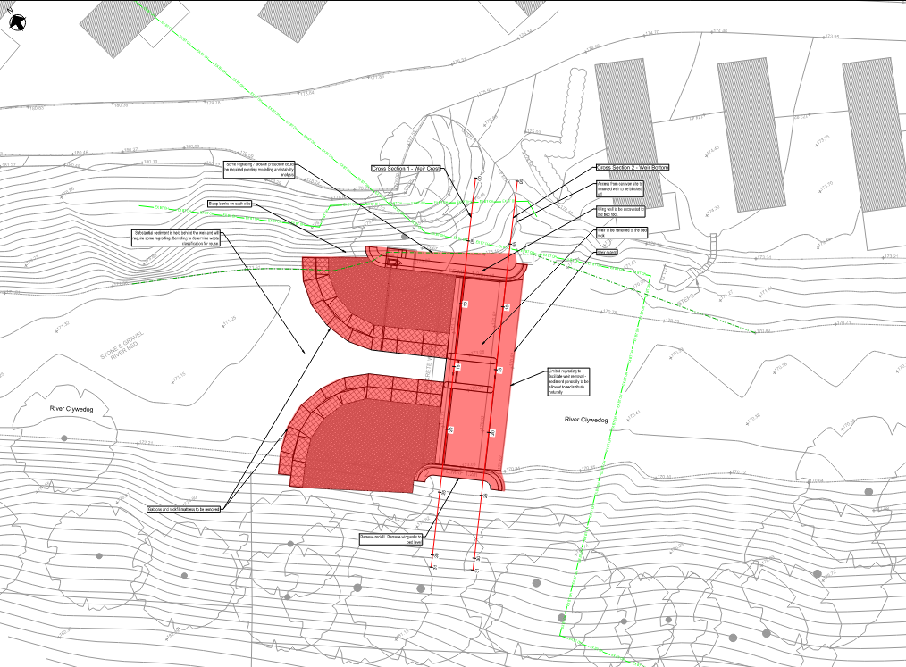
Annotated Site Map – Proposed Scheme

Slide 4
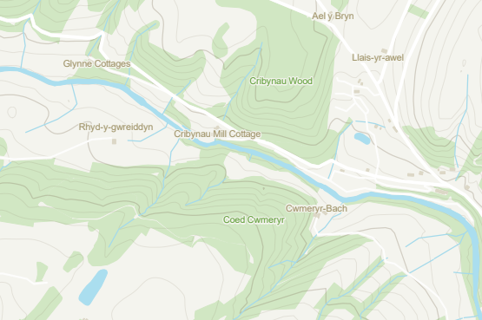
Annotated Site Map - Photos
1a
1b
2.1
2.2
3
4
5
6

Slide 5
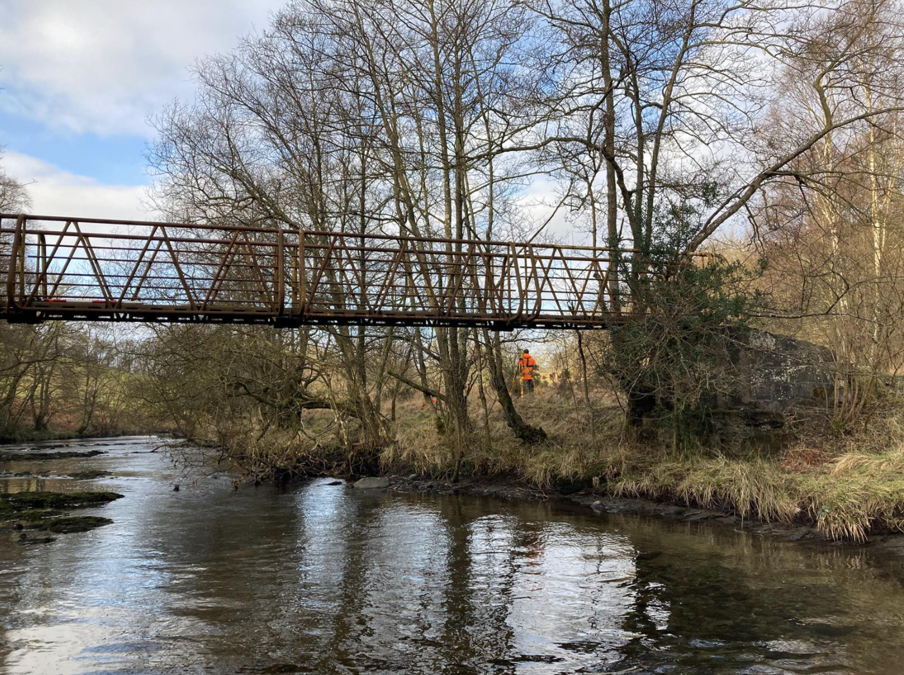
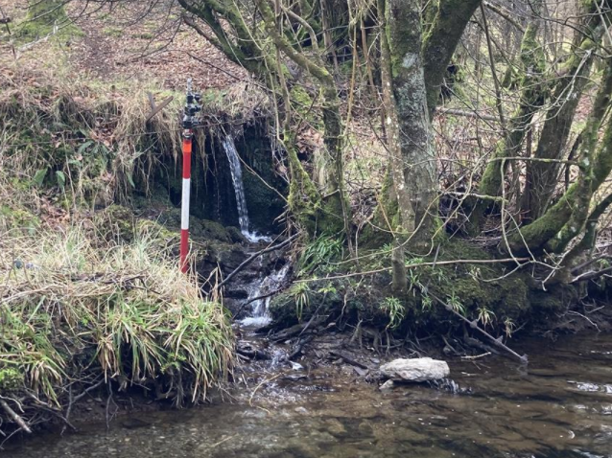
Photograph 1a and 1b – Open Channel Upstream of the weir
Photograph 1a
Bridge spans approximately 16m across river
Photograph 1b
Incoming channel

Slide 6
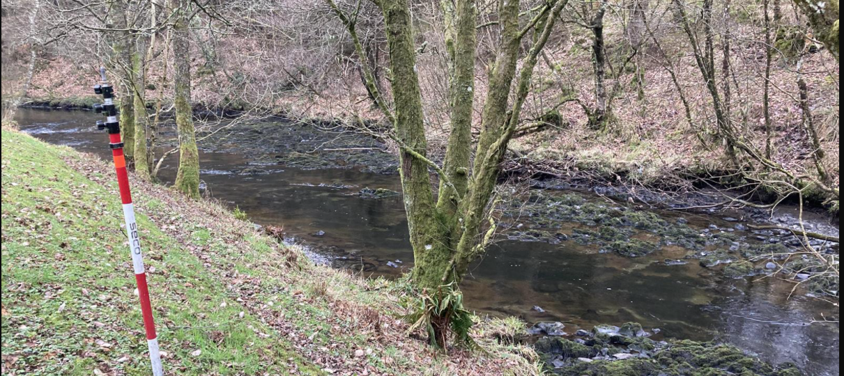
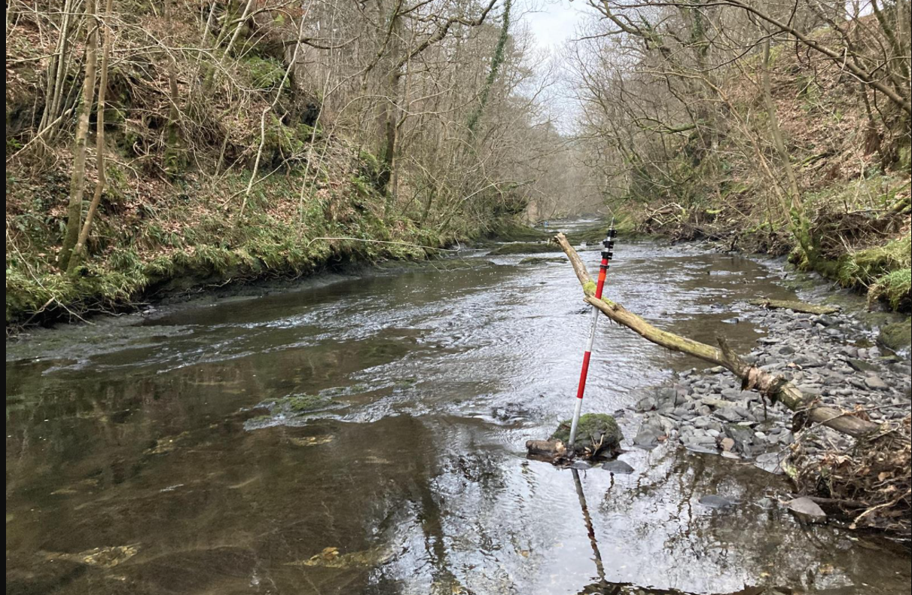
Photograph 2.1 and 2.2 – Open Channel Upstream of Weir
2.1 Before Bend
Orange dot represents where the ‘After bend’ photo was taken
2.2 After bend

Slide 7
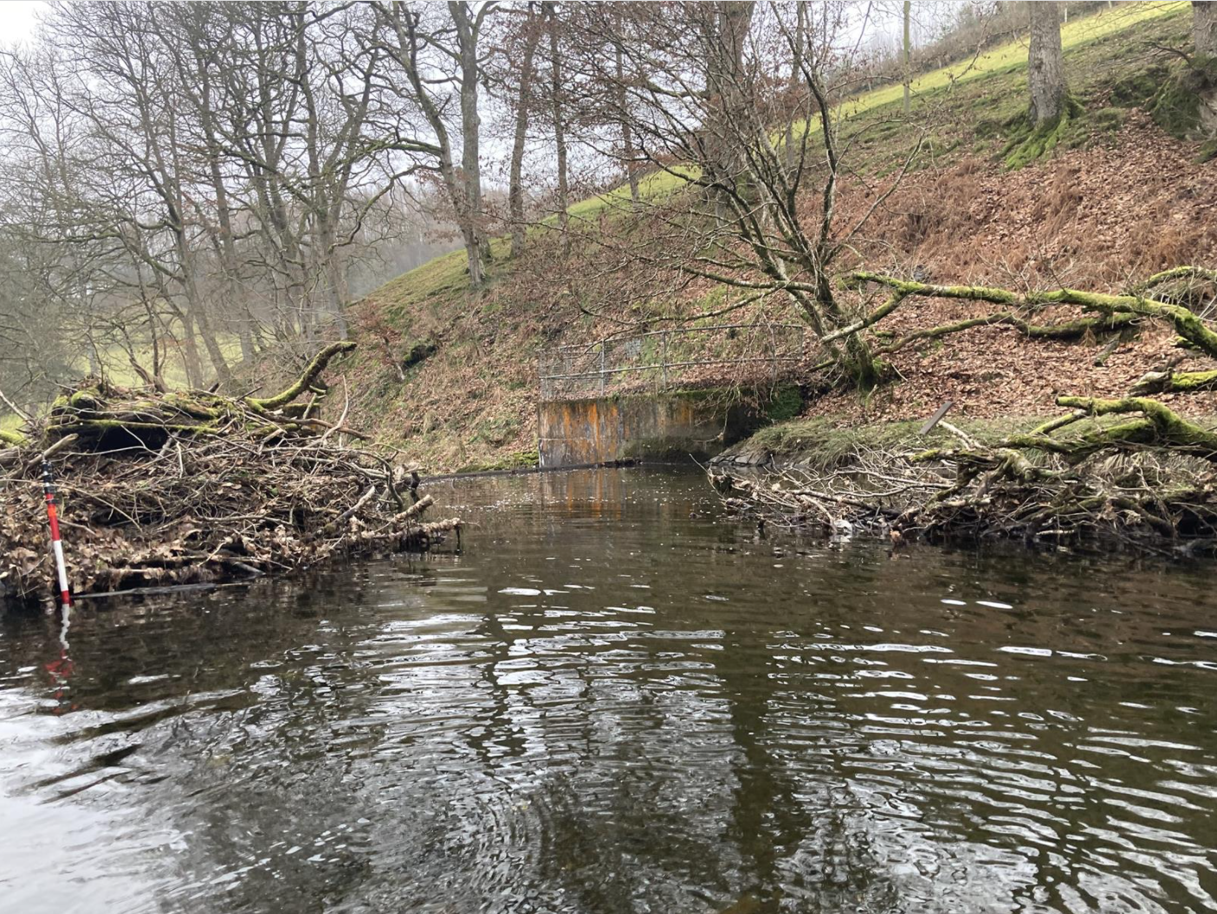
Photograph 3 – Upstream of Weir looking downstream
Red area indicates the area where substantial sediment deposition will be cleared
Blue lines represent where the Gabions are, stretching approx. 10-15m behind the crest of the weir
Wing walls will be demolished as will the entirety of the weir itself

Slide 8
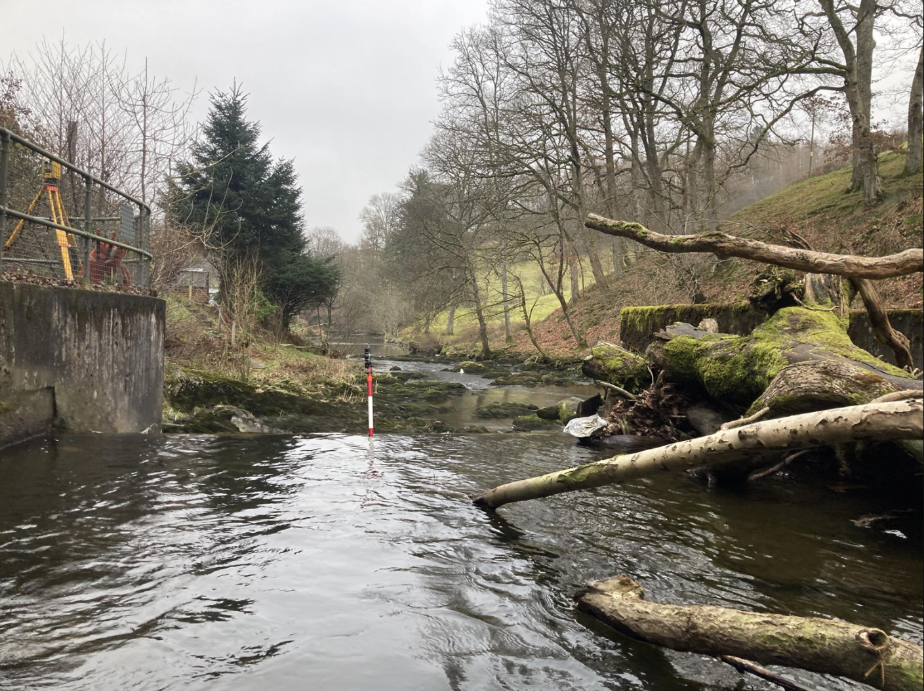
Photograph 4 – Weir Crest looking downstream
Concrete platform on the left
Concrete funnel on the right
Width of weir (including funnel) approximately 15m

Slide 9
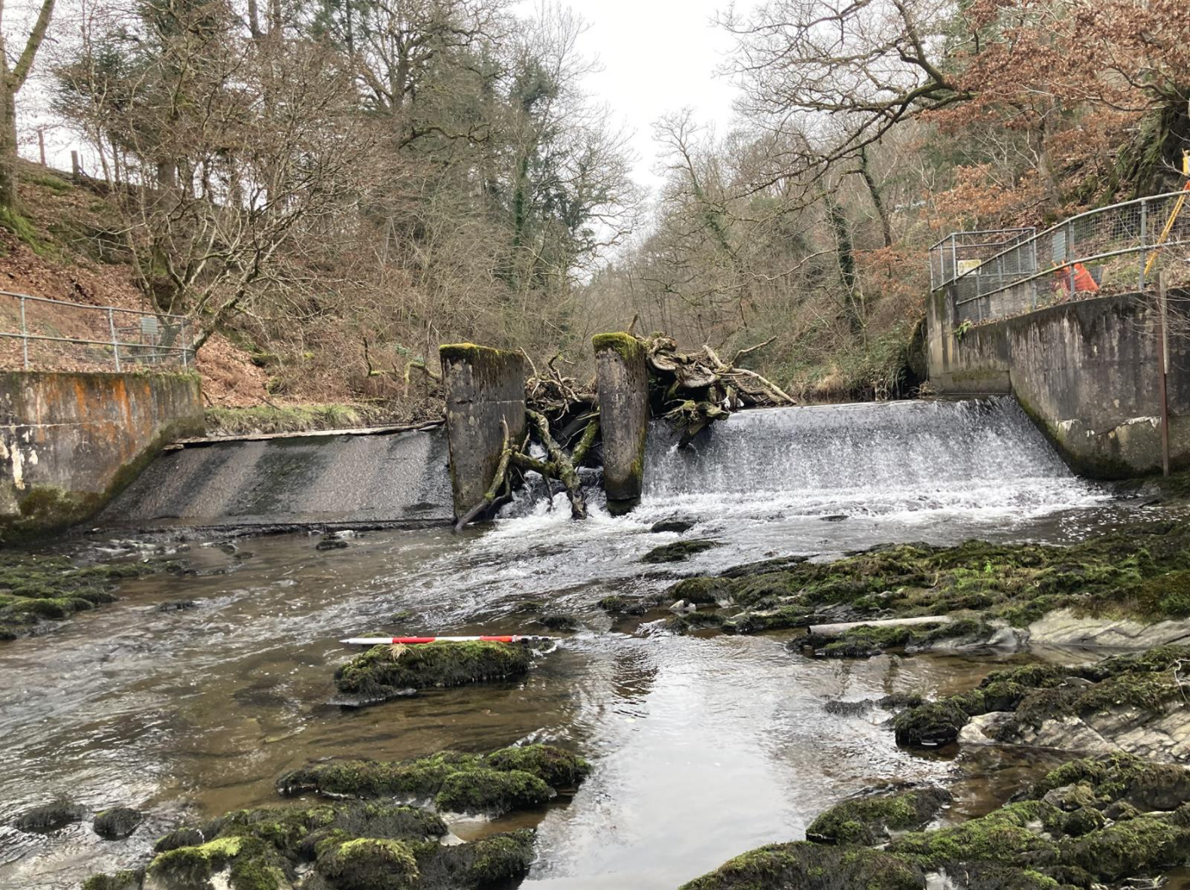
Photograph 5 – Downstream Toe of Weir looking upstream
Fish pass approximately 2.5m width
Concrete stands on each side, approximately 12 Sqm each
Wood and debris disrupting fish passage
The entirety of the weir and the wing walls will be demolished and the bank regraded on the left (facing downstream)

Slide 10
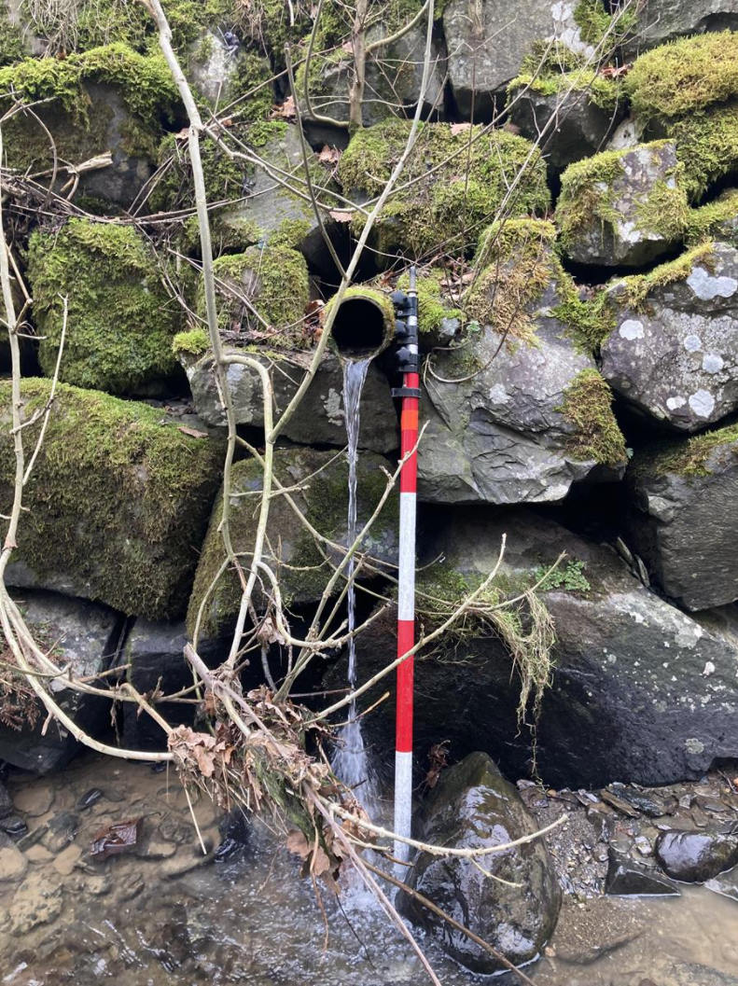
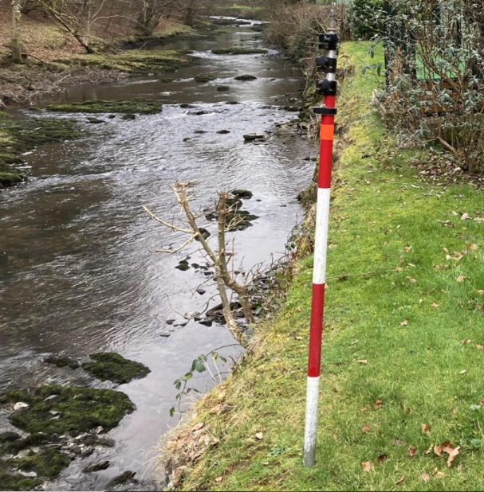
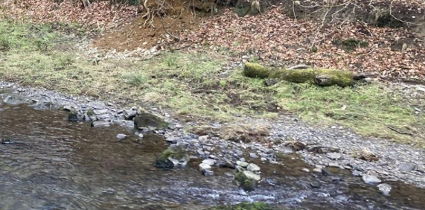
Photograph 6 –Incoming Pipe
Diameter approximately 150mm
Right bank soil substrate
Left bank substrate gravel
Substrate – left bank and right bank
Left bank
Right bank

