Slide 1
Photo Album
by Davies, Carwyn

Slide 2
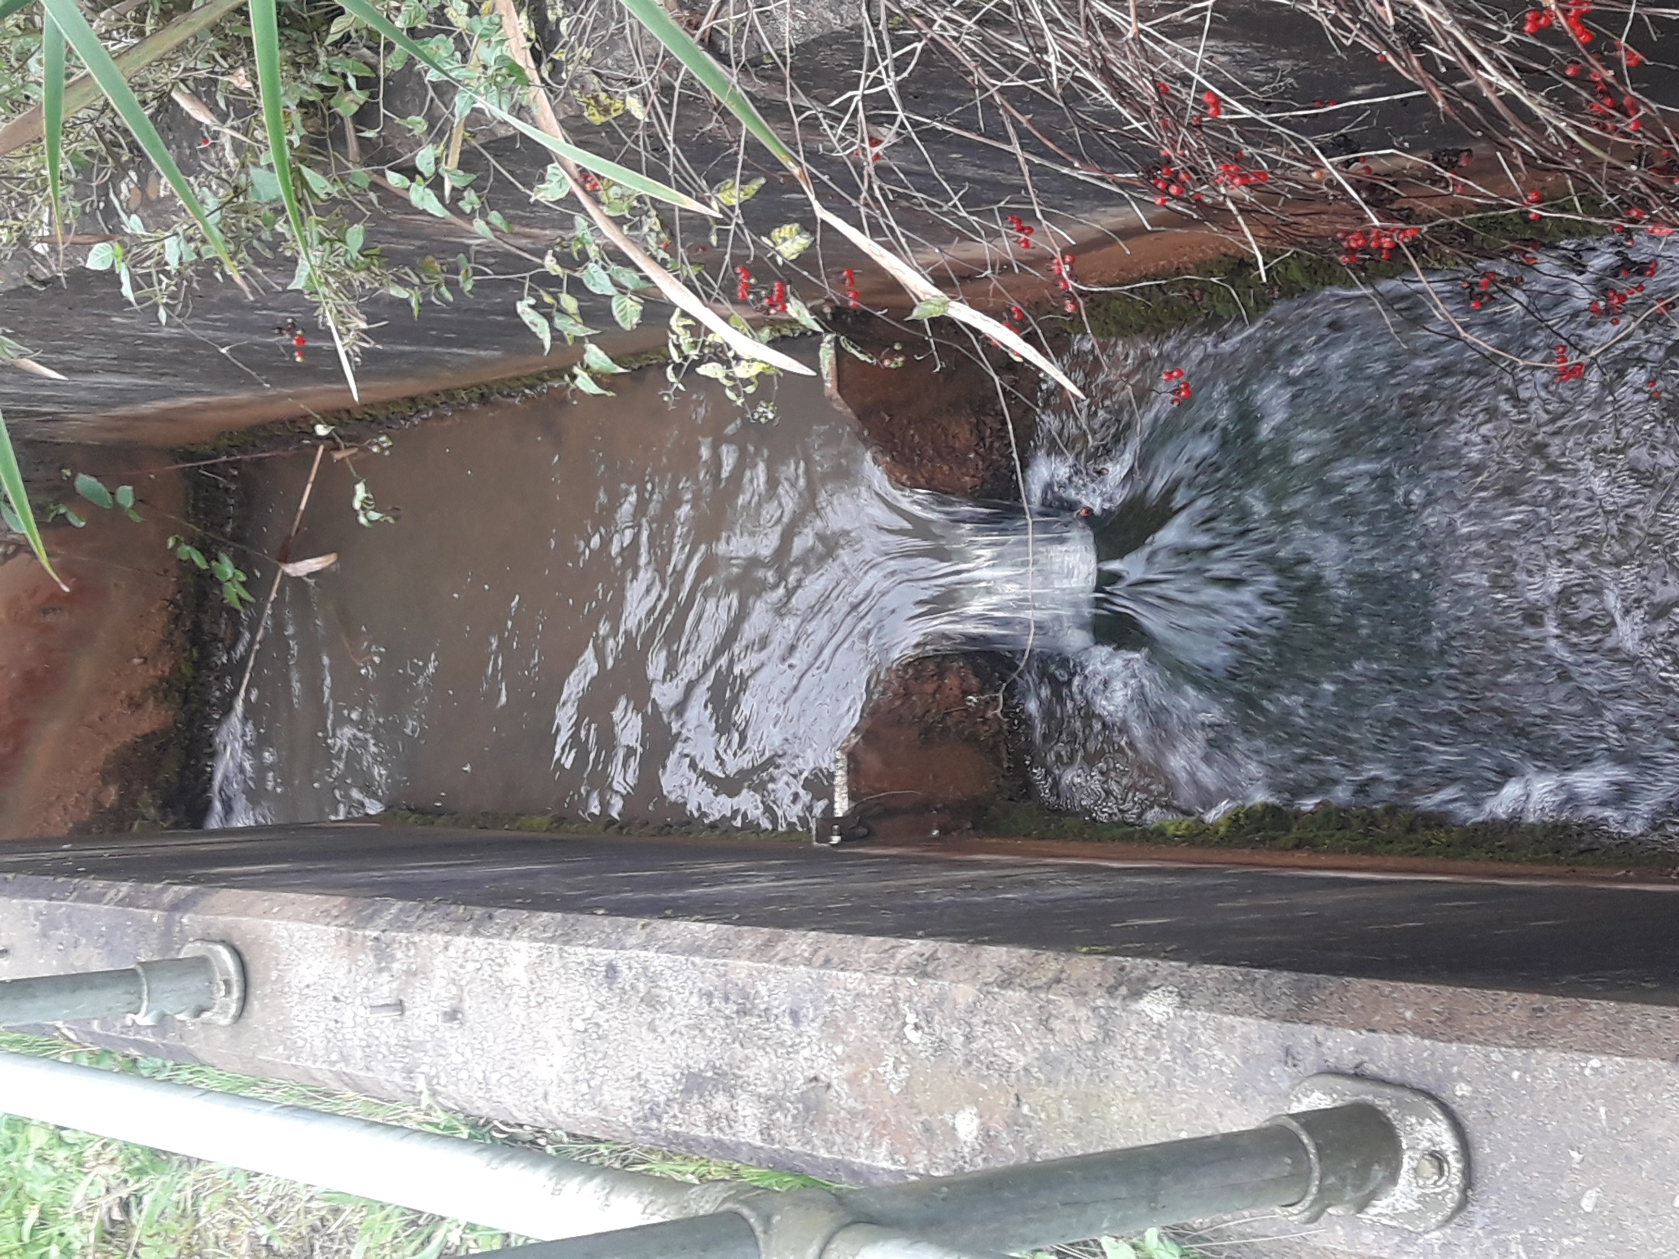

Slide 3


