Slide 1

Glamorgan Recycling Ltd
Visited: 27th April 2023
Purpose: Follow-up Visit to Site Condition Inspection Dec 2022 re actions
Location: Berth 31, Wimbourne Rd, Barry Docks, Barry, CF63 3DH.
EPR/AB3690CP
Surrender Application refs: PAN-020061
Persons Present: Senior Industry & Waste Regulation Officer Lovelock, Elysia and Environment Officer Grabham, Alex.

Slide 2
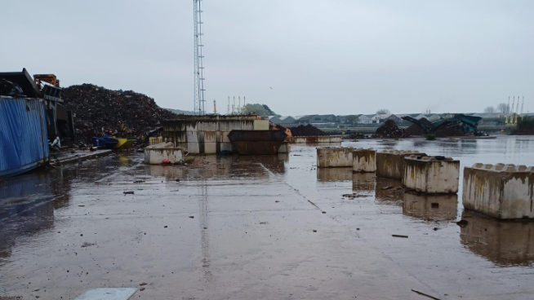

Slide 3
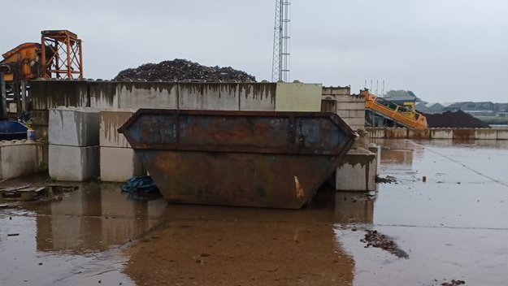

Slide 4


