Slide 1
22/60/1/0068
Bryngwyn WTW
Site inspection
Photographs – 16/11/2018
by Anna Fracchiolla & Jeremy Goddard

Slide 2
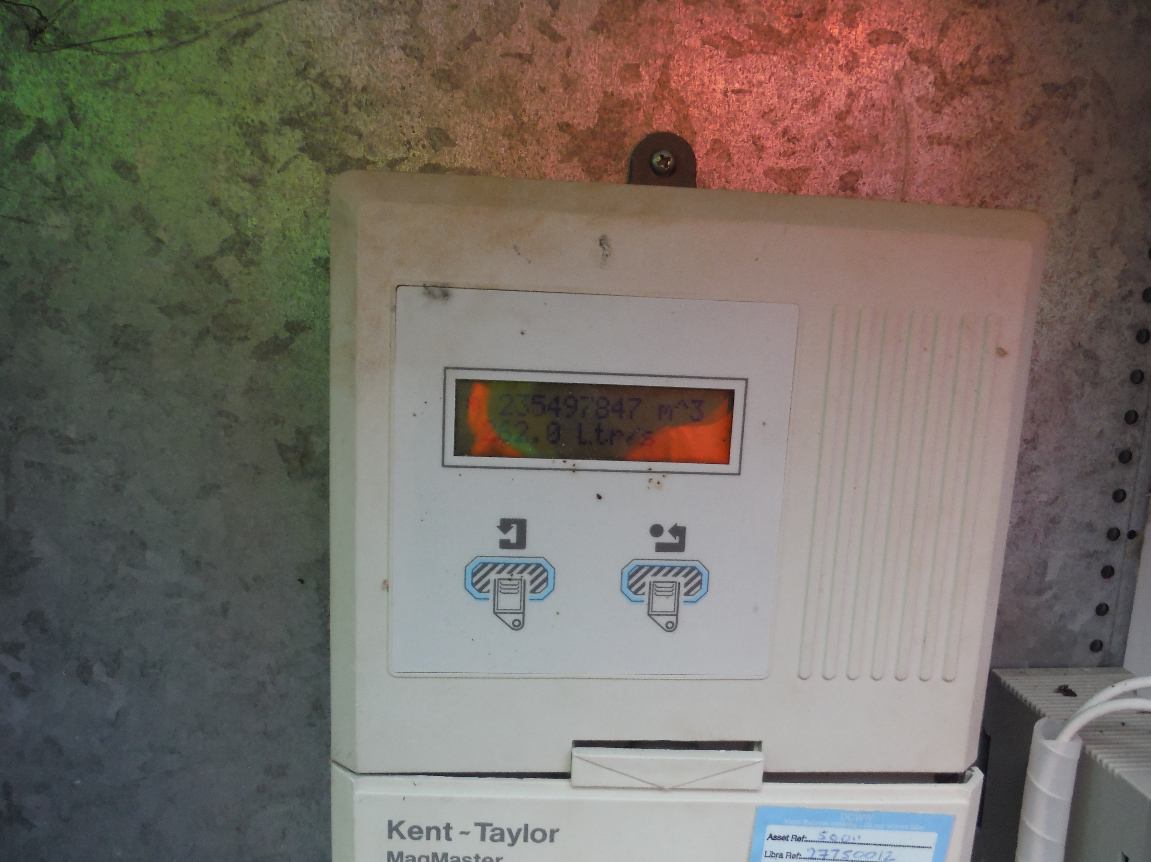

Slide 3
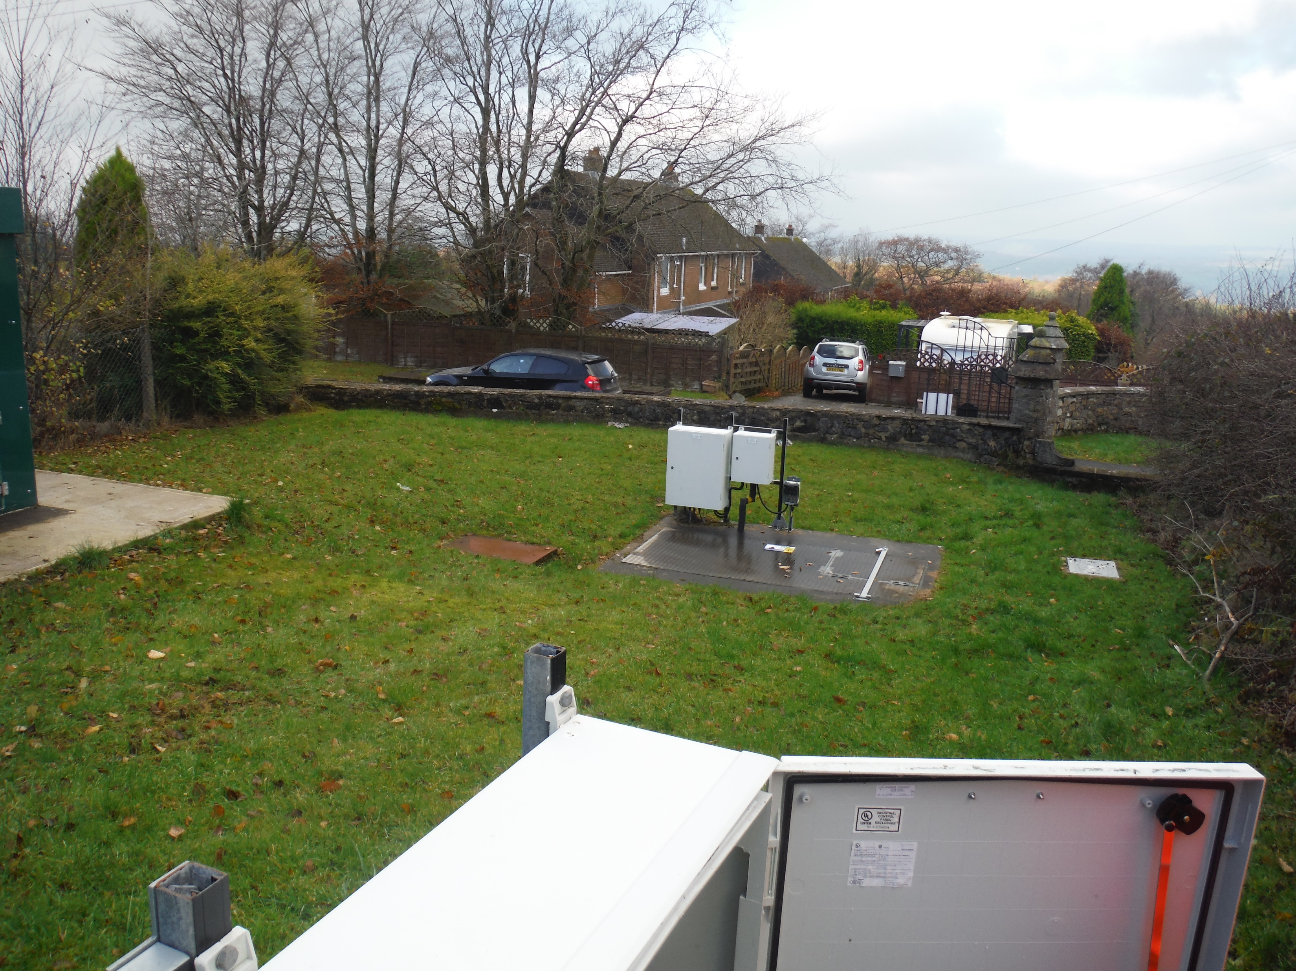

Slide 4
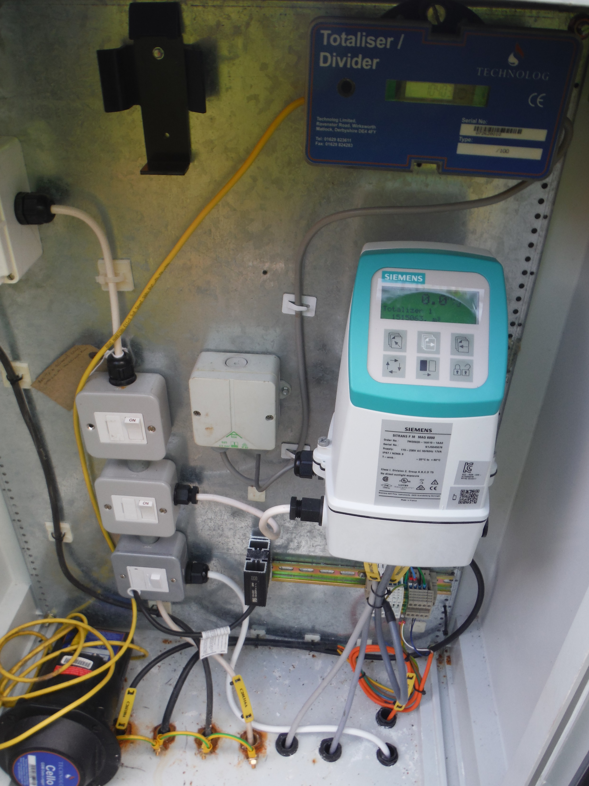

Slide 5


