Slide 1
Pembrokeshire Metal Recycling CB3694ZT
Site visit photos 15 Feb 2024
by Ellar, David

Slide 2
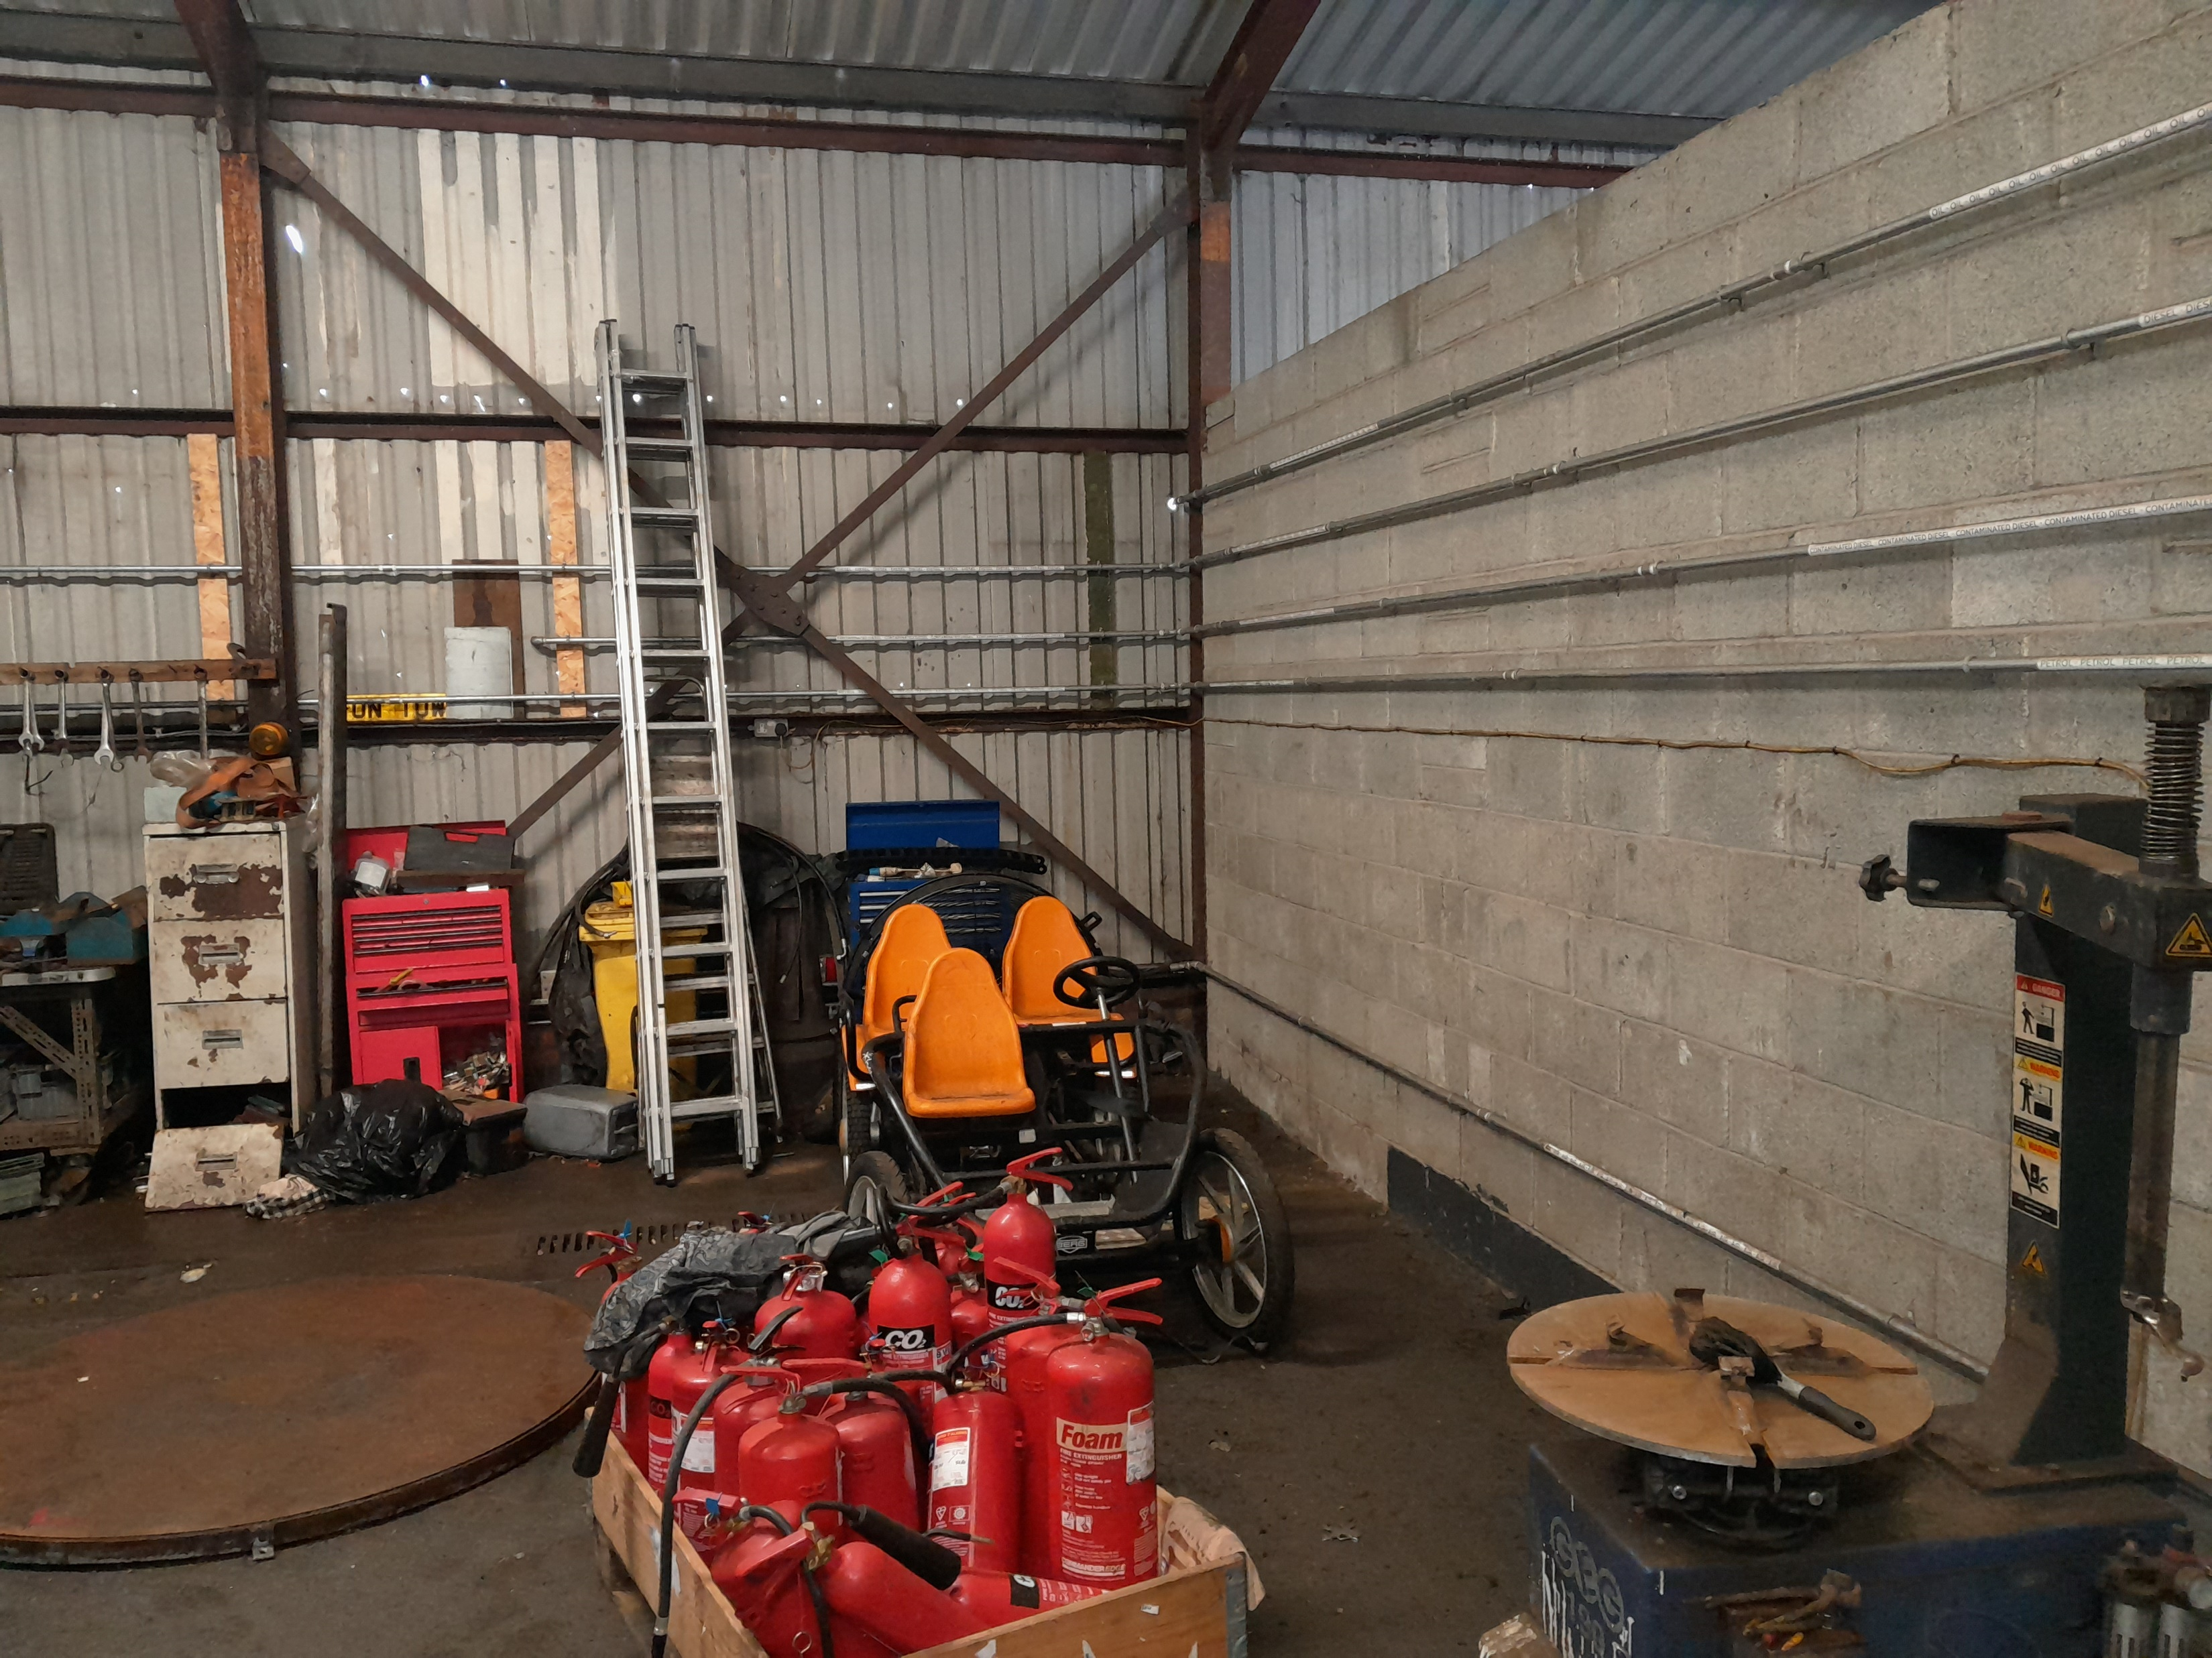

Slide 3
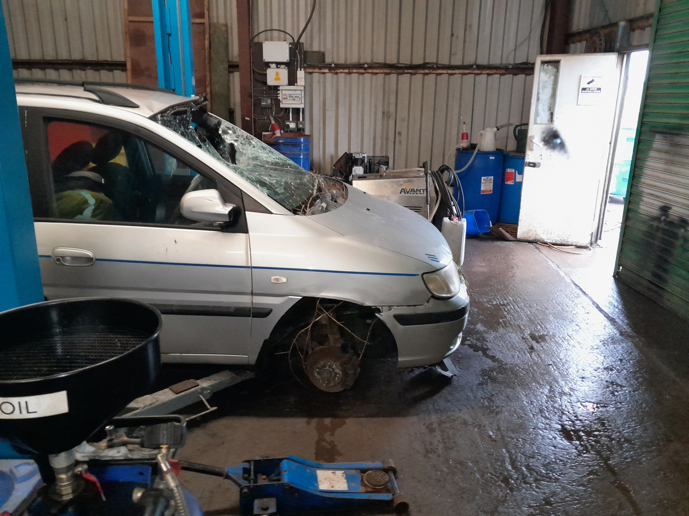

Slide 4
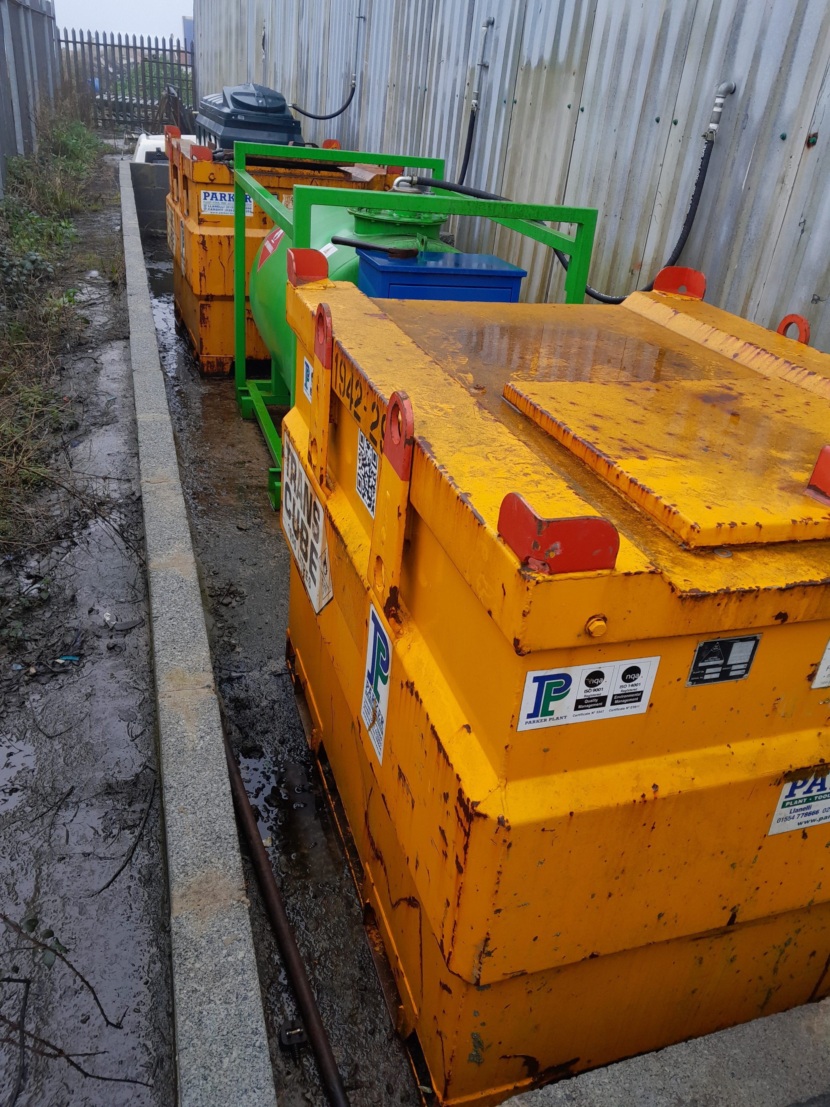

Slide 5
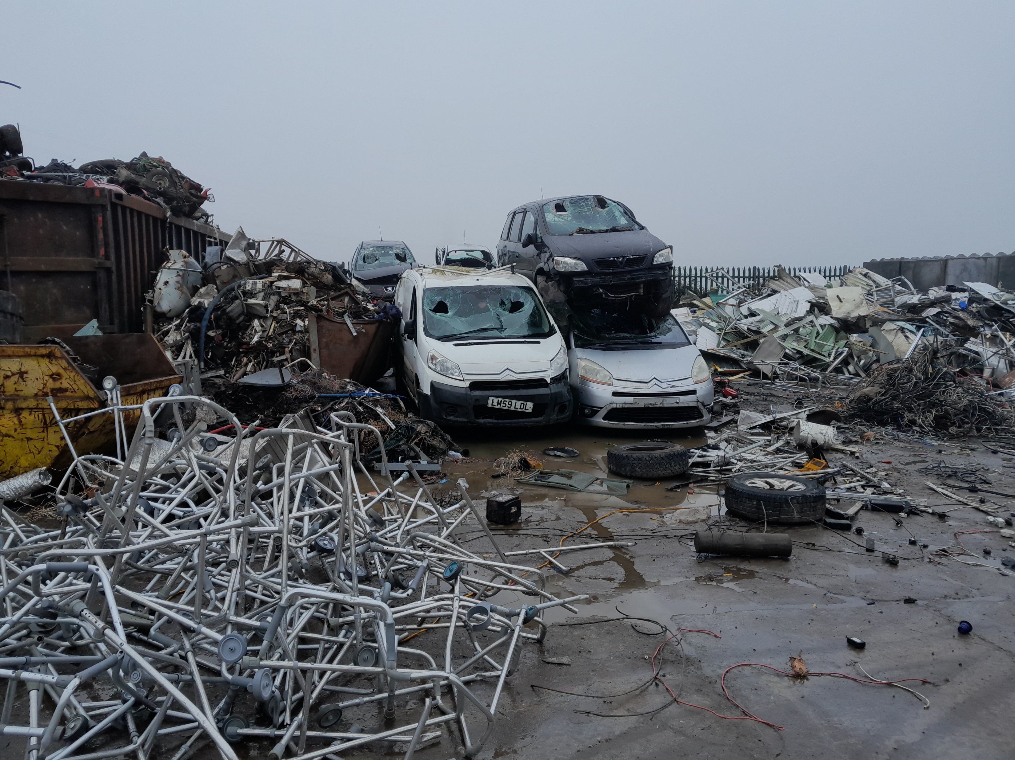

Slide 6
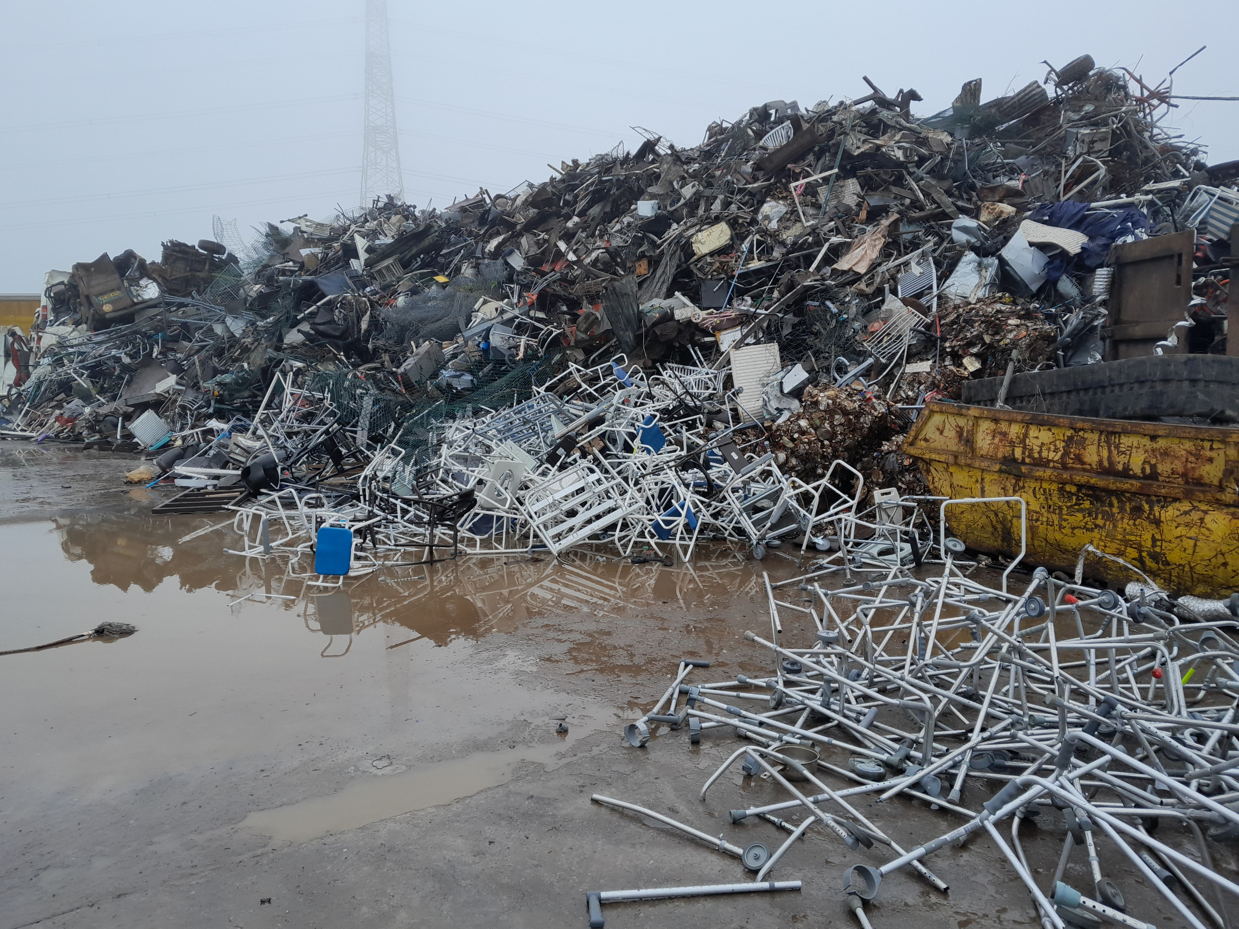

Slide 7
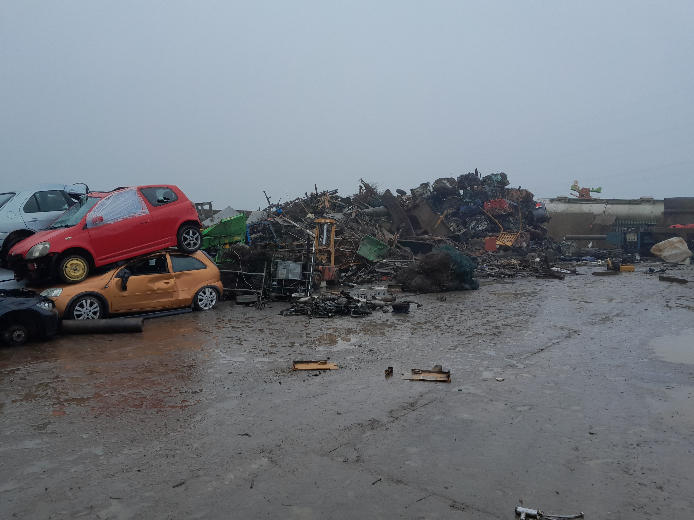

Slide 8
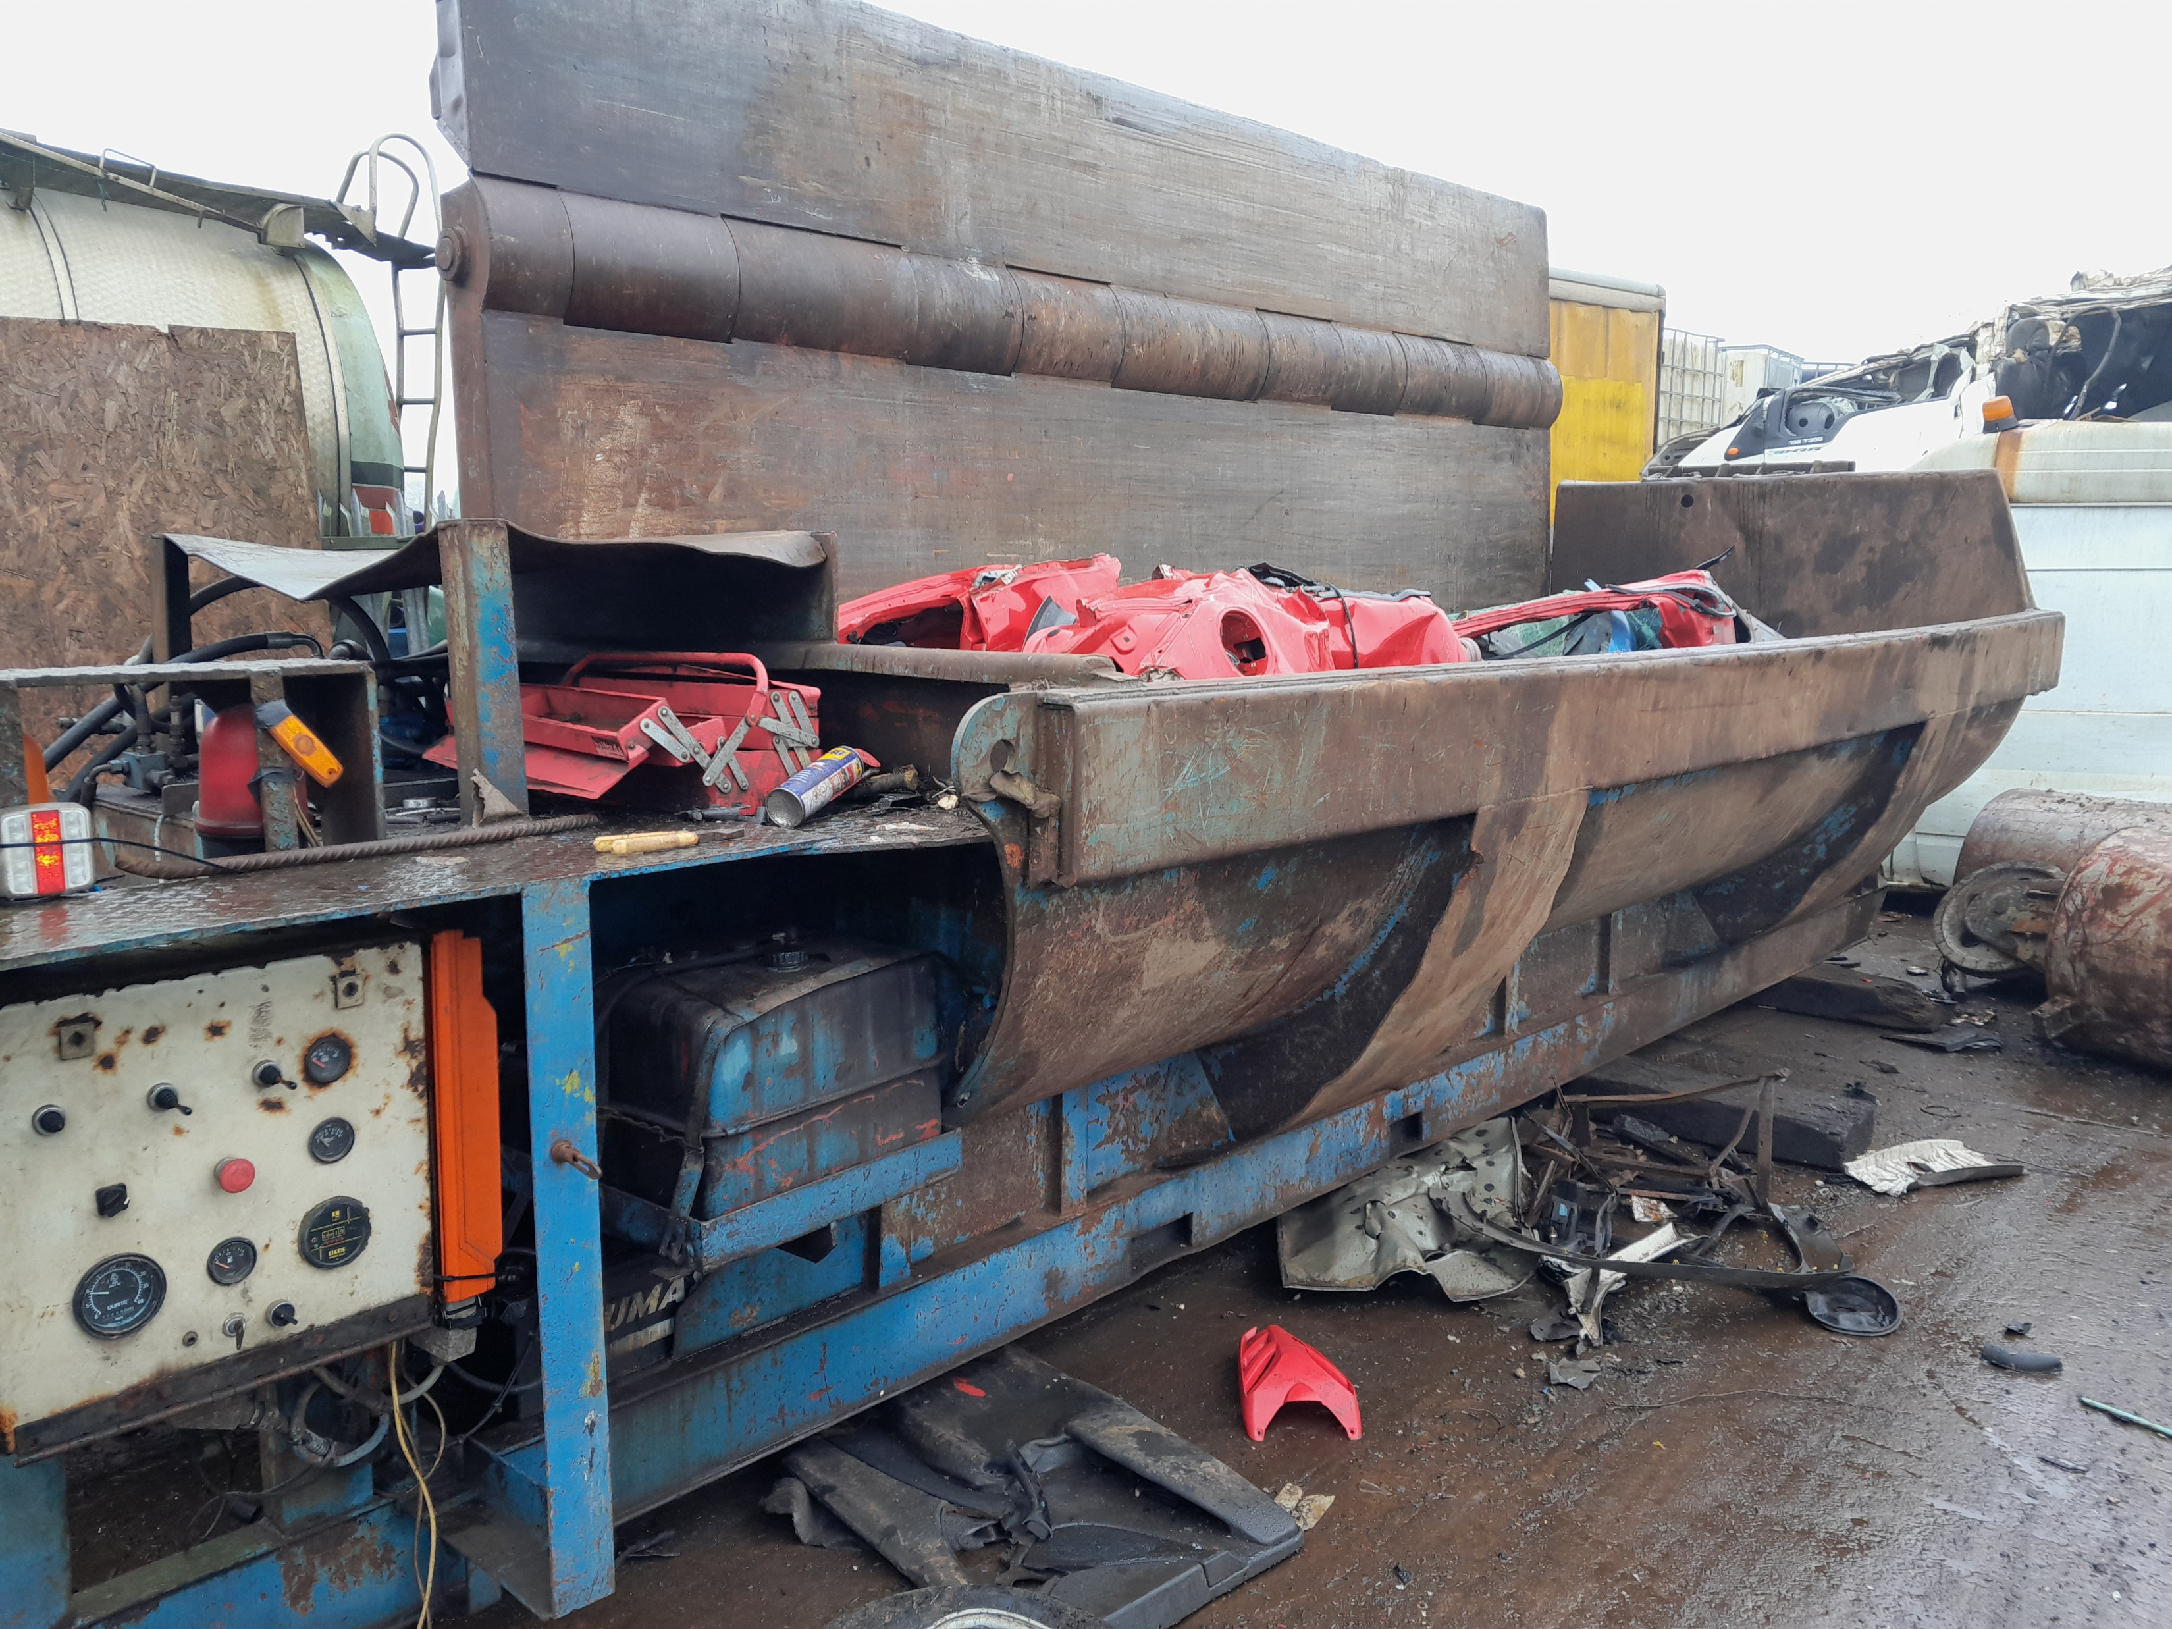

Slide 9


