Slide 1
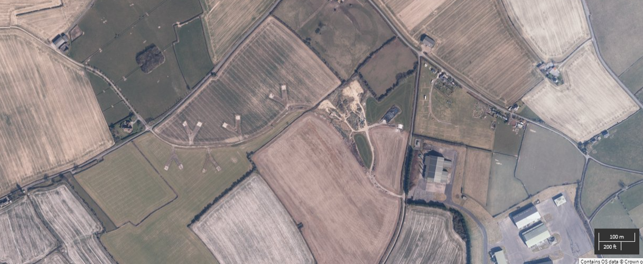
Scott Walton Contracting—general layout
Site boundary-area covered by the SCR
External yard area used for storage of inert material only.
Area made up of hardstanding and compacted soils.

Slide 2
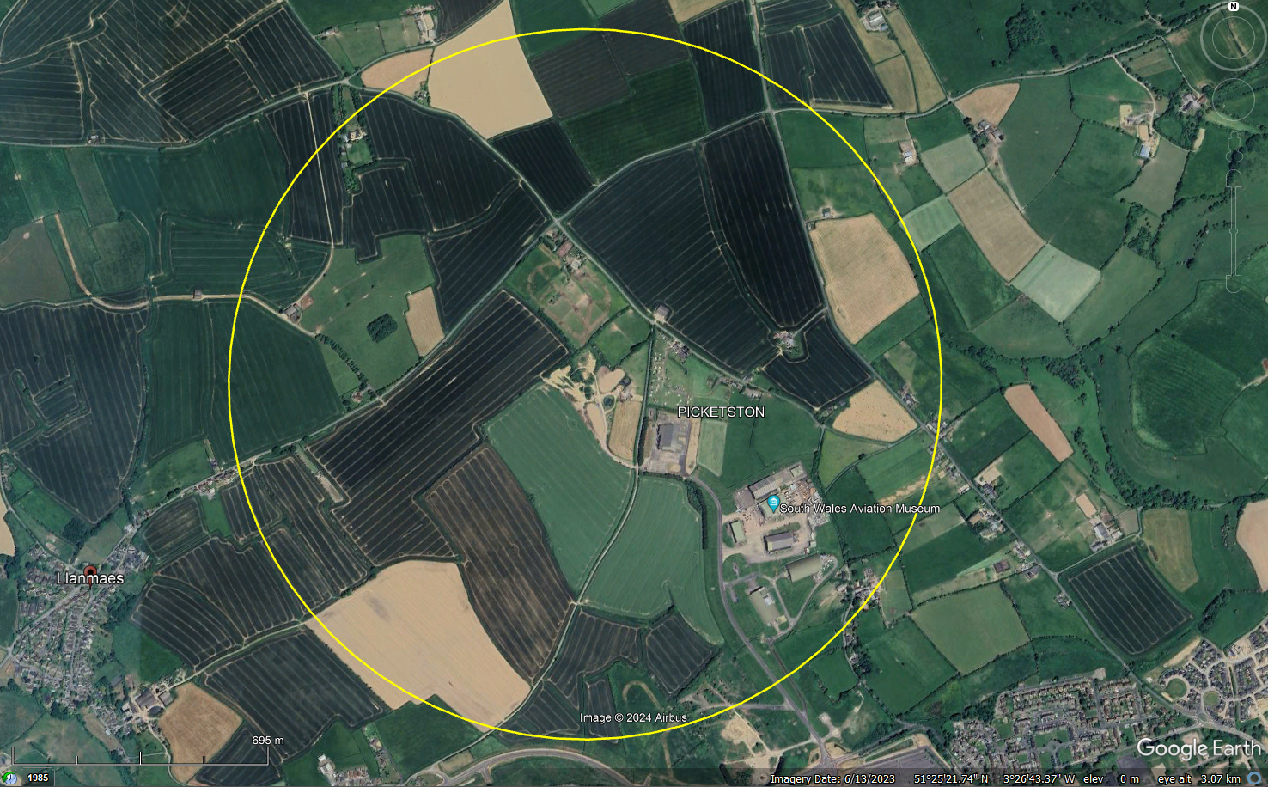
Scott Walton Contracting—Receptor Locations
Farm and small holdings
Caravan Park
Filming studio
Industrial/commercial
area

Slide 3
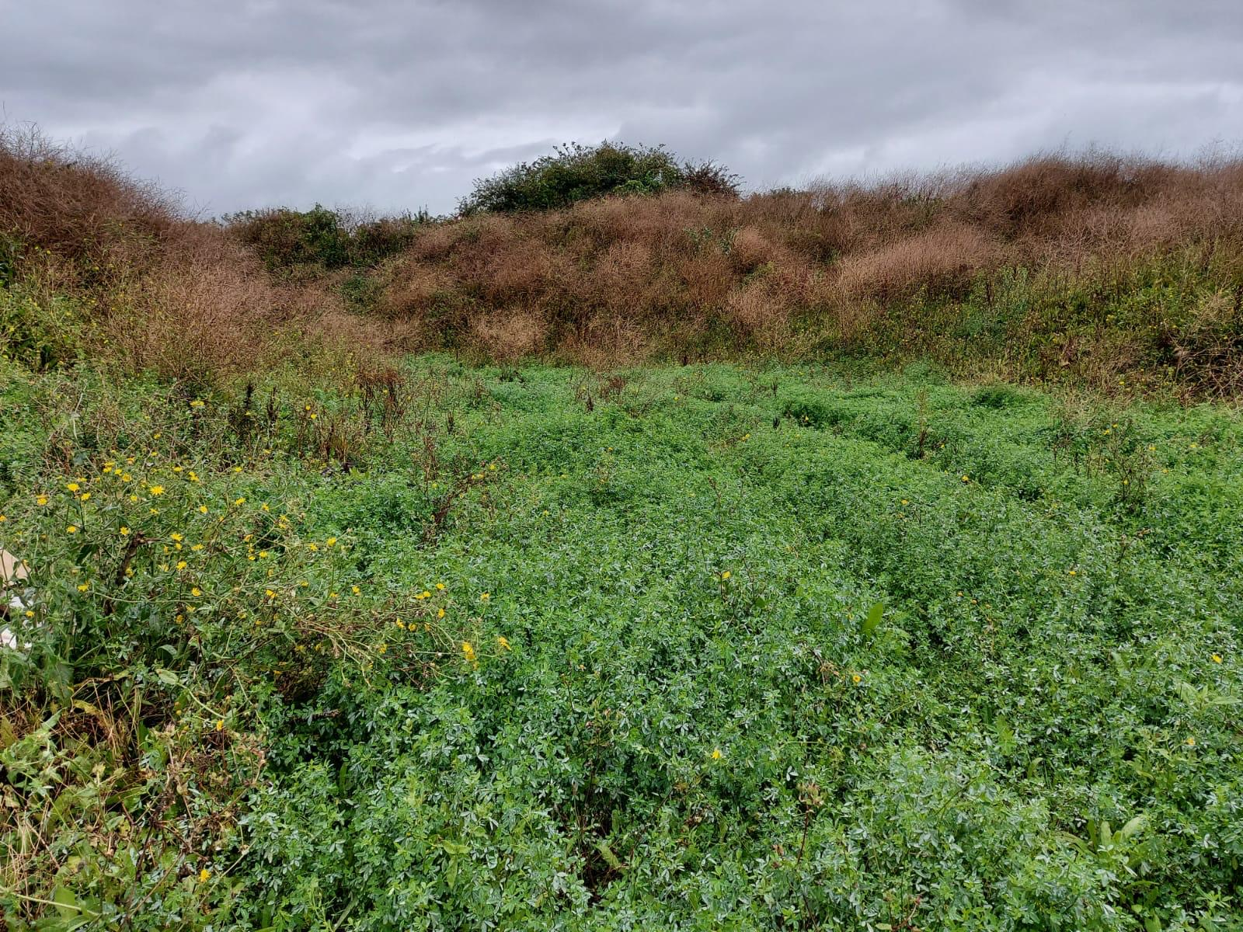
Scott Walton Contracting--Surrender images

Slide 4
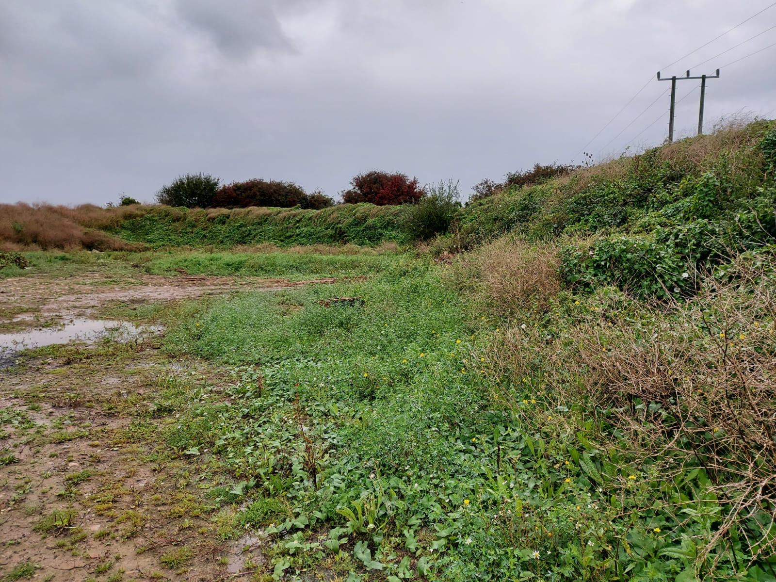
Scott Walton Contracting--Surrender images

Slide 5
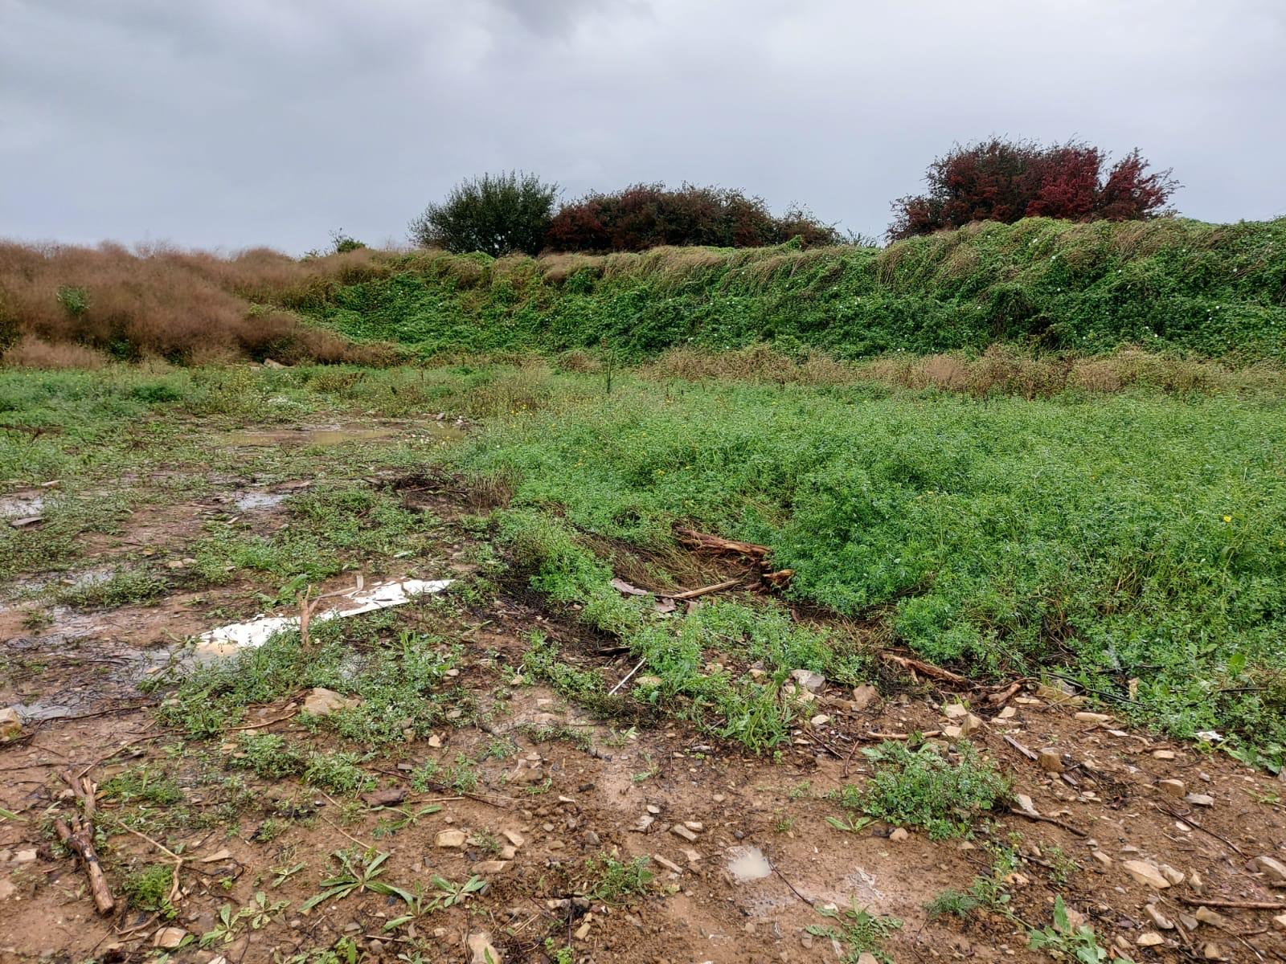
Scott Walton Contracting--Surrender images

Slide 6
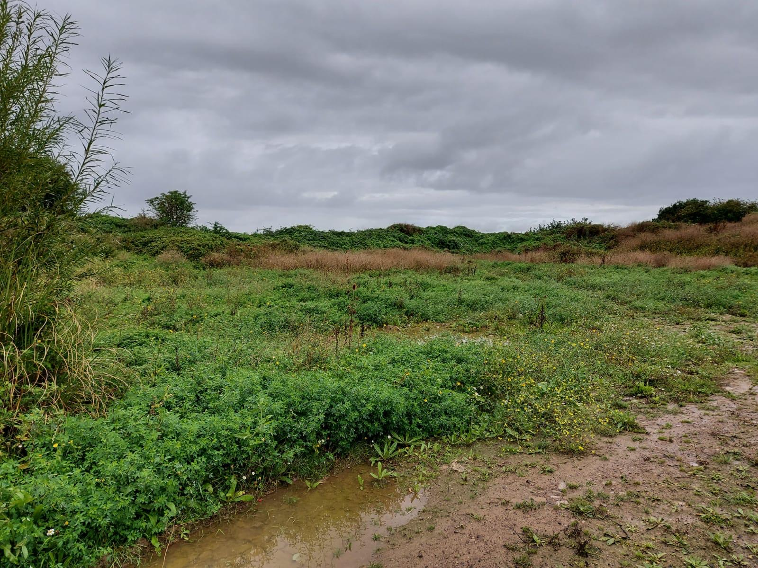
Scott Walton Contracting--Surrender images

