Slide 1
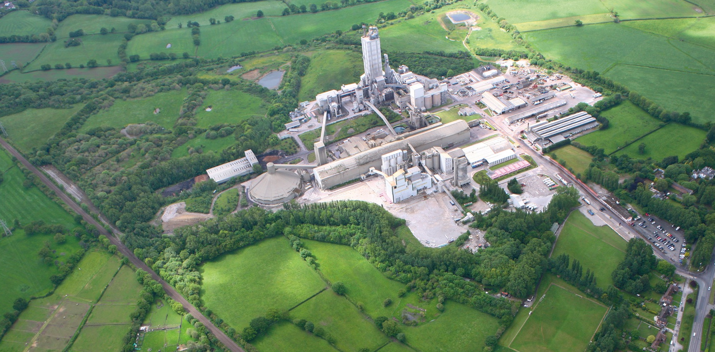

C.Blackburn, R.Morse, E.Heaton, J.Chester-Parsons

Slide 2

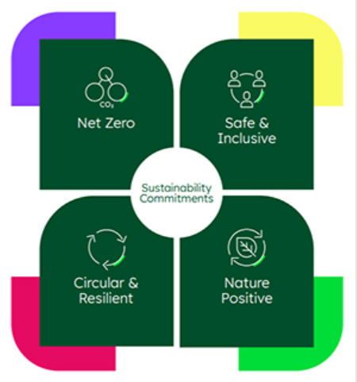
Environmental impact and climate change
By 2030 Heidelberg Materials UK has set various climate commitments including:
        Reduce scope 1 CO₂ emissions to 400kg/t of cementitious product
        Maximise the use of alternative fuels – above 80%
        Reduce electricity consumption by 10% from a 2016 baseline
        Reduce carbon impact of operations with a scientific-based target of 15% reduction from a 2016 baseline

Slide 3
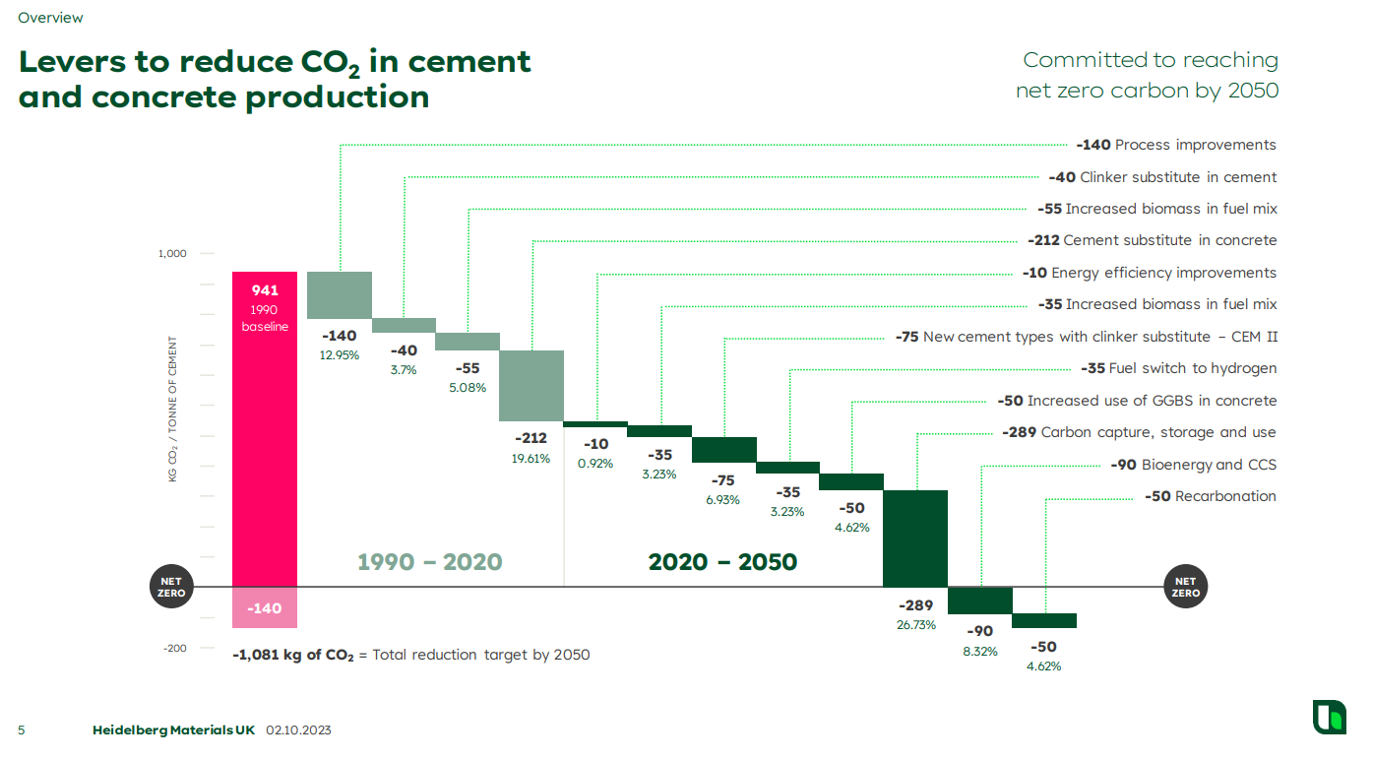
Why CCS
Between 2020 and 2050 we can continue to reduce CO₂ emissions through further improvements. However, these can only reduce it to a certain extent. Carbon Capture and Storage clearly has huge potential for us to reach our goal of net zero by 2050
Heidelberg Materials – CO₂ Road map
The CO₂ reduction journey started well before HyNet: In 1990 with process improvements and over the years moving onto clinker substitutes, biomass/alternative fuels and cement substitutes in concrete
Heidelberg Materials: Committed to reaching net zero carbon by 2050

Slide 4
Why CCS?
This is because the primary reaction to produce cement is calcination: the decomposition of limestone into calcium oxide with a by-product of CO₂.
This CO₂ accounts for 68% of the total CO₂ from cement production, with fuel combustion making up the further 32%.
Since there is no alternative to cement production and the use of alternative fuels can only go so far, carbon capture and storage is the only option left to become net zero.

Slide 5
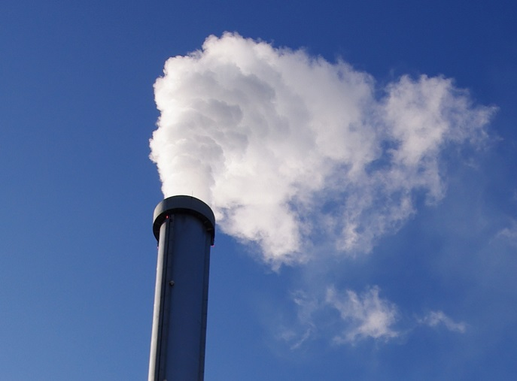
Emissions
Padeswood Emissions | Reportable Emissions | Sustainable Biomass
Total emissions 2023 | 359,676 tCO2e | 29,629 tCO2e
The carbon capture process doesn’t remove all CO₂ from the flue gas. At the end of the process, 6t/h of CO₂ is still released into the atmosphere. However, this is the bio fraction of CO₂ and comes from the burning of alternative fuels in the kiln. As the CO₂ comes from a sustainable source it is not classed as a pollutant and the process can still be called net zero.

Slide 6
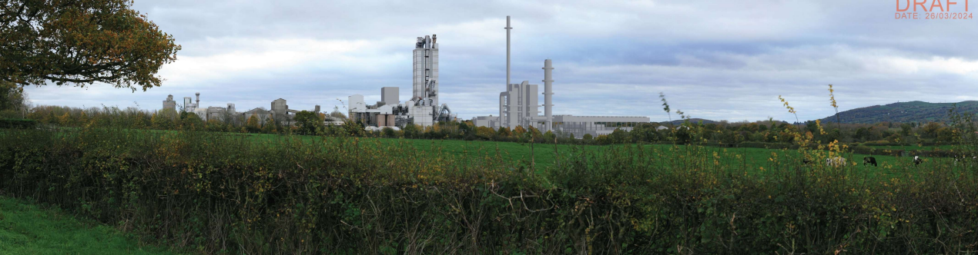
Links to site
No direct impact to the operation of the cement plant
One stream leaving Cement operations (dirty flue gas to CCS plant)
Increased traffic on the main site road during construction but limited effect on traffic in operation
Effluent streams returning to cement operations from the quencher to be used in cement mill, raw mill, GCT
Absorption tower, washing tower, quenching tower
New stack
Regeneration tower

Slide 7
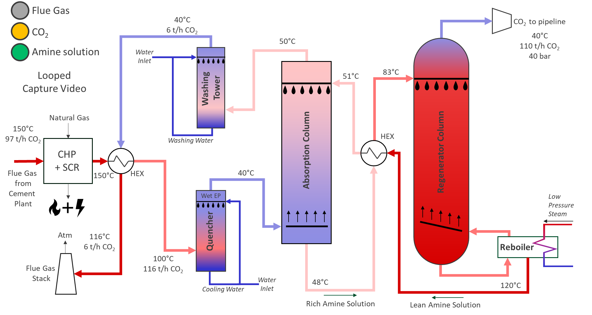

Slide 8
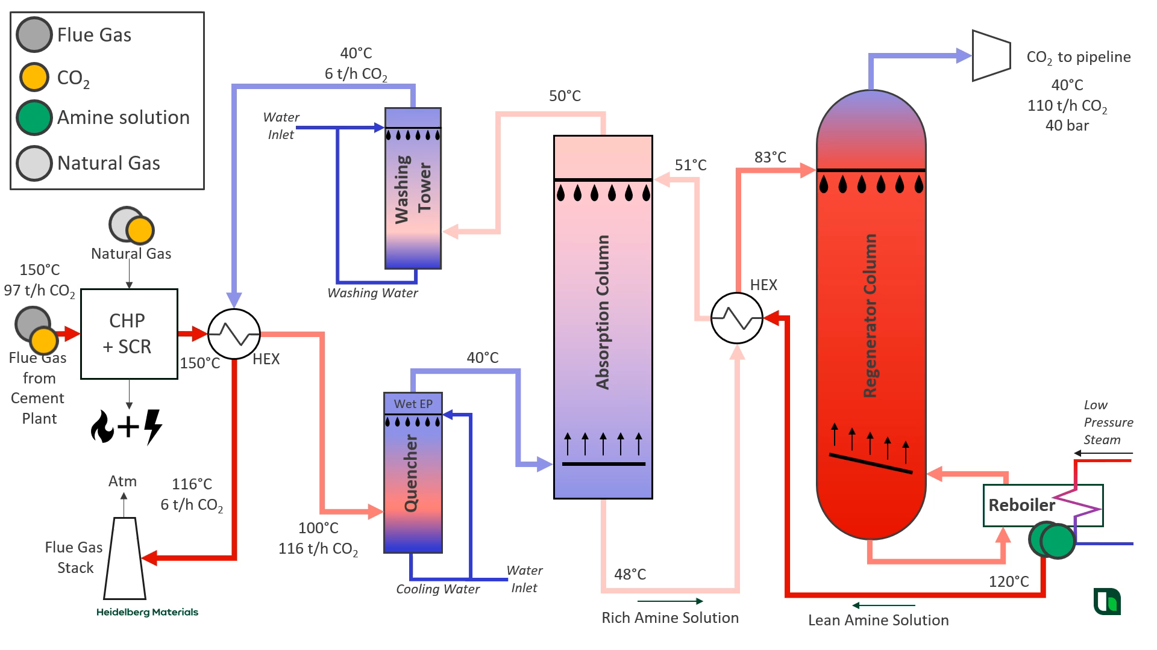

Slide 10
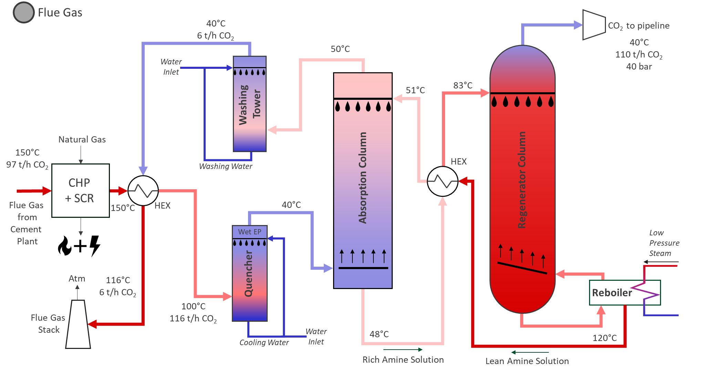

Slide 12
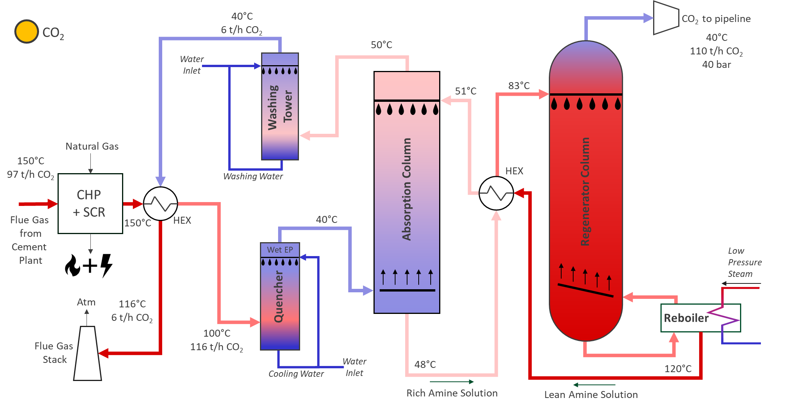

Slide 14


Slide 16
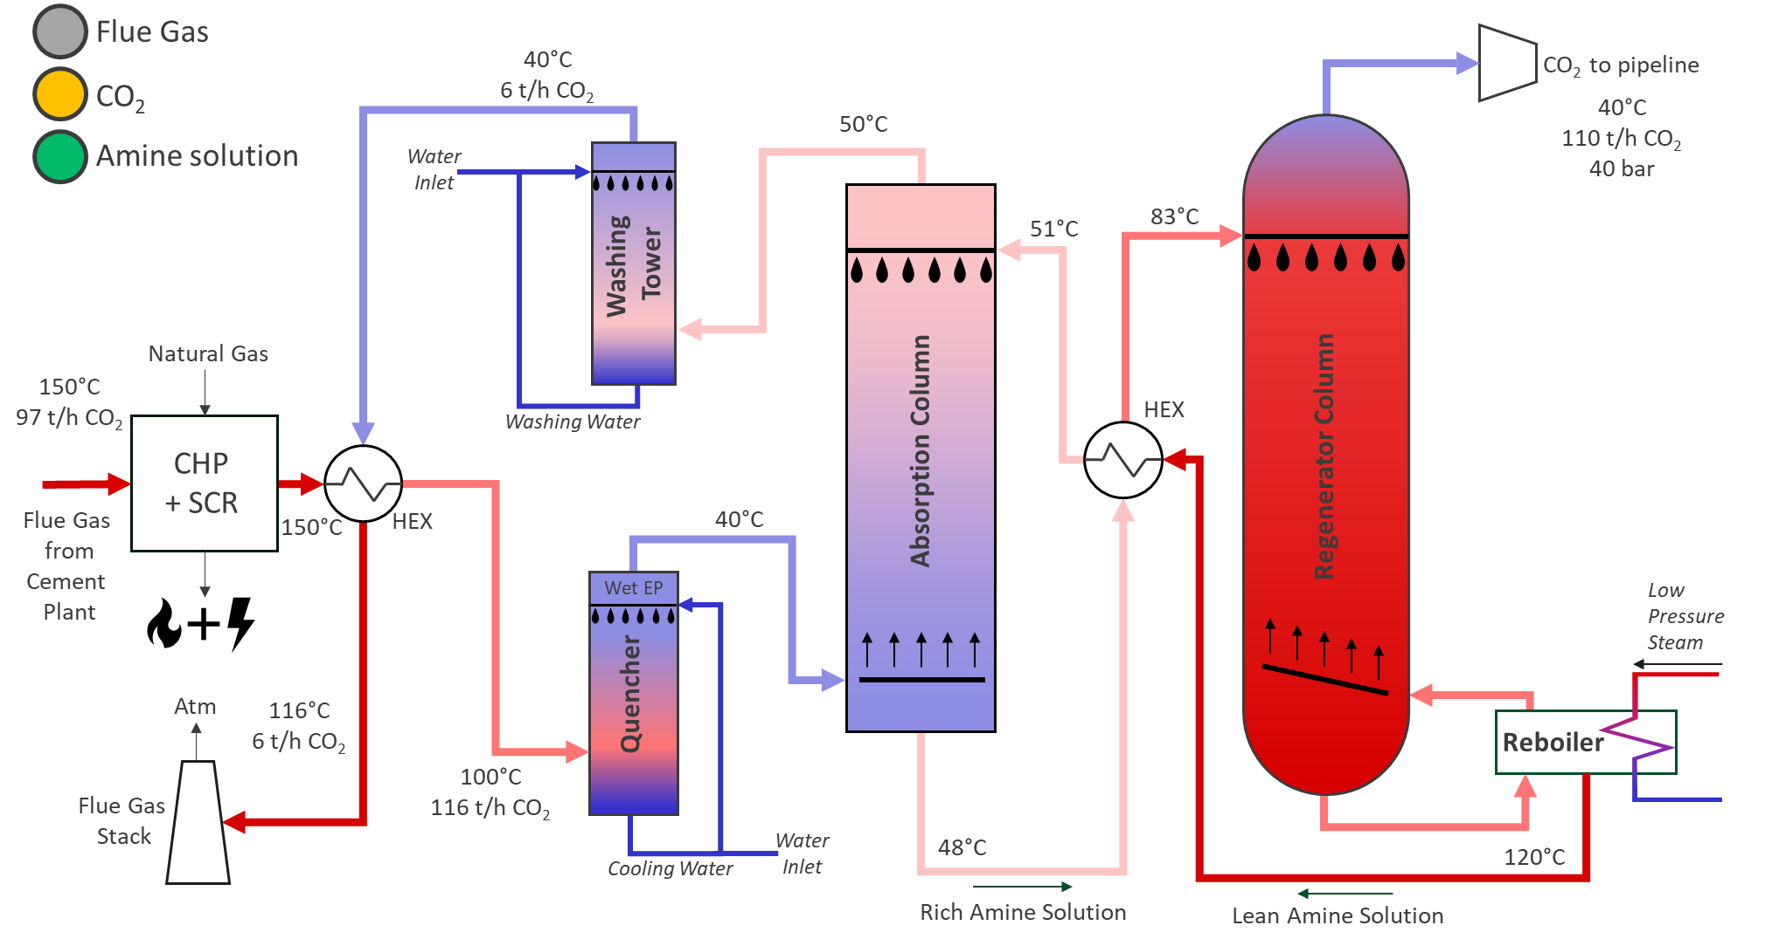

Slide 19
CHP + SCR
A CHP is a combined heat and power generator. It burns natural gas to generate heat and power efficiently. The heat and power is then used in the rest of the process. For example, the heat generated (in the form of steam) is then used within the reboiler.
A CHP is needed due to limited electricity supply from the grid.
SCR is selective catalytic reduction. This removes any trace impurities that could reduce the efficiency of the carbon capture process.

Slide 23
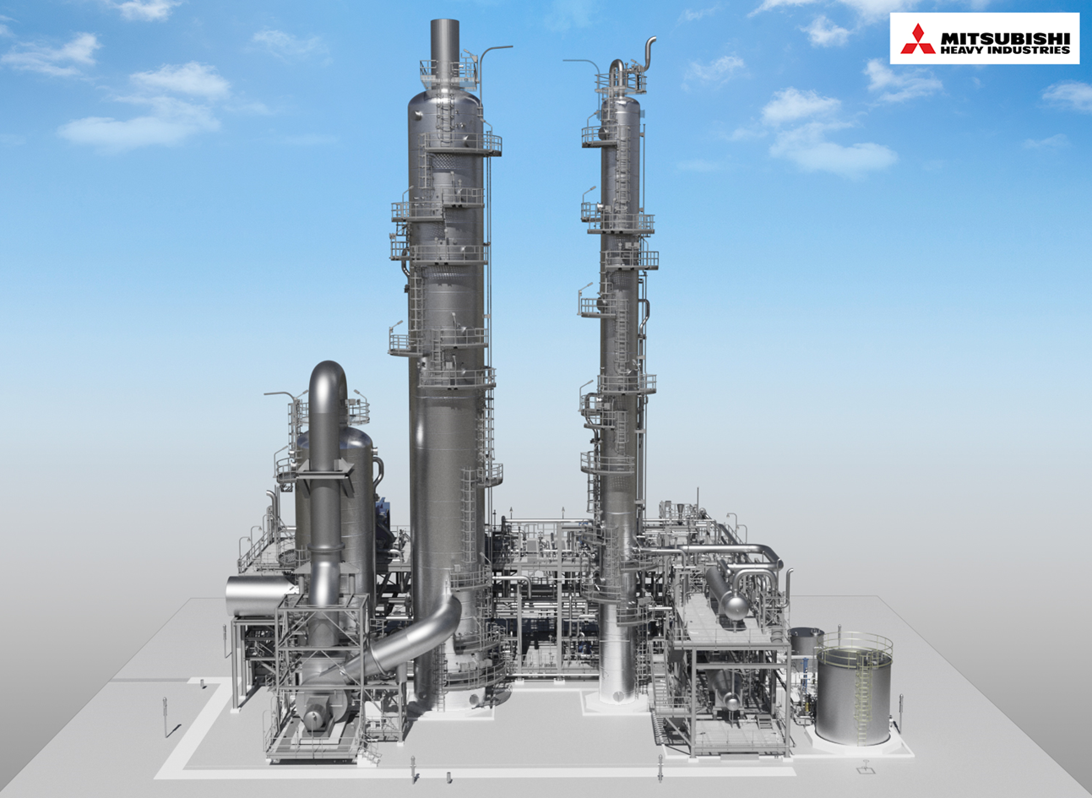
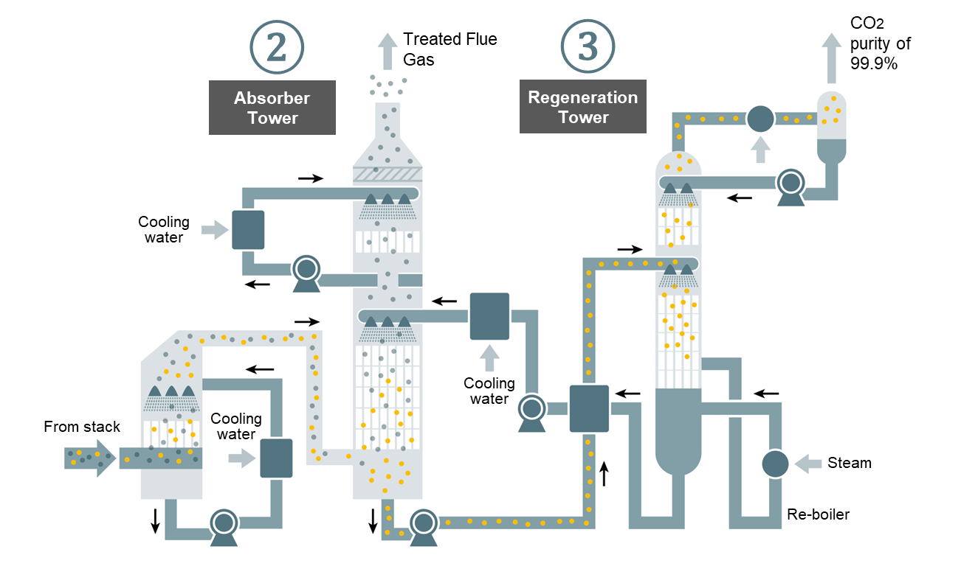
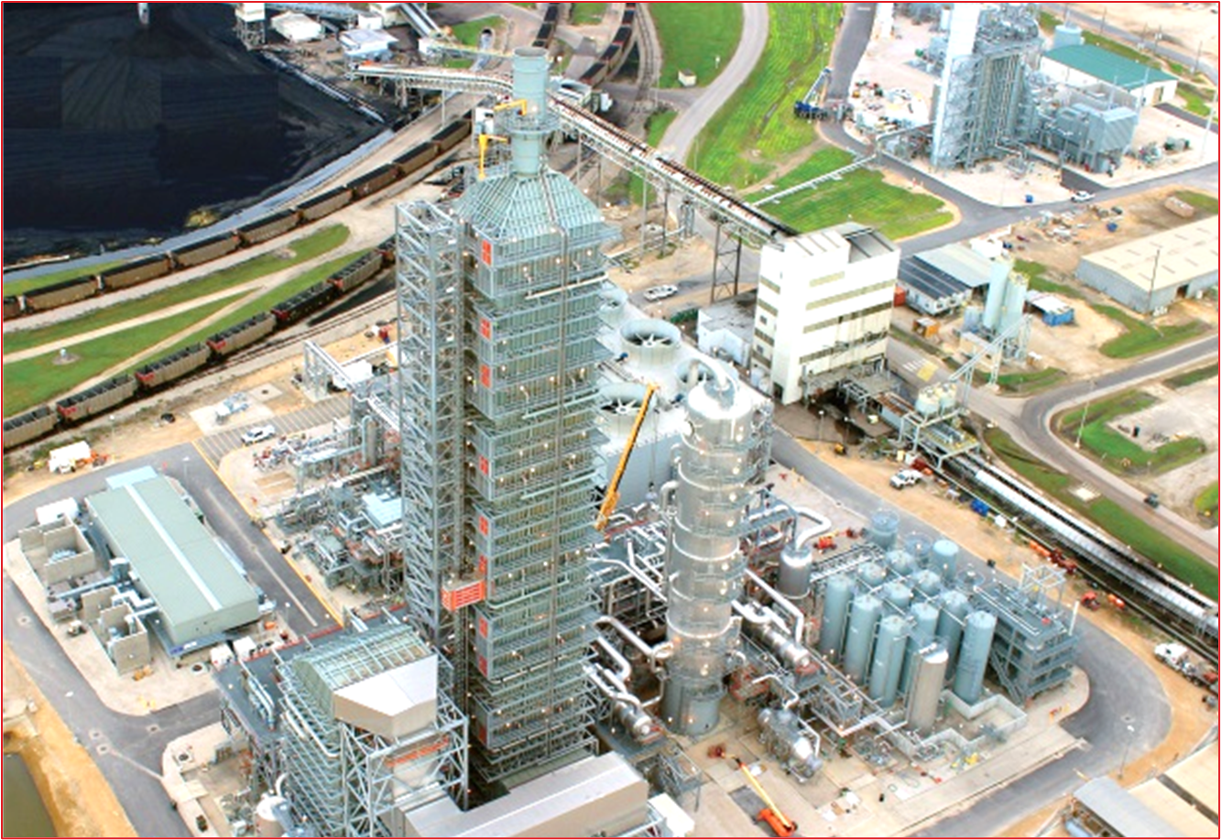
Quencher
The Quencher cools down the CO₂ rich flue gas using cooling water. This is because the CO₂ absorbs into the amine solvent much easier at lower temperatures.
A wet electrostatic precipitator (ESP) removes any particles from the gas stream before it enters the absorber.
A flue gas desulphuriser (FGD) is used to remove sulphur impurities from the flue gas.

Slide 27
Absorber
The CO₂ rich flue gas stream flows upwards into the absorber whilst the amine solvent flows down. The CO₂ is absorbed into the solvent, creating a carbon rich amine stream which flows out of the bottom of the absorber. The cleaned flue gas (95% CO₂ removed) exits out of the top.
The absorption process is exothermic meaning it produces heat, hence why the two outlet streams are hotter than the inlet.
The temperature throughout the absorber needs to be maintained at 40-50°C for optimal absorption.

Slide 31
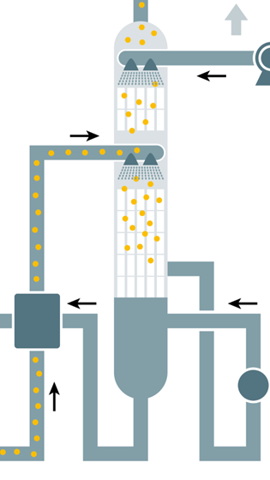
Regenerator
The carbon rich amine stream gets heated up in a heat exchanger before entering the regenerator column. The CO₂ is stripped from the solvent here. In simple terms, the CO₂ goes up the column and the amine goes down.
The amine enters a reboiler where it is heated enough to remove any remaining CO₂ in the amine solution after the regenerator column. This then re-enters the regenerator and joins the pure CO₂ gas stream travelling to the compressor system. The amine has then been regenerated and recycles back around ready to capture more CO₂ from the flue gas.
Regenerator
Regenerator Re-Boiler

Slide 35
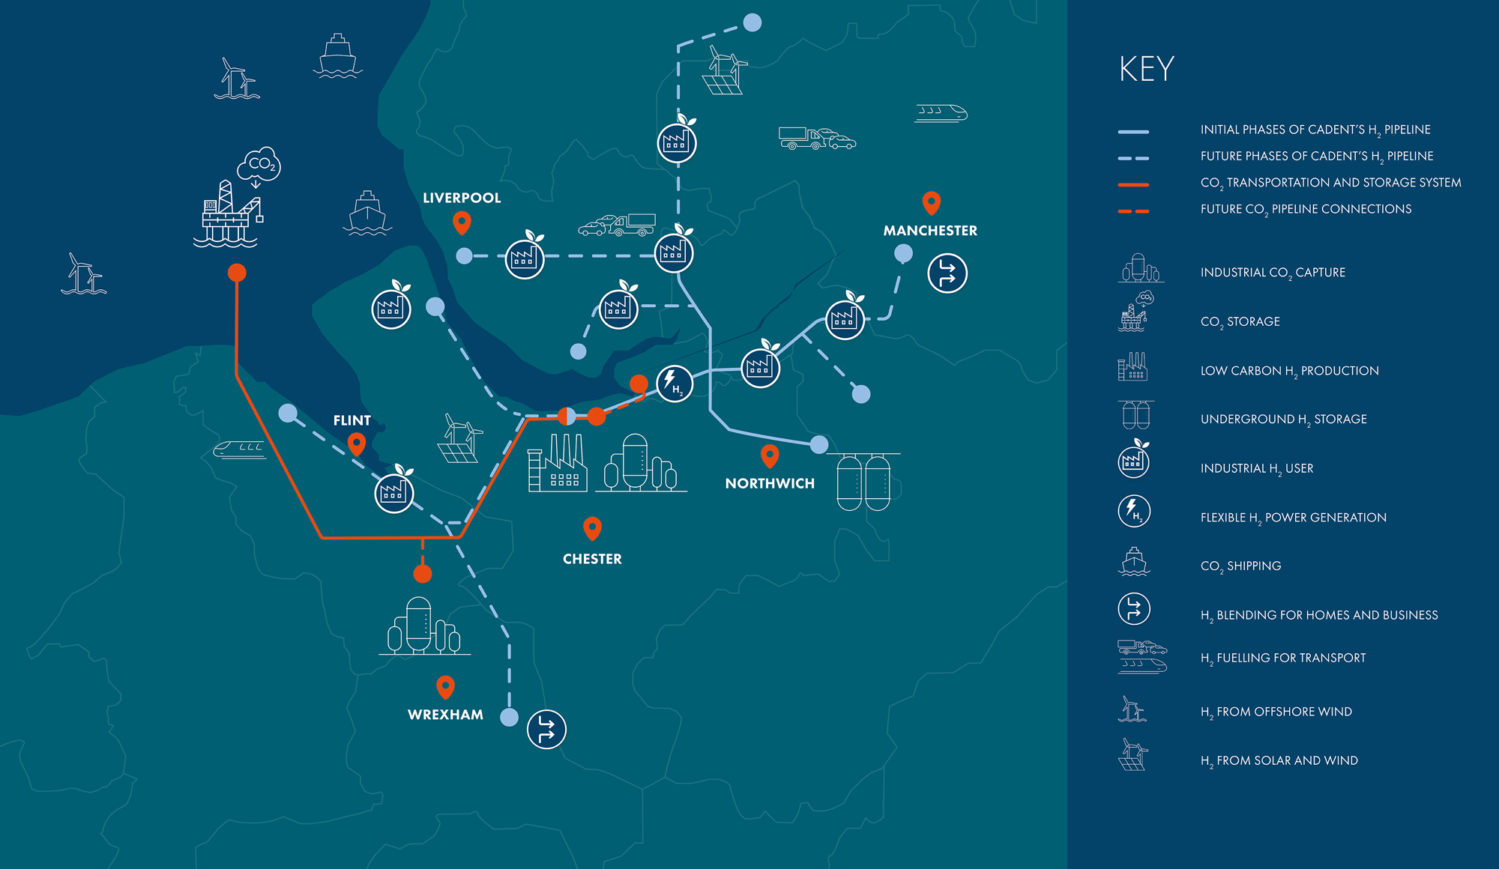
Compressor
The 99.9% pure CO₂ stream is then compressed to 40 bar before leaving site through a pipeline. This pipeline will transfer the CO₂ to underground storage in old gas/oil wells in the Irish Sea where it will remain indefinitely.
Padeswood Cement Works
Hynet pipeline layout

Slide 39
Washing Tower
The washing tower uses water and acid to clean the flue gas of amine impurities before it is released to the atmosphere. The amine captured re-enters the system via a makeup stream. Reclaiming amine this stage not only helps us adhere to our emission limits but also reduces the amount of fresh amine solution required.

