Slide 1
Tegfan Recycling 18/4/19
by Davies, Eleanor

Slide 2
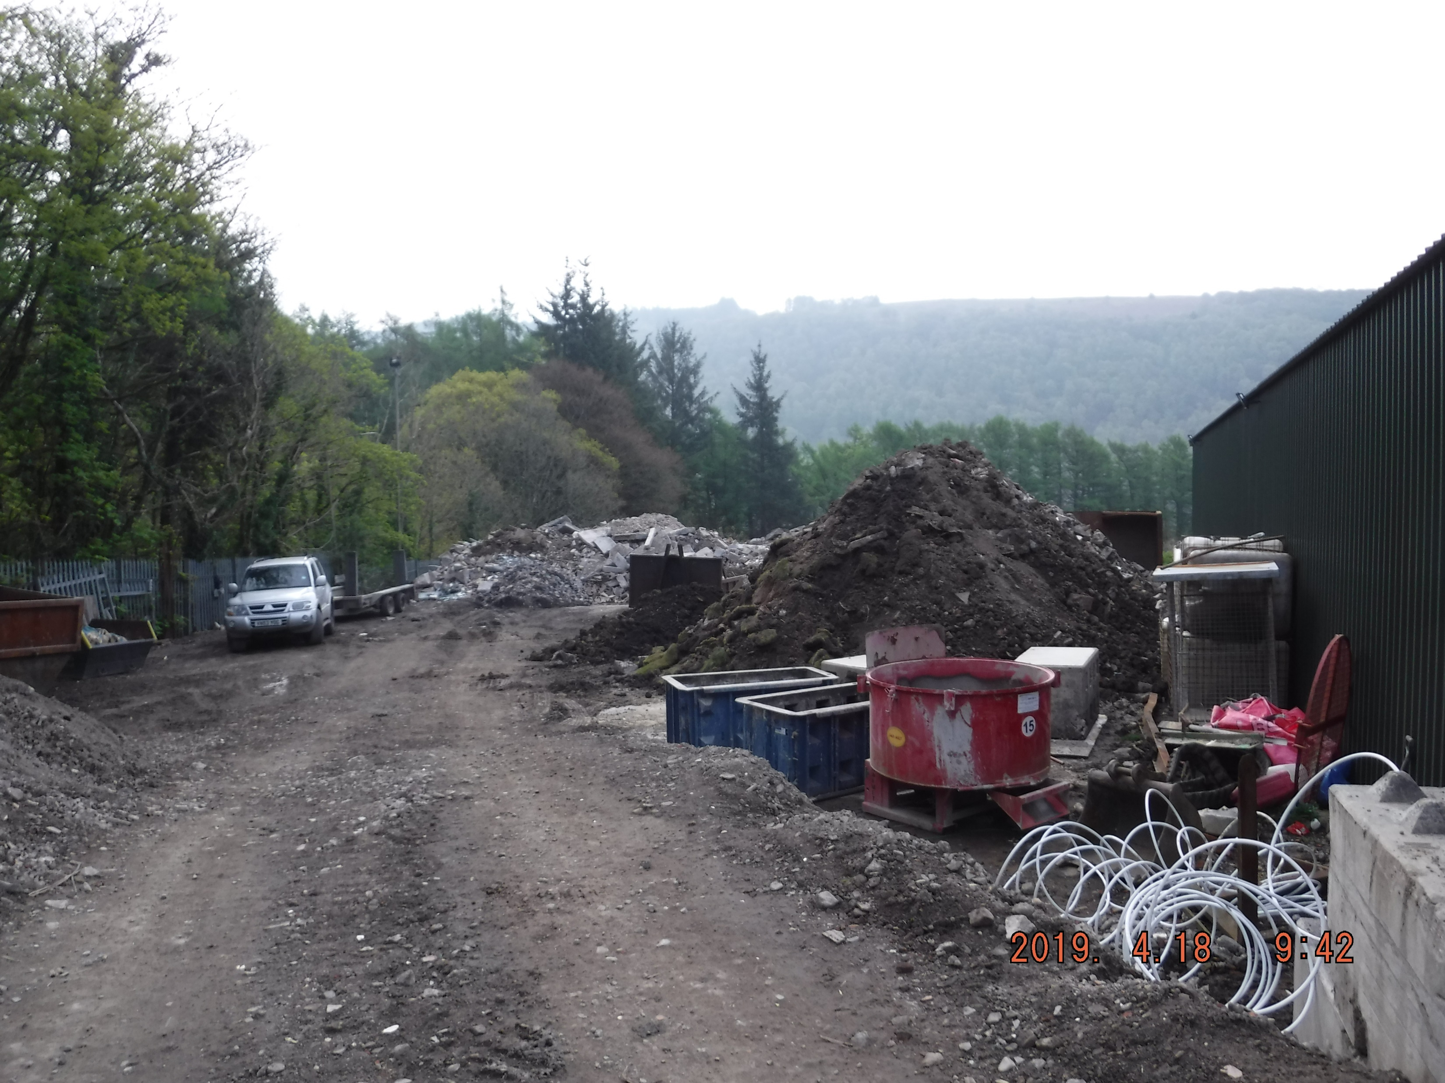

Slide 3
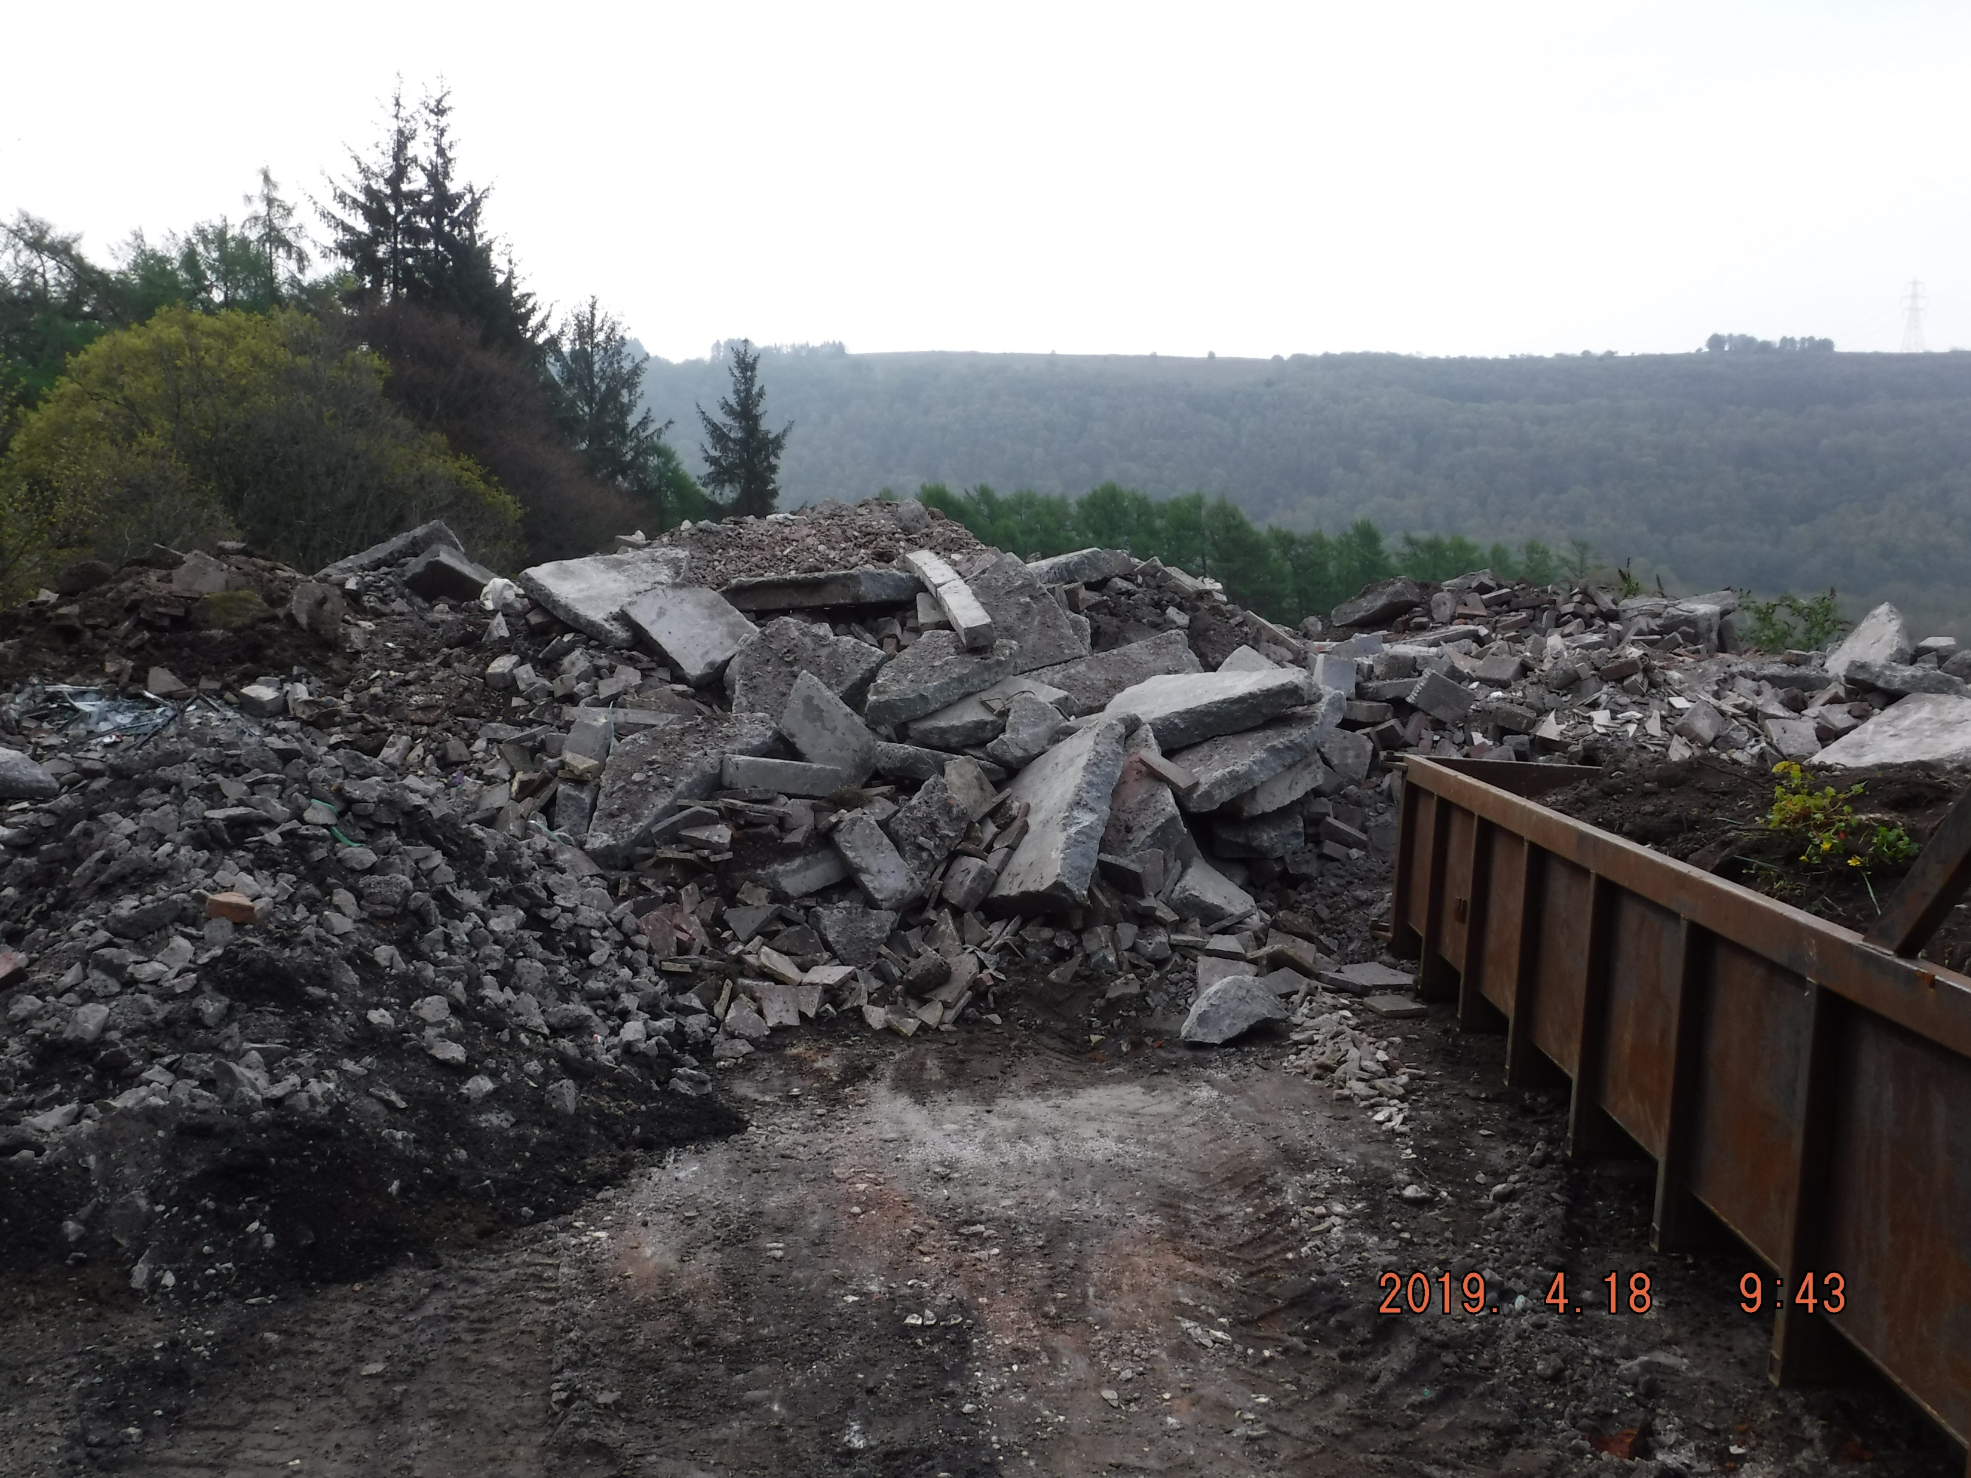

Slide 4
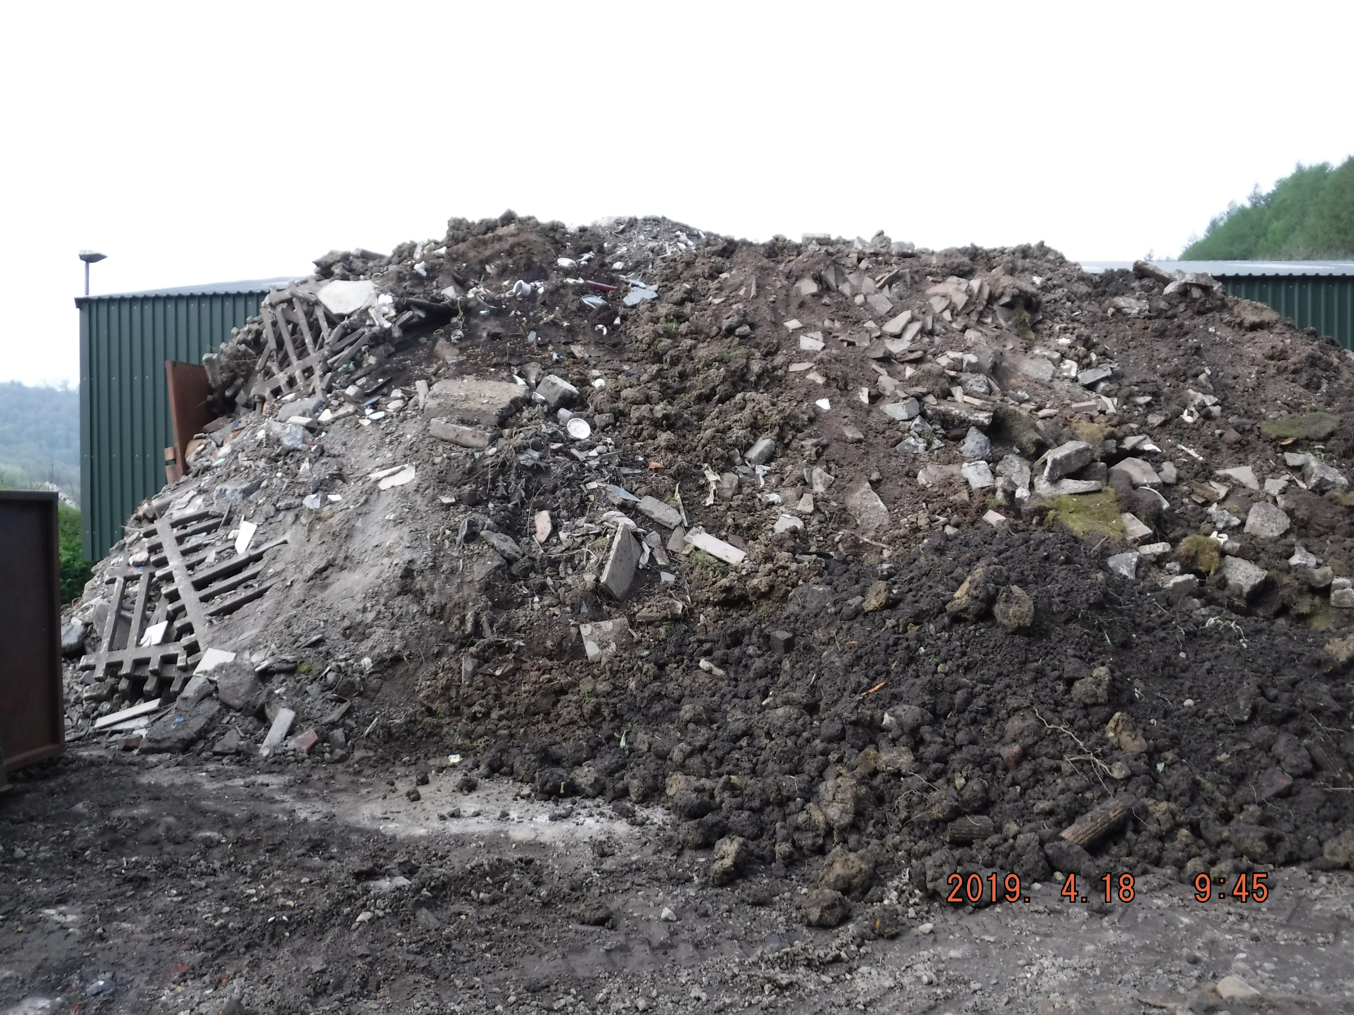

Slide 5
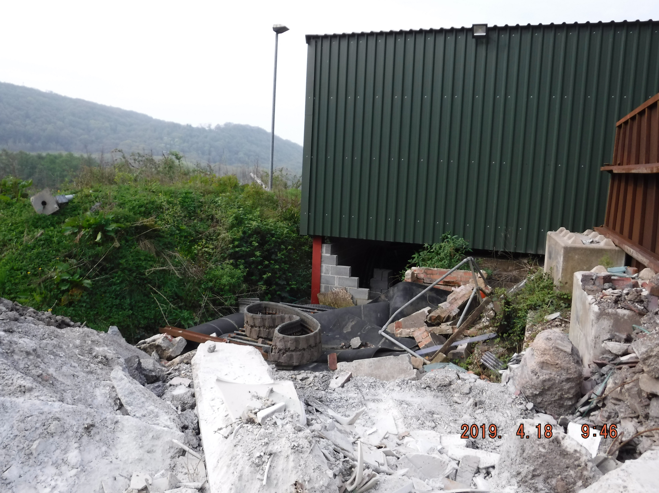

Slide 6
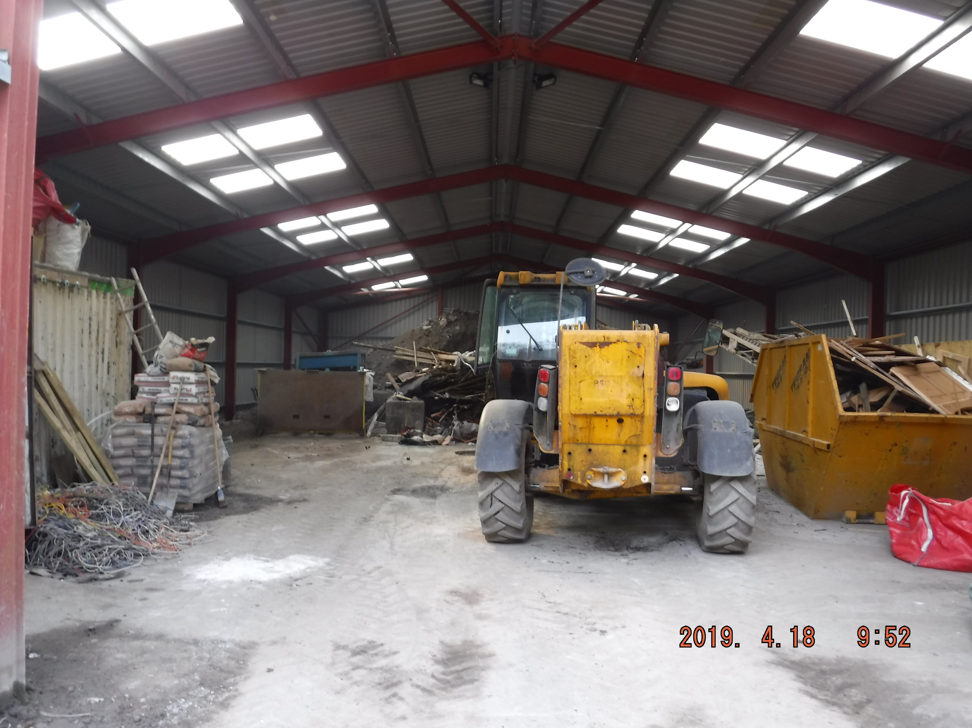

Slide 7


