Slide 1
22/60/01/0068
Manorafon Abstraction
Site Inspection
16/11/2018 - Photographs
by Anna Fracchiolla & Jeremy Goddard

Slide 2
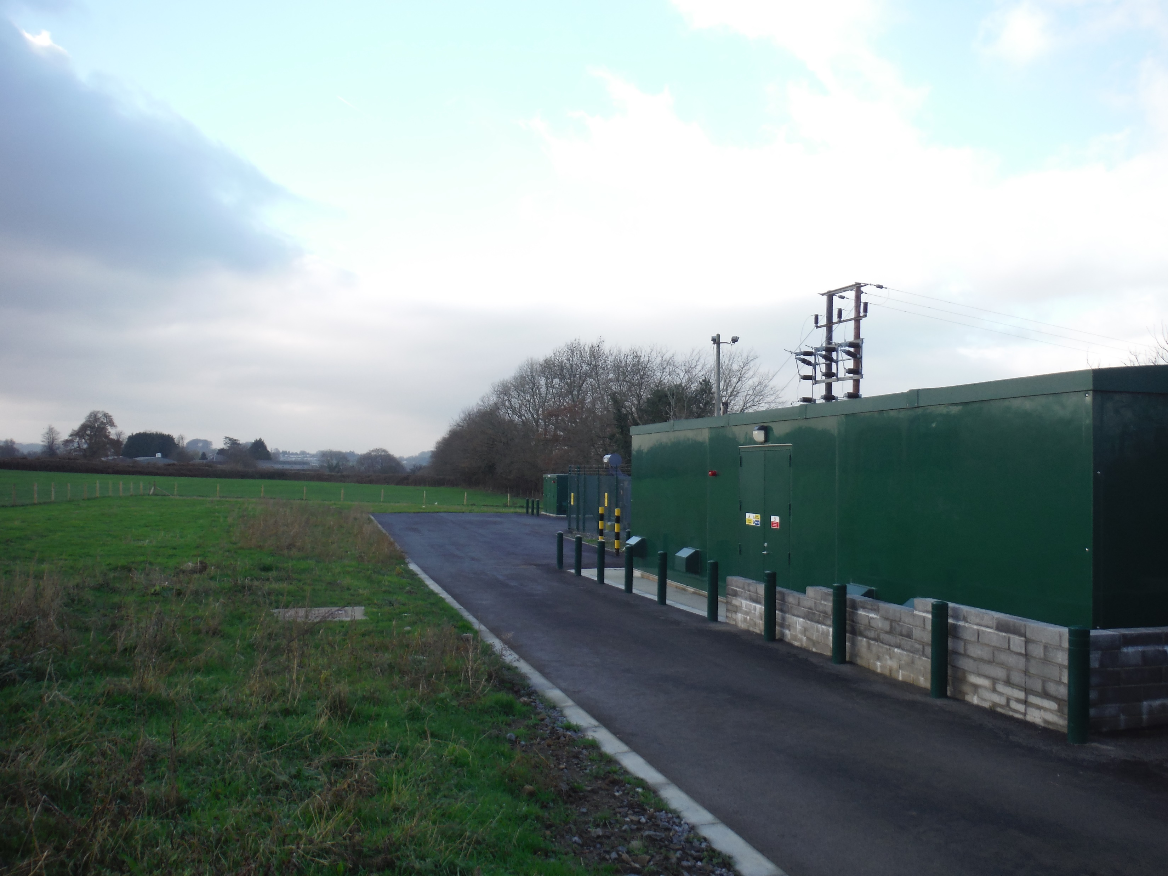

Slide 3
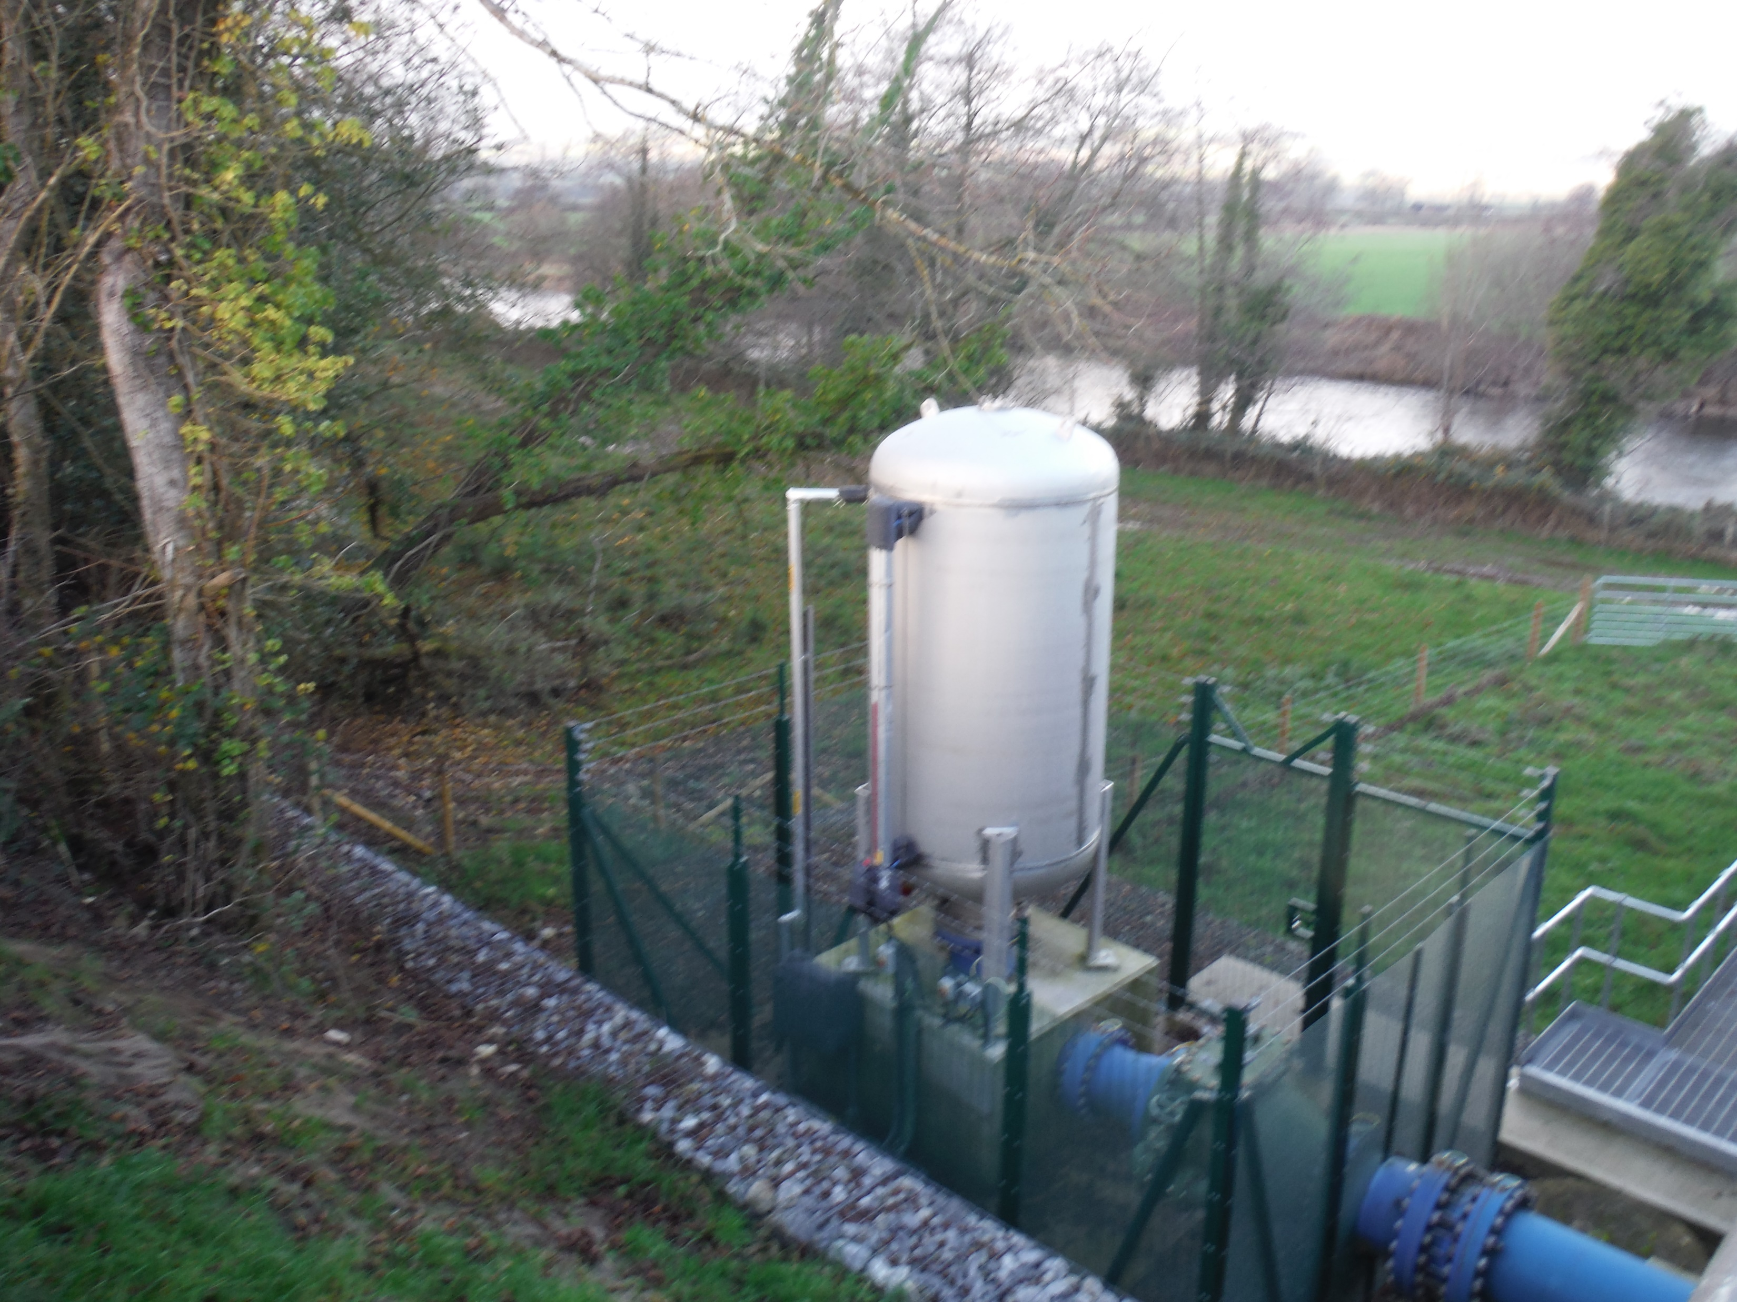

Slide 4
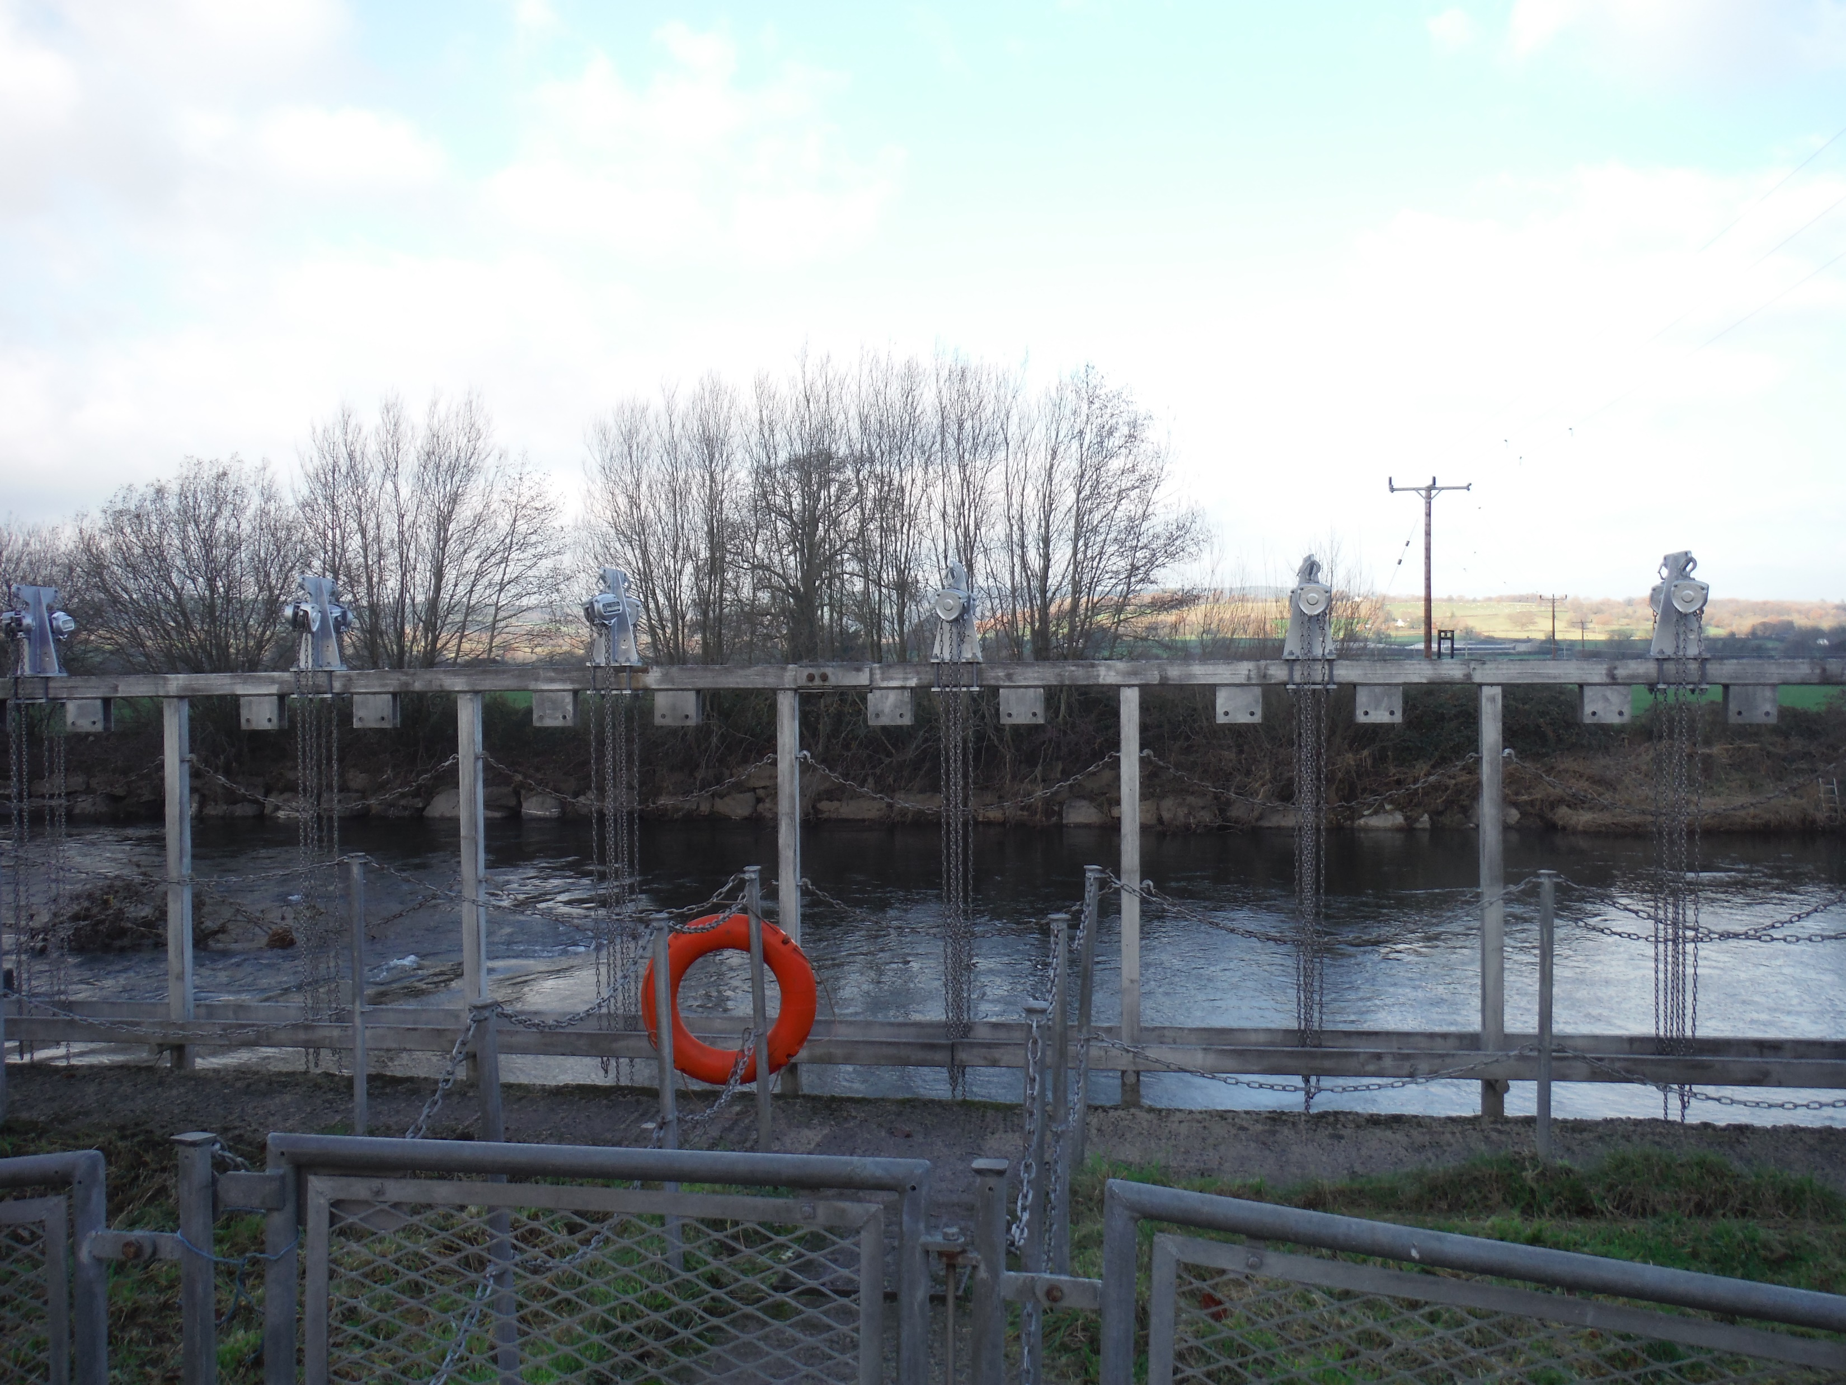

Slide 5
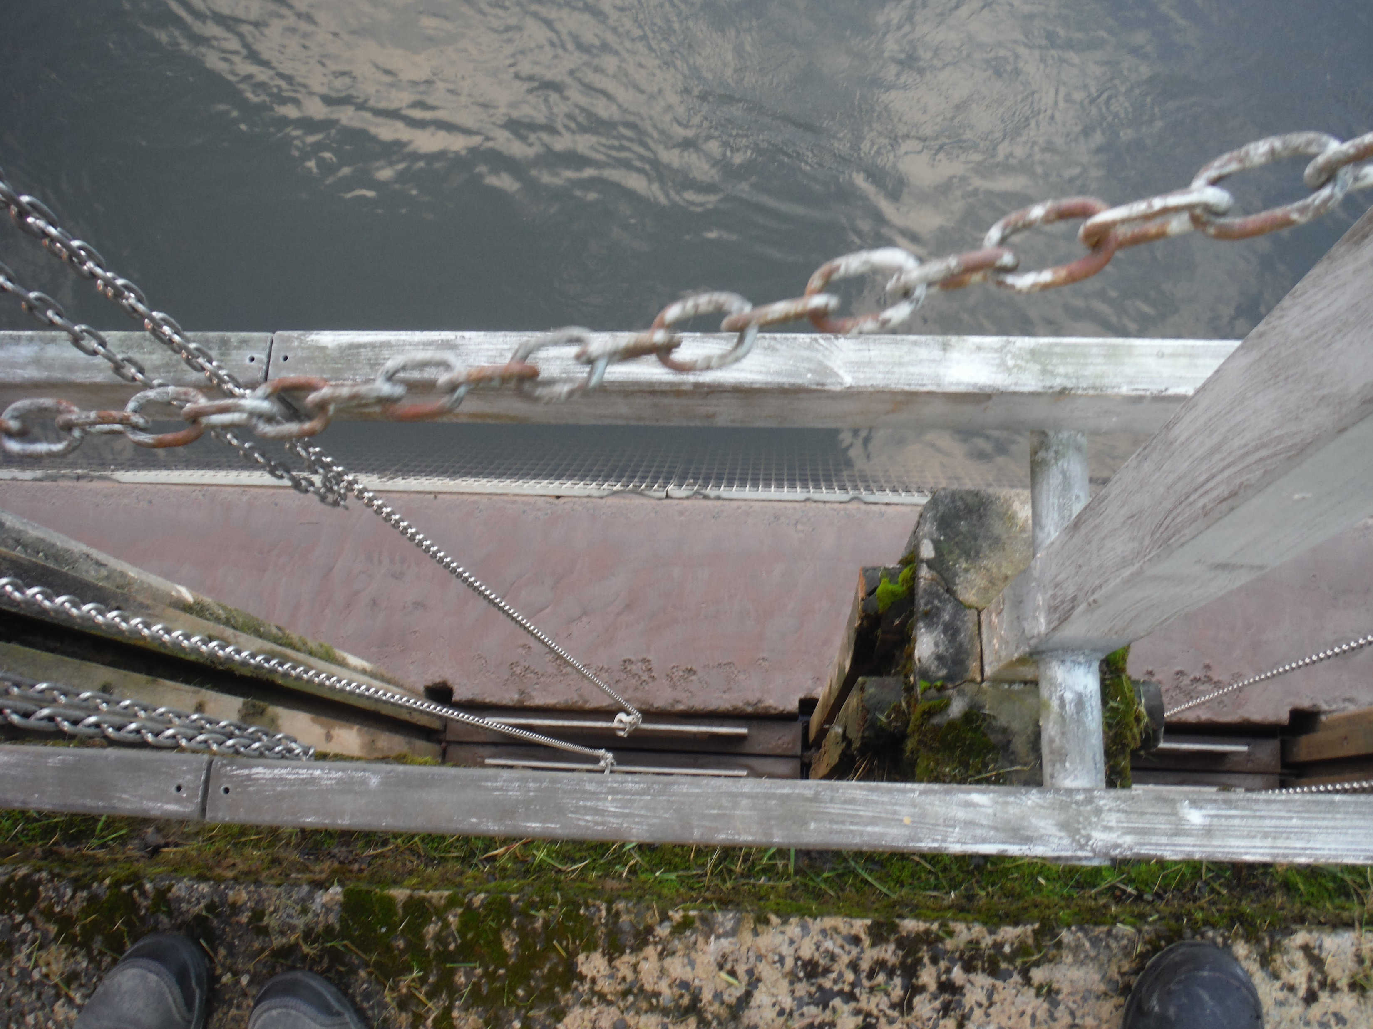

Slide 6
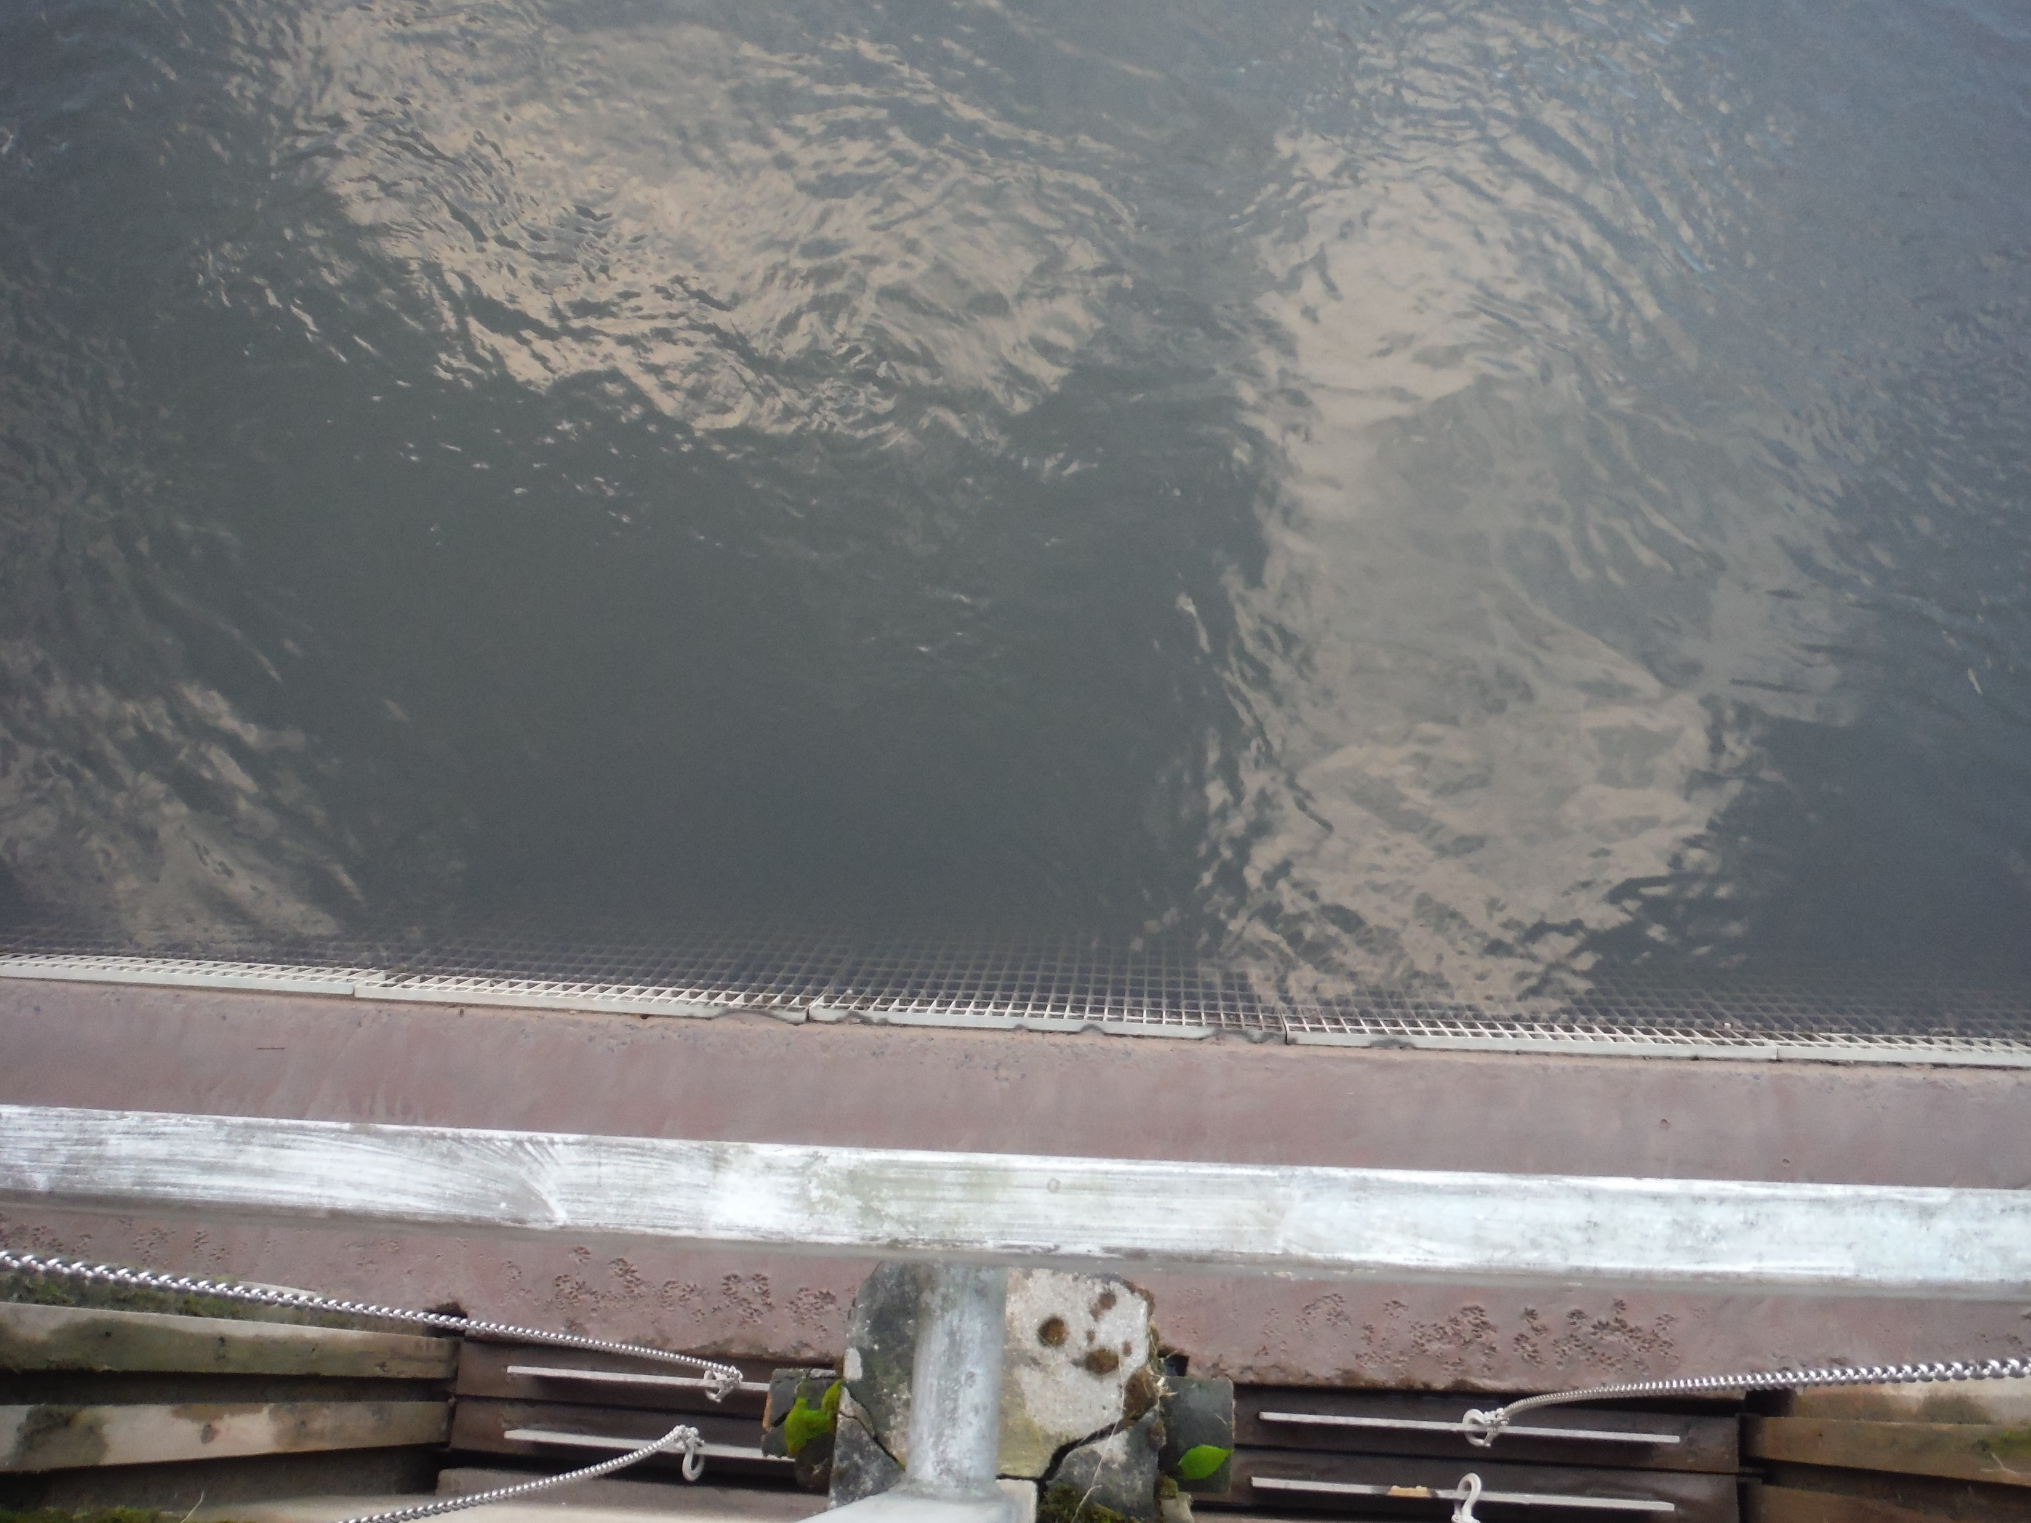

Slide 7
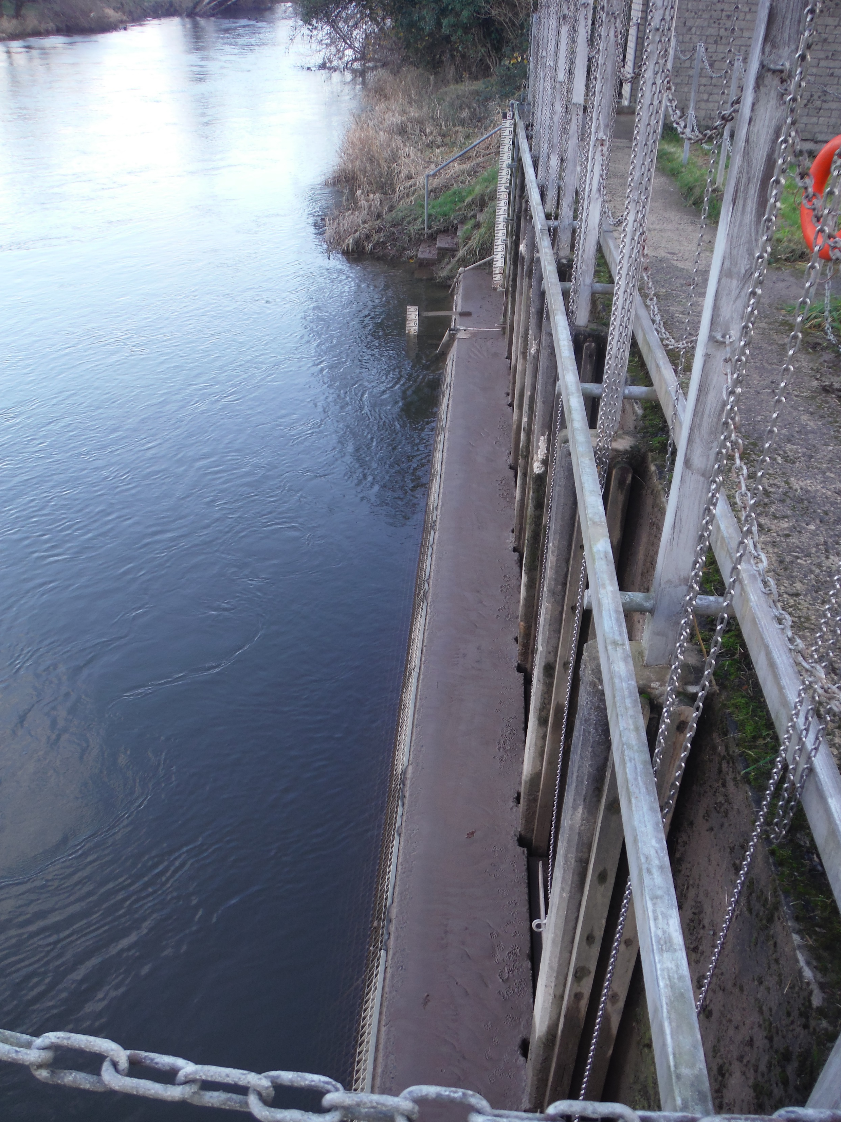

Slide 8
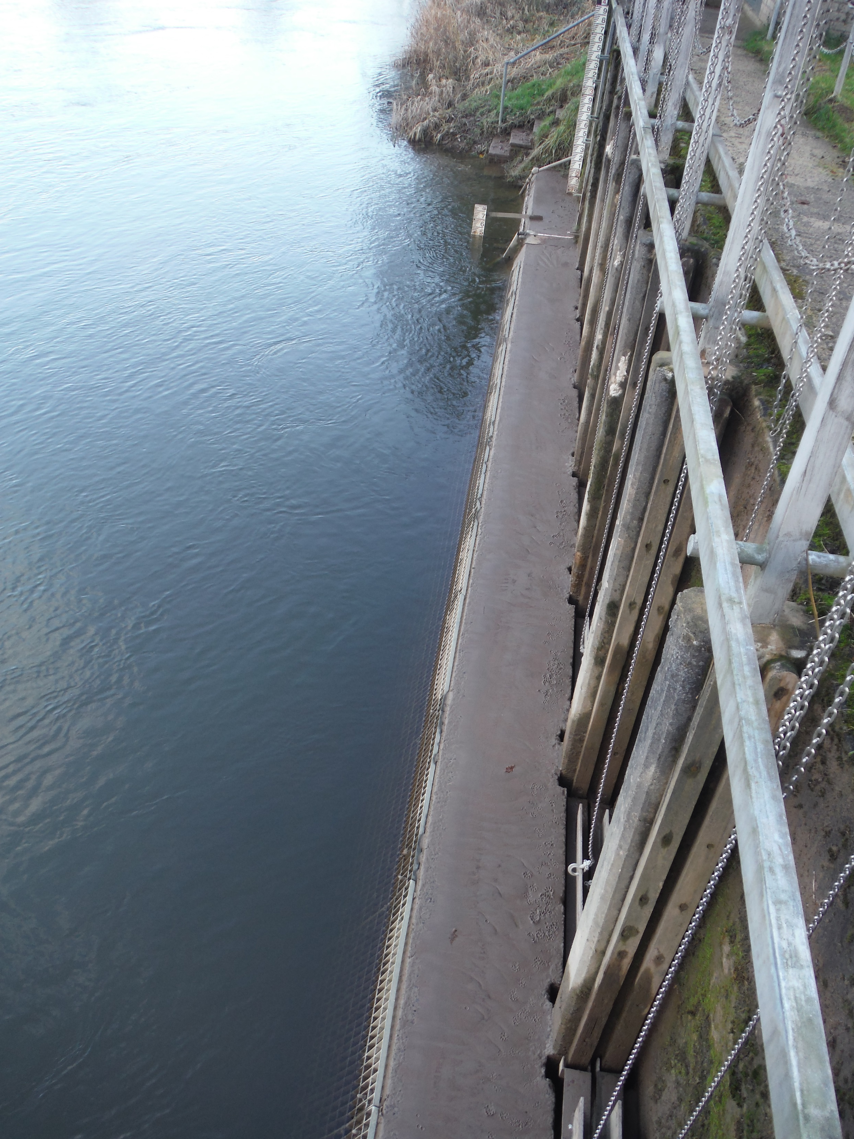

Slide 9
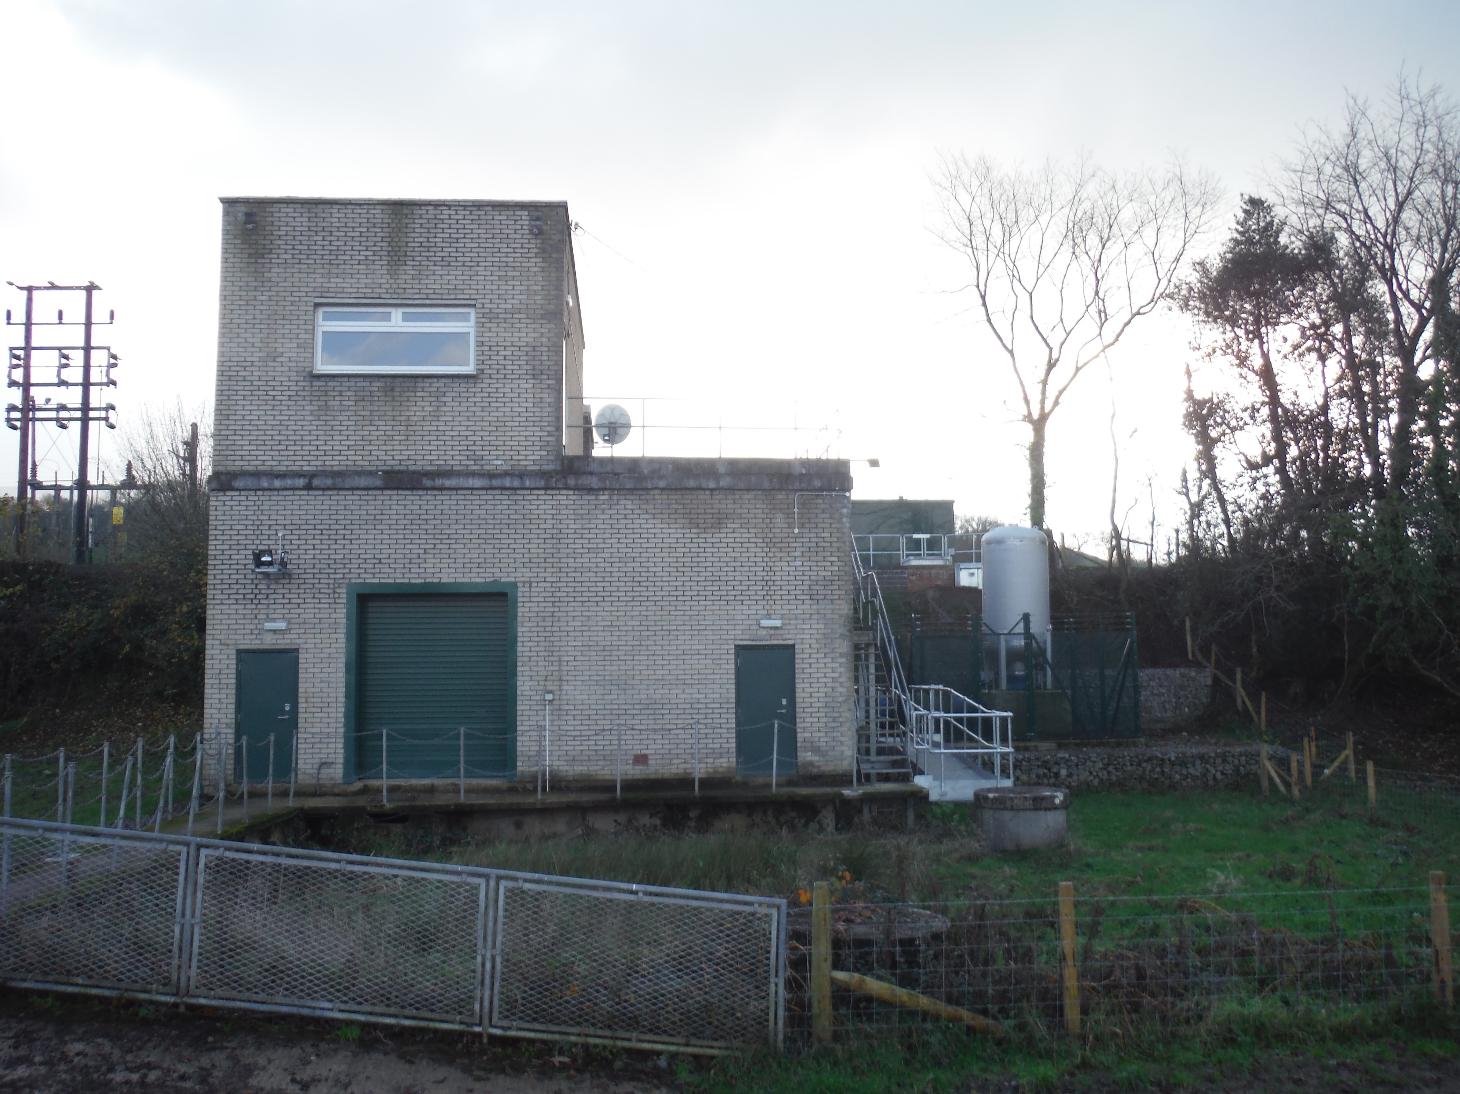

Slide 10


