Slide 1
CSO at the rear of the pavilion, Corwen site inspection photos 11.09.2025
by Chisnell, Amy

Slide 2
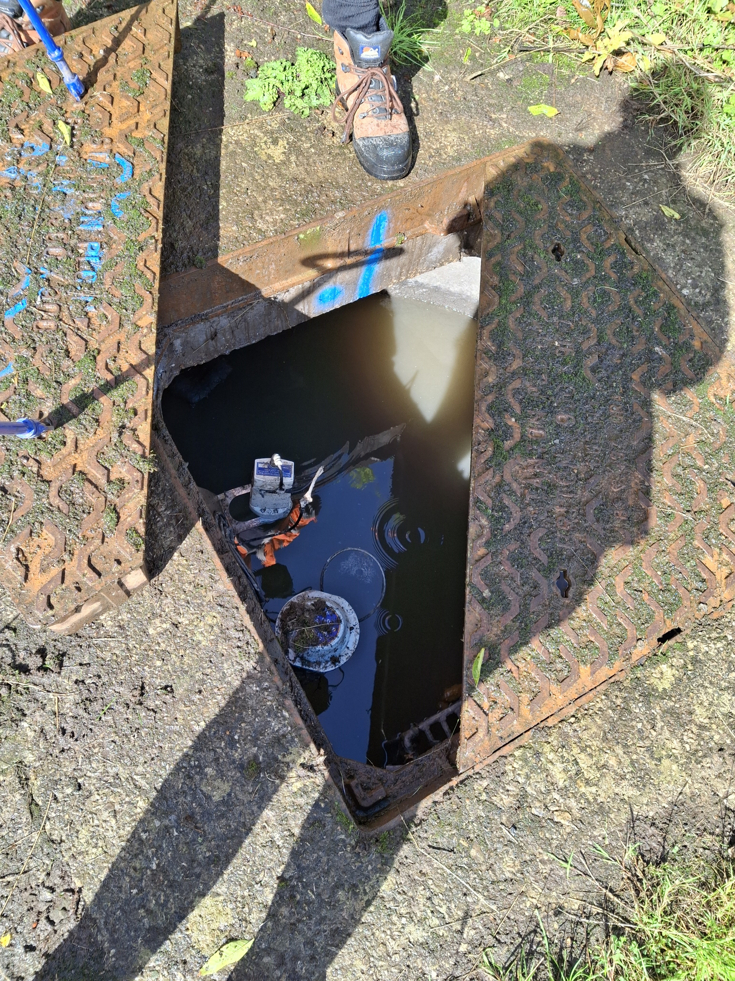
Notes:
High level in the CSO – level sensors almost submerged

Slide 3
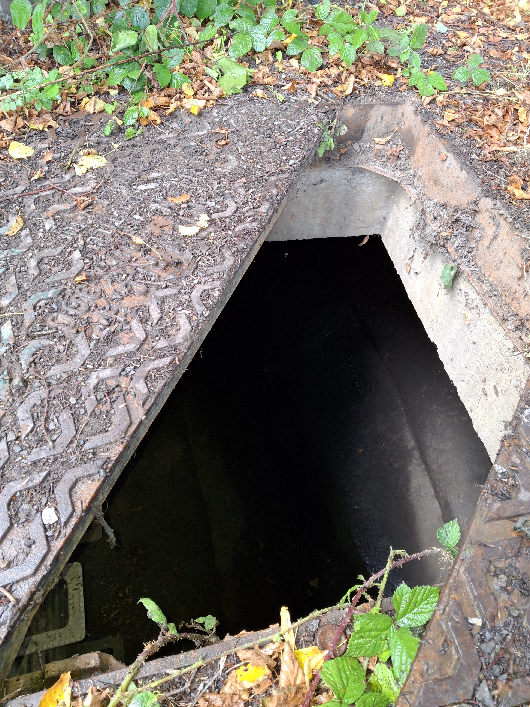
Notes:
Flow in chamber – CSO in spill at outlet – chamber feeds into culverted section of the watercourse – v. strong detergent smell

Slide 4
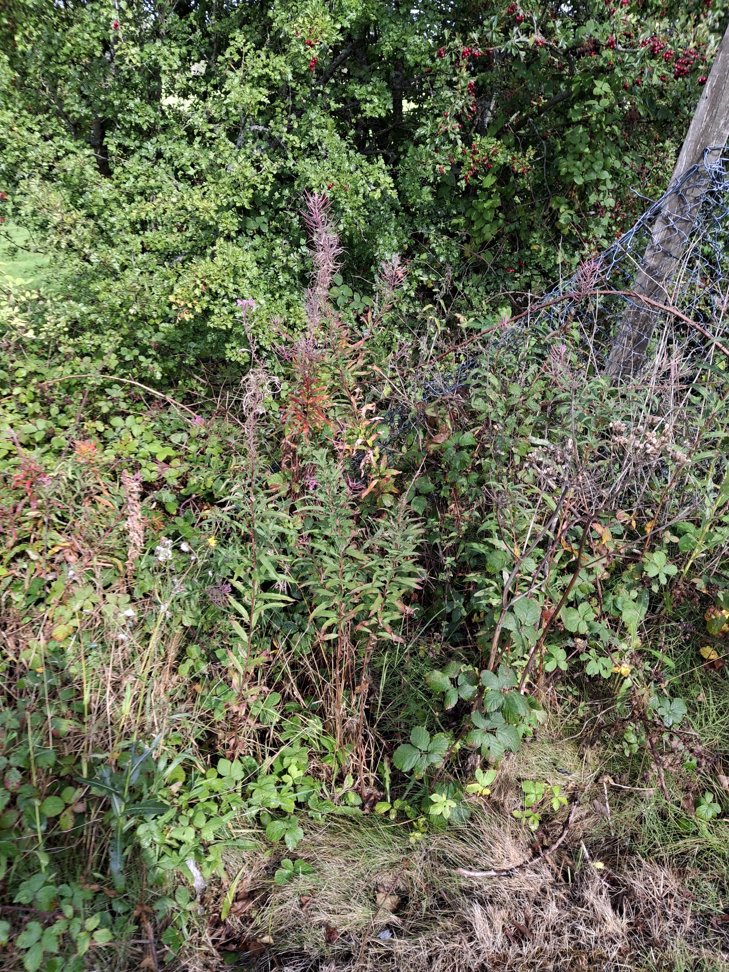
Notes:
Point where outfall discharges to watercourse very overgrown

