Slide 1
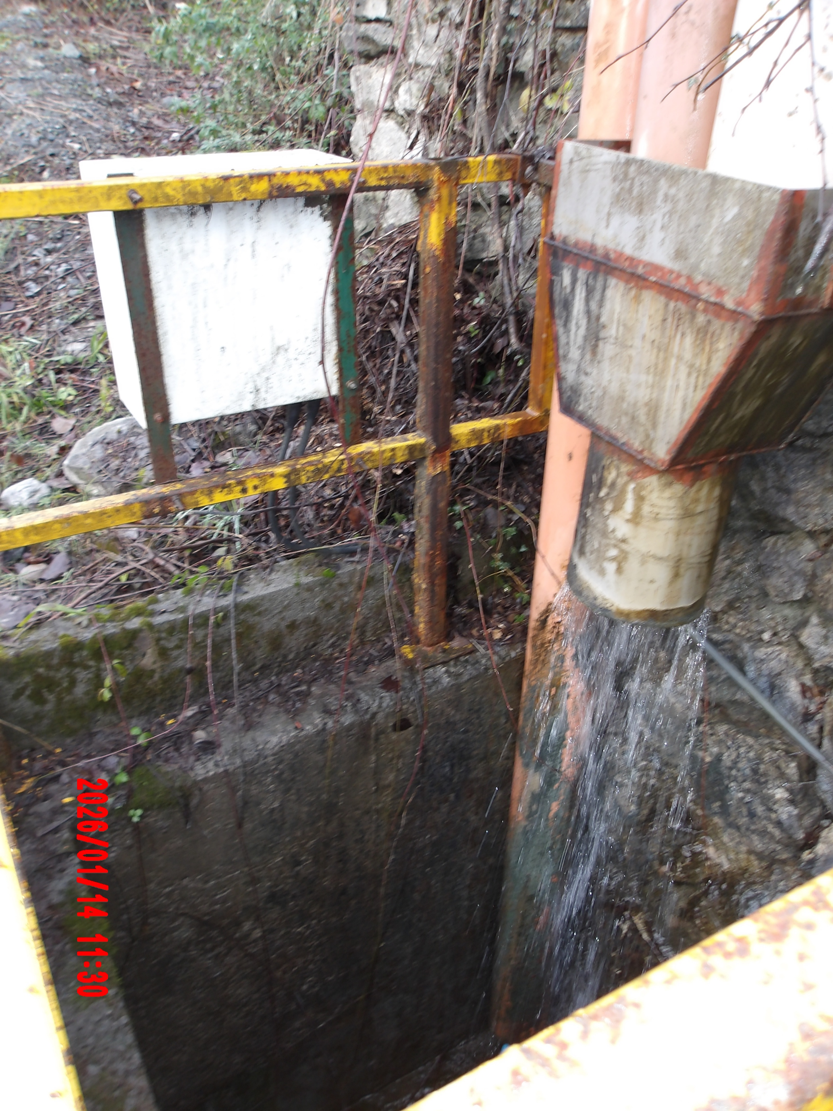
Dolyhir sample point

Slide 2
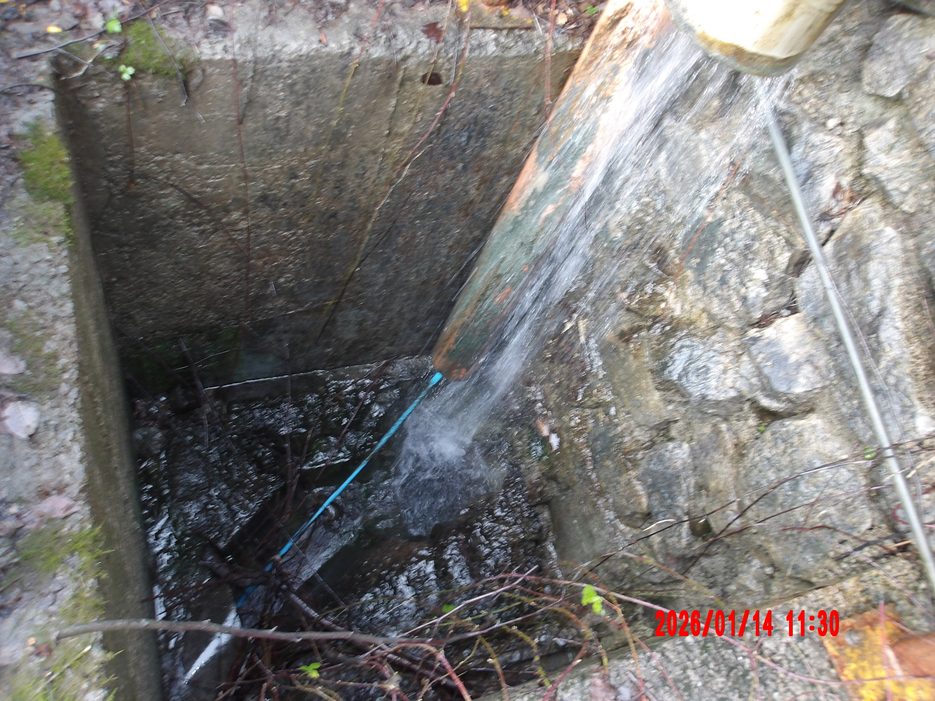
Dolyhir sample point

Slide 3
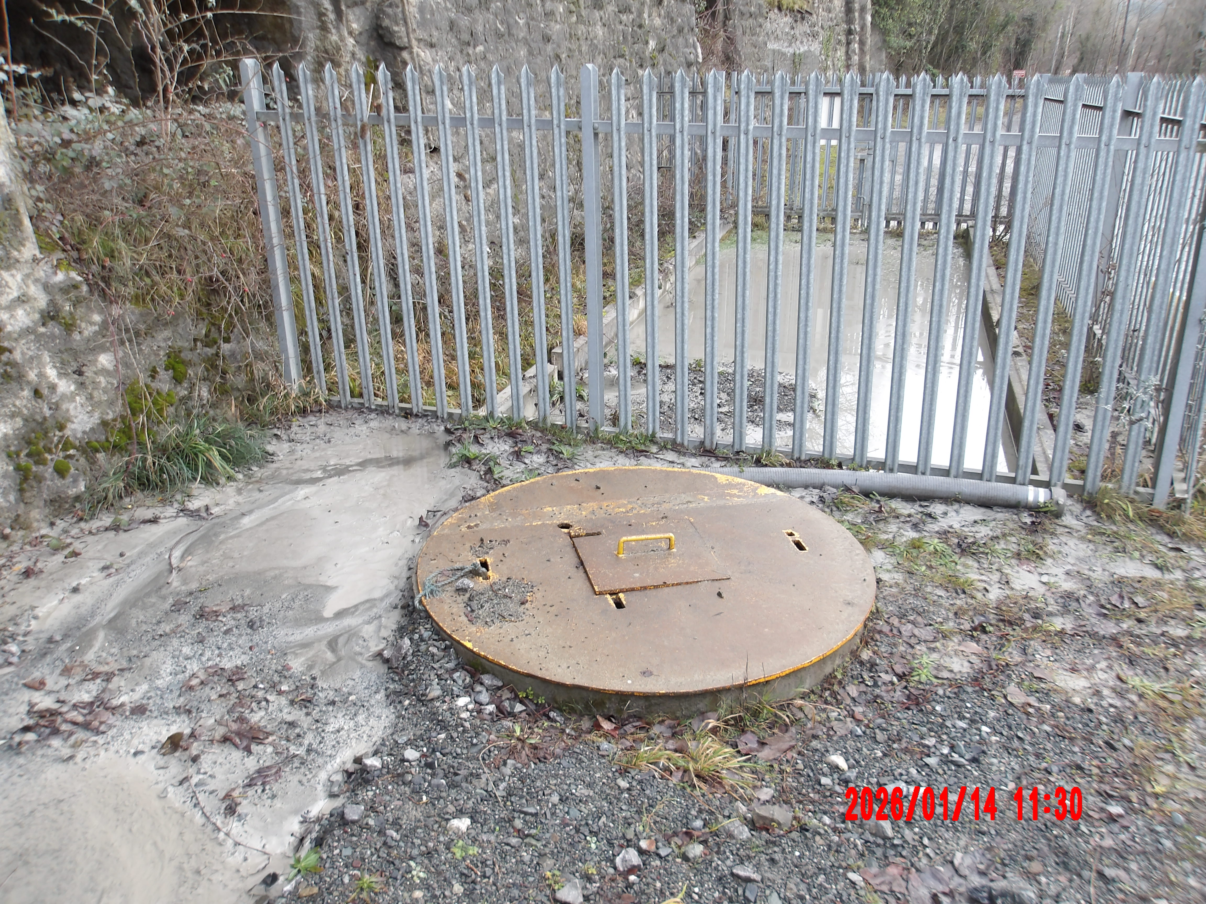
Settlement lagoon below sample point
Full at time of visit with evidence of nearby run-off

Slide 4
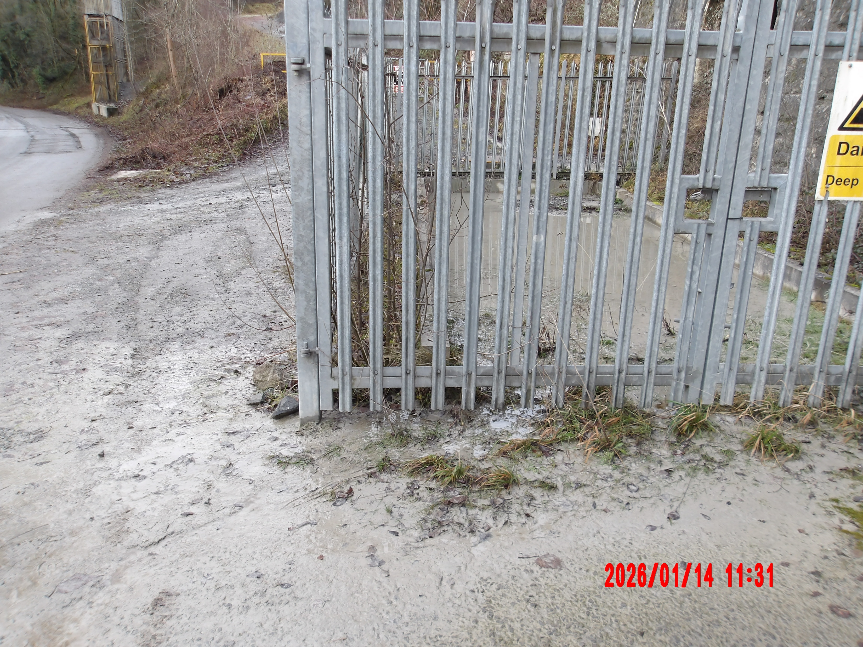
Settlement lagoon below sample point
Full at time of visit with signs of run-off

Slide 5
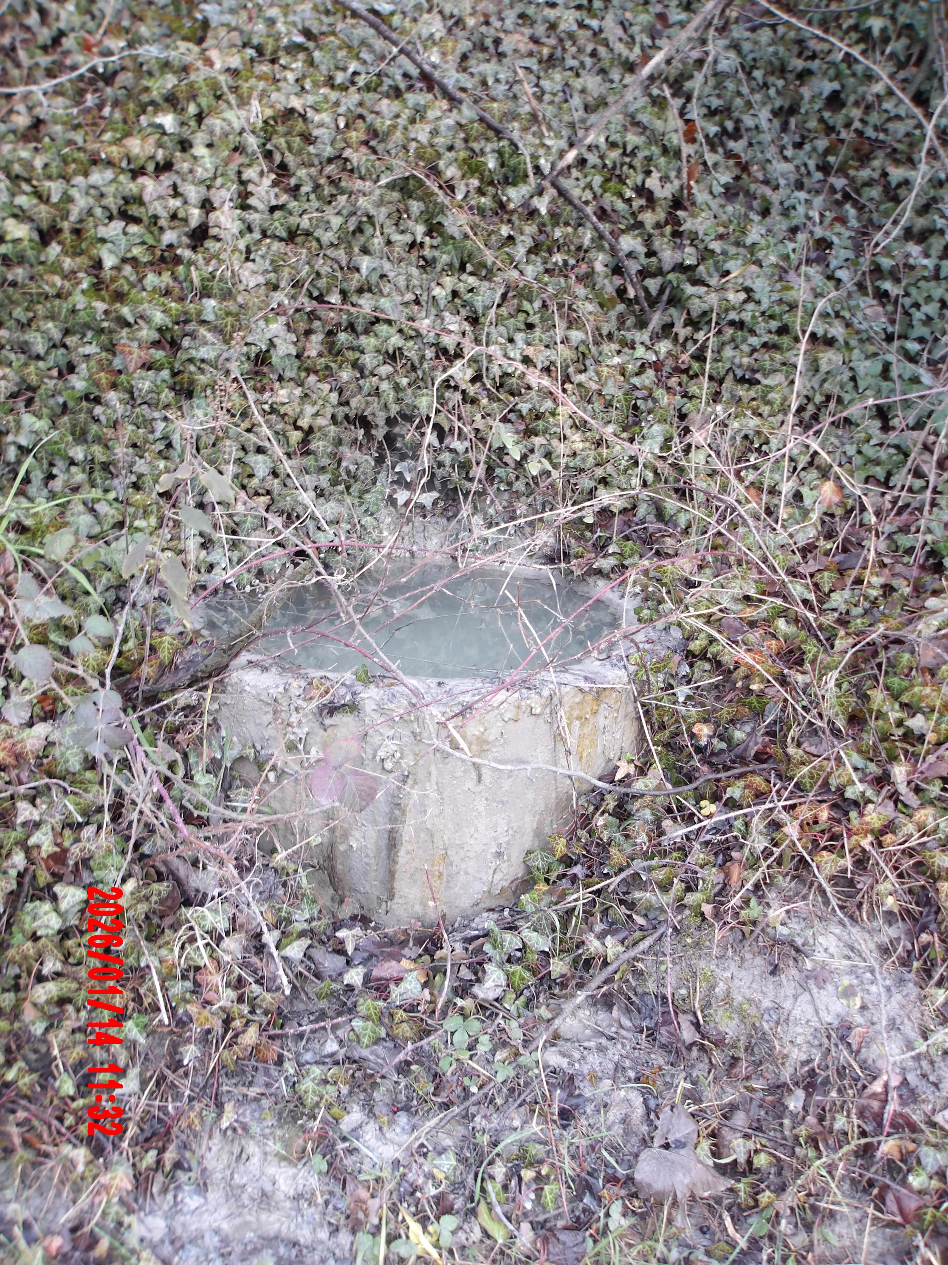
Small settlement pool
Part of site drainage, note signs of run-off

Slide 6
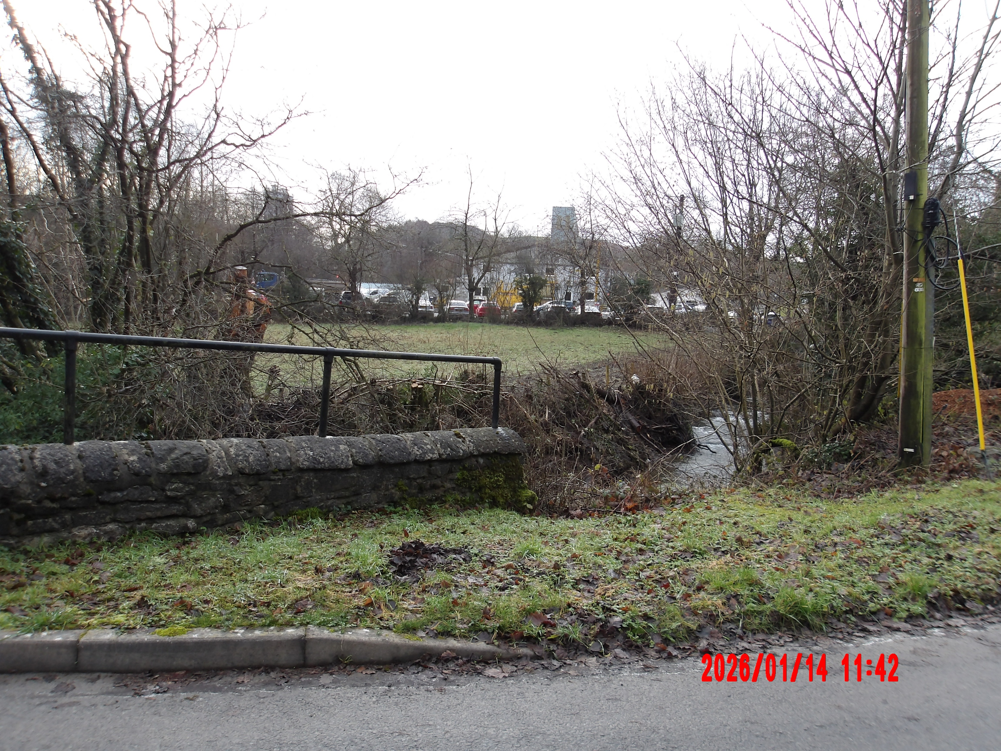
Dolyhir meadows SSSI
Following works undertaken by Tarmac.

