Slide 1
191204 Cillefwr Depot
by Edwards, Michael

Slide 2
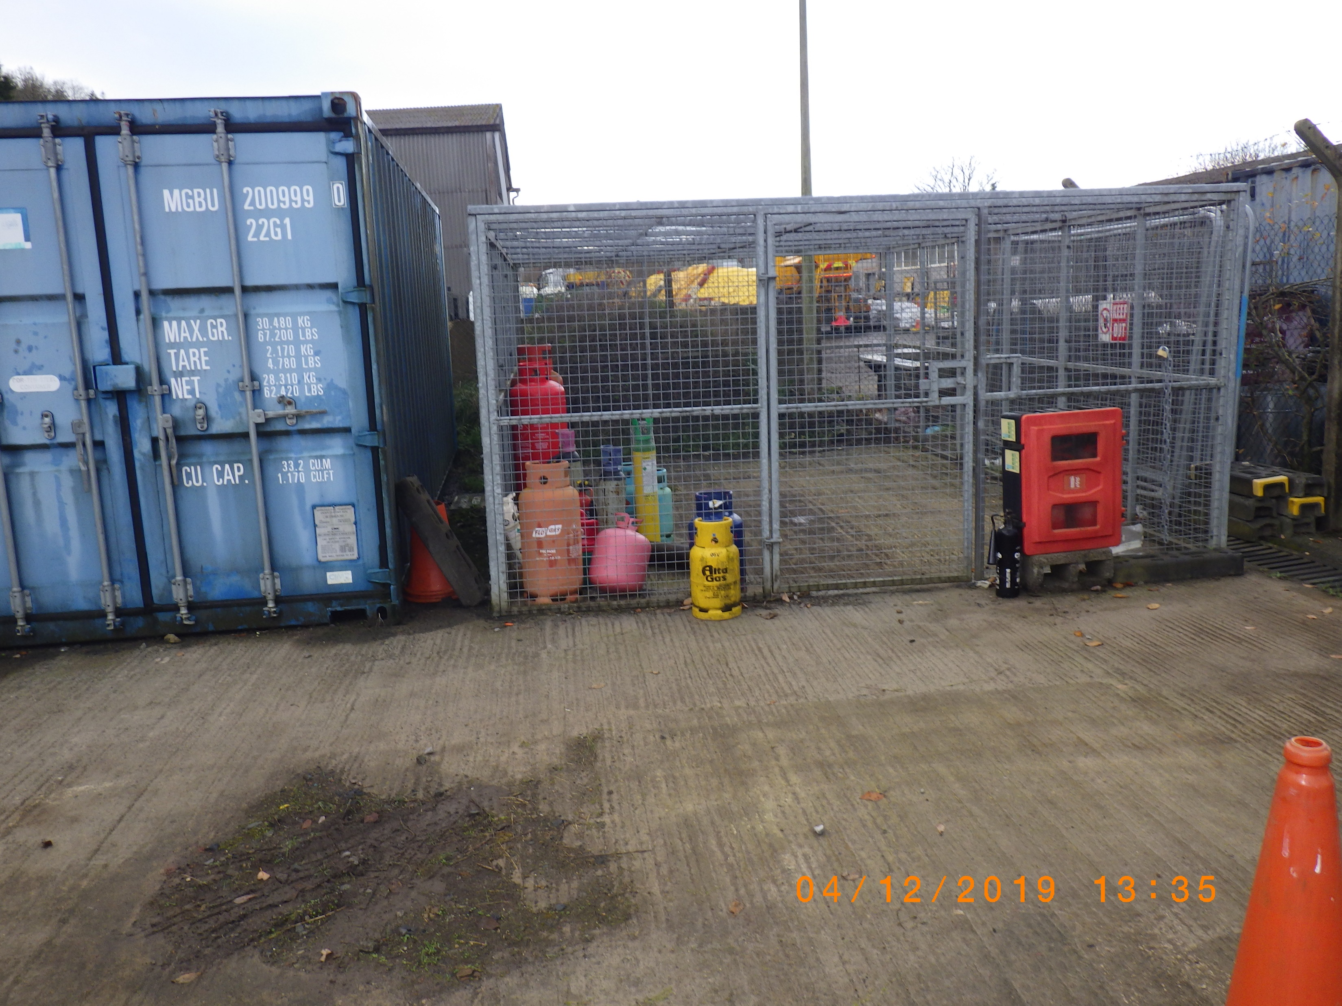

Slide 3
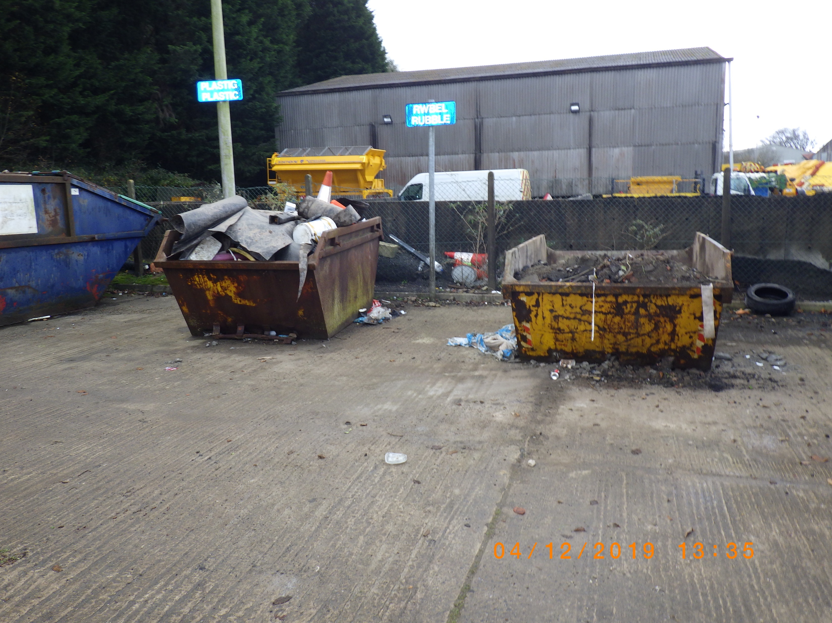

Slide 4
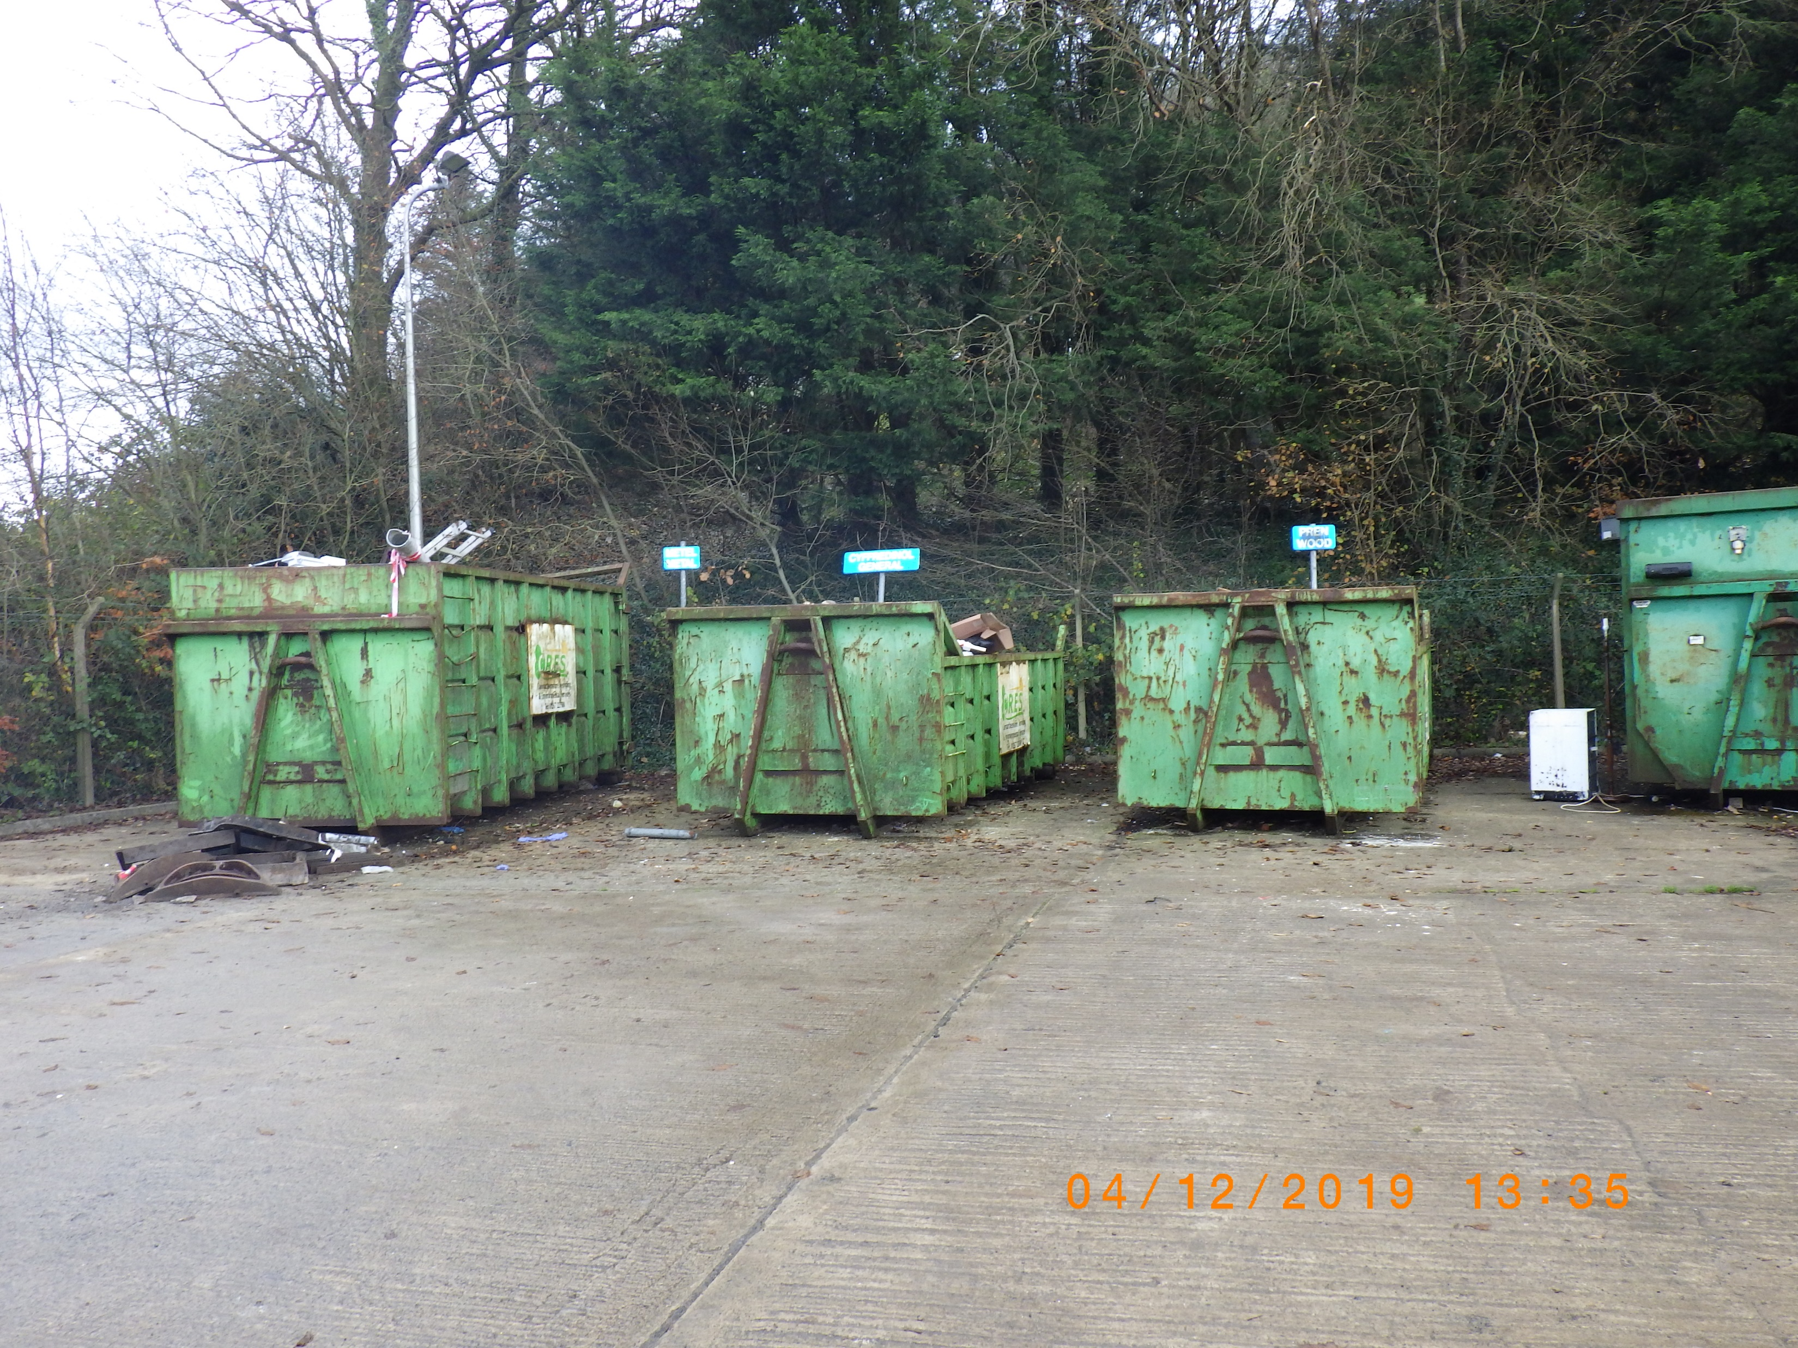

Slide 5
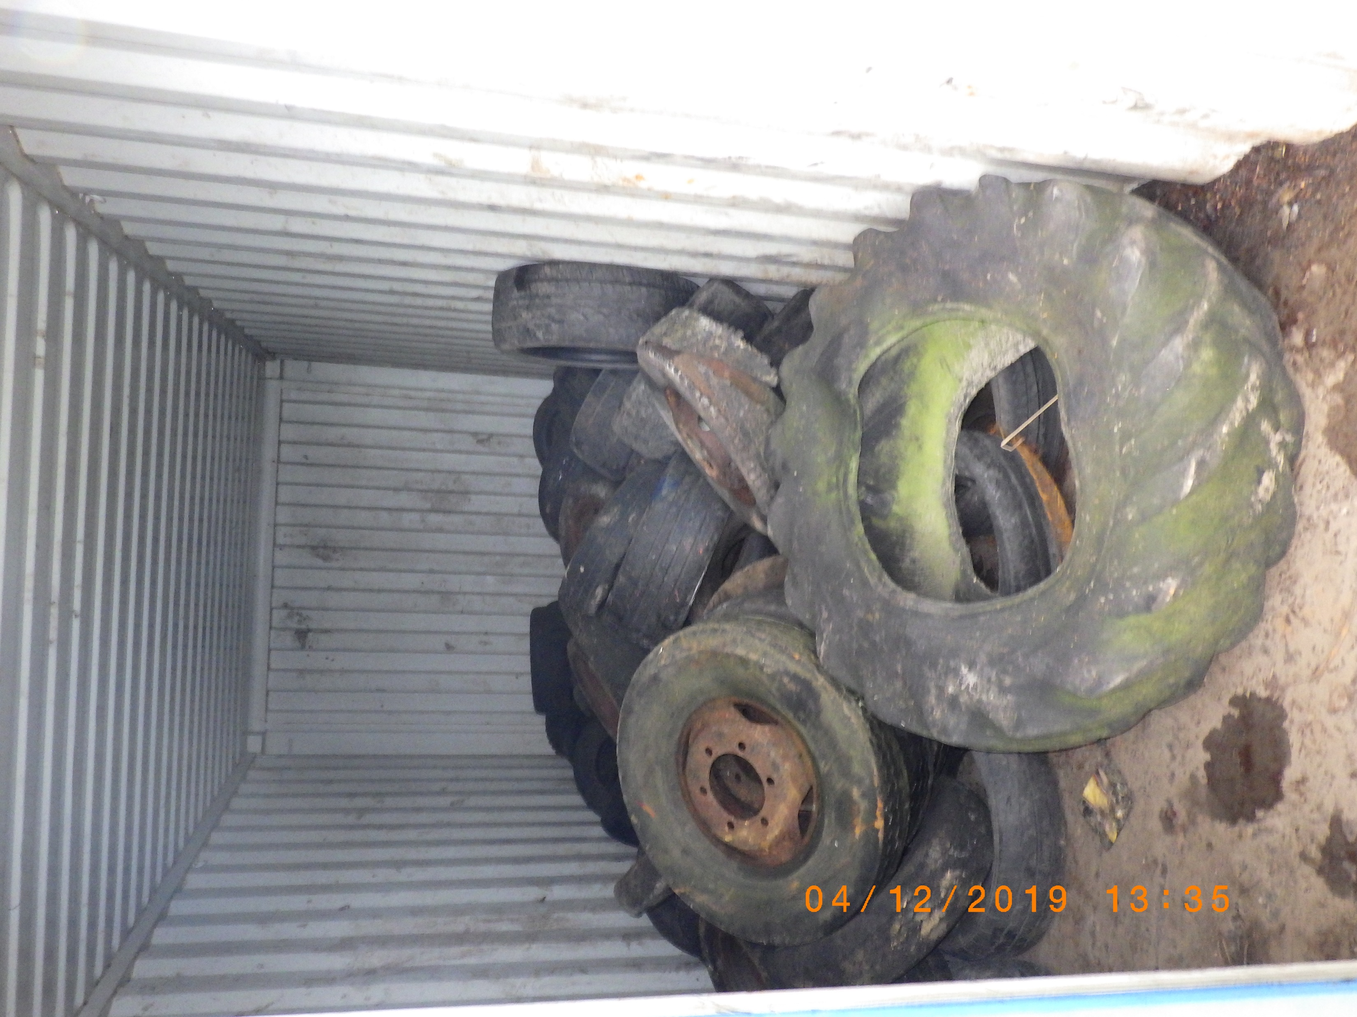

Slide 6


