Slide 1
200123 Greenacres Skips
by Edwards, Michael

Slide 2
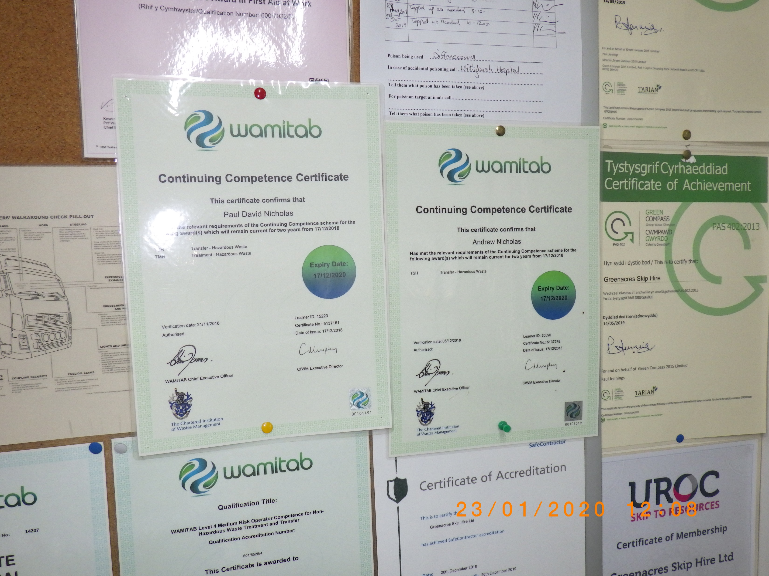

Slide 3
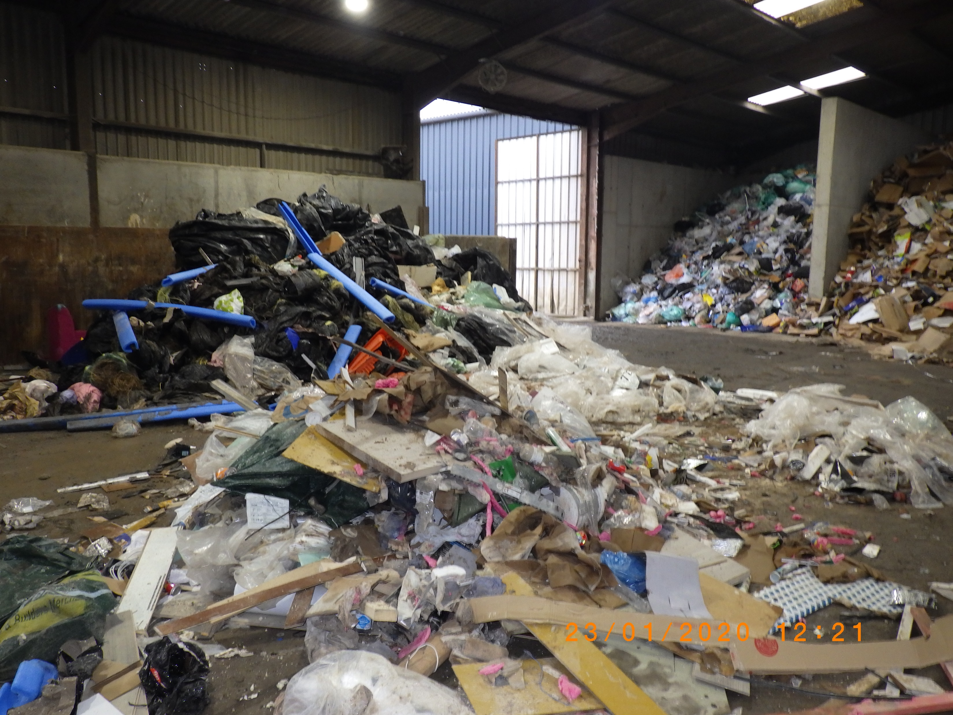

Slide 4


