Slide 1
Glan-yr-afon Waste Transfer Station Compliance Visit Photographs
19th October 2020
Malcolm Dines

Slide 2
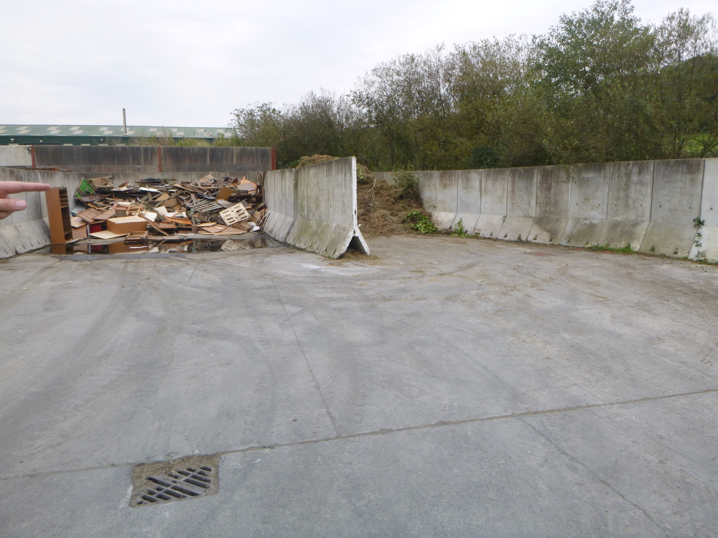

Slide 3
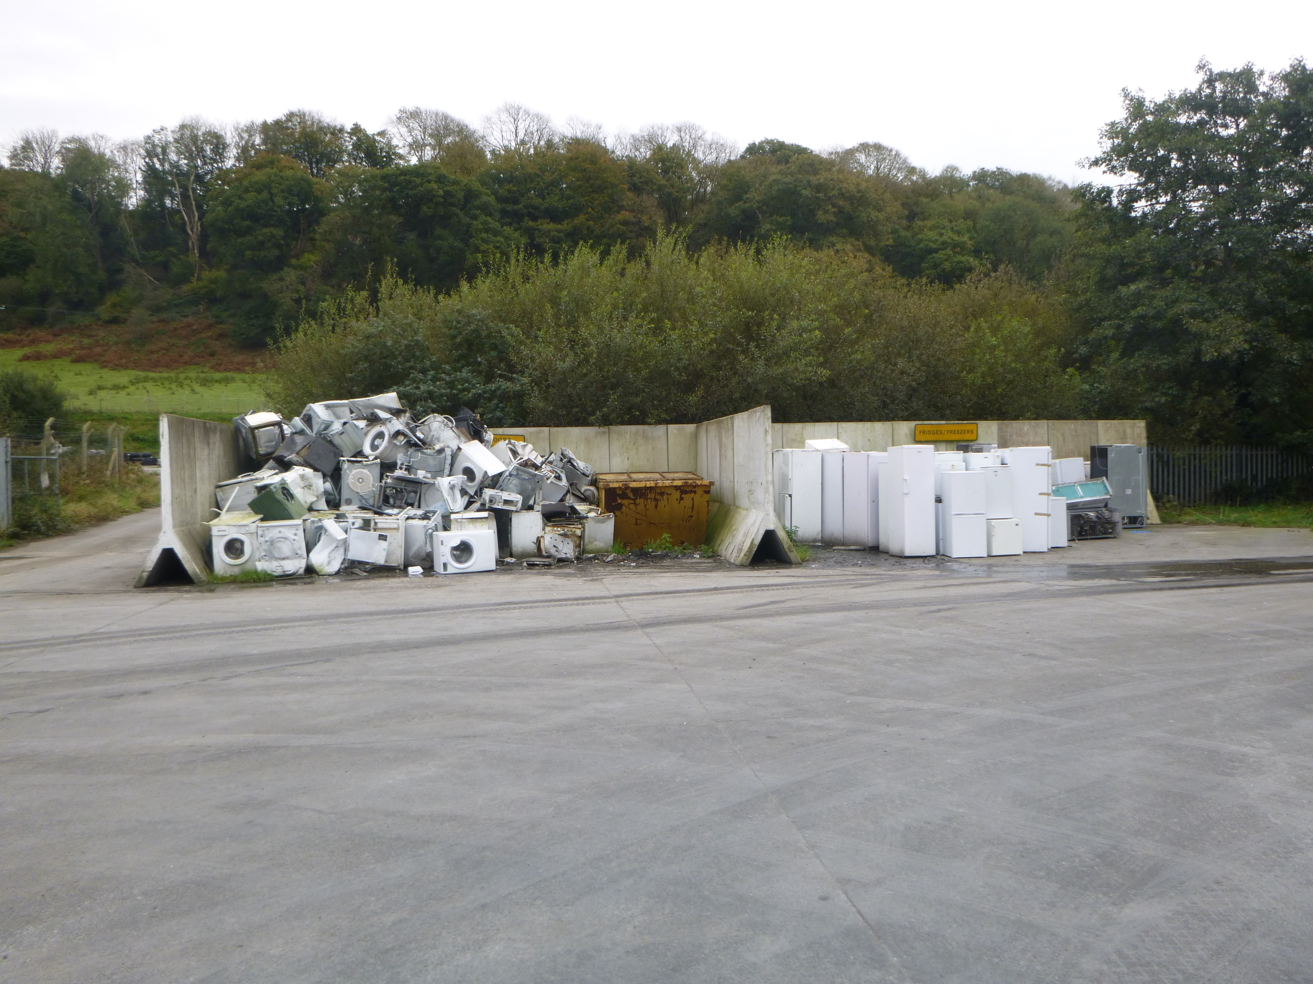

Slide 4
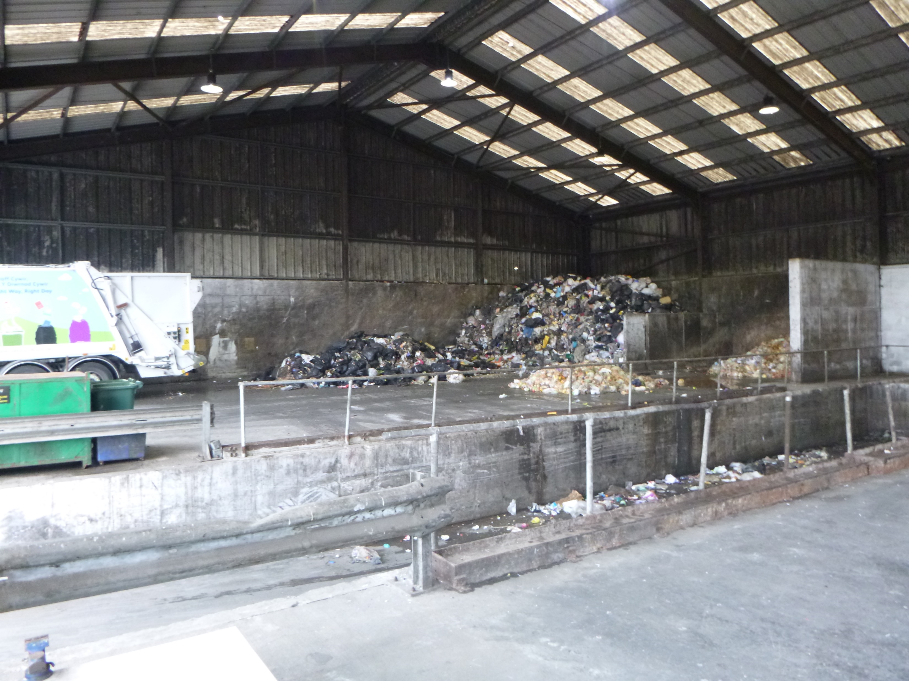

Slide 5
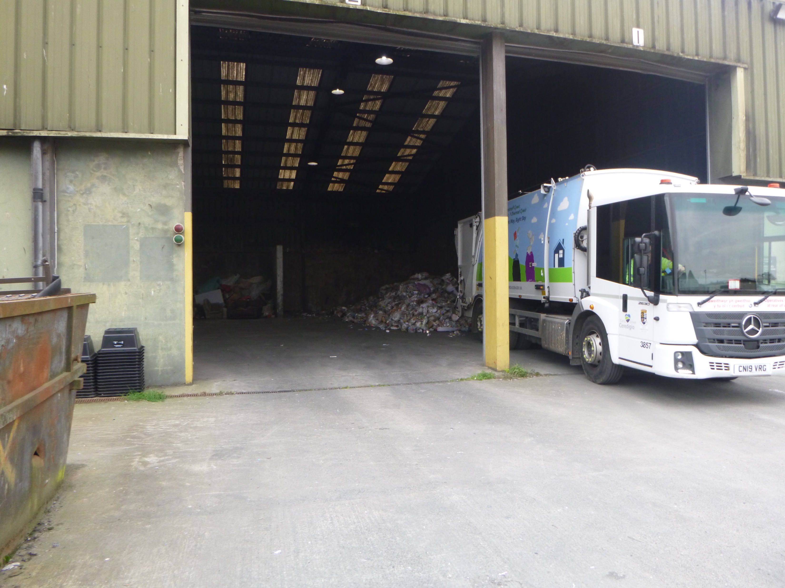

Slide 6
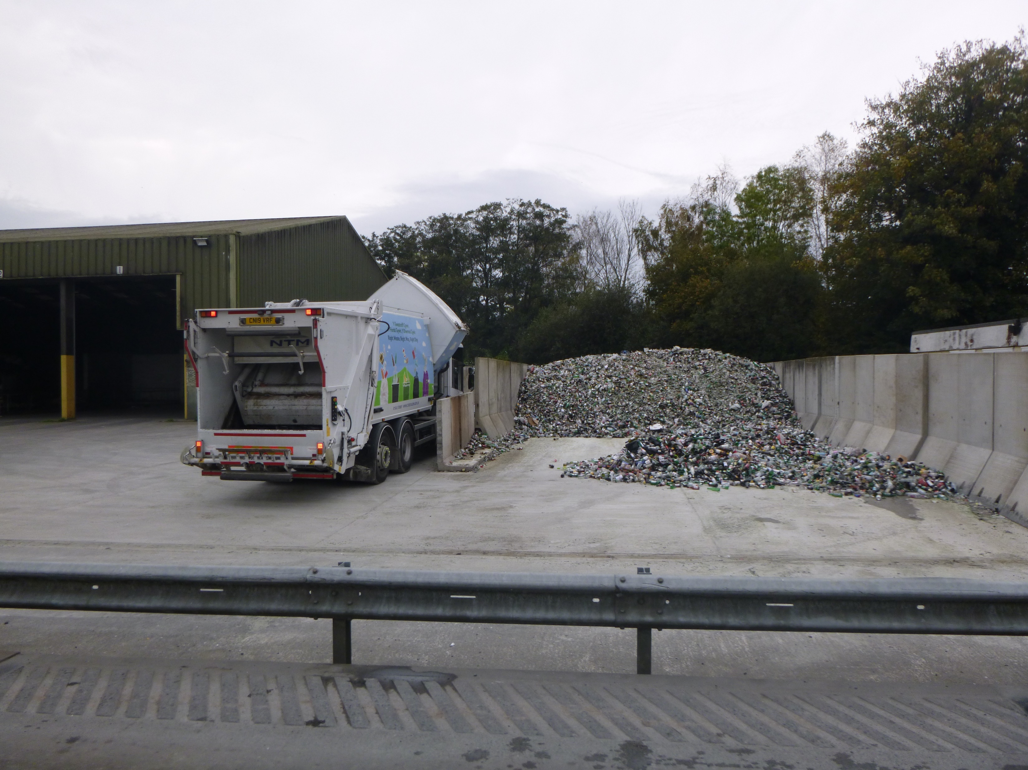

Slide 7
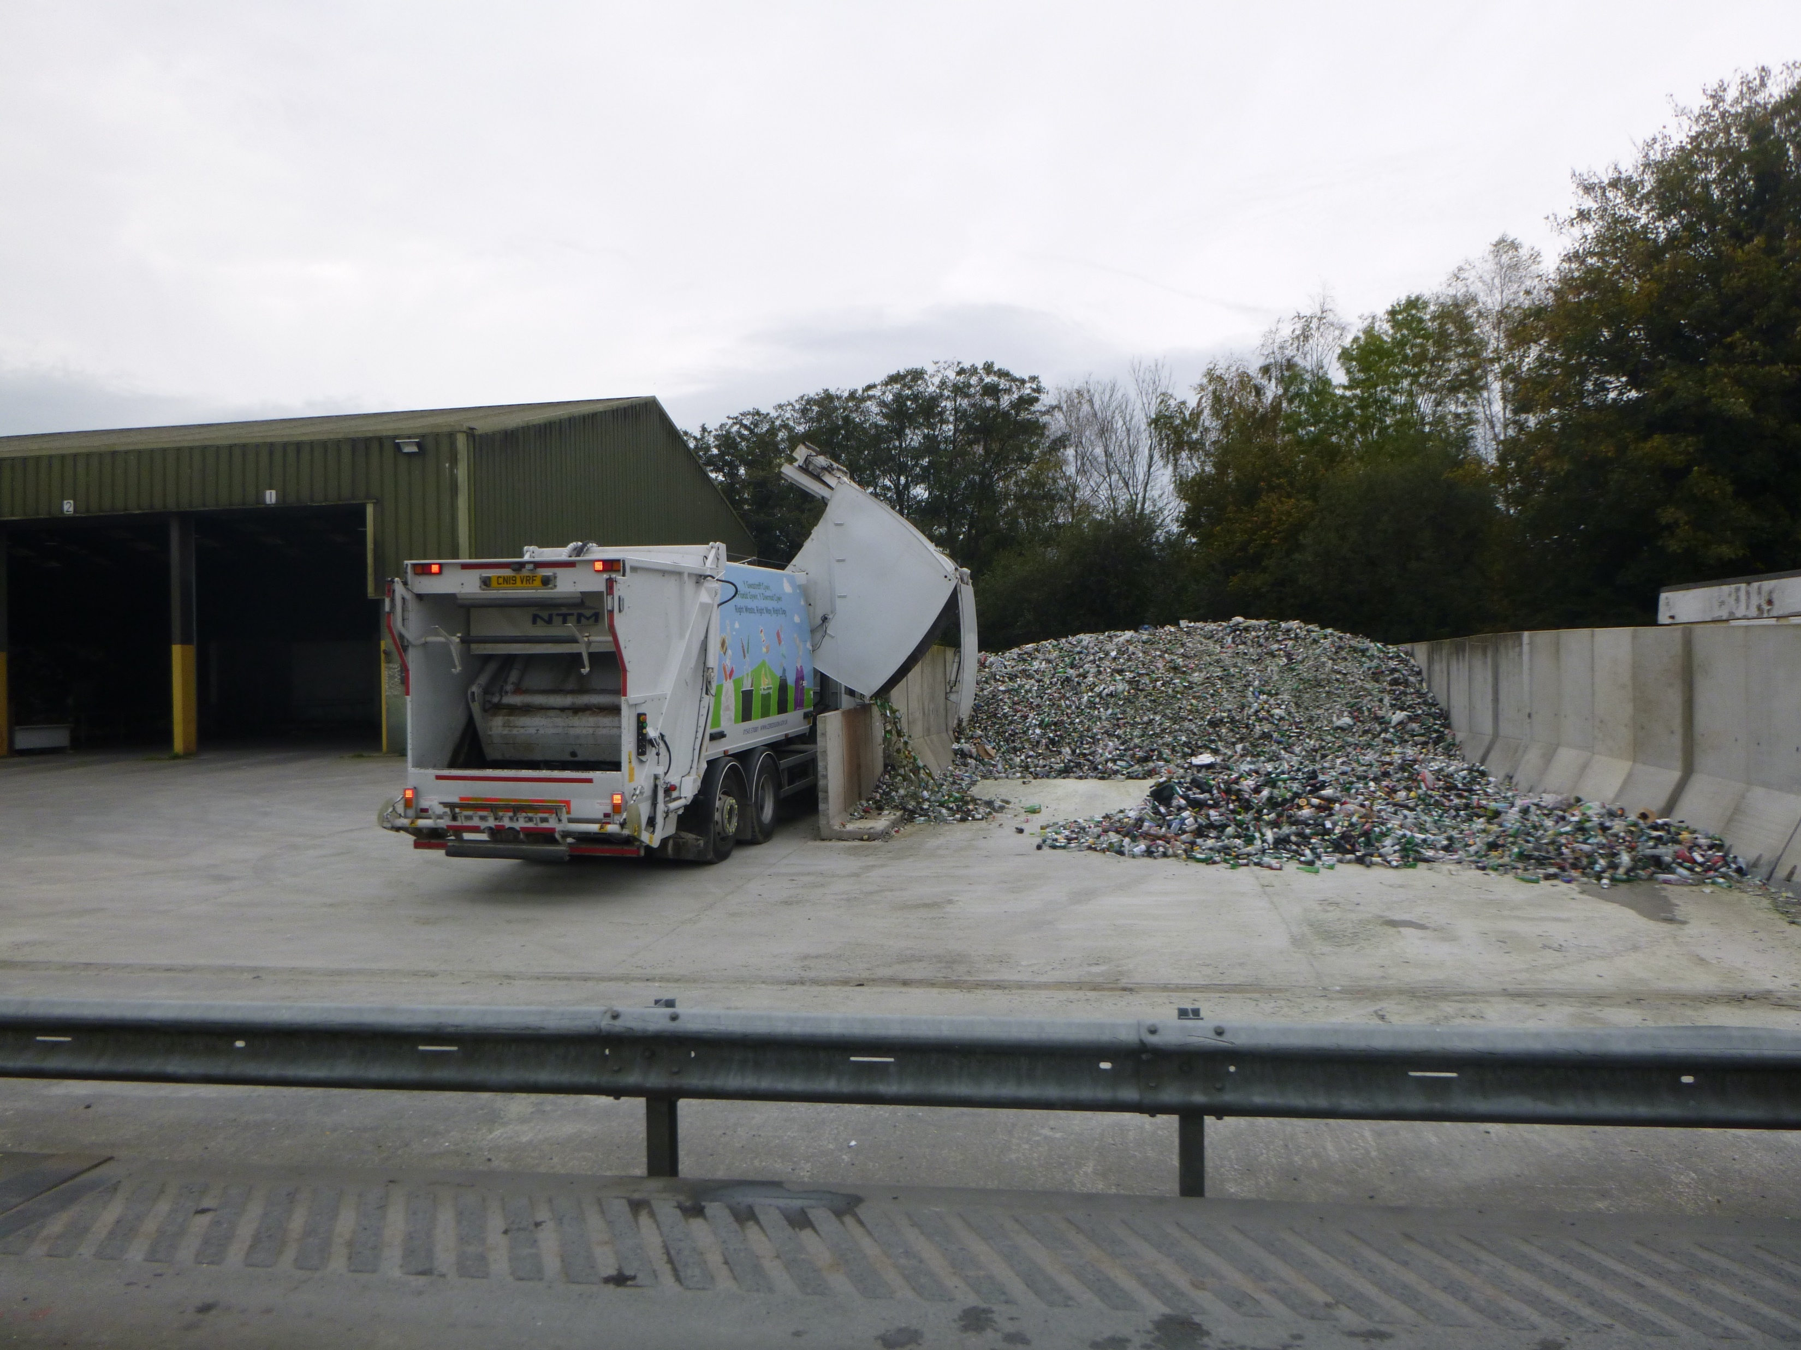

Slide 8
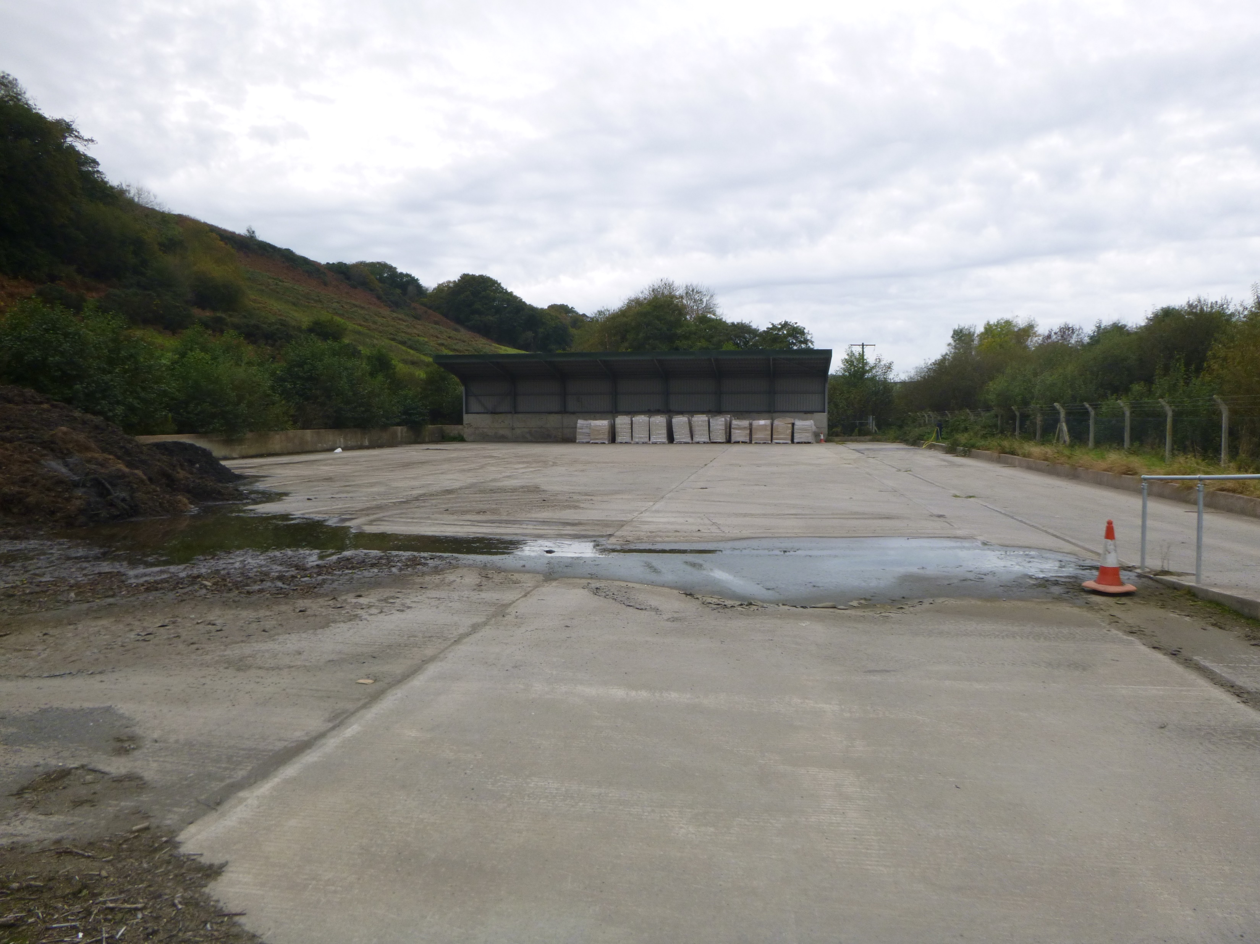

Slide 9


