Slide 1
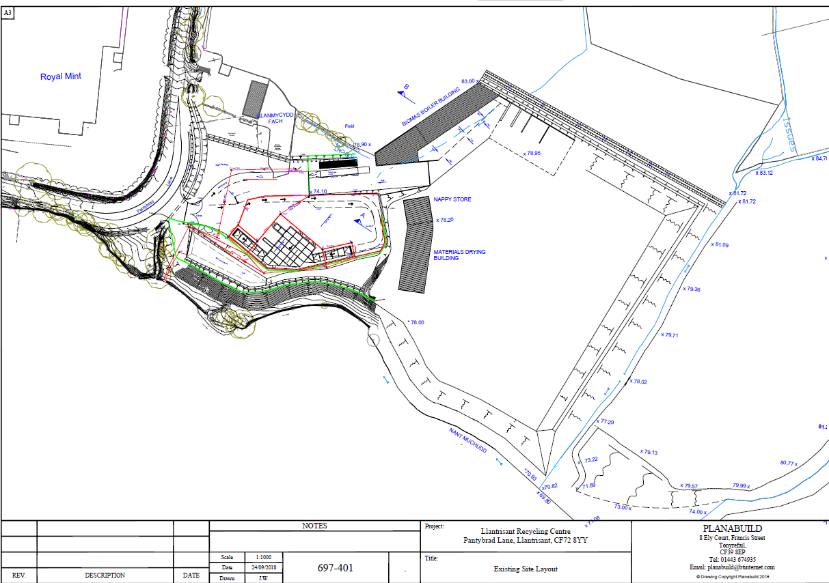
Key:-
Figure 1 Appendix A
FRS access, equipment and drainage
Water storage tanks
Lagoon for drainage
Drainage channel
Direction of waste water flow
Access route
River access points
Field access points
Water shut off valves
Surface water drain
Surface water flow direction(piped)
Surface water outfall
Staff meeting point
Fire extinguishers
FRS vantage areas
Site run off outfall (new)
The ‘off site’ emergency information pack is held within the security cabin, on site, next to the weighbridge office.
Fuel Tank—2,500l
Spill kits & PPE, PCE
SP
SP
Settlement pond-Spring water (312,165l)
Lined storage lagoon-site water (1,024,500l)
Nant Mychydd River
N
SW
Prevailing wind direction

Slide 2
Waste storage and plant locations
Waste stockpiles (air drying bays)—predominantly glass wastes for drying process. Will be used for other wastes (e.g. textiles/mattresses) when required for transportation purposes only.
Glass treatment area
Unprocessed glass
Processed glass
Quarantine area
Unprocessed wood
Quarantine area
Wood treatment area
Processed wood piles
Internal storage bays (not heated)
Road sweepings storage
Waste stockpiles (air drying bays)—predominantly glass wastes for drying process. Will be used for other wastes (e.g. textiles/mattresses) when required for transportation purposes only.
Unprocessed Green waste
Green waste treatment area
Composting area
Processed (Oversized) Green waste
Fixed plant locations

Slide 3
Infrastructure
Existing series of concrete bays
New series of concrete bays/wall to be installed
Spring water storage
Lines storage lagoon-site water
Waste storage building
Existing area for treatment/storage--concreted

Slide 4
Stack management and separation distances
10-15m
15-20m
15-20m
40m
15-20m
20-25m
20-30m
5-10m
15-20m
Separation distances justified within the previous FPMP, please see this document for reasoning
7m
3-3.5m between windrows
Fixed plant locations

Slide 5
Clay bund locations
Clay bund at the top of ramp access
Example clay bund at fire location
Fixed plant locations

