Slide 1

Effluent Plant DCS Modifications
May 2021

Slide 2
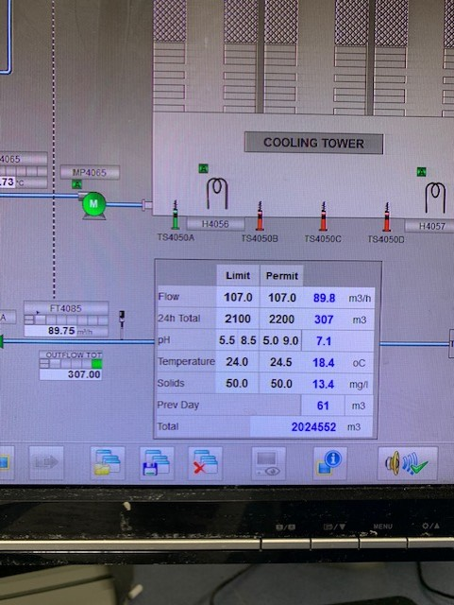
After the Effluent breach whereby the total discharge limit of 2200m3 during a 24 hour period was exceeded, several modifications have been made to prevent a reoccurrence.
1. The Effluent discharge flow totaliser will now reset to zero at 12:00 noon instead of 00:00 midnight. This now matches the same 24 hour window recorded on Proficy.
2. Once the discharge totaliser reaches 2200m3, the Effluent will automatically go into recirc and prevent any further flow to the Estuary.

Slide 3
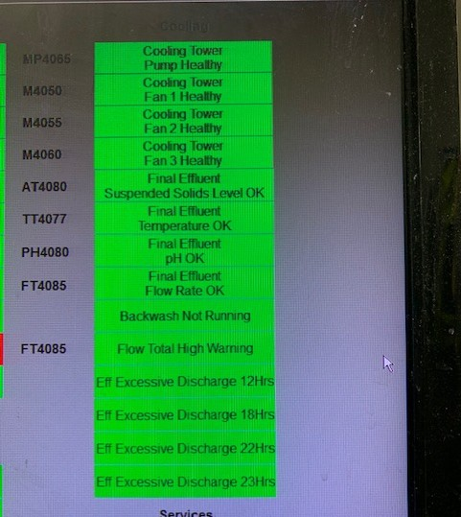
3. An additional alarm has been added onto the alarm page to indicate when the total flow has reached 2100m3, 100m3 before the system will go into recirc.
4. The alarm page also includes expected flow totaliser warnings. This is based on real-time discharge flow rates over 12, 18, 22 and 23 hour periods.
Example:
If the discharge flow remains above 91.7m3/h for more than 12 hours, the alarm will sound as this would give an expected total discharge of 2200.8m3 for the 24 hour period.
This is the same for 18, 22 and 23 hour flow predictions.
The alarm will clear if the discharge flow rate is reduced to a level below the predicted 2200m3 limit for the 24 hour window.

Slide 4
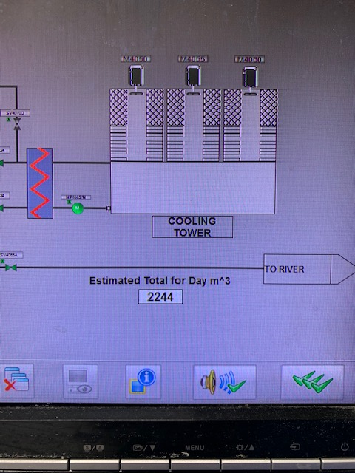
5. The estimated discharge flow totaliser for the 24 hour period is visible on the main ‘Effluent’ page on the DCS. The predicted value will update every minute based on the flow discharge rate.
The measures put in place allow the maximum time possible for the cause of excessive water discharge to be identified and resolved before the Effluent goes into recirc.

