Slide 1
Rees Metals Visit
10/6/21
by Edwards, Michael

Slide 2
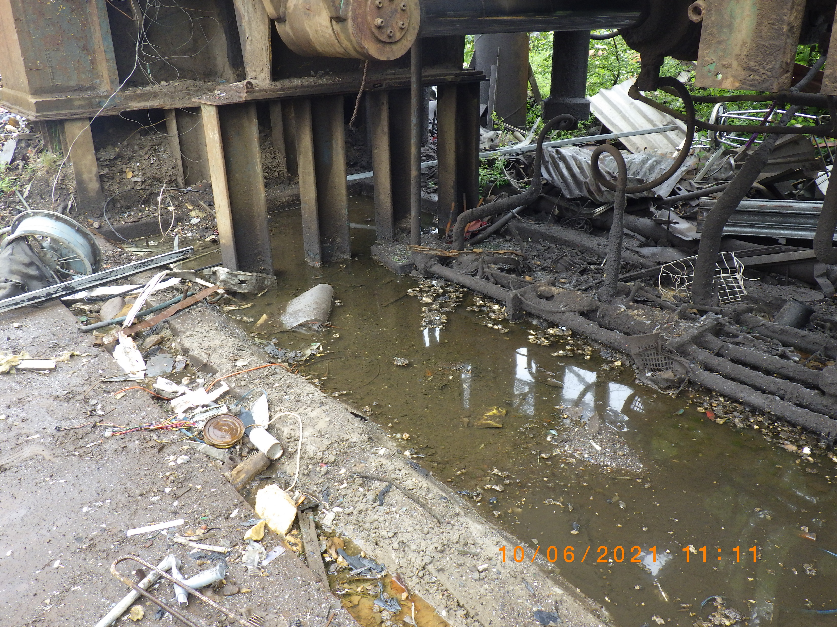

Slide 3
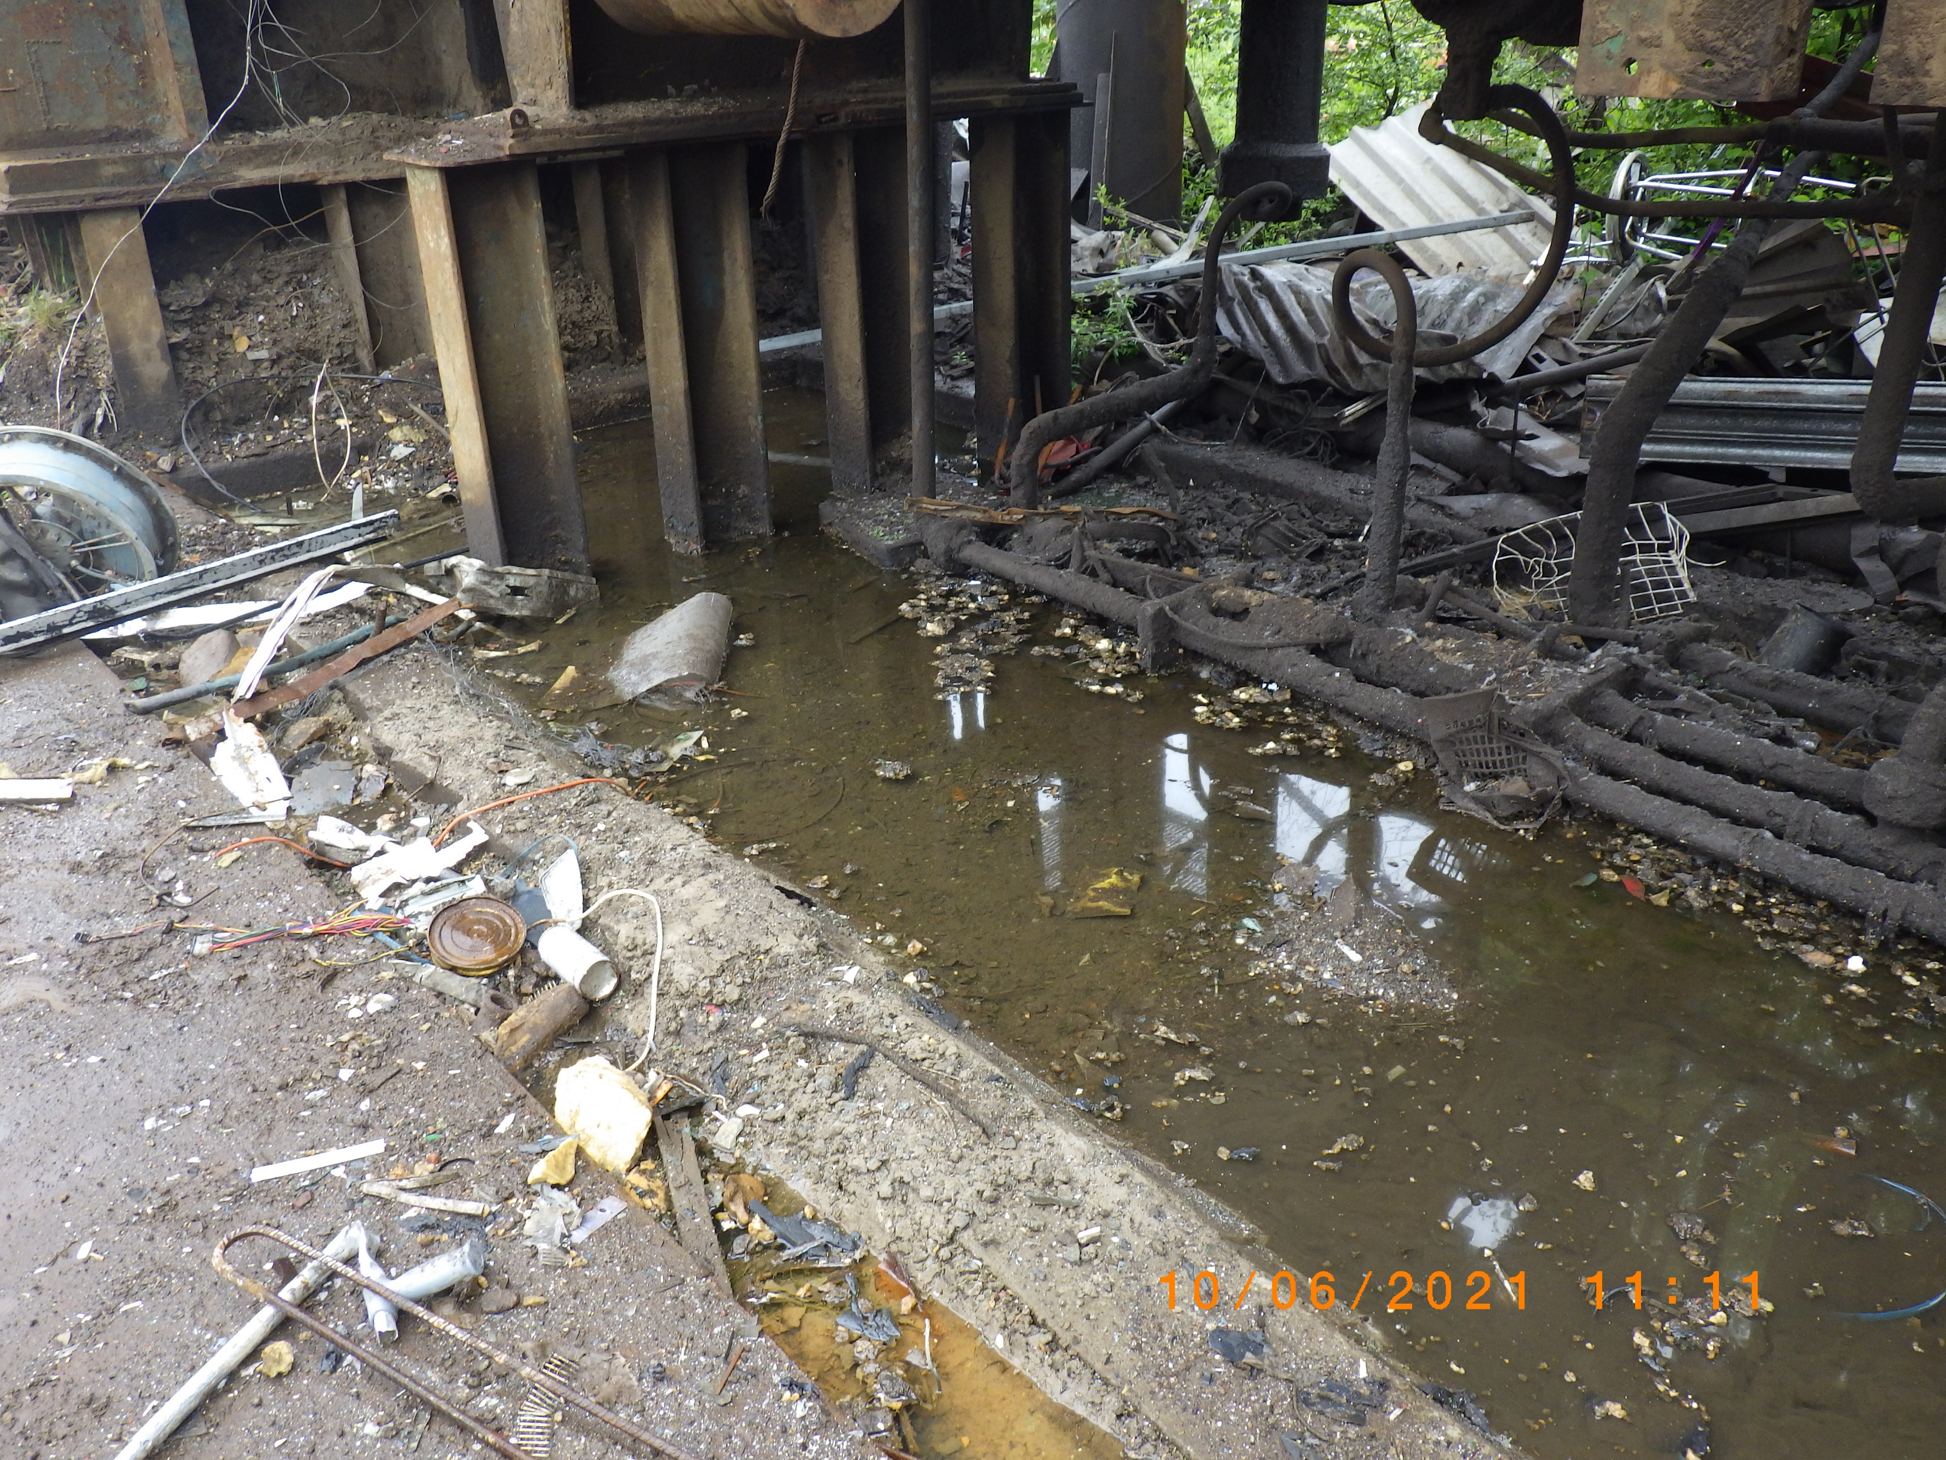

Slide 4
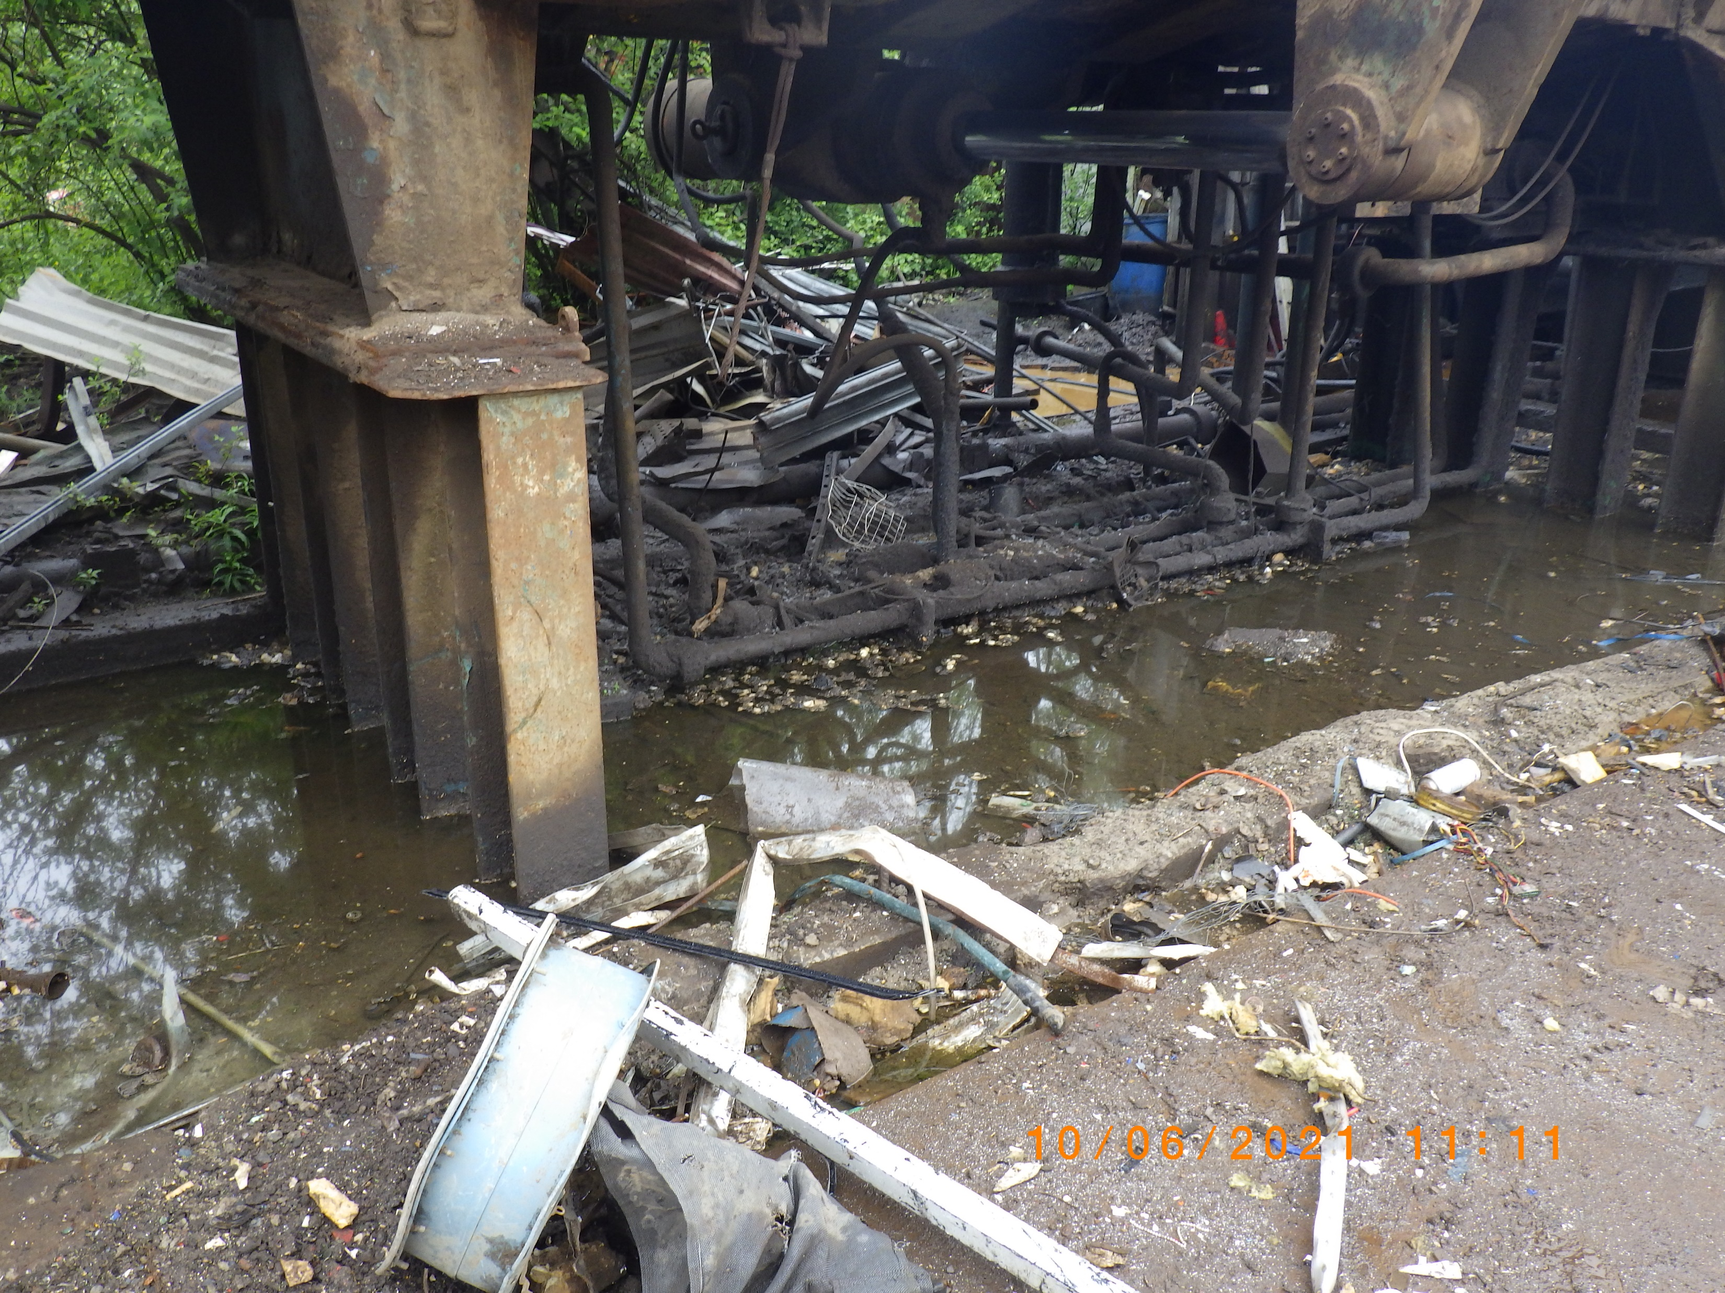

Slide 5
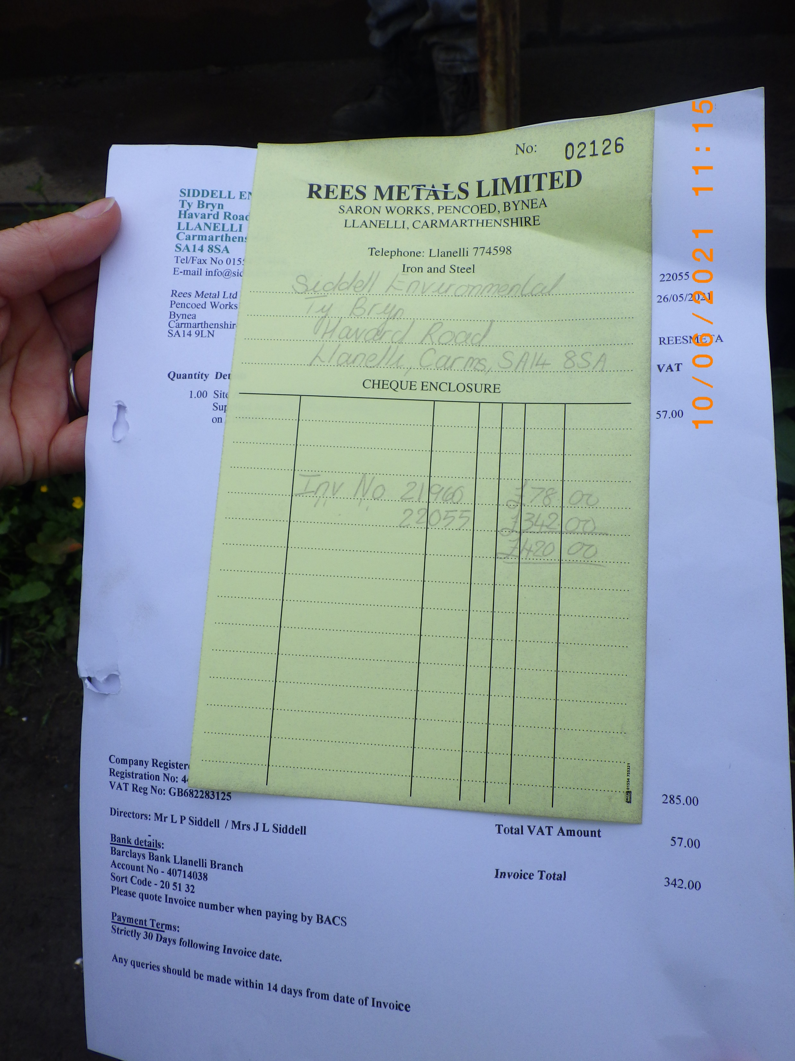

Slide 6


