Slide 1
Briton Ferry Shipping Services 13/5/21
by Edwards, Michael

Slide 2
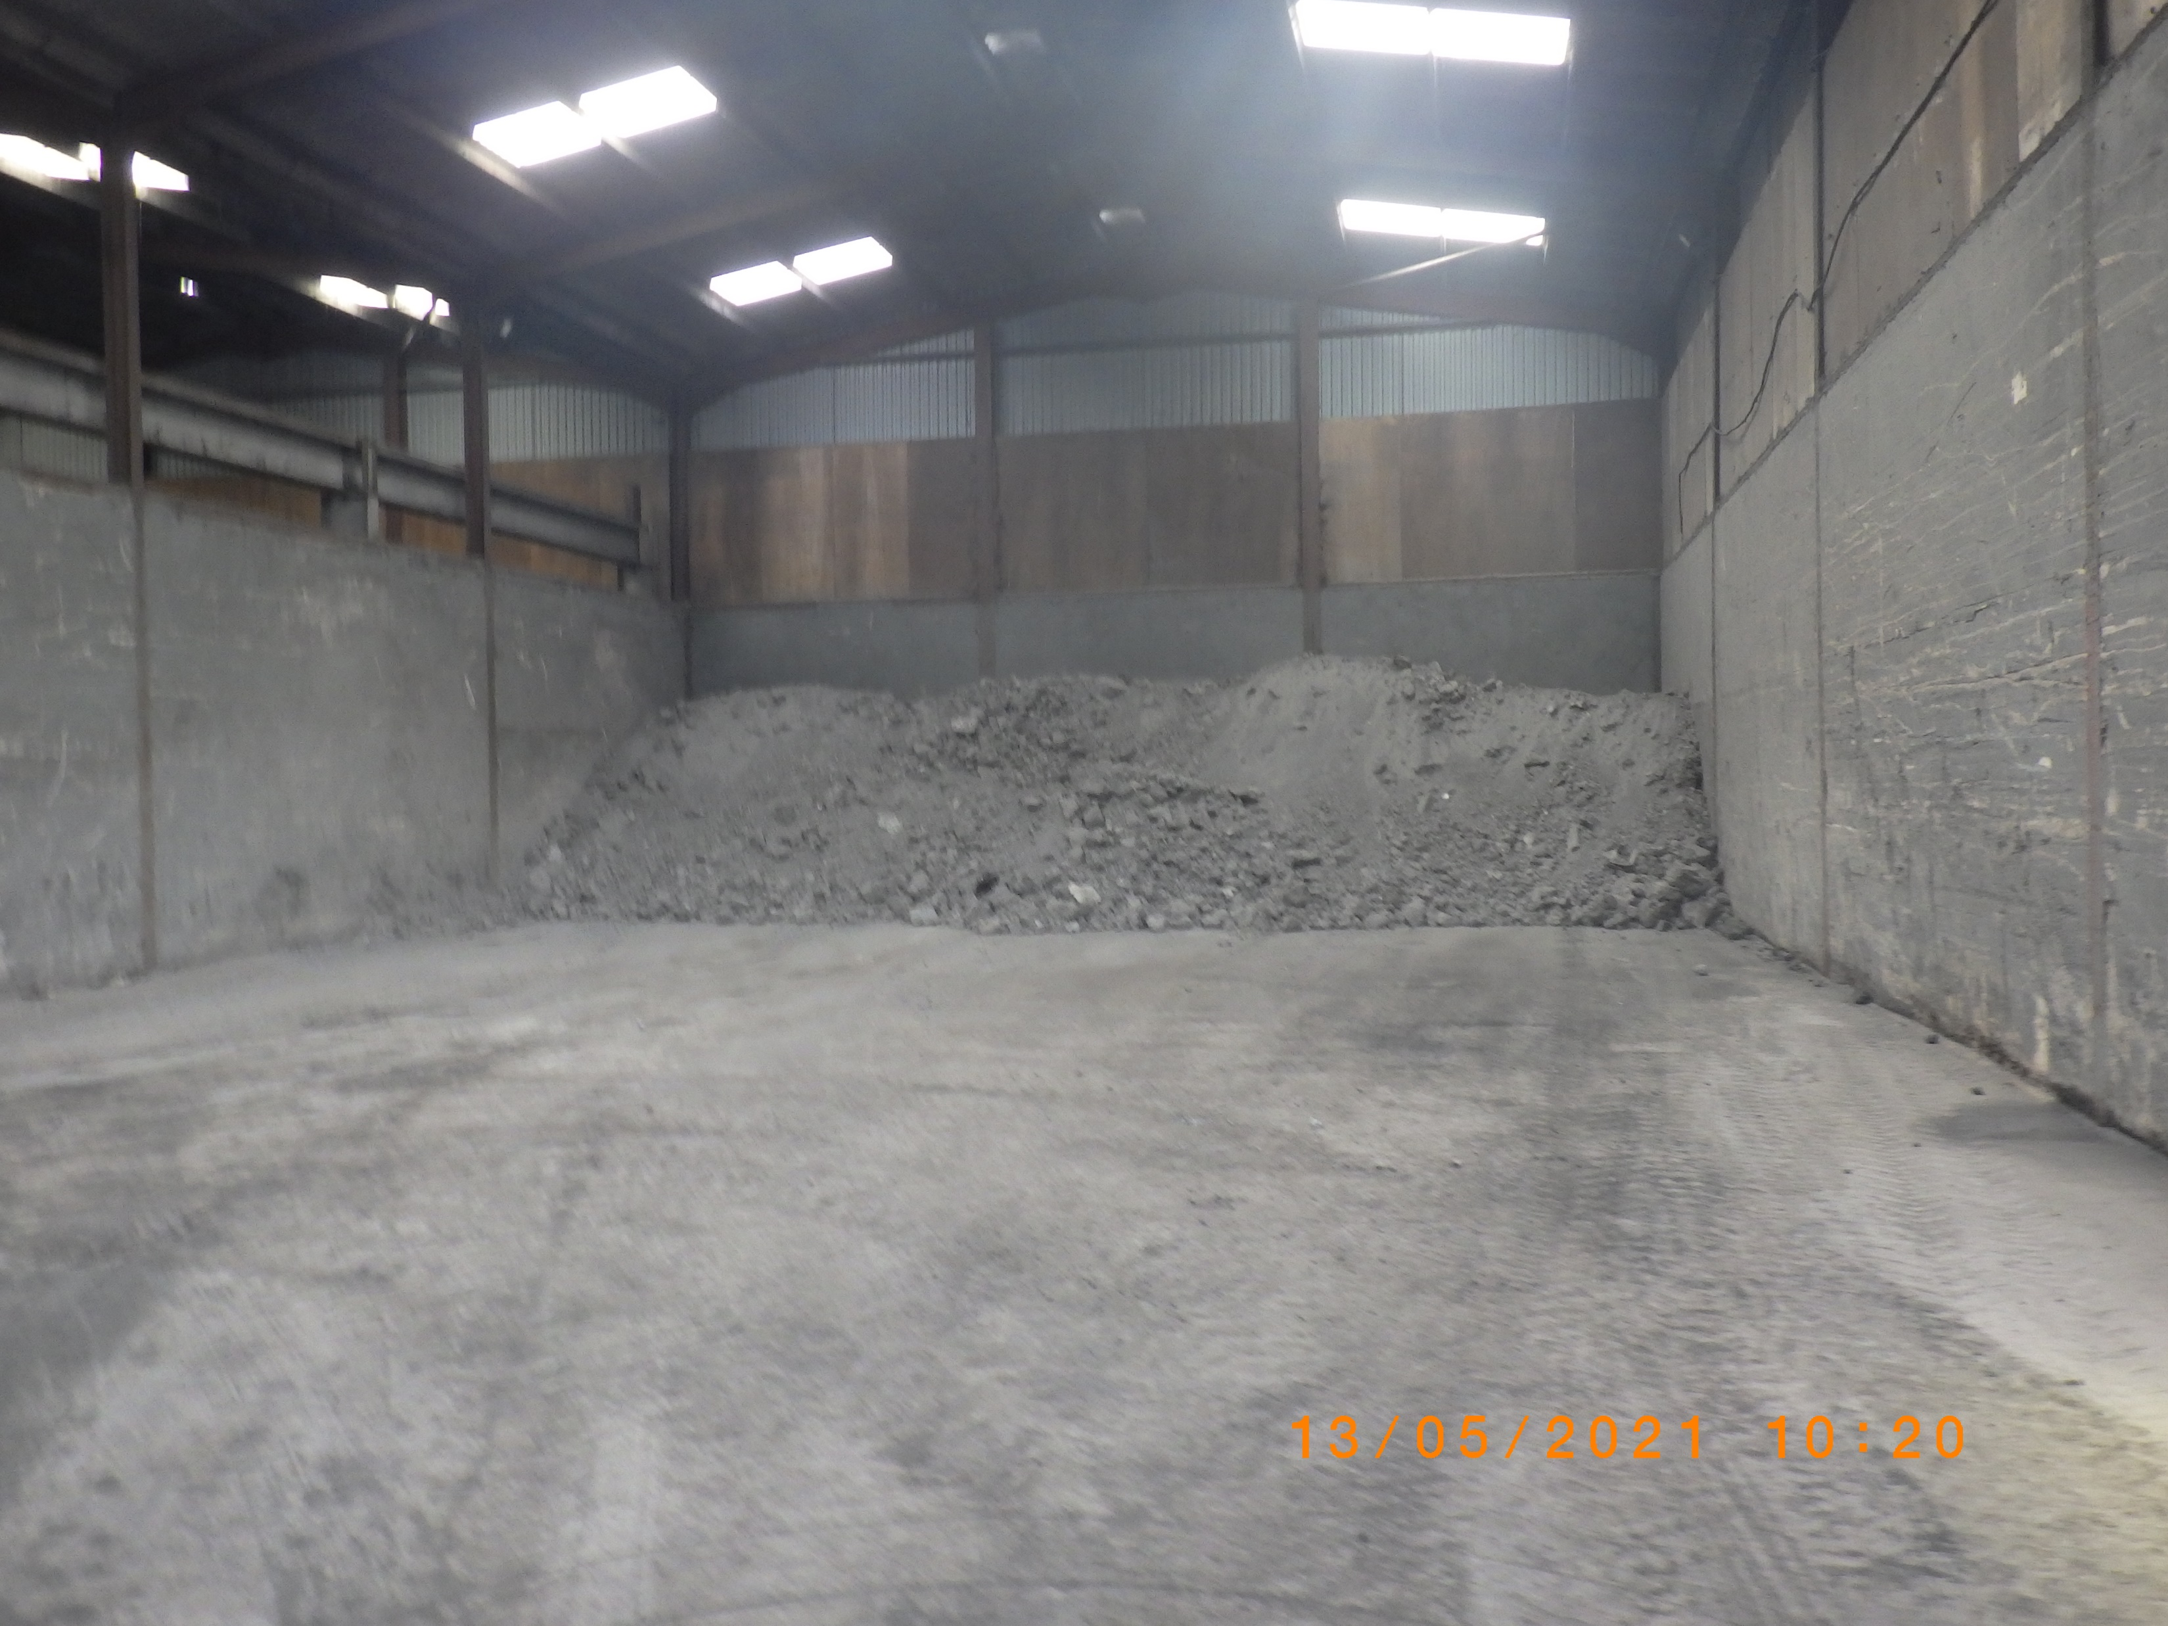

Slide 3
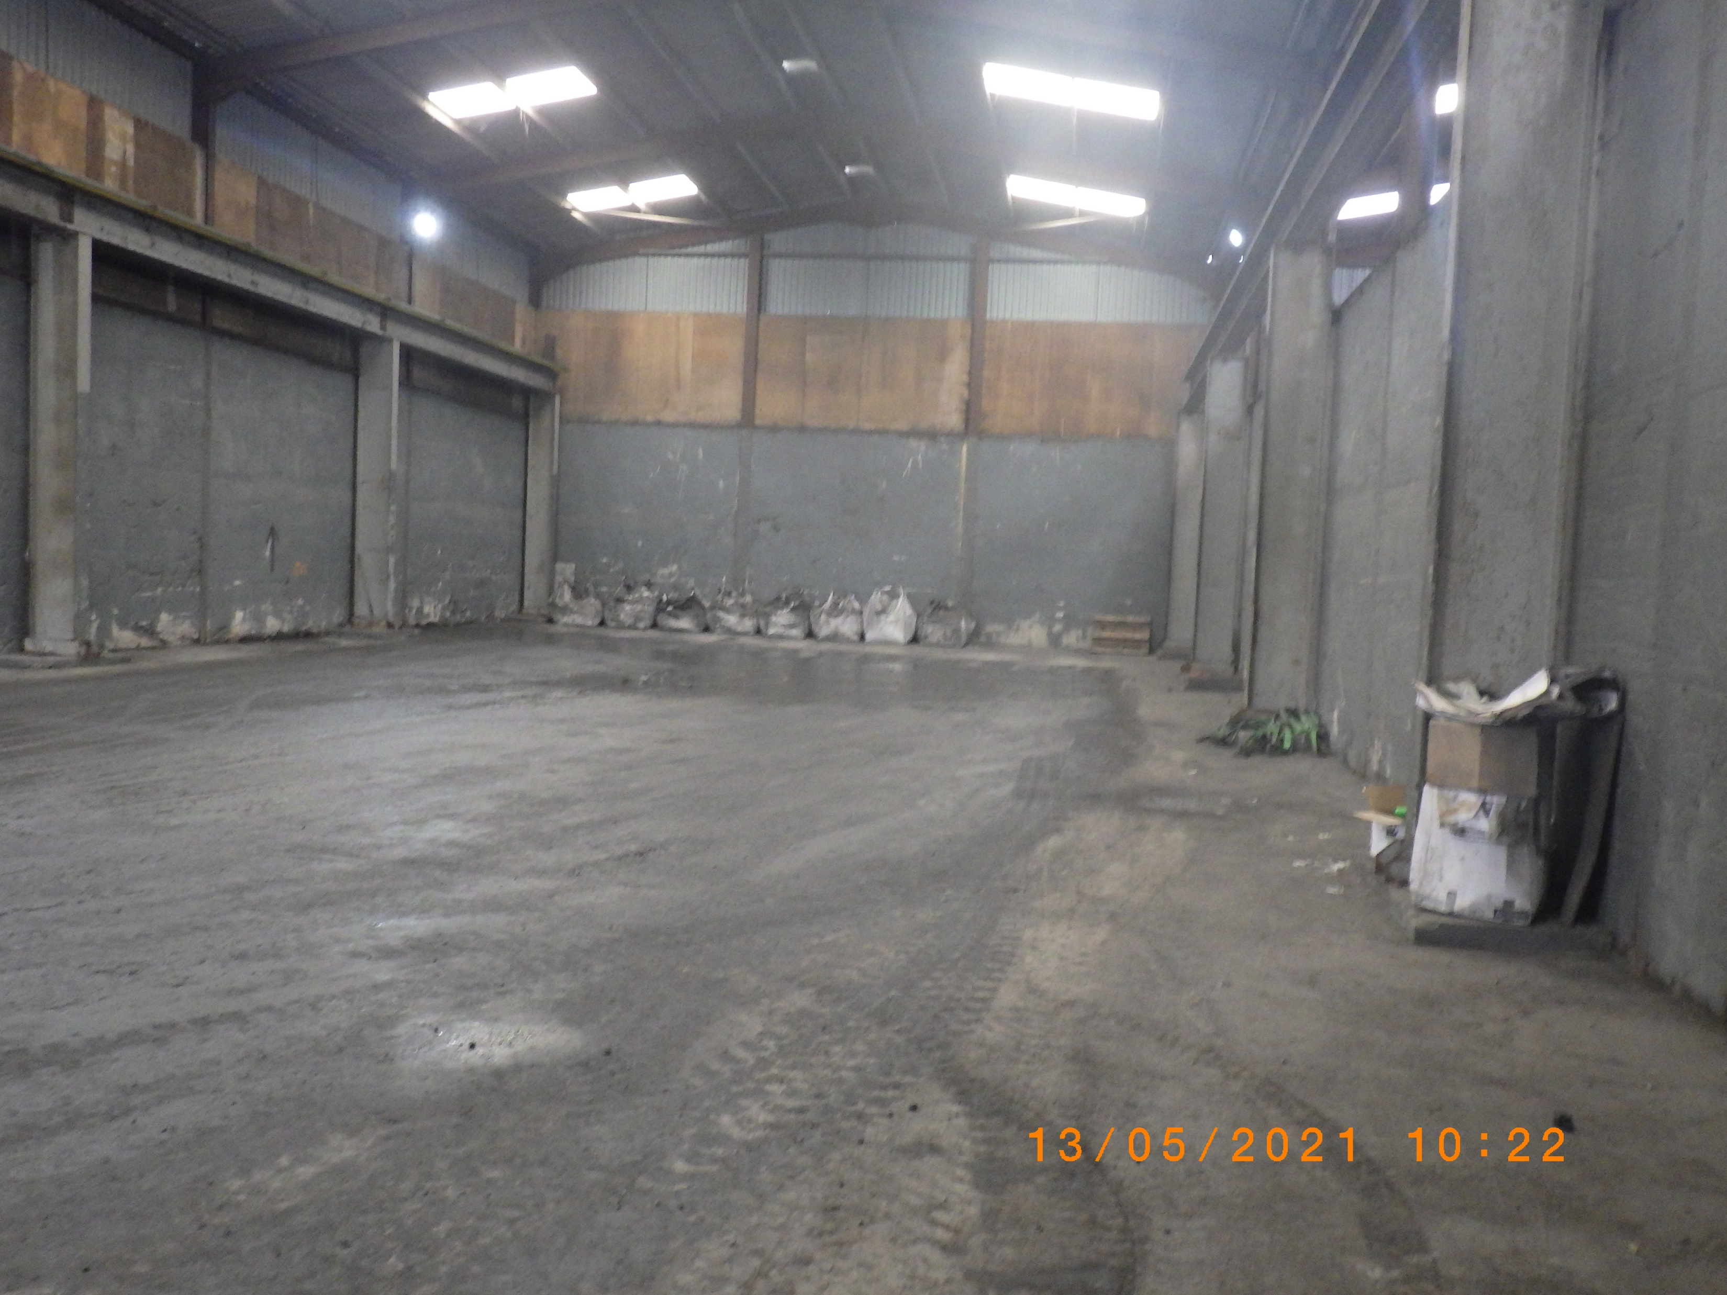

Slide 4
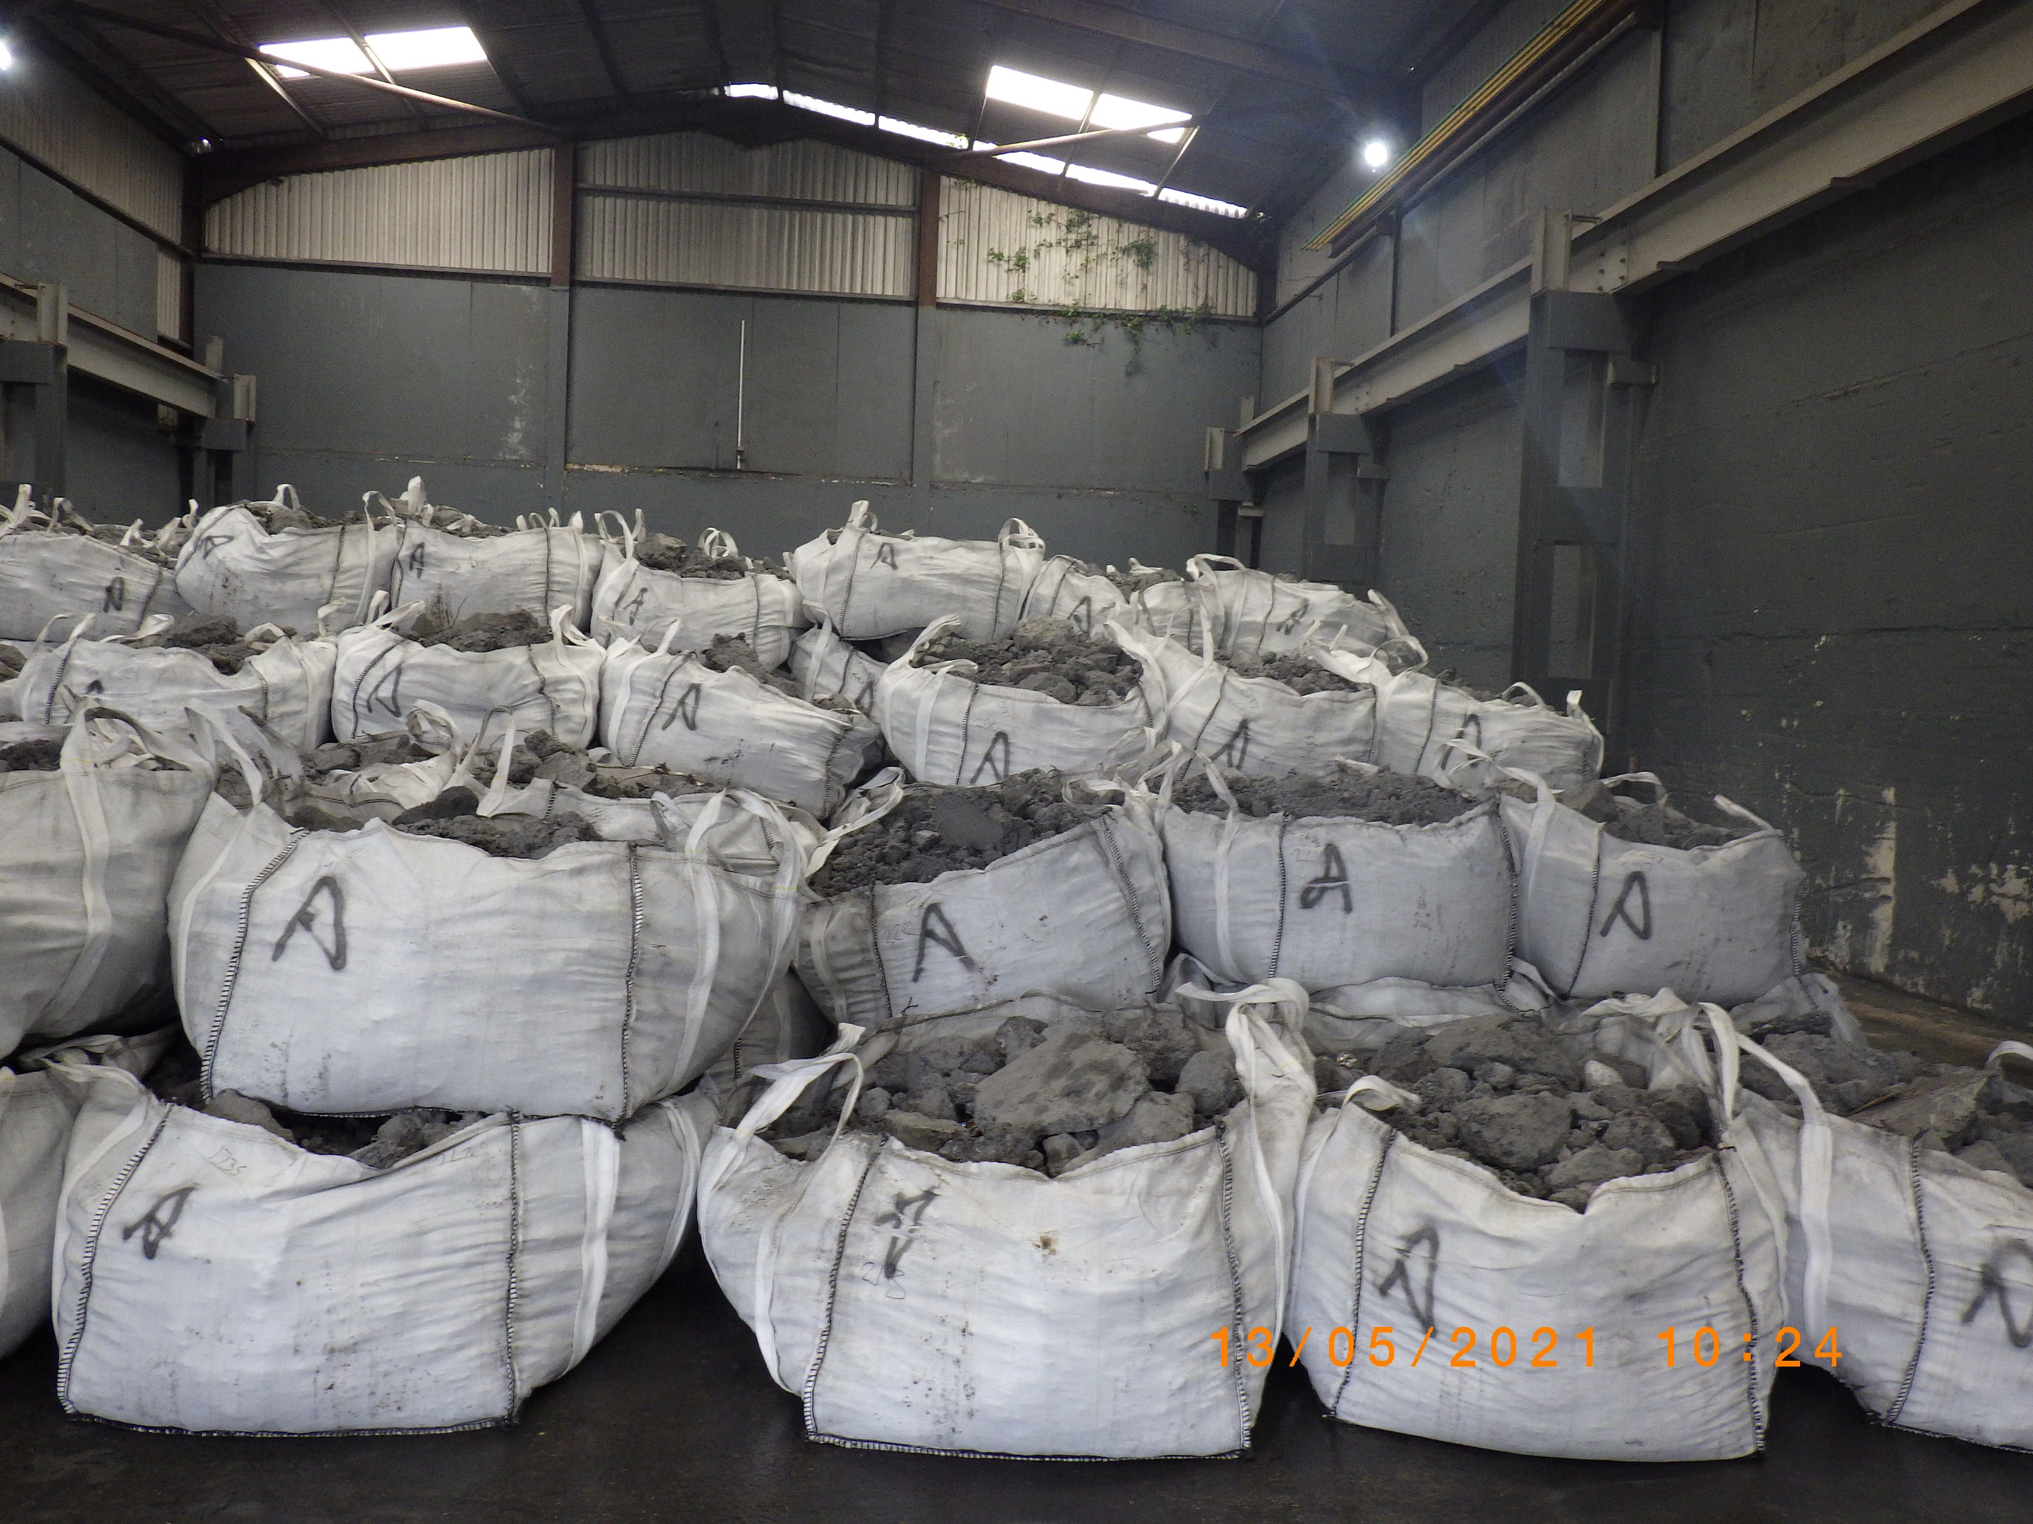

Slide 5


