Slide 1
Briton Ferry CA Site Inspection 13/5/21
by Edwards, Michael

Slide 2
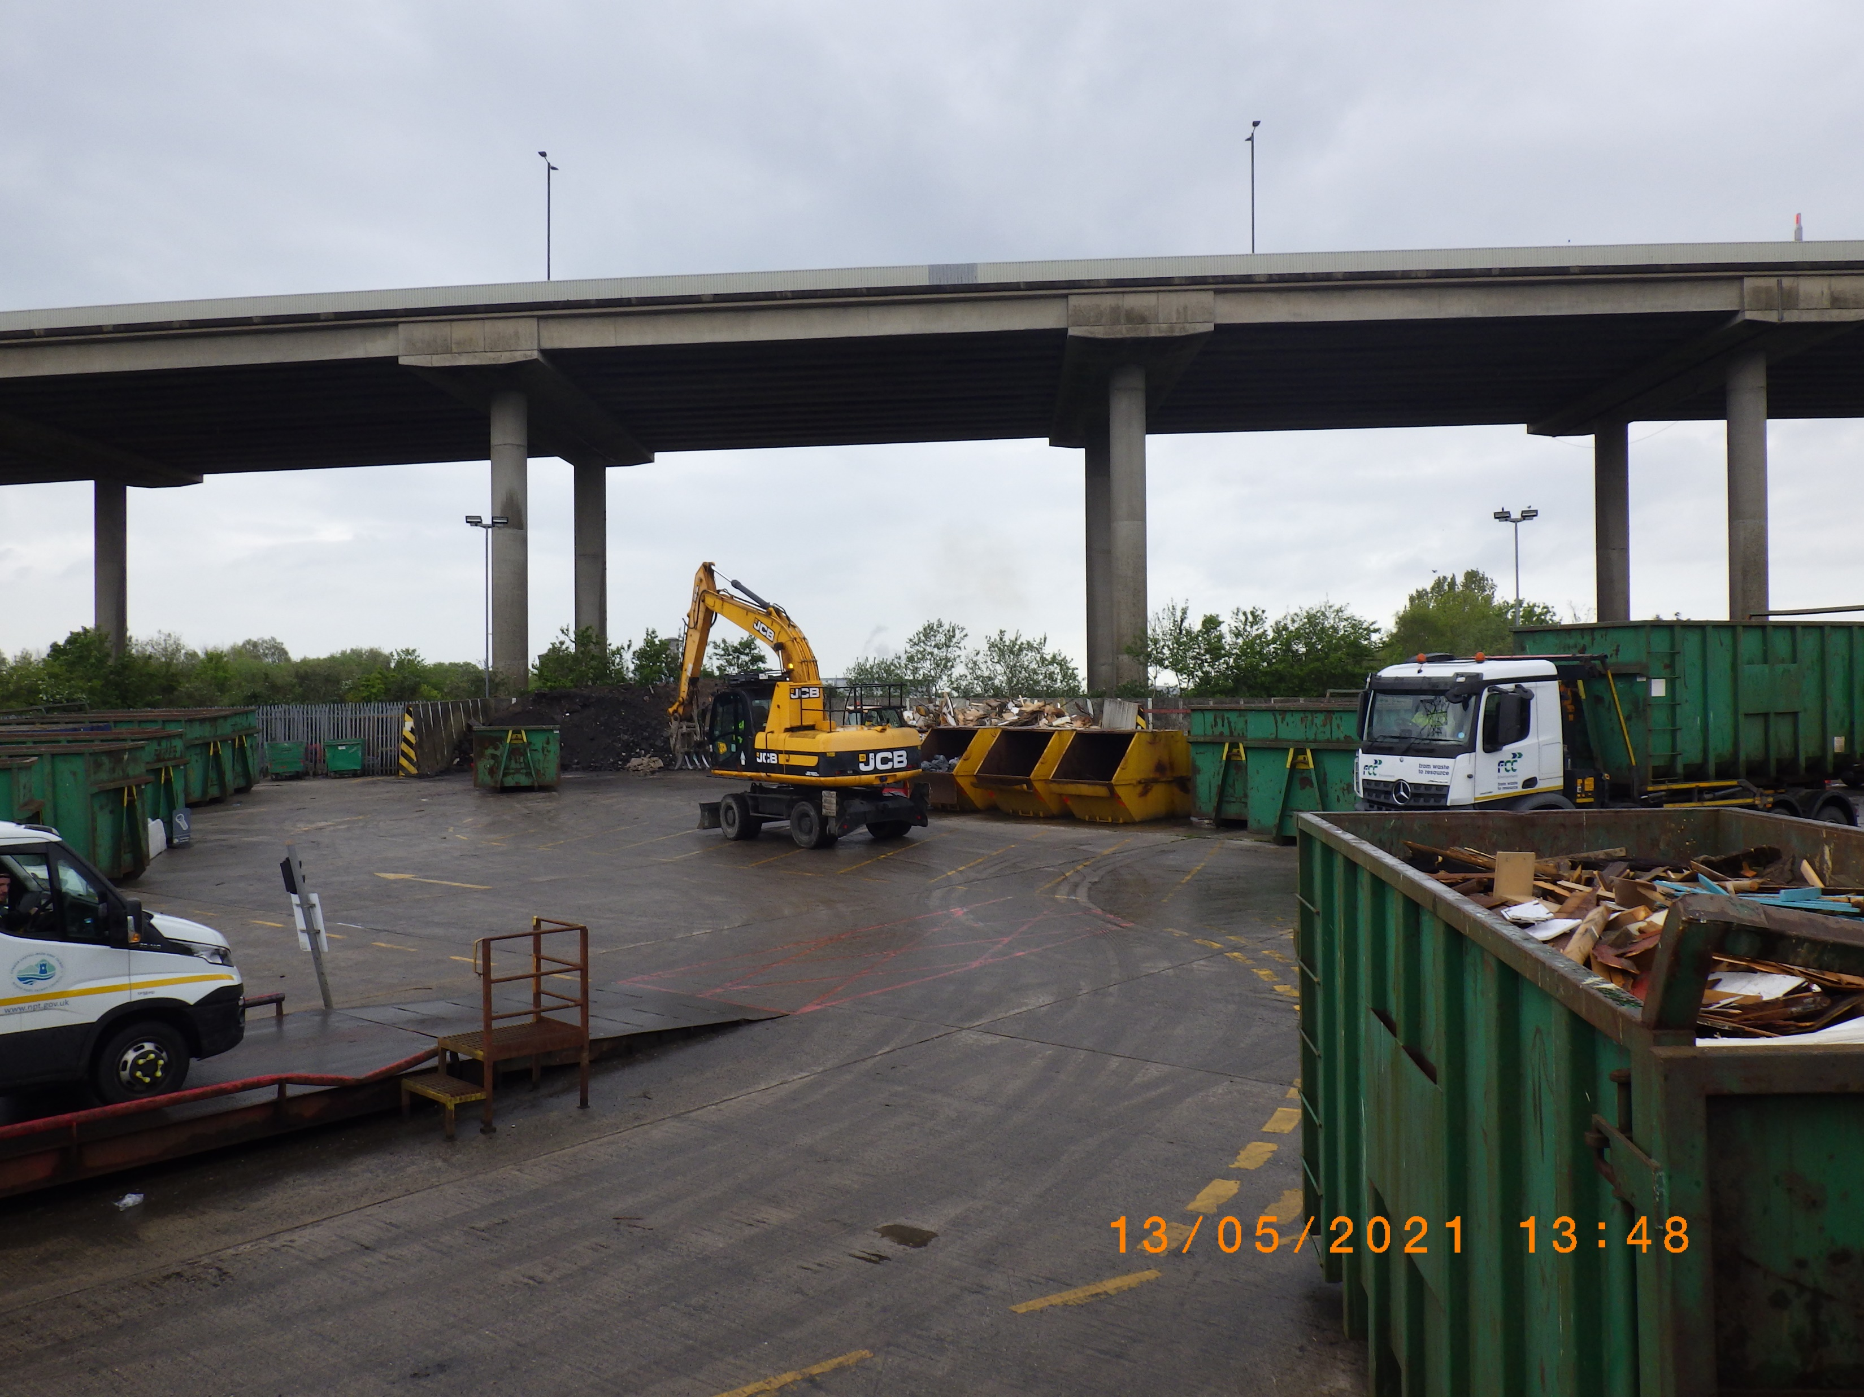

Slide 3
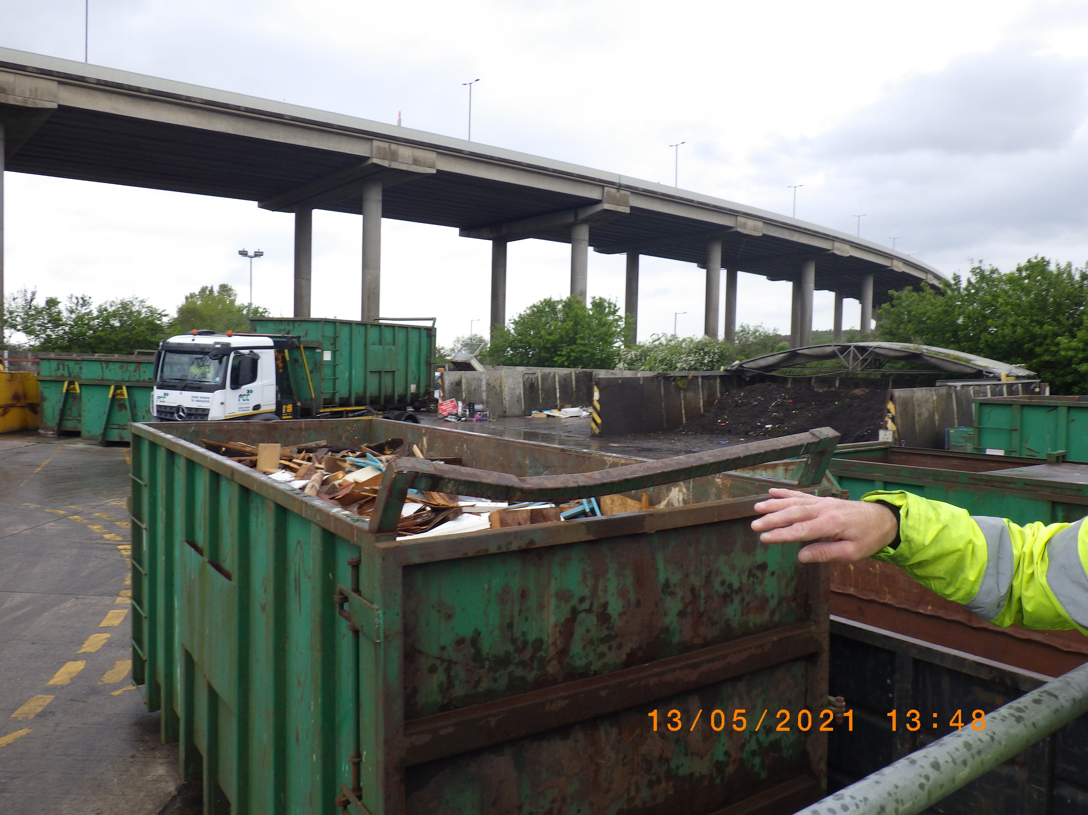

Slide 4
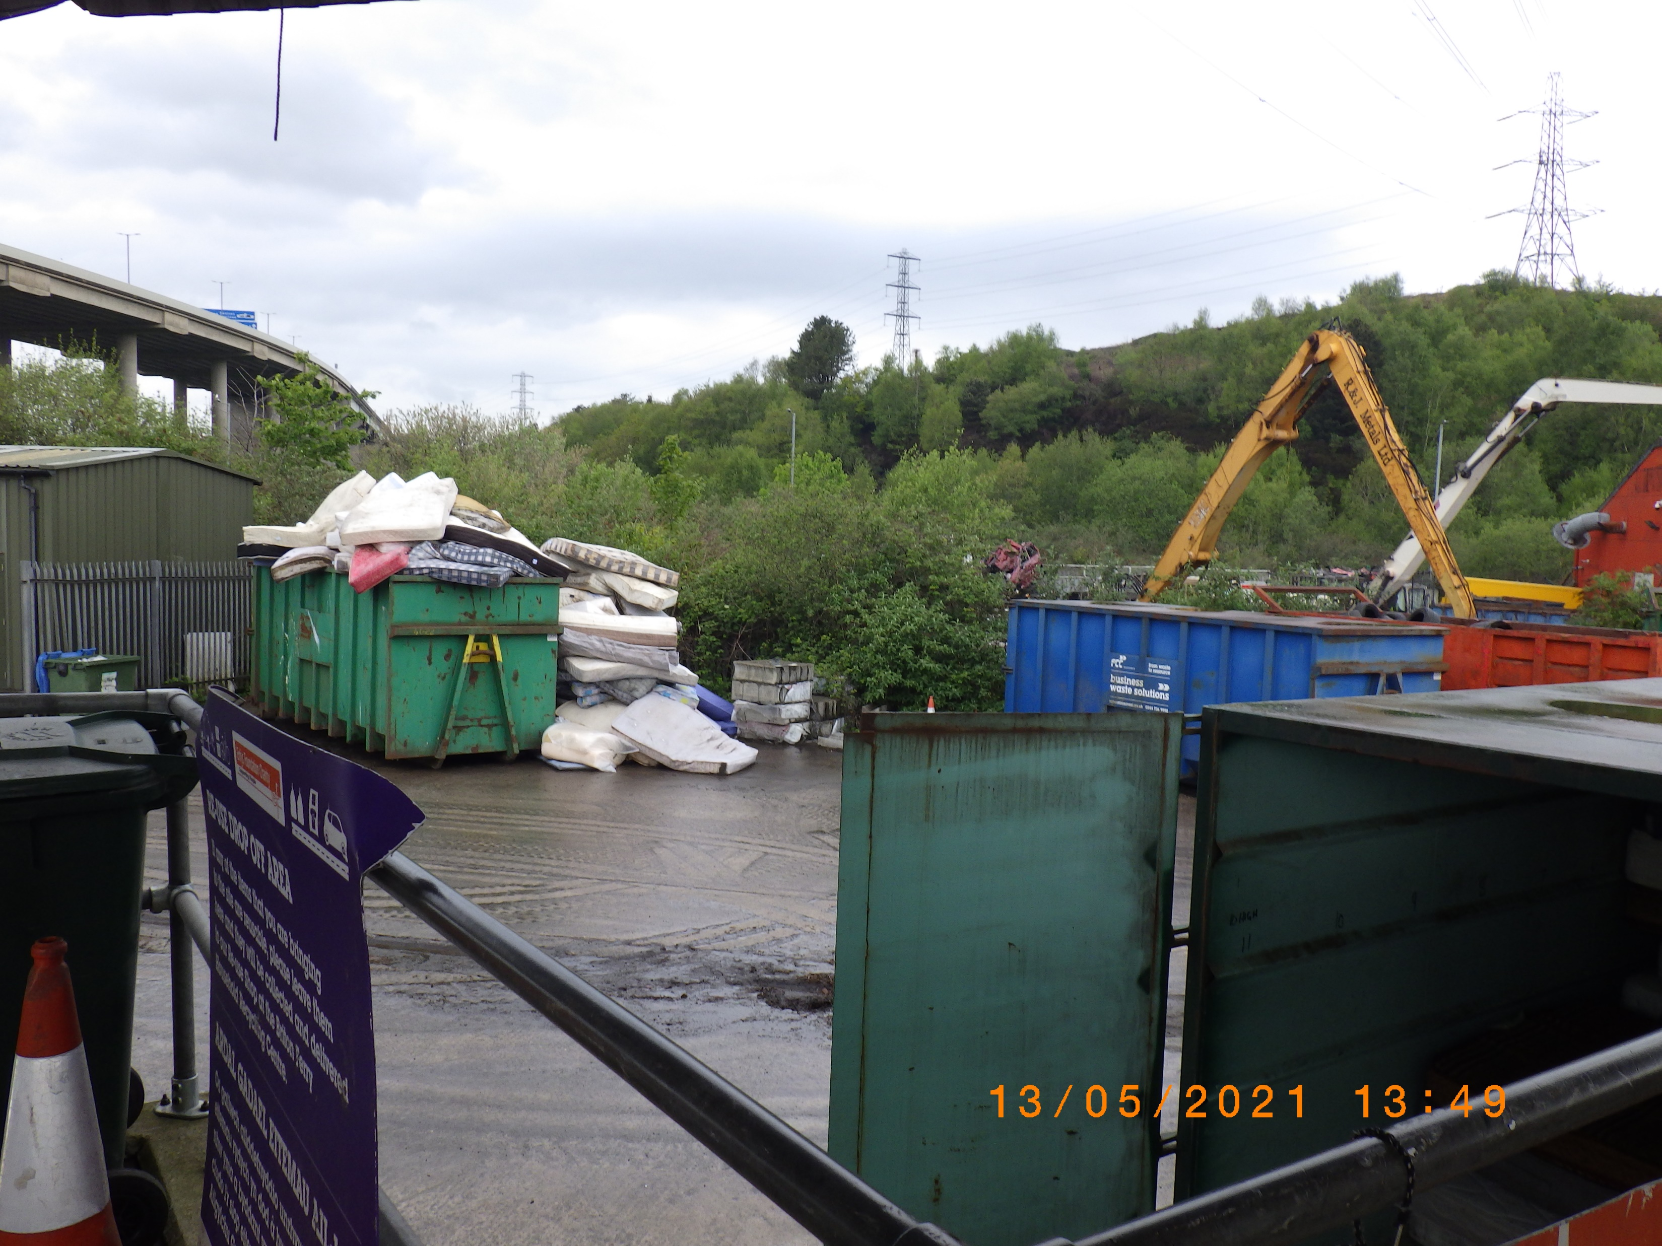

Slide 5
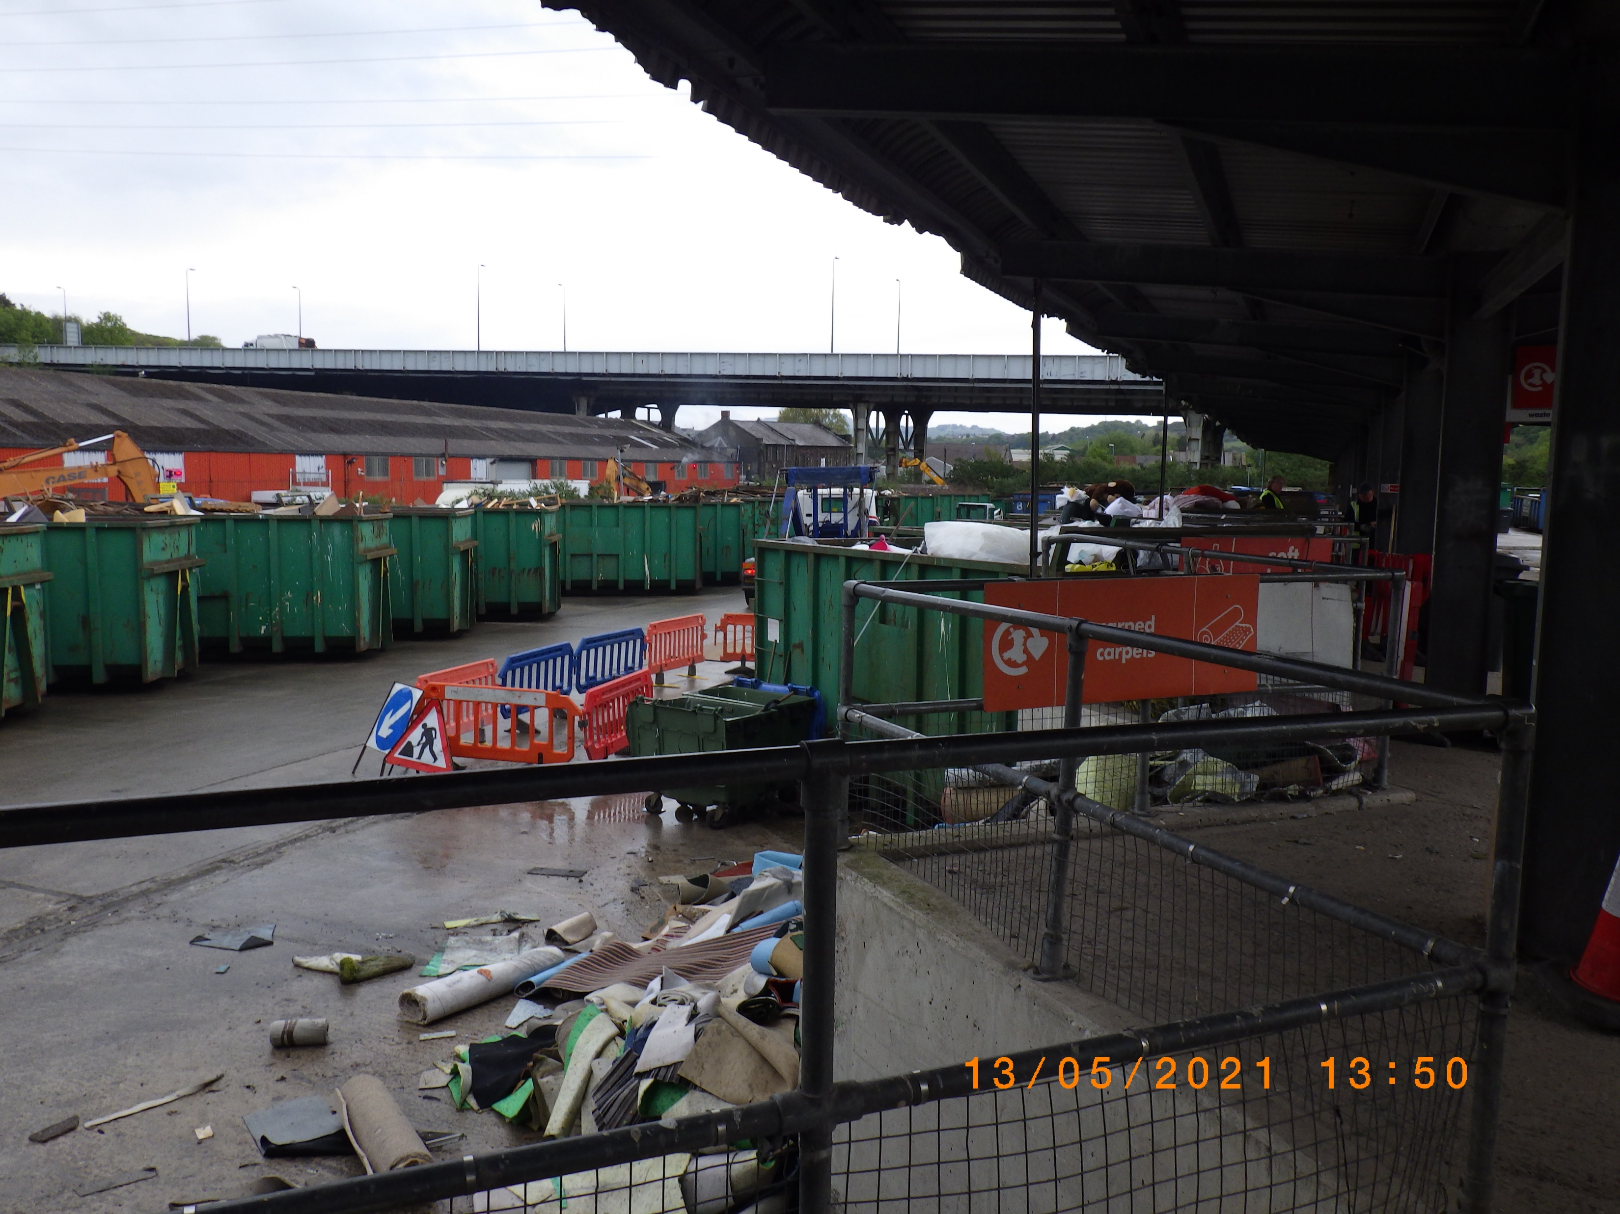

Slide 6


