Slide 1
Coomb Farm Site Inspection 07/05/20
by Edwards, Michael

Slide 2
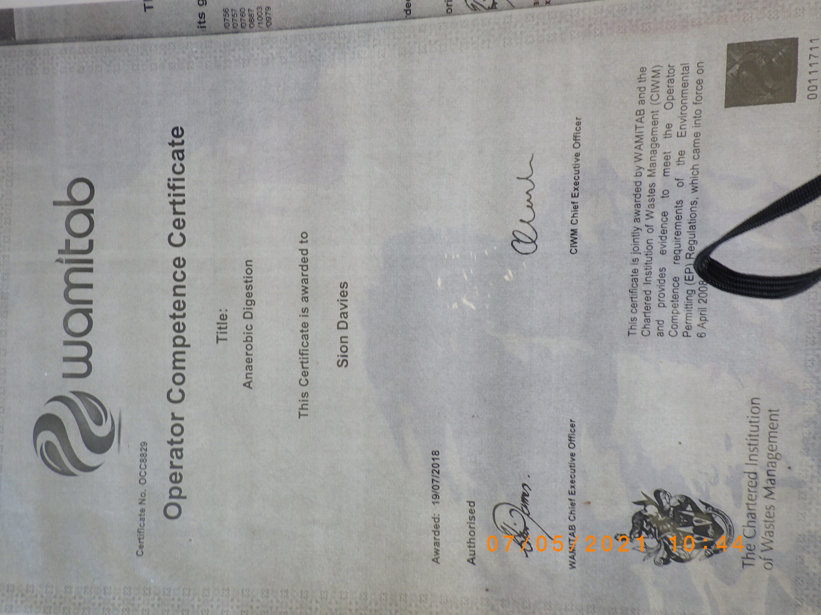

Slide 3
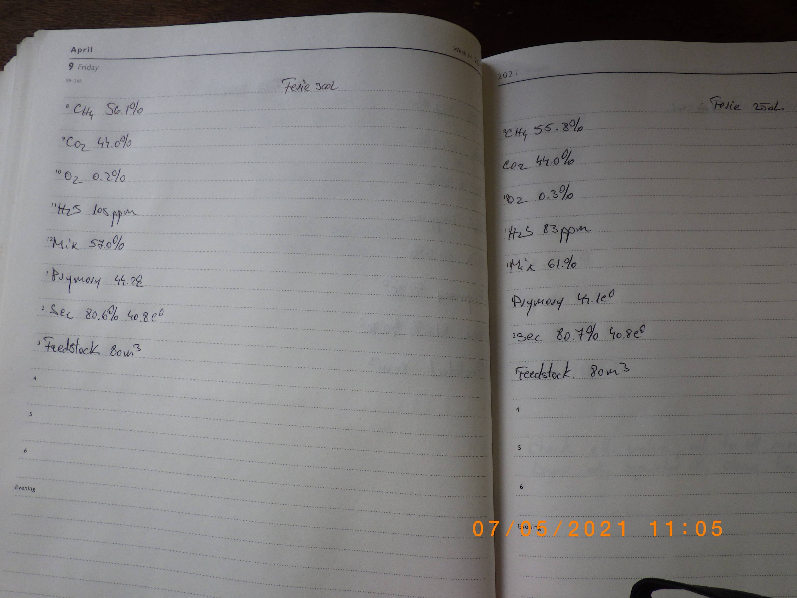

Slide 4
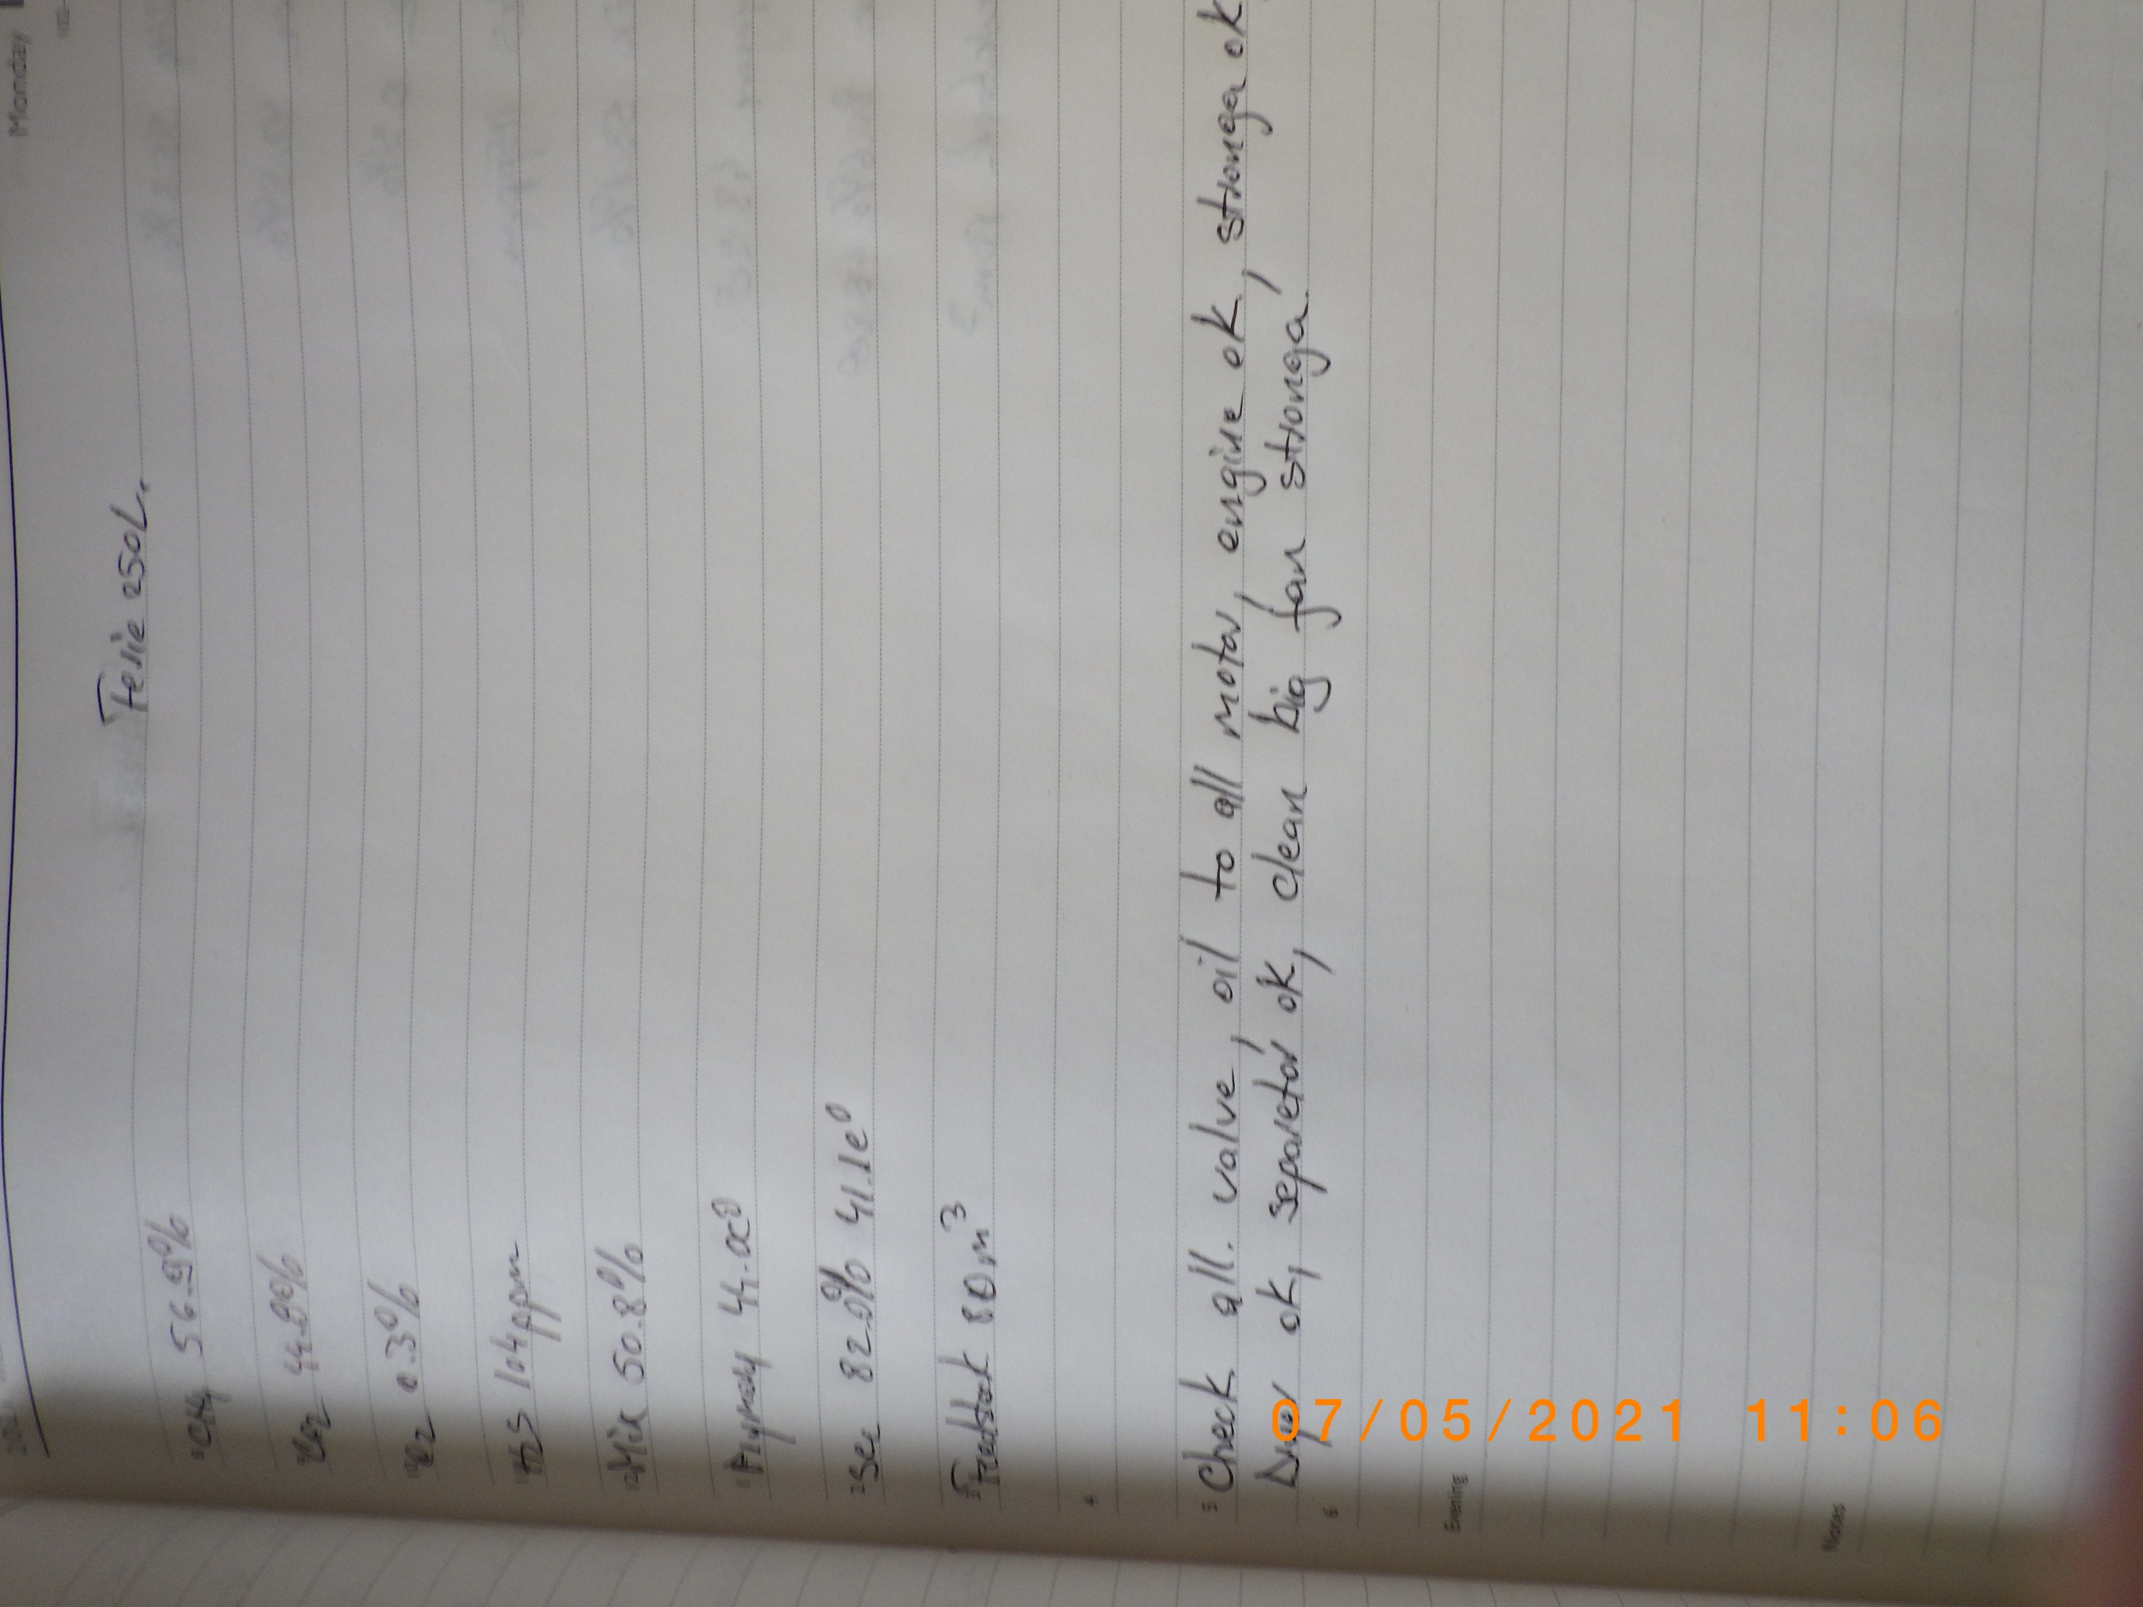

Slide 5


