Slide 1
JD Jones Site Inspection
05/05/21
by Edwards, Michael

Slide 2
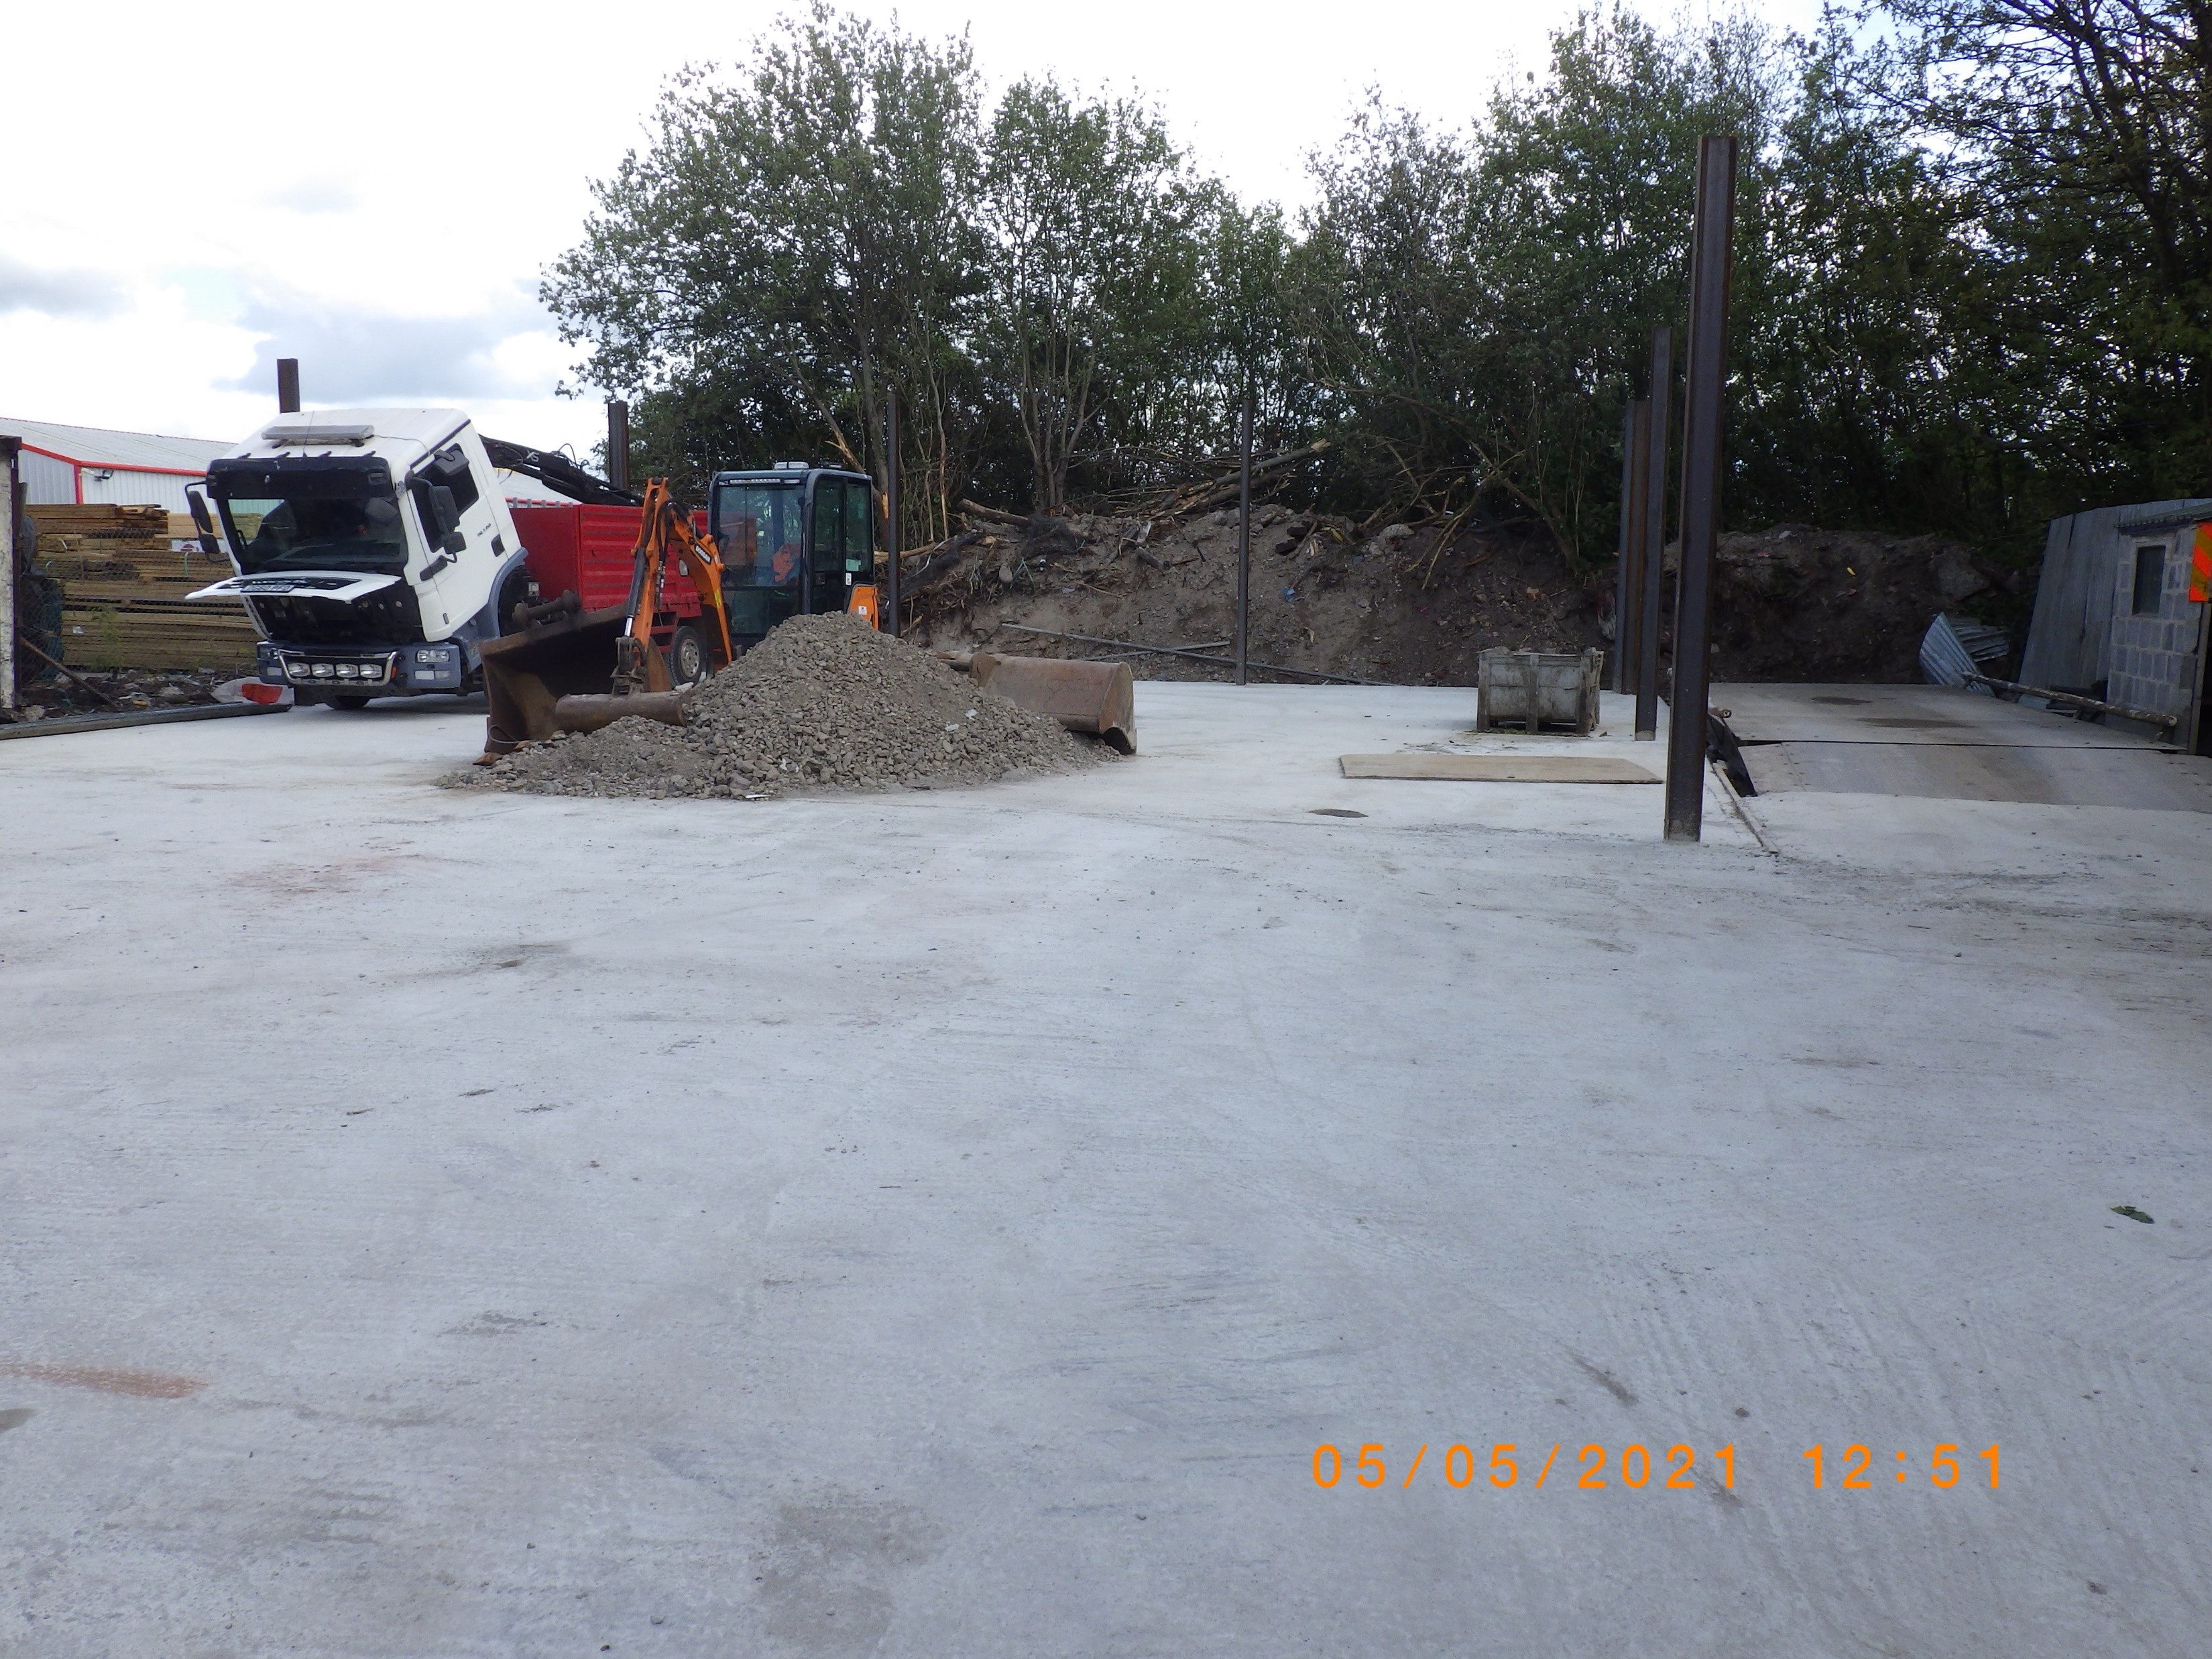

Slide 3
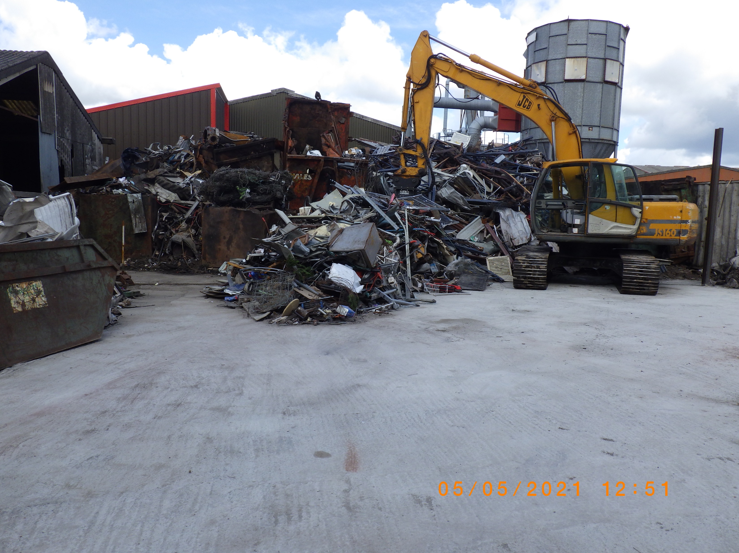

Slide 4


