Slide 1
Rogerstone Park
Environmental Management
Review
Jan 2018 - Dec 2018

Slide 2
Results of Audits/Compliance
Relevant Changes
Environmental Tracking
Environmental KPIs Trends
Permit Compliance
Carbon Reporting
Environmental Responsibilities
Internal/External Communication
Mini Audit Schedule
Mini Audit Example
Site EMS / Register of Legislation

Slide 3
Audit Results/Compliance
Natural Resources Wales
    No reportable incidents
    Compliance visit by NRW on 7th Nov 2018; to:
Basic permit release points and permitted operations check– A full site walkover to ensure the permit reflects site activity.
Odour abatement system audit.
S1 effluent outlet – Assess function and MCERTS compliance.
ISO14001 Site Audits
    June + November (to ISO14001:2015)
    All completed and no major NCs.
Relevant Changes
    New SHE Controller in Sept 2018
    New Group Environmental Manager November 2018 (will have some impact on Group EMS requirements)

Slide 4
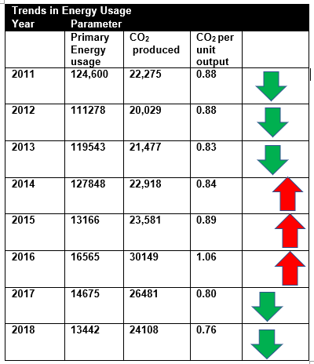
KPI Water Trends

Slide 5
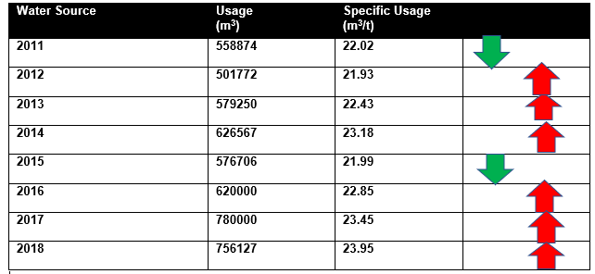
KPI Energy Trends

Slide 6
Regulatory Compliance - Permit
Environmental Projects Completed 2018
    CHP Project completed. Plant switched on December 2018. The site is the first in the group to utilise this technology, and the first site in Wales to incorporate the legal requirements (MCP Regs) into Environmental Permit.
    Environmental Training improvements budgeted for for end of financial year (into 2019) – IEMA training.
    LED Lighting throughout factory and offices – rolling plan. T5/T8
    ESOS Energy audit undertaken – October 2018.
    Food Waste Minimisation Projects – Increase amounts of packed food (suitable for human consumption) going to food charity FairShare.
    Spill Kit renewals Sept 2018.
    Environmental measurement to be added to Paperless system auditing process.

Slide 7
Regulatory Compliance - Permit
Permit Compliance
    Emissions monitoring satisfactory (from all emission points)
    All submission deadlines met (Pollution Prevention Plans, Water)
    MCERTS inspections undertaken (QMS) and passed Sept 2018
Trade Effluent Discharge (sewer)
    Some minor breaches of parameters
    Investigations were undertaken and recorded through EMS.
    Heavy metal content satisfactory
    Daily discharge amounts not exceeded

Slide 8
Regulatory Compliance - Carbon Trading
Climate Change Agreement (UK)
The site PASSED the two year CCL target end of 2018.
    Voluntary – 2 year scheme.
    This was the THIRD target period. (2018 is reporting year)
    Target was 2303/kWh – Achieved 2204/kWh
    Achieved billing discount of XXXX over 2018/209 billing years.
European Emissions Trading Scheme (EUETS)
    Non Voluntary
    Over 20 MW thermal capacity (natural gas)
    External Audit Process – Undertaken successfully January 2018.
    Site is compliant with all 2018 requirements of the Regulations
Notes:
Add info

Slide 9
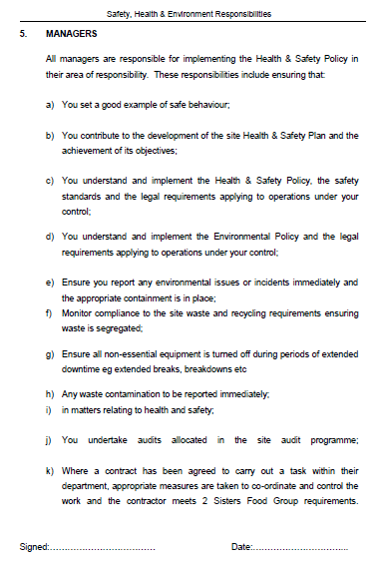
Environmental Responsibilities
Notes:
Keep

Slide 10
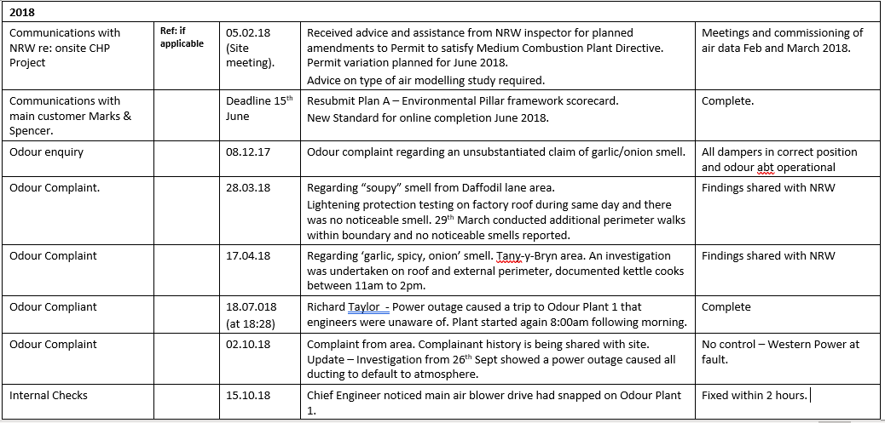
Communications – Internal & External
Notes:
Replace

Slide 11
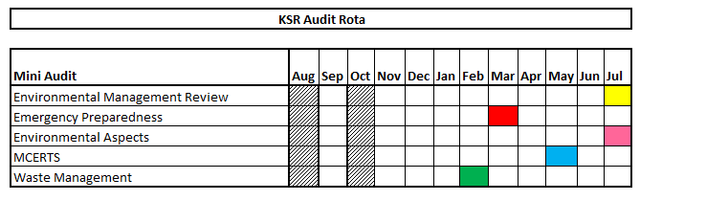
Internal Mini Audit Schedule
Notes:
Dave sent new one

Slide 12
Environmental Management System
Site EMS
    Reviewed and found to be suitable and sufficient – passed transition into new standard
    3 Year Environment Plan reviewed and updated
    All internal procedures reviewed and updated as required – some changes to site Register of Legislation incorporated.

