Slide 1
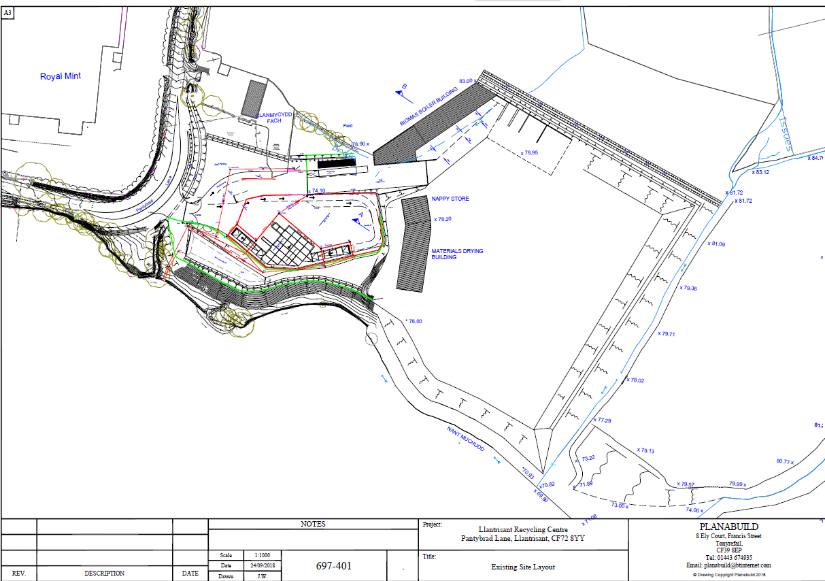
Key:-
Figure 1 Appendix A
Existing Concrete & waste storage
New concreted area
20,000l water storage tank
Submerged tank for drainage
Drainage channel
Concrete ‘lego’ block walls
Road Sweepings area
New EWC reception areas
Segregated waste storage areas
Direction of waste water flow
Access route
River access points
Field access points
Quarantine area
Water shut off valve
Surface water drain
Surface water flow direction
Surface water outfall
Staff meeting point
Fuel Tank—2,500l
Spill kits
SP
Nant Mychydd River
SP
N
SW
Prevailing wind direction

