Slide 1
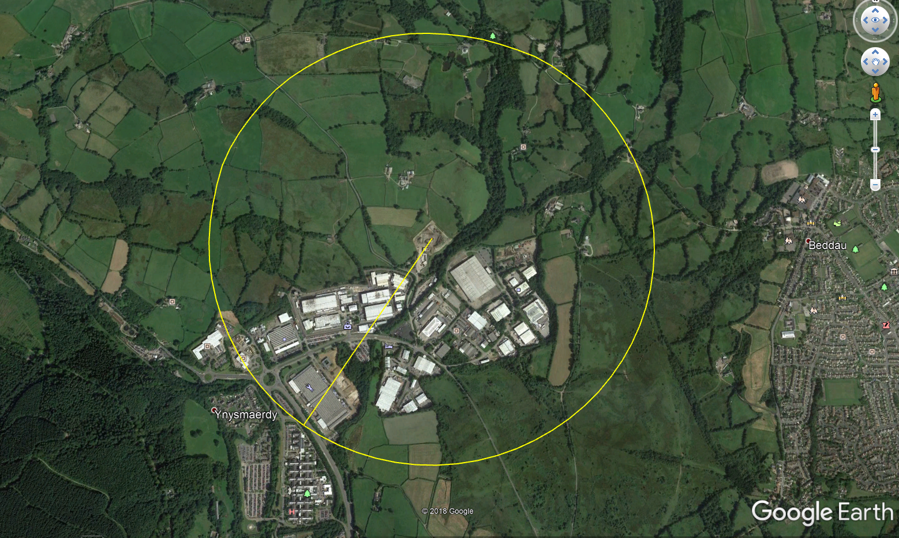
Figure 2 Appendix A
Agricultural Properties
LRC
1KM
Commercial/industrial area—100m to 1km from site
Hospital—just over 1km away

