Slide 1
Uncertainty and variability on compliant calibrations at low particulate emissions levels
1
Notes:
1

Slide 2
Uncertainty and variability on compliant calibrations at low particulate emissions levels
Low particulate levels and issues with the Standard Reference Methods BS EN 13284-1, BS EN 13284-2 and Technical Guidance note M20.
Low particulate levels and influences on the automated measuring system (AMS) responses.

Slide 3
Uncertainty and variability on compliant calibrations at low particulate emissions levels
Before we begin, one point to consider;
4.4.4 Calibration for Dust Concentration Measurement
To measure the dust concentration, the correlation between the primary measured variable scattered light intensity and the actual dust concentration in the duct must be established, for this purpose, the dust concentration must be determined by means of a gravimetric measurement.
The above statement is taken from the operating manual from an MCERT approved CEM and holds true for all of the MCERT approved particulate analysers currently on the market, regardless of manufacturer or measurement principle.

Slide 4
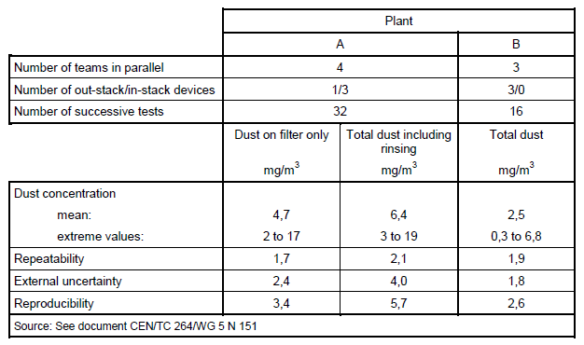
Low particulate levels and issues with existing Standard Reference Methods and Technical Guidance notes
BS EN 13284-1 – Stationary source emissions — Determination of low range mass
concentration of dust.
Validation work for this standard was conducted at two plants;
Plant “A” - Four teams using the standard returned results of 3 to19 mg/m3 (32 tests).
Plant “B” - Three teams using the standard returned results of 0.3 to 6.8 mg/m3 (16 tests).

Slide 5
Low particulate levels and issues with existing Standard Reference Methods and Technical Guidance notes
EA Technical Guidance Note M20 - If the emissions are typically below the 95% CI of the ELV, then an AST is permitted instead of a QAL2
For sites with an ELV of 10mg/Nm3 this caveat would only apply with emissions below 3mg/Nm3.
EA Technical Guidance Note M20 3.5.16 QAL 2 for particulate CEMs
  The error associated with the SRM increases significantly when the dust concentration is below 5 mg/Nm3. Great caution should be applied when making a QAL2 assessment on processes with dust levels lower than 5mg.m-3.
INERIS study on AMS and SRM performances and the impact on the feasibility of lowering ELV’s in the context of the BREFs and BATs (22.07.2016);
INERIS conclusion - Analysing QAL 2 test reports confirms the impossibility of establishing a calibration function for particulate concentrations under 5 mg/Nm3 and with current manual sampling practices to obtain a valid QAL 2 calibration below 10mg/Nm3.

Slide 6
Low particulate levels and issues with existing Standard Reference Methods and Technical Guidance notes
EA Technical Guidance Note M20 – what happens if we can’t derive a valid calibration due to very low particulate levels.
3.5.4 Regulation when particulate monitors cannot be calibrated
If a test report states that a particulate monitor cannot be calibrated due to very low emissions, then the output of the CEM will be qualitative. Whilst it may be possible to intuitively set the reading of the CEM to provide an output in mg.m-3, such readings will be an approximation at best, with a strong likelihood of high levels of uncertainty. Unless it is possible to produce higher, representative emissions from the process,
It is recommended that such readings should be disregarded for regulatory purposes when compared to an ELV, even if there is an apparent breach of the ELV
In addition if a valid calibration couldn’t be derived it wouldn’t be appropriate to use AMS data for pollution inventory reporting.

Slide 7
Low particulate levels and issues with existing Standard Reference Methods and Technical Guidance notes
INERIS study on AMS and SRM performances and the impact on the feasibility of lowering ELV’s in the context of the BREFs and BATs (22.07.2016);
The Inter Laboratory comparisons made on industrial sites when validating the standard reference method (Particulates) show that the uncertainty is about 60% for average concentrations around 10mg/Nm3 and even higher uncertainty for particulate emissions under 10mg/Nm3.
BS EN 14181: 6.3 Parallel measurements with the SRM, note 7: If the emissions are at low levels the SRM measured values can be improved for manual SRM by extending
the sampling time.
To achieve the desired target uncertainty for the SRM test during a BS EN 13284- 2 QAL 2 would require sampling (each test) lasting up to 4 hrs.
note : BS EN 13284-2 and TGN M20 standards allows calibrating with a limited number of 5 (instead of 15) parallel, long-term measurements.

Slide 8
Low particulate levels and issues with existing Standard Reference Methods and Technical Guidance notes
EA Technical Guidance Note M20 3.5.15 calibration Procedure C for low-level clusters;
  The SRM measurements are used to verify that the CEMs respond to even low concentrations of the determinand. The difference between the average of the SRM and CEM results should not differ by more than half the allowance 95% confidence interval of the daily average ELV.
  For Particulate (if an ELV of 10 was applied) this implies that the difference between the CEM and SRM should be no more than 1.5mg/Nm3, which is an unlikely given the uncertainties involved.

Slide 9
Low particulate levels and issues with existing Standard Reference Methods and Technical Guidance notes
BS EN 14181 – valid calibration range
  The valid calibration range is either the calibration range from zero to the maximum value of the calibrated AMS measured values at standard conditions, determined during the QAL2 procedure, plus an extension of 10 % or to 20 % of ELV, whichever is greater.
  If a QAL 2 calibration was possible, the highest AMS value achieved + 10% would become the valid calibration threshold, if the highest value during the calibration was 6mg/Nm3 this would set the valid calibration range from 0 to 6.6mg/Nm3 and with the calibration in place a new QAL 2 would be required if more than 5 % of the number of AMS measured values (calculated weekly) were above 6.6mg/Nm3 for more than 5 weeks.
  Without question with ELV’s of 10mg/Nm3 and the difficulty in achieving an acceptable valid calibration range will lead to an increased number of QAL 2 re-tests and will result in significant additional operator costs for no additional environmental benefit

Slide 10
Low particulate levels and issues with existing Standard Reference Methods and Technical Guidance notes
BS EN 14181 – Test of Variability and Test of Calibration (Acceptance of Calibration Function)
The variability is accepted if Standard deviation (SRM - CAL CEM ) ≤1.5 x σ 0 x Kv
The calibration is accepted if the mean difference (SRM - CAL CEM ) < t 0.95 (N-1) x Sd / SQRT (N) + σ 0
  σ 0 standard deviation associated with the uncertainty derived from requirements of legislation is used in both the Test of Variability and Test of Calibration.
σ 0 = ELV x (MU / 100) / 1.96
  The above formula is used in the outcome of both the Test of Variability and Test of Calibration calculations and lower ELV’s could lead to a greater number of failures of this part of QAL 2 exercises.

Slide 11
Low particulate levels and issues with existing Standard Reference Methods and Technical Guidance notes
Summary;
It is generally agreed that calibrations sub 5mg/Nm3 should not be attempted and attempts to calibrate between 5mg/Nm3 and 10mg/Nm3 will lead to an increased number of repeat QAL 2 tests due to failures of either test of variability, test of calibration or invalid calibration ranges.
With ELV’s of 10mg/Nm3 CEM readings should be disregarded for regulatory purposes, including pollution inventory reporting, CEMS should be used for qualitative monitoring of emissions only.

Slide 12
Uncertainty and variability on compliant calibrations at low particulate emissions levels
Before we continue, one point to remember;
4.4.4 Calibration for Dust Concentration Measurement
To measure the dust concentration, the correlation between the primary measured variable scattered light intensity and the actual dust concentration in the duct must be established, for this purpose, the dust concentration must be determined by means of a gravimetric measurement.
The above statement is taken from the operating manual from an MCERT approved CEM and holds true for all of the MCERT approved particulate analysers currently on the market, regardless of manufacturer or measurement principle.

Slide 13

Particulate Sampling
we also know it as!!

Slide 14
Standards
BS EN 13284-1
BS EN 13284-2
BS EN 15259
BS EN 14181
BS ISO 10155
BS ISO9096
BS EN 15267
M1
M2
M20
The above also have Method implementation Documents MIDs

Slide 15

Influences on particulate CEMs characteristics
Particle size
Particle Colour
Particle shape
  Moisture
Opaqueness
Reflectivity l ytivitcelfeR

Slide 16
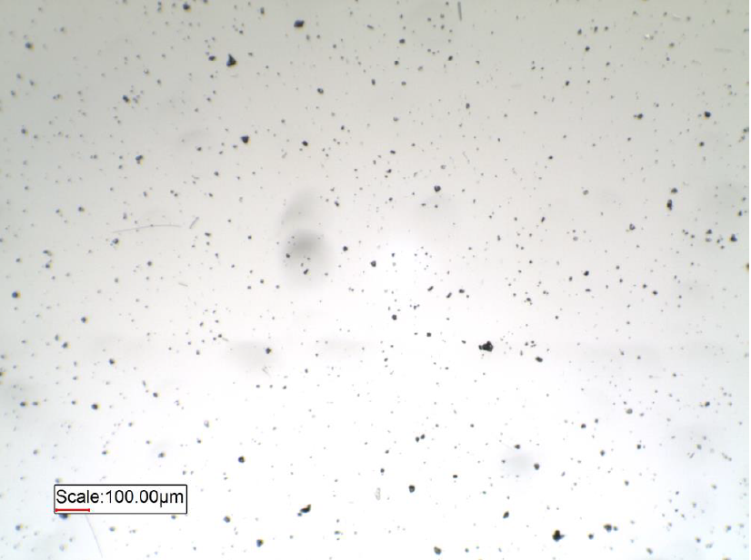
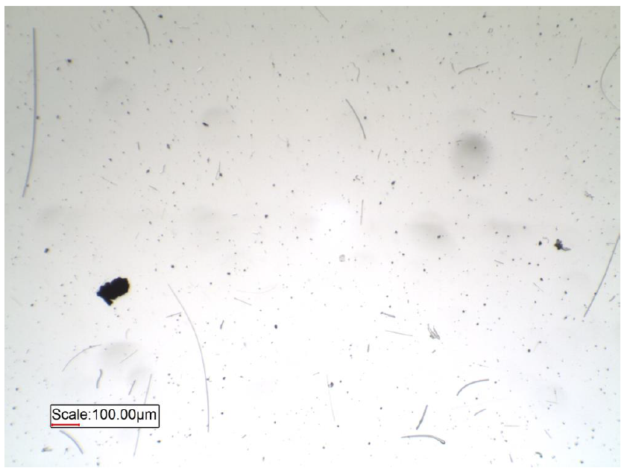
“Particulate Size”
Pages 12-13 Engineers Note Book
  Double Particle Size = Halve the Sensitivity (D-R800- D-R290 Transmission and Scatter ).
  Double Stack Diameter = Double the Sensitivity ( Transmission )

Slide 17
Double Particle Size = Halve the Sensitivity
Analyser / CEM
Reflector
Reflector
Light beam
RAIN
Fog

Slide 18
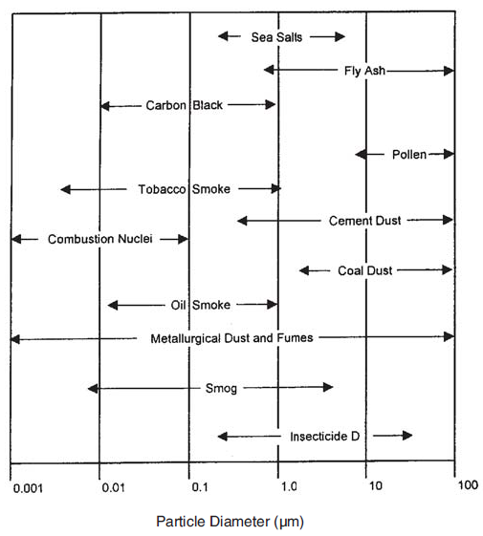
Size Ranges of Common Atmosphere Particles
Pages 12-13 Engineers Note Book

Slide 19
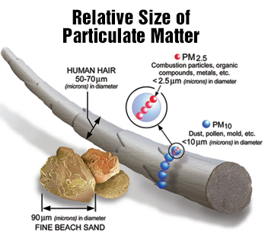
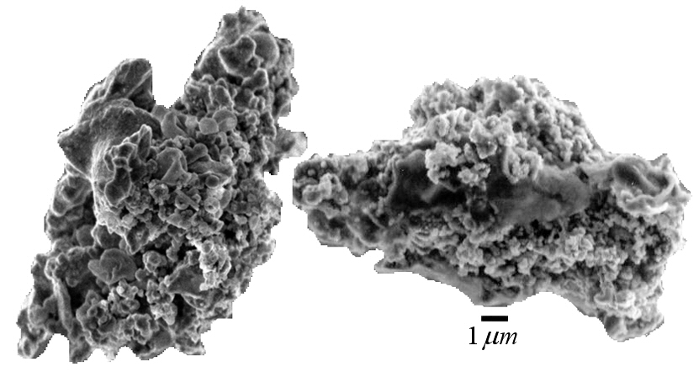
Relative Size of Particulate Matter
Pages 12-13 Engineers Note Book

Slide 20
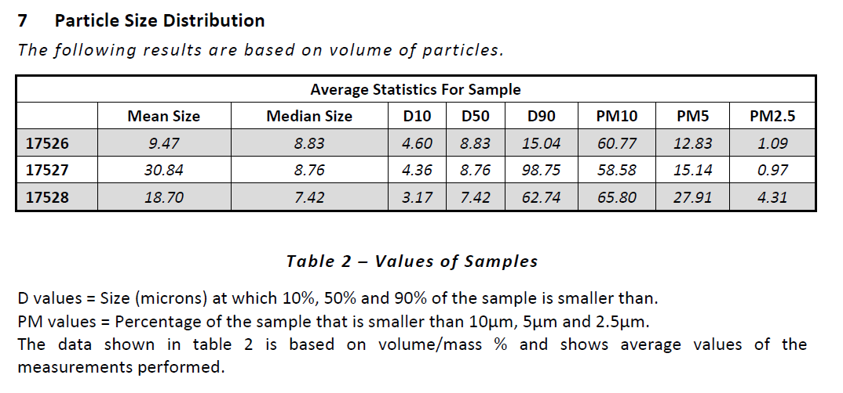
Particle Size Analysis
Analysis Results above are based on a Cement Plant

Slide 21
Dew Point(Moisture)
Dew point
Every gas mixture contains a defined quantity of humidity. The maximum possible saturation humidity is dependent on the temperature: if air is continuously cooled, with constant absolute
air humidity the relative air humidity increases up to 100%. If the air is further cooled, the humidity condenses as water drops and affects the measuring result in optical and Tribo-electric measuring procedures.

Slide 22
Particle Colour
Particle Colour

Slide 23
Particle Shape, Opaqueness and Reflectivity
Particle shape
Opaqueness
Reflectivity l ytivitcelfeR

Slide 24
Summary;
The CEM response and valid calibrations are dependant on the particulate characteristics remaining the same/consistent, any change in particle size, colour, shape, opaqueness, reflectivity or stack moisture levels can significantly change CEM responses.
Any small change in particle characteristics following QAL 2 calibrations would change CEM responses, potentially invalidating existing calibration curves, especially with ELV’s of 10mg/Nm3.
The above would mean an increased number of QAL 2 re-tests and will result in significant additional operator costs for no additional environmental benefit.

