Slide 1
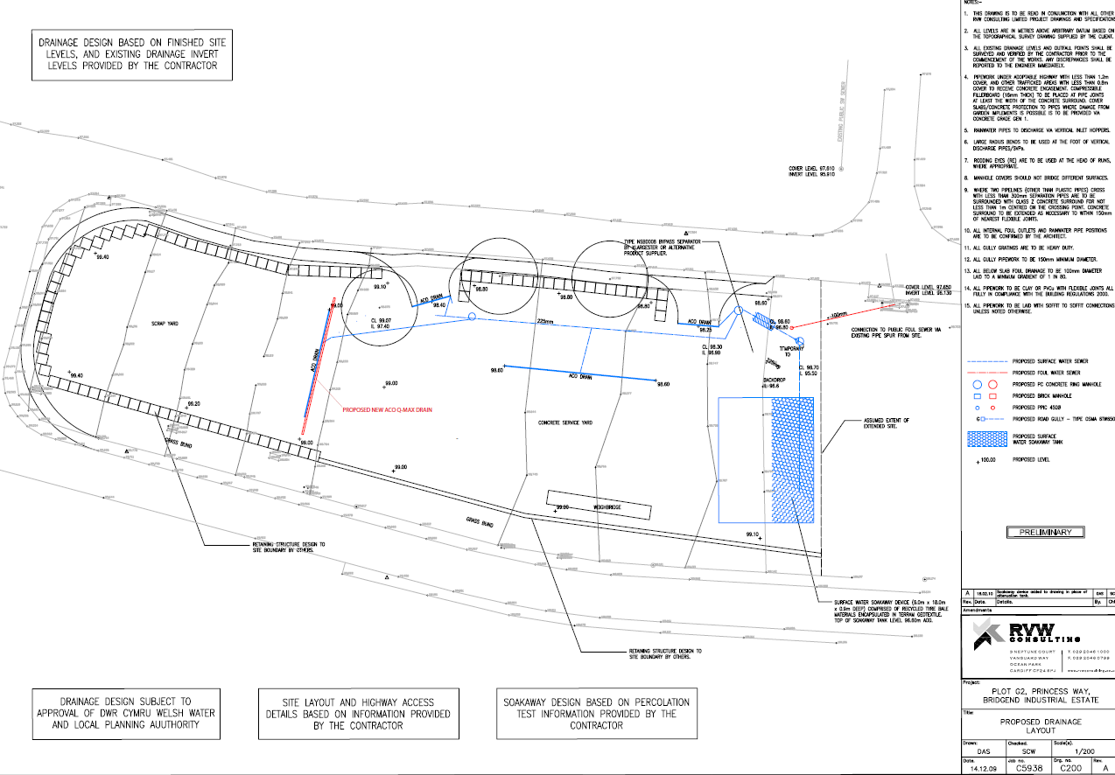
Key:-
Loose non-ferrous storage area
Loose unprocessed steel storage area
Loose processed steel storage area
Pre-depollution ELV storage area
Baled waste storage bunker
Quarantine storage area
Battery storage
Baler shears
Offices/public drop off
Quarantine skips and tyre skip
Fuel store with 3m gap to building
Waste liquid storage area
Surface flow direction
Location of fire extinguishers and pollution prevention kit
Depollution Building
Depollution bay
Bunker locations
Lead acid battery storage
Quarantine area with 1 skip of wood and 1 skip of general waste
Prevailing wind direction to the SW
N

