Slide 1
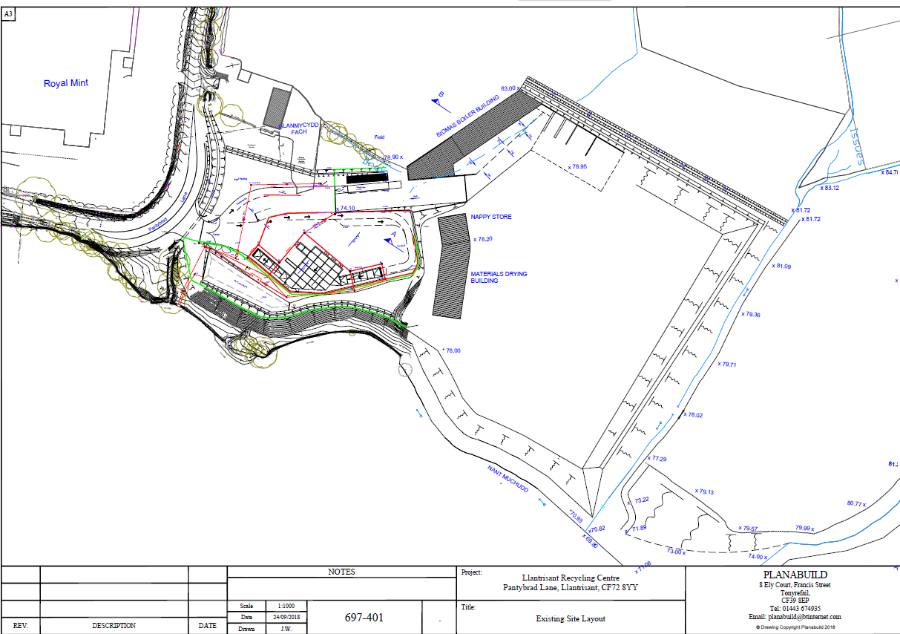
Key:-
Figure 1 Appendix A
FRS access, equipment and drainage
20,000l water storage tank
Lagoon for drainage
Drainage channel
Direction of waste water flow
Access route
River access points
Field access points
Water shut off valves
Surface water drain
Surface water flow direction
Surface water outfall
Staff meeting point
Fire extinguishers
FRS vantage areas
The ‘off site’ emergency information pack is held within the security cabin, on site, next to the weighbridge office.
Fuel Tank—2,500l
Spill kits & PPE, PCE
SP
SP
Settlement pond
Nant Mychydd River
N
SW
Prevailing wind direction

Slide 2
Waste storage and plant locations
Inert storage
Unprocessed wood
Wood treatment
Unprocessed glass
Glass treatment
Processed glass
Processed wood
Quarantine area
Unprocessed stockpiles (New EWC codes)—external storage
Processed (segregated) waste stockpiles (new EWC codes)—internal storage
Compost Windrows
Road sweepings storage
Green waste treatment
Fixed plant locations
Unprocessed Green waste

Slide 3
Infrastructure
Existing series of concrete bays
New series of concrete bays to be installed
Waste storage building
Concrete-area to be laid
Existing concreted area

Slide 4
Stack management and separation distances
10m
40m
20m
10m
20m
30m
10m
10-12m
3.5m
10m
Separation distances justified within the previous FPMP, please see this document for reasoning
7m
Fixed plant locations

Slide 5


