Slide 1
Llwyn y Goes STW
BN0025701
Inspection – 30/10/2018
by Jeremy Goddard, Callum Stone & Alastair Wilson

Slide 2
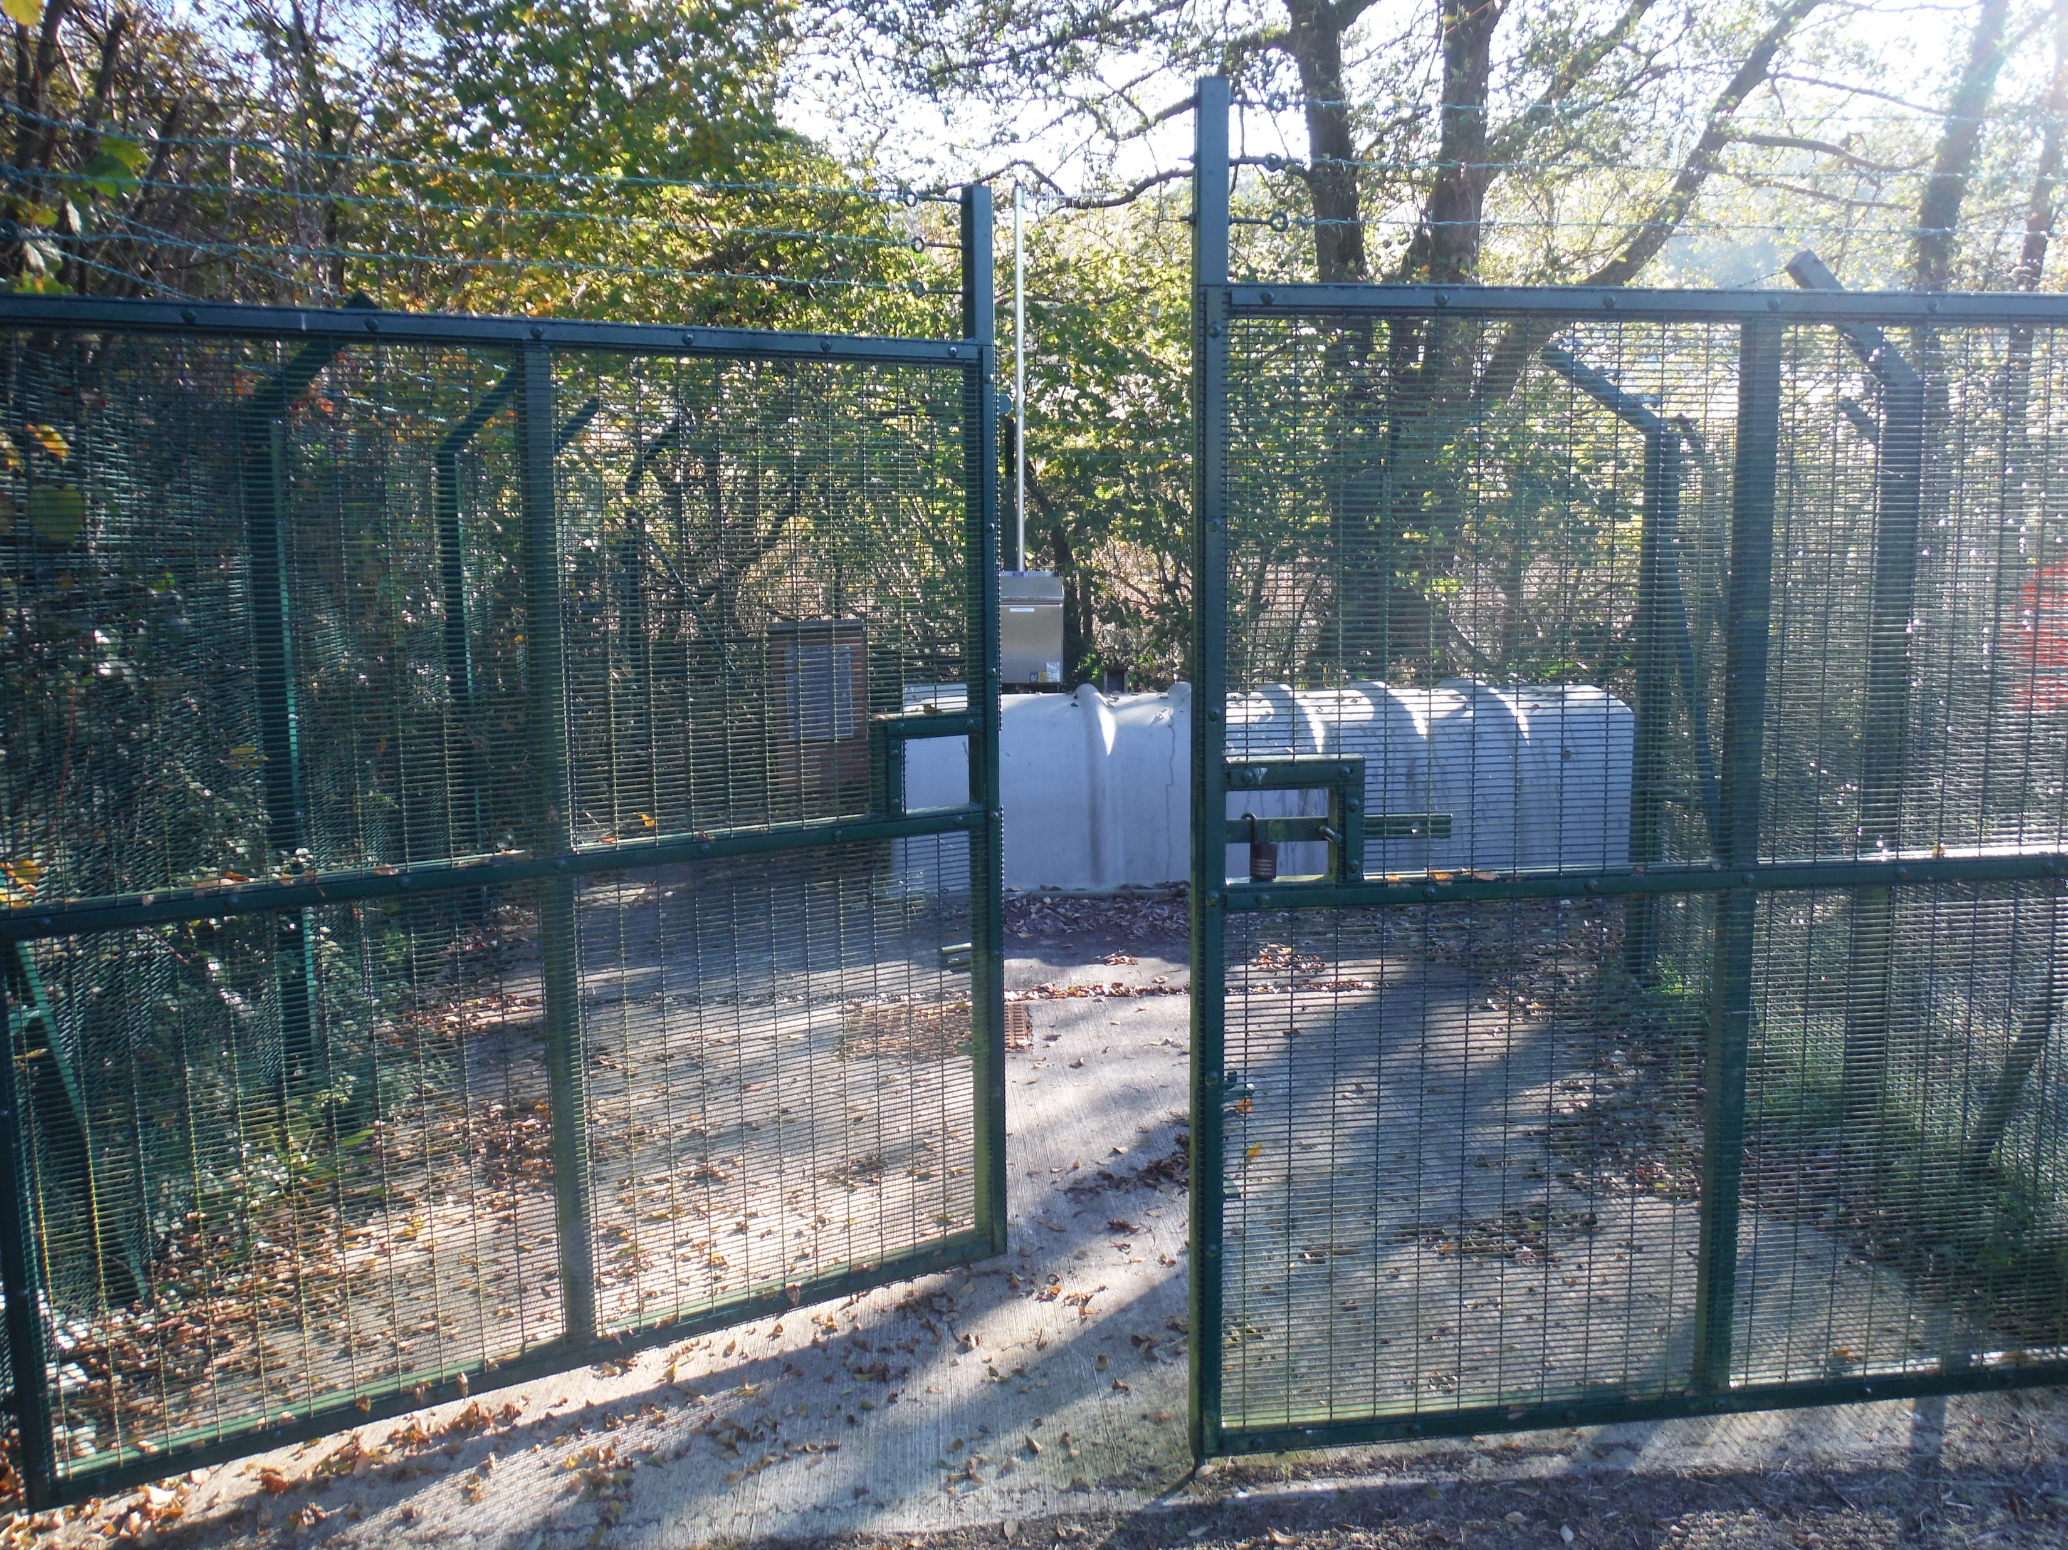

Slide 3
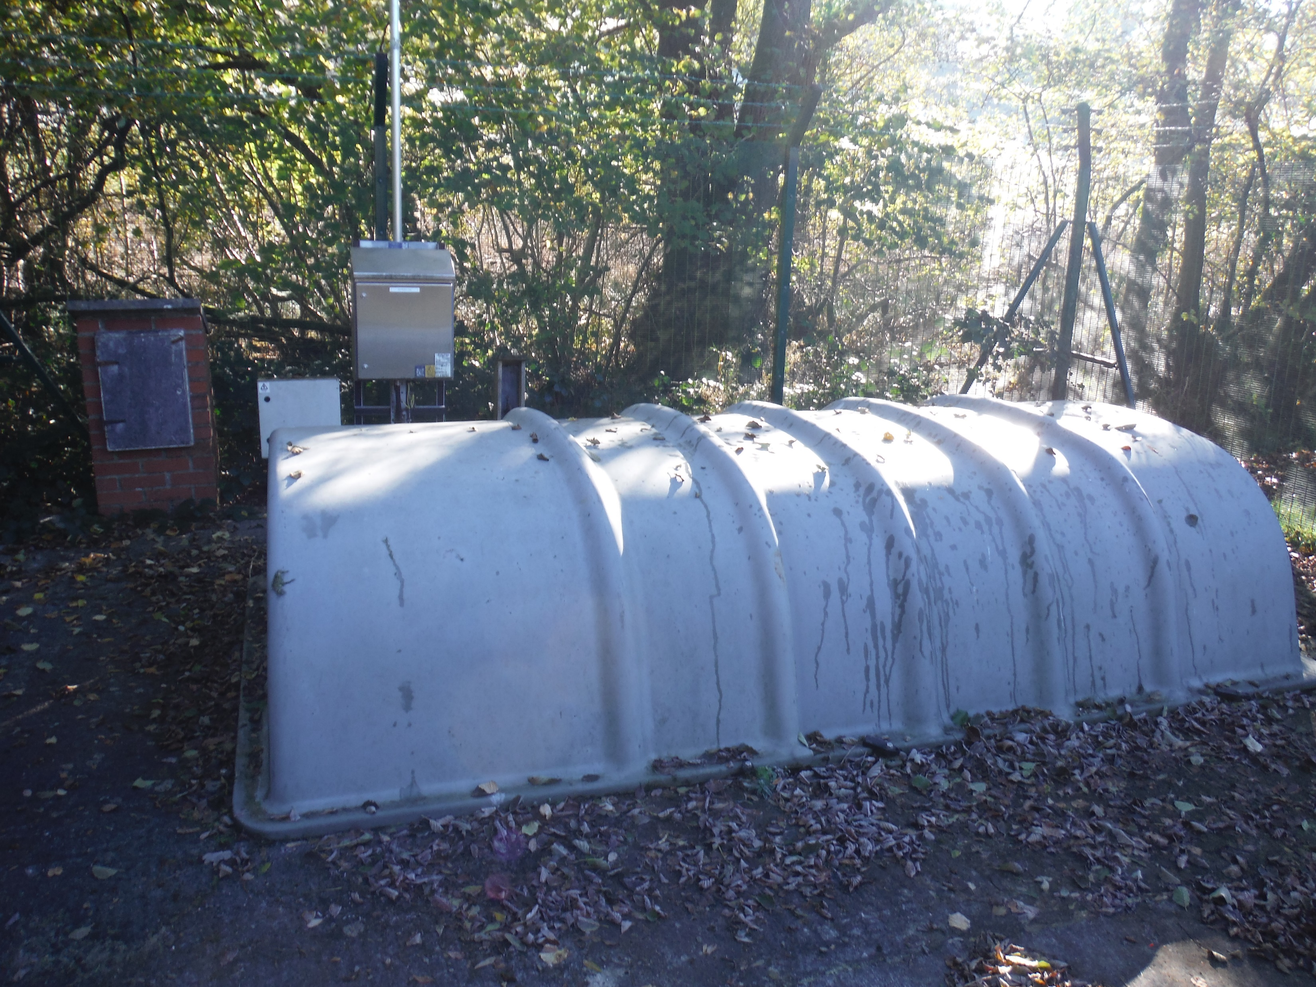

Slide 4
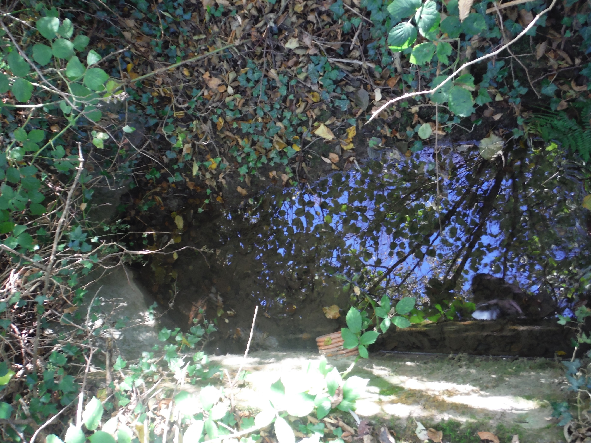

Slide 5
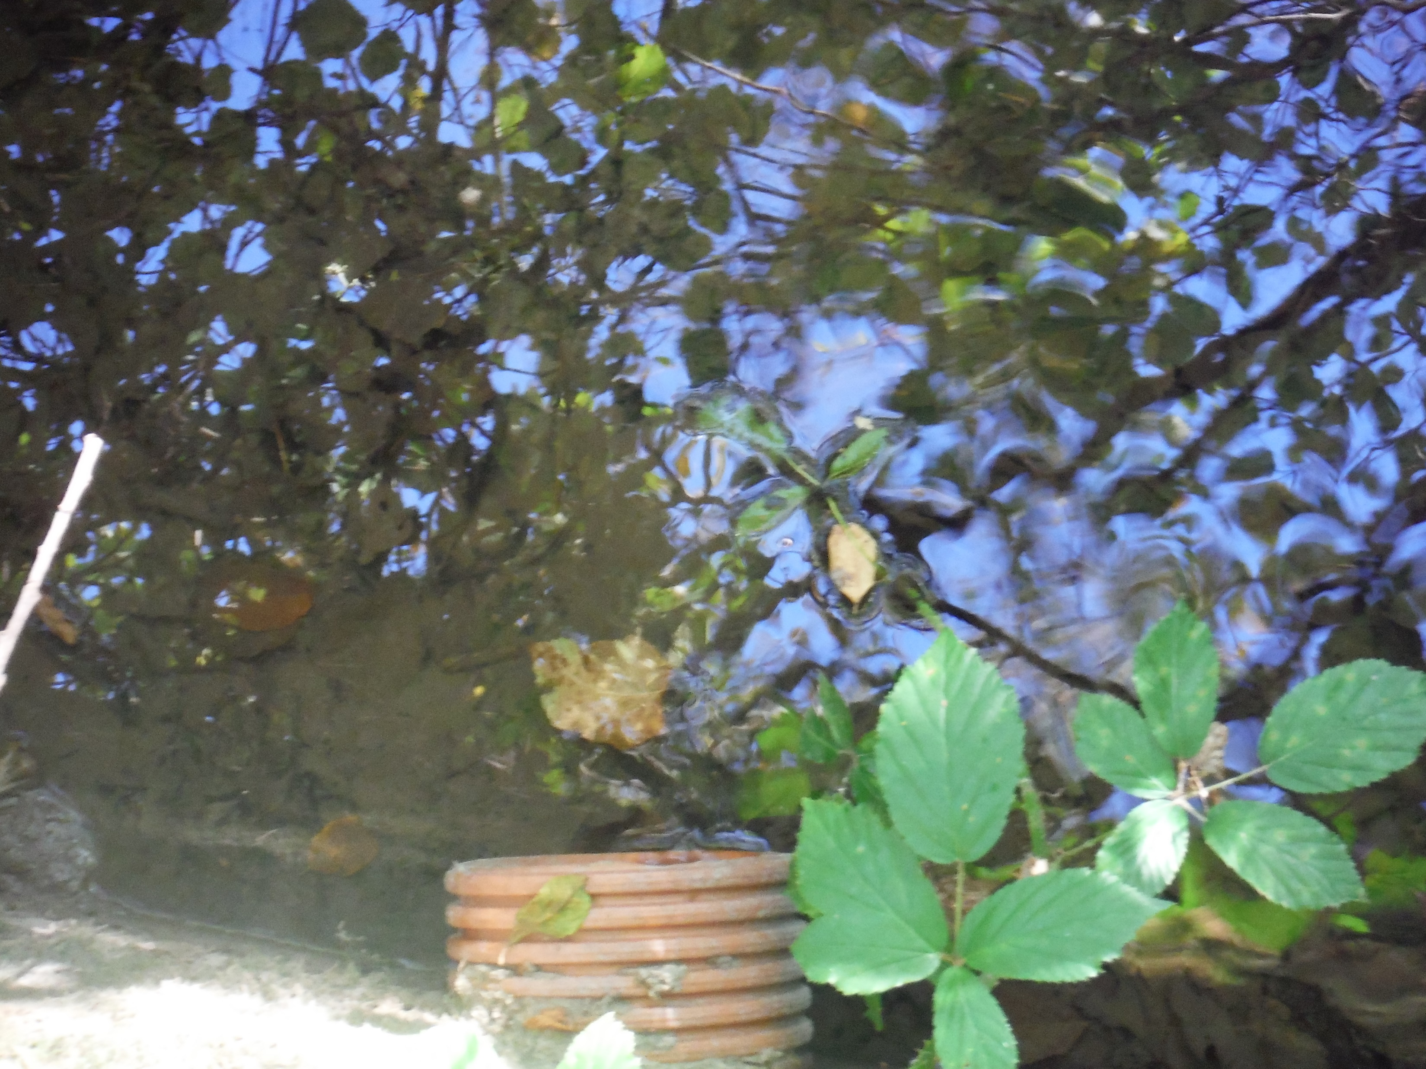

Slide 6
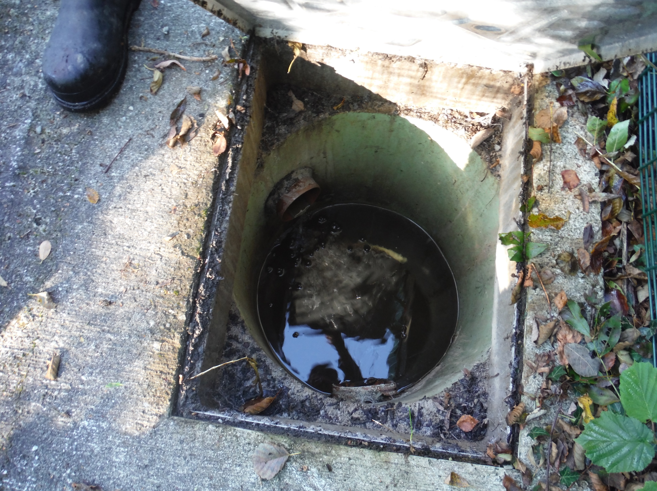

Slide 7
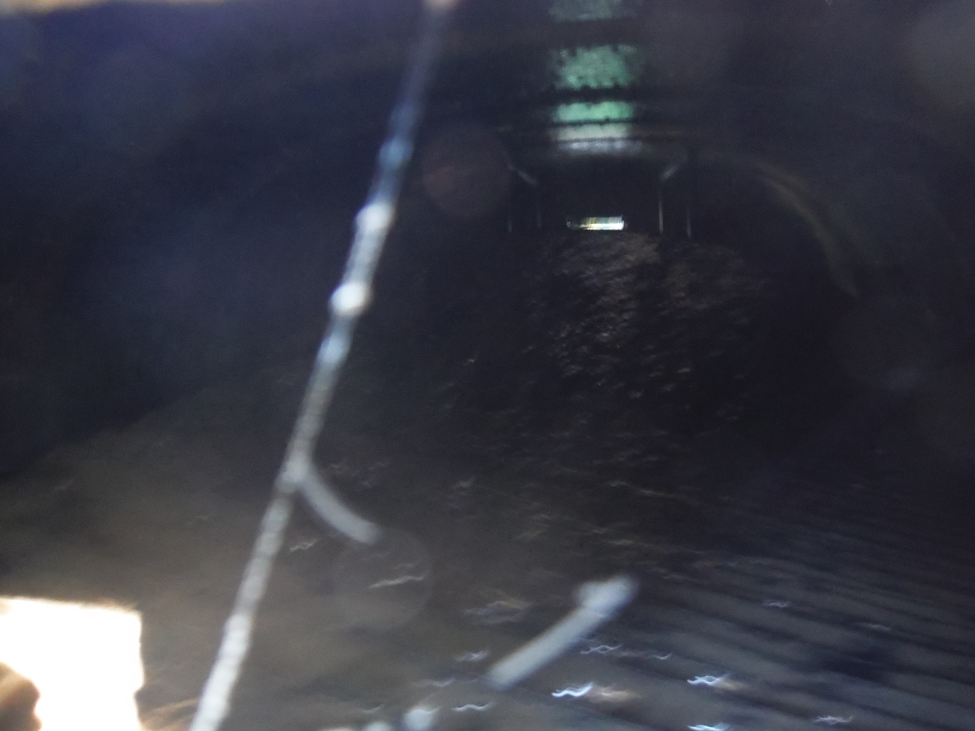

Slide 8


