Slide 1
Olmarch STW
BN0015901
Inspection – 30/10/2018
by Jeremy Goddard, Callum Stone & Alastair Wilson

Slide 2
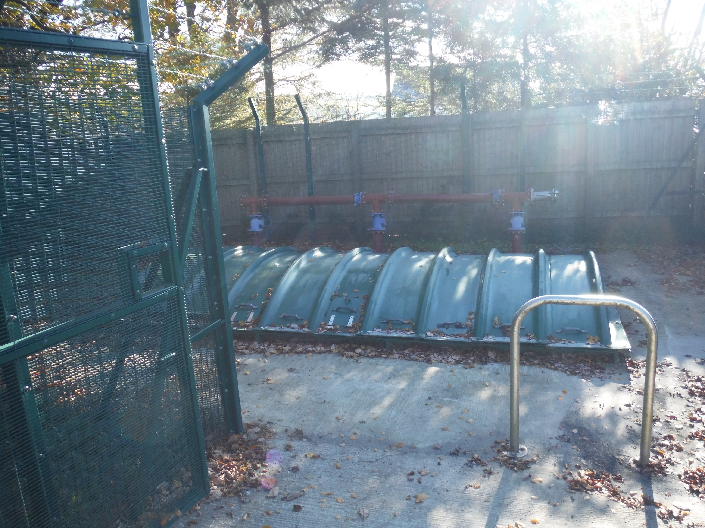

Slide 3
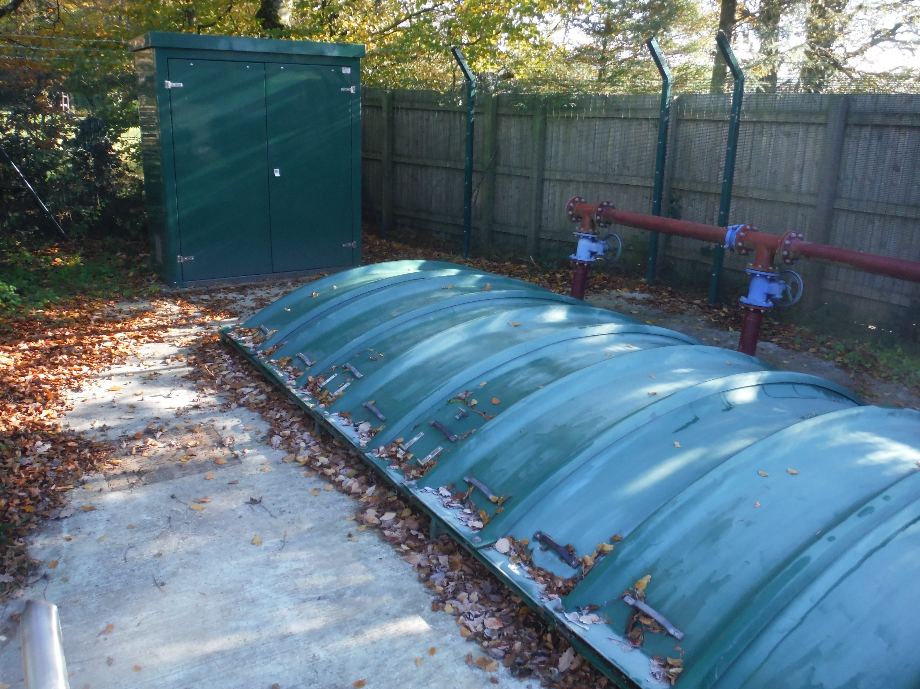

Slide 4
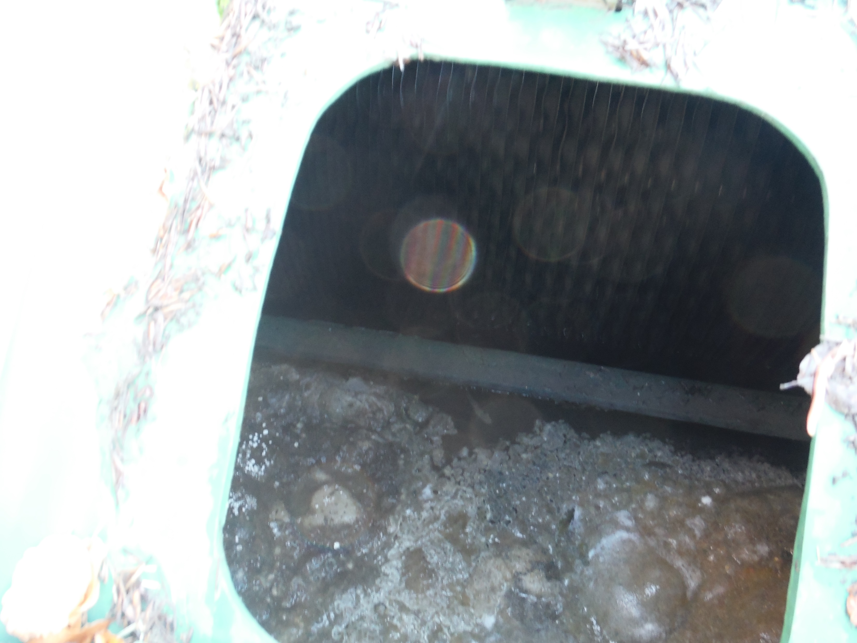

Slide 5
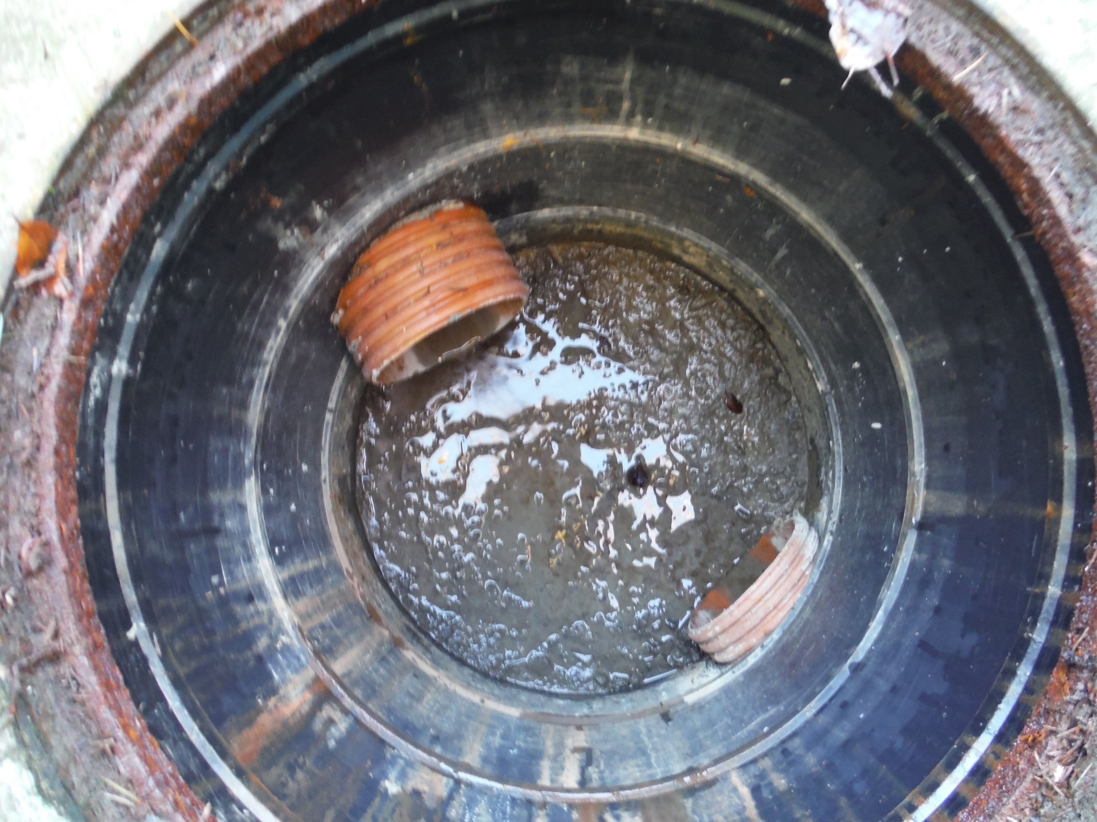

Slide 6
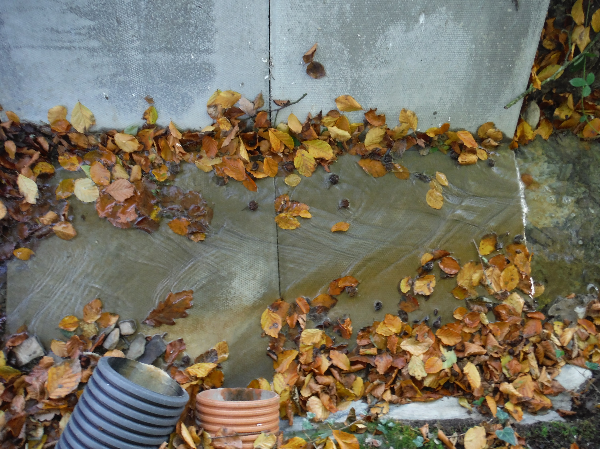

Slide 7


