Slide 1
Cilcennin STW
BN0268801
Inspection – 30/10/2018
by Jeremy Goddard, Callum Stone, Alastair Wilson

Slide 2
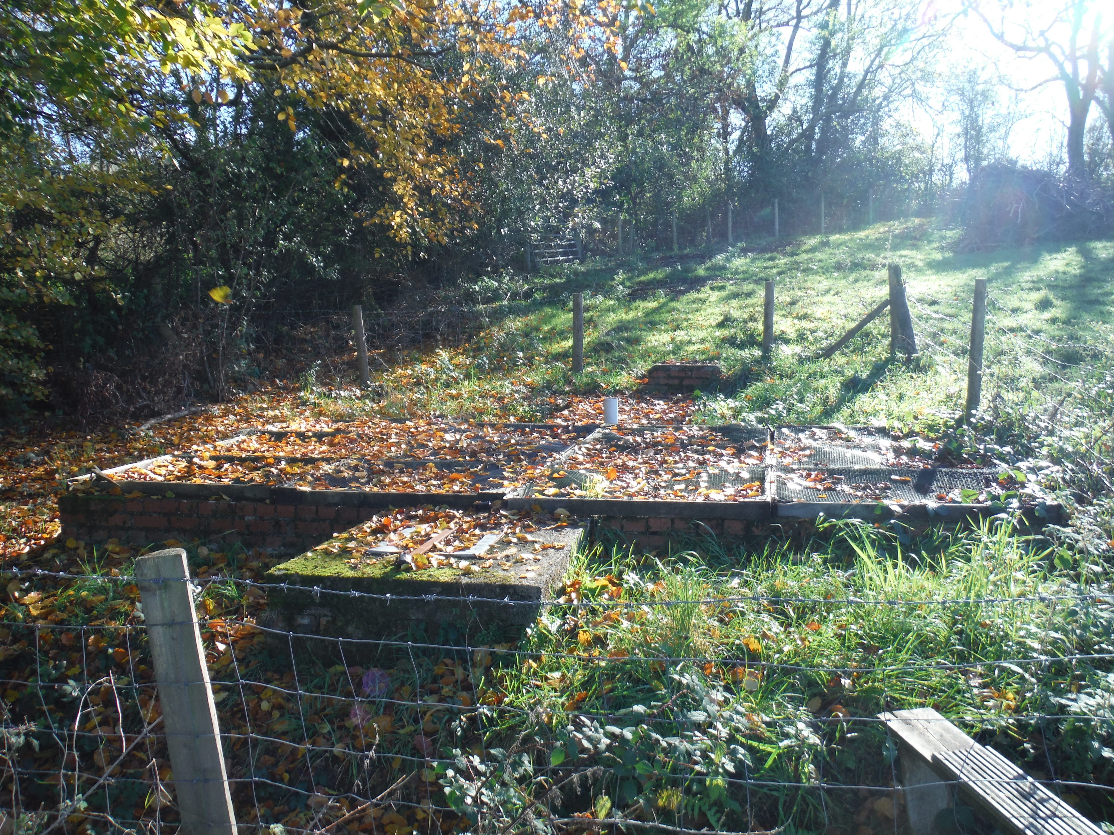

Slide 3
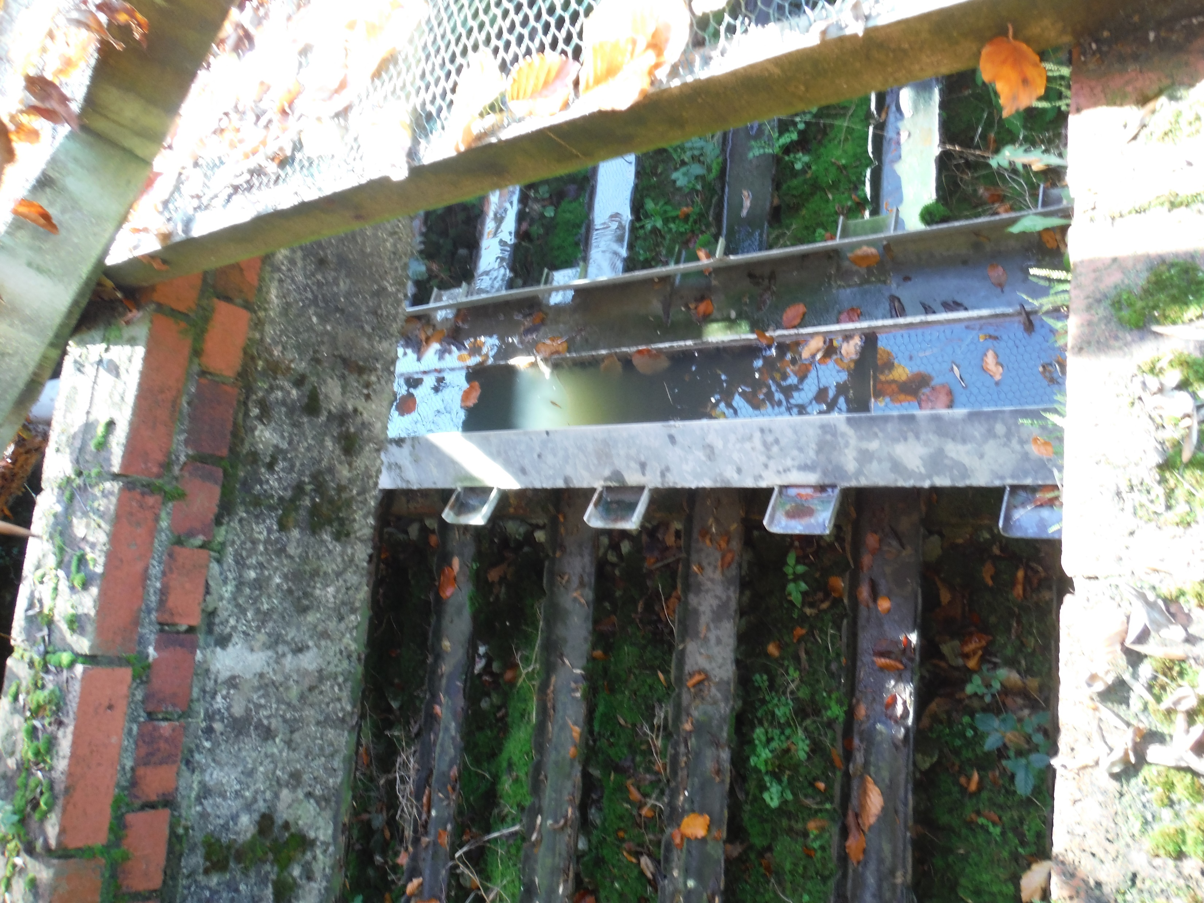

Slide 4
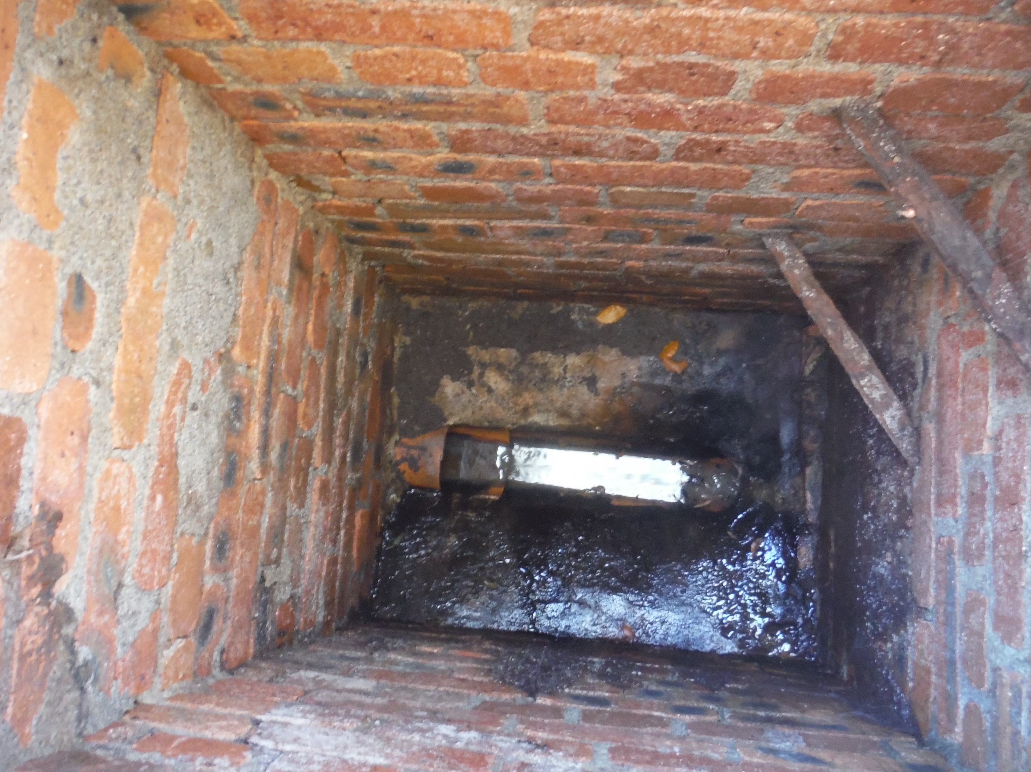

Slide 5
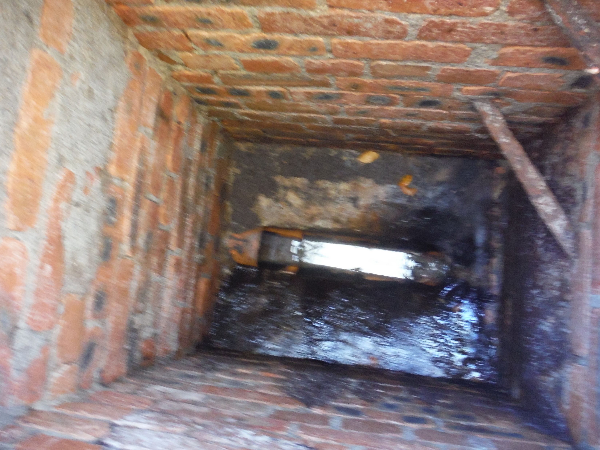

Slide 6


