Slide 1
Rheidol Recycling Park Compliance Visit Photos
Taken by Malcolm Dines on 13th October 2021

Slide 2
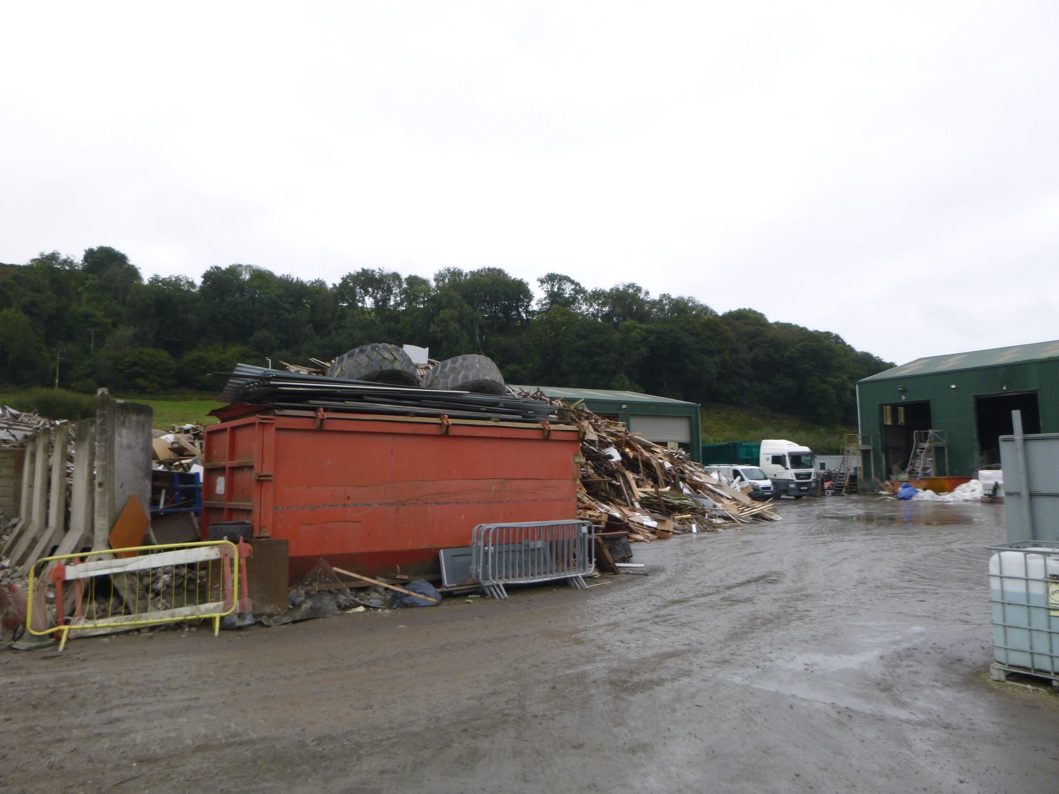
View of main yard from weighbridge showing extent of encroachment of wood waste stockpile into yard

Slide 3
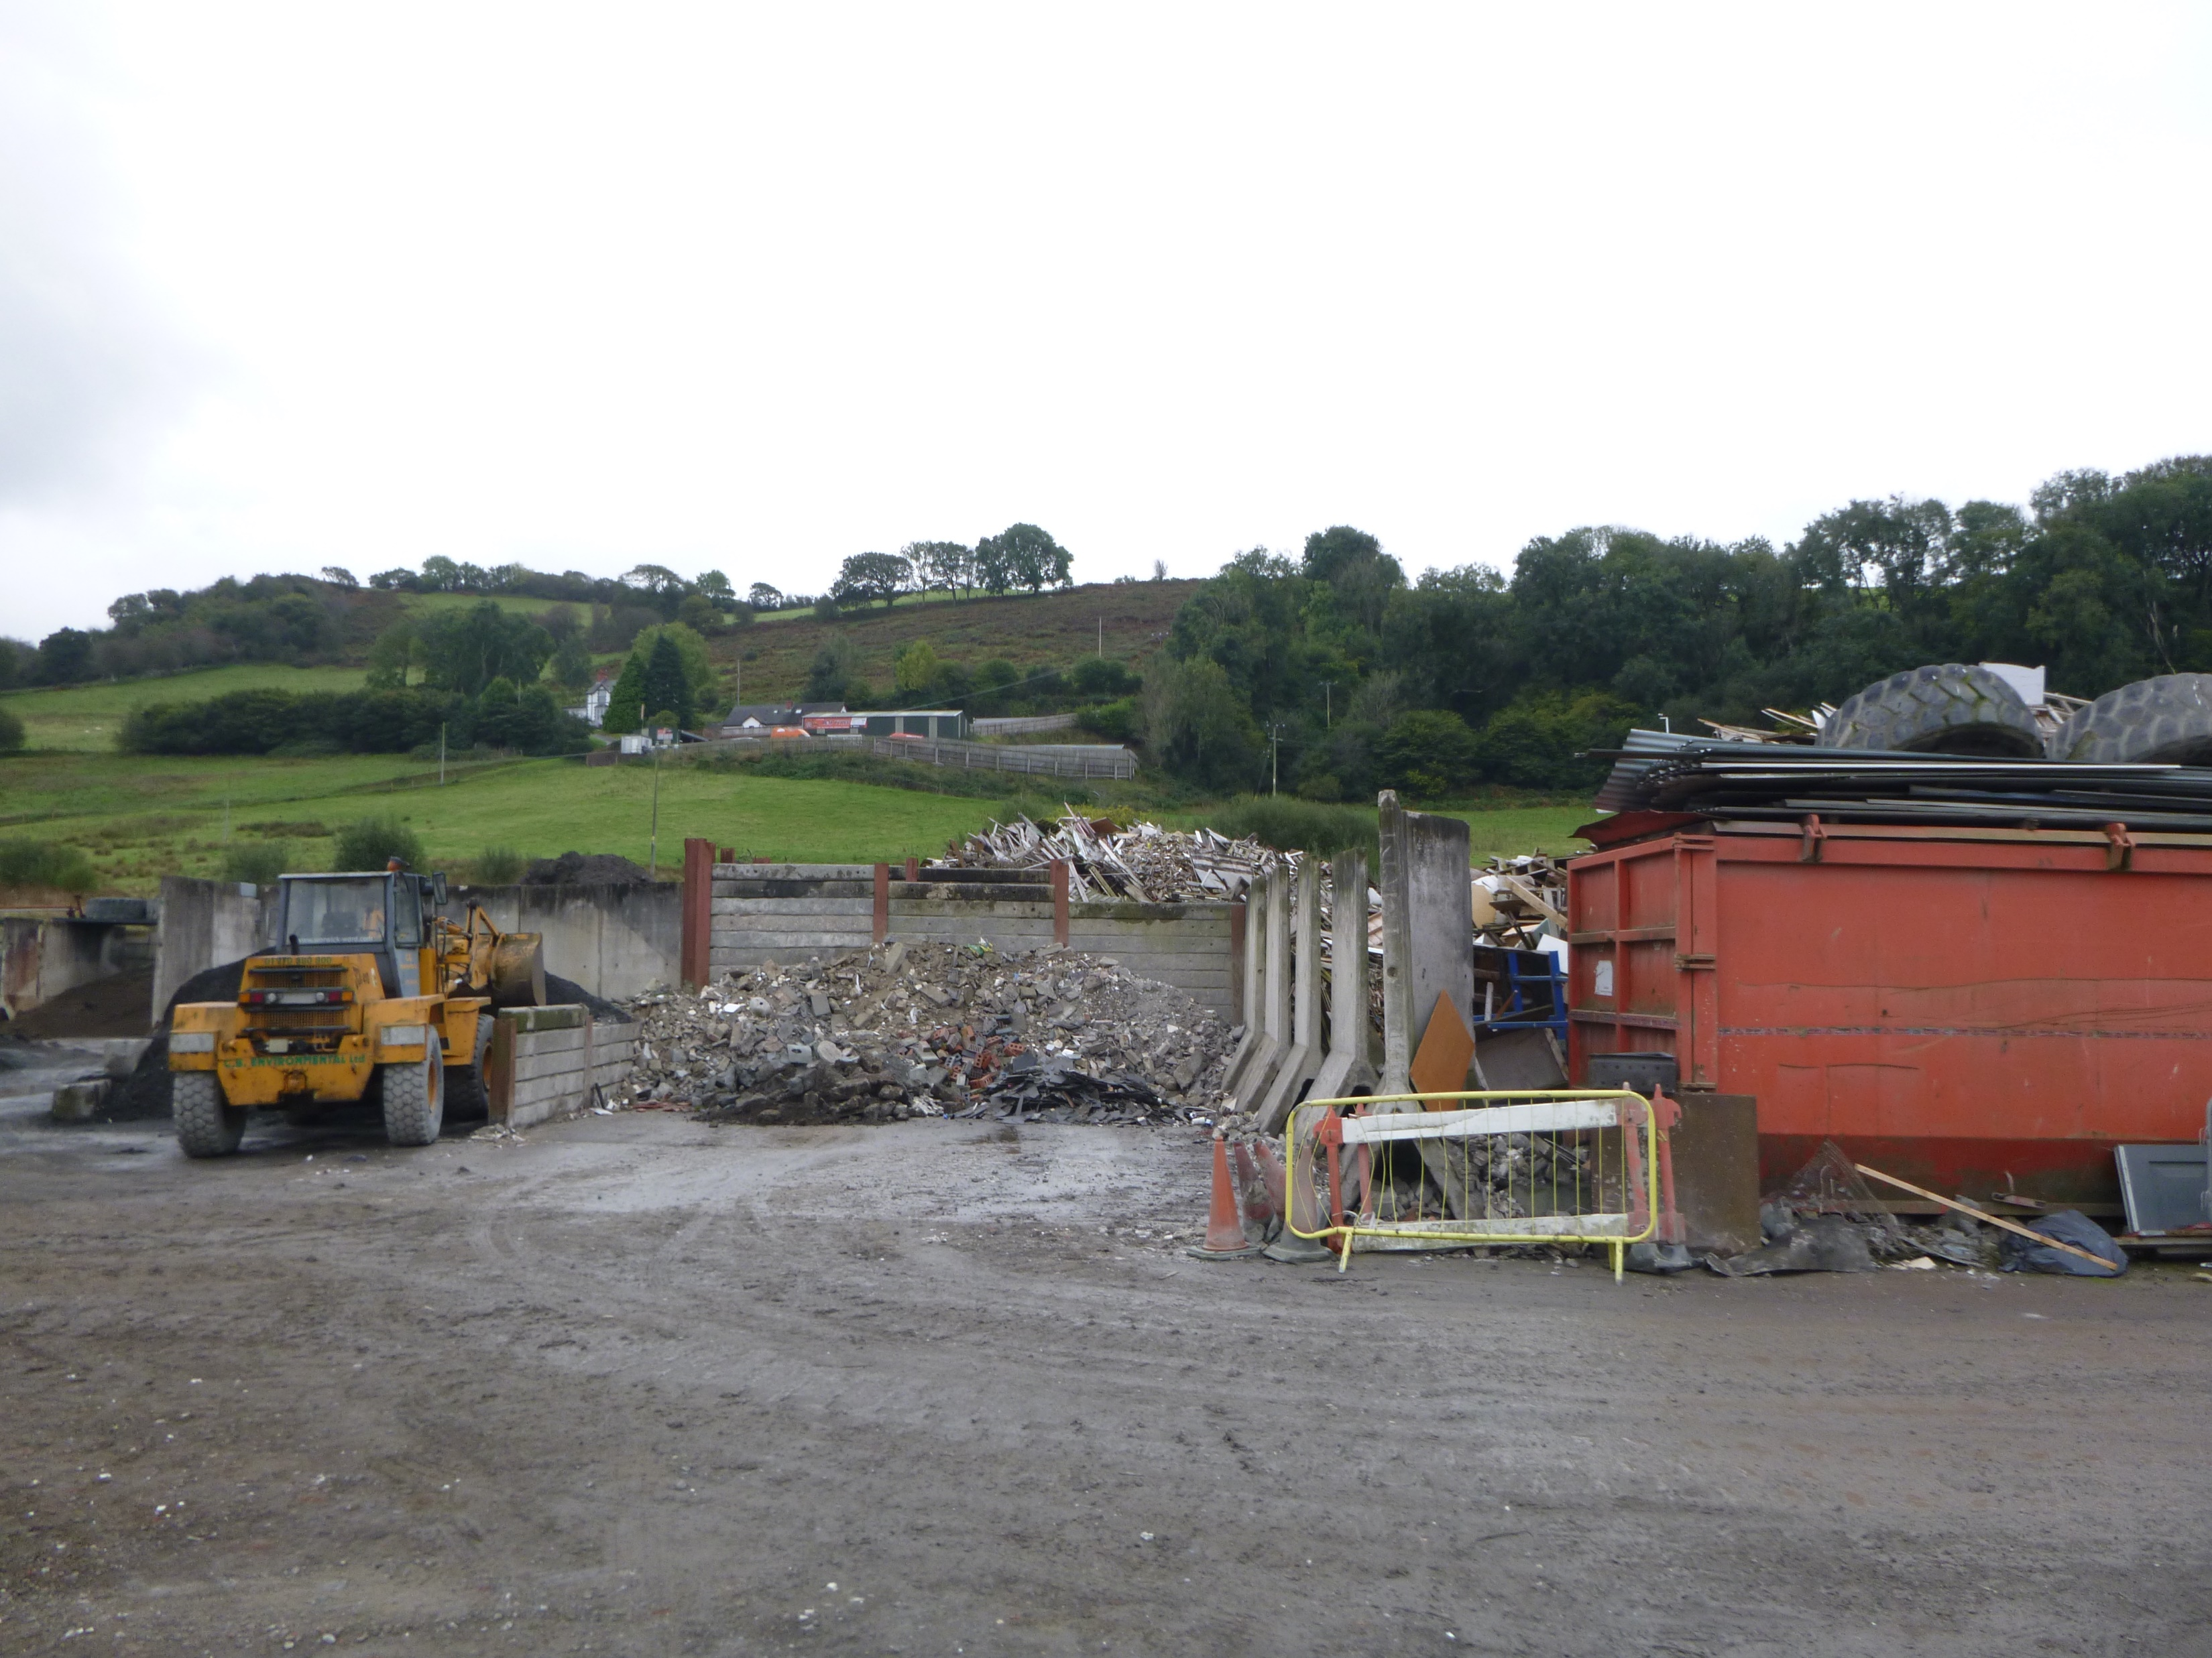
Aggregate processing area with additional wood waste storage behind the bay

Slide 4
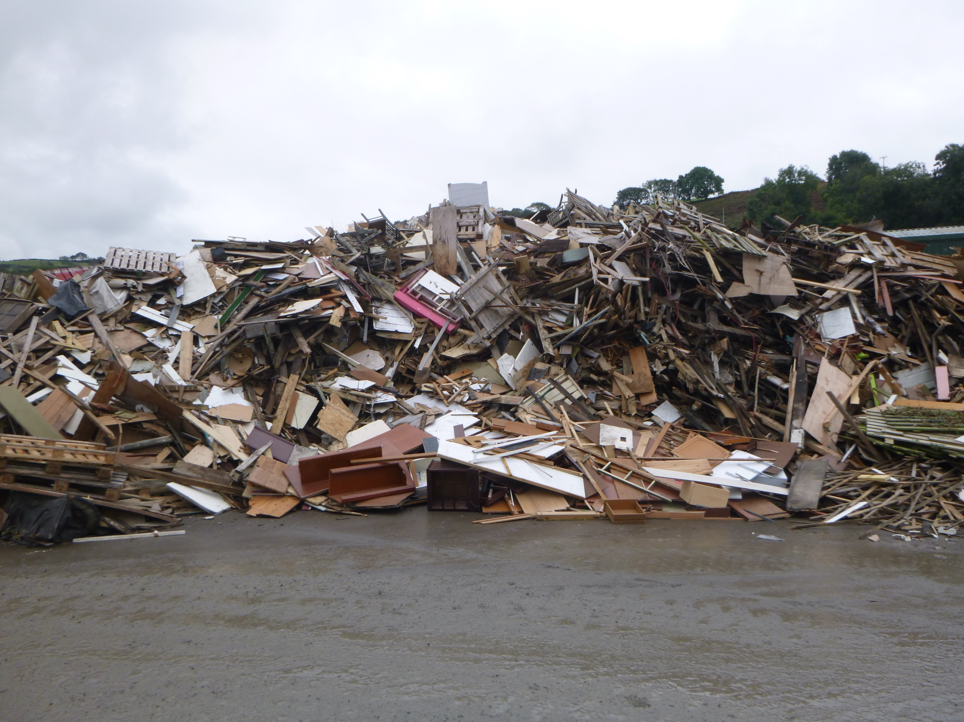
Wood waste stockpile on main yard big enough that ELV shed is not visible behind

Slide 5
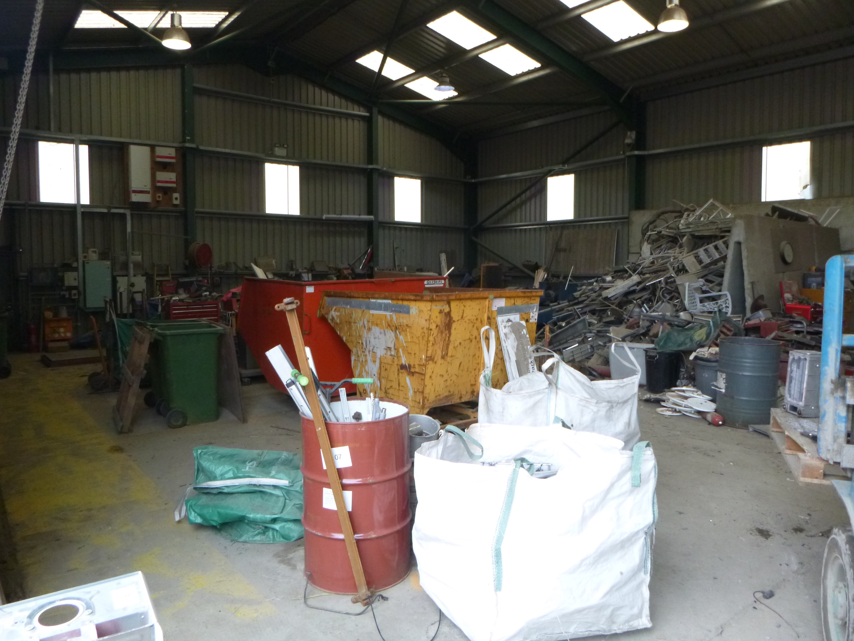
Inside of ELV shed

Slide 6
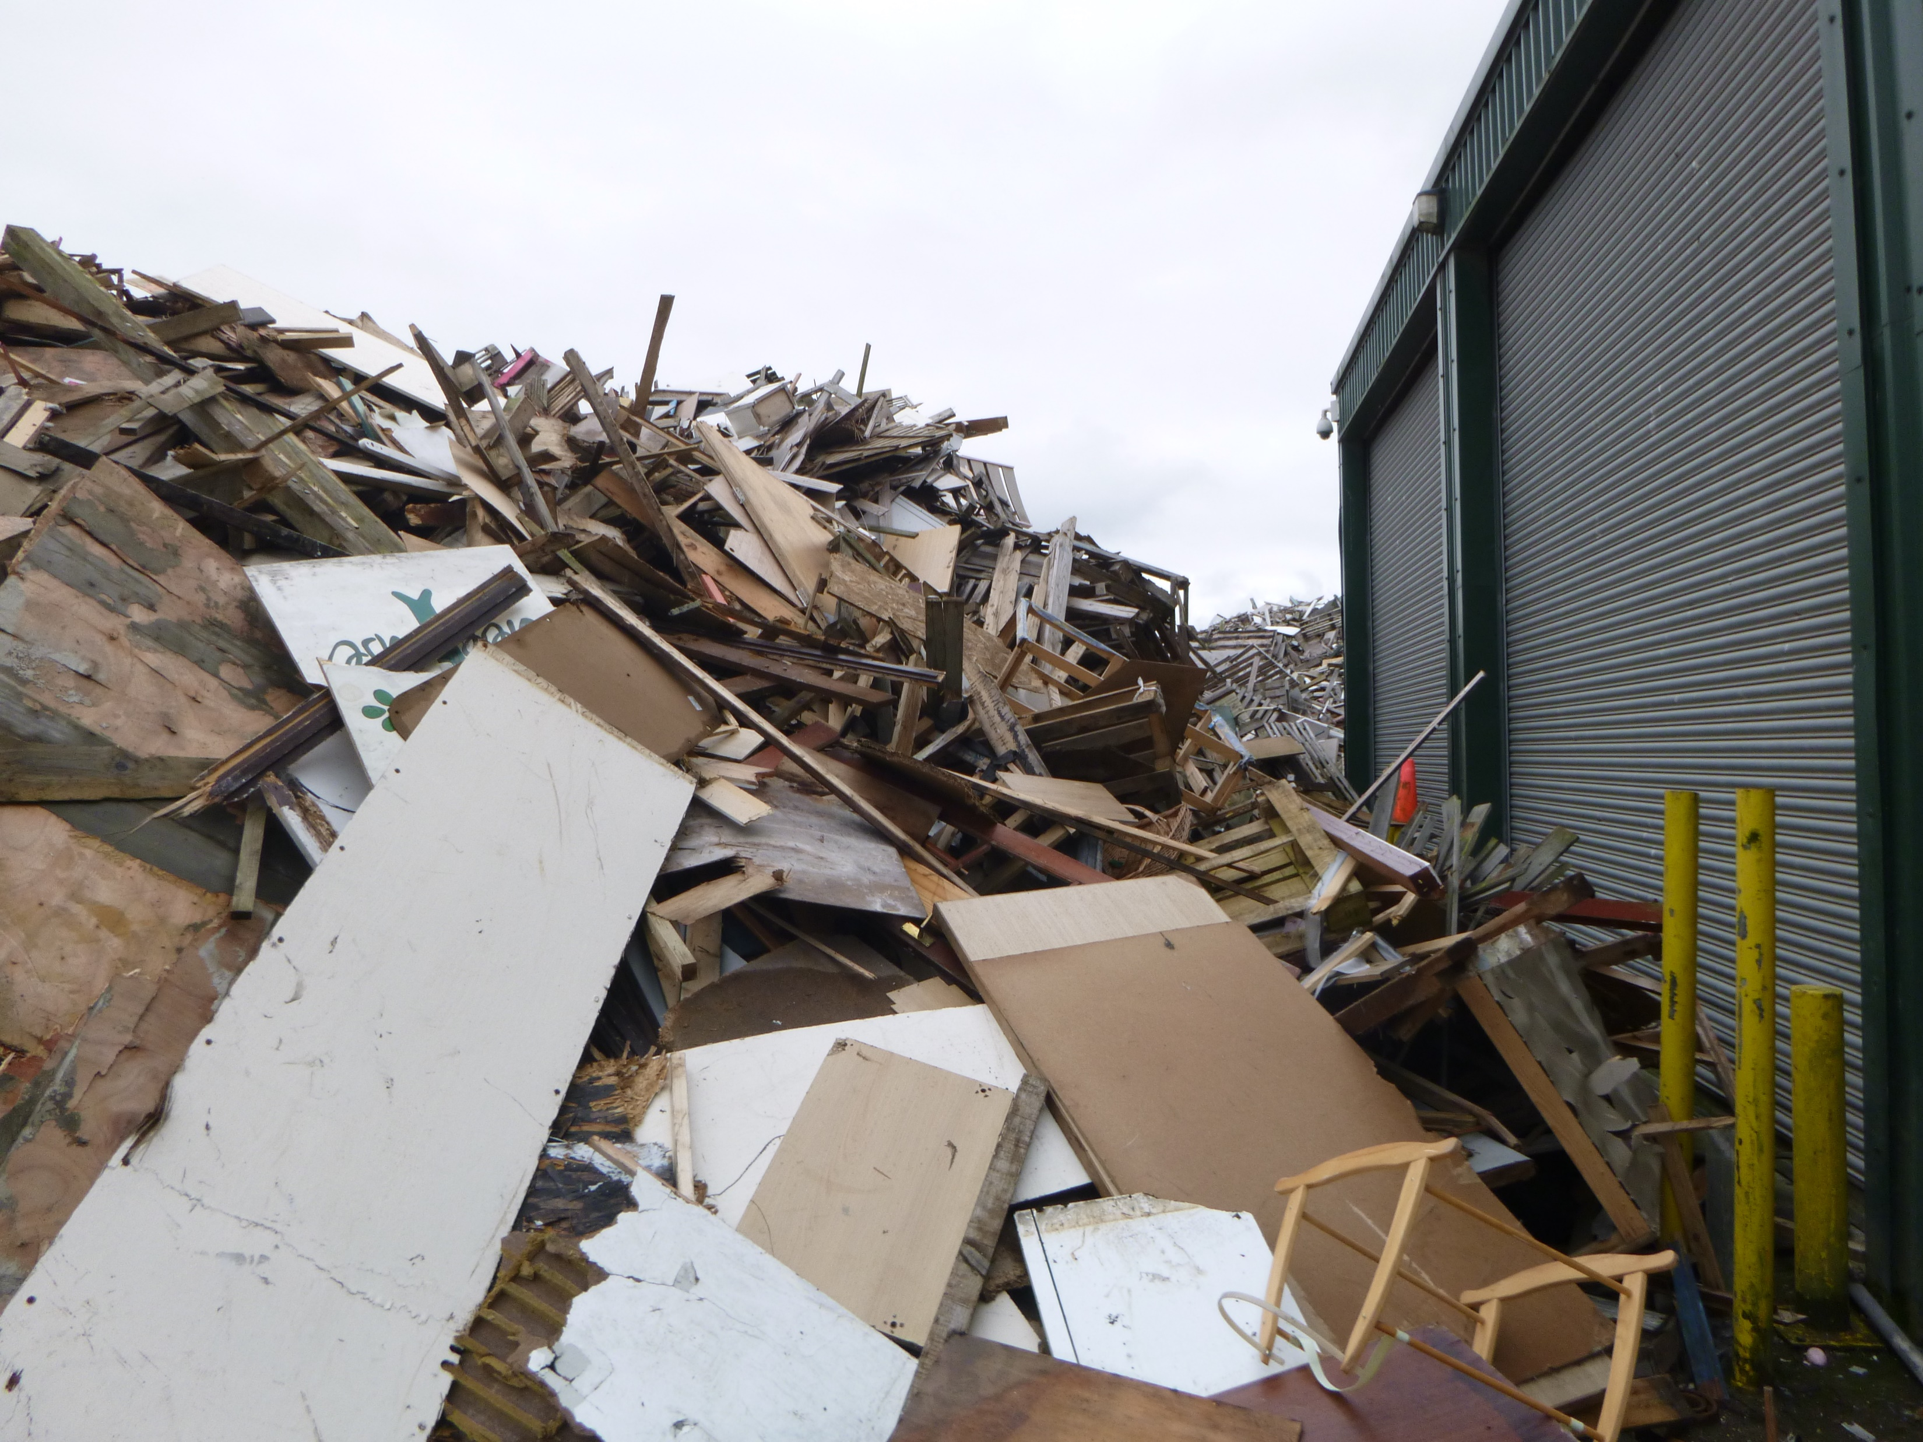
No separation between wood waste stockpile and ELV building

Slide 7
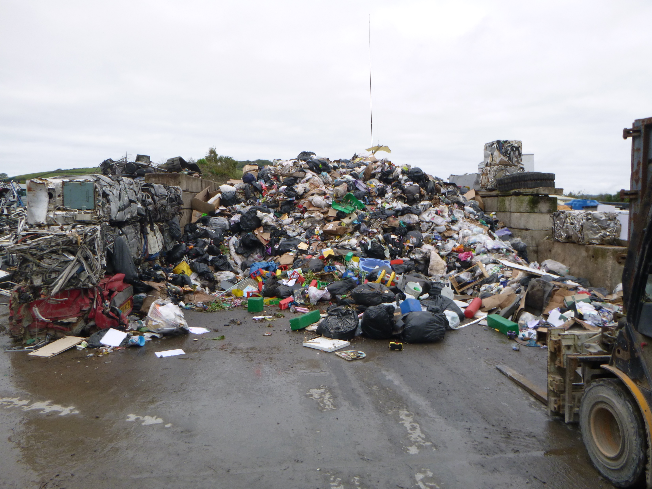
Mixed municipal waste bay with scrap metal used to create bay push walls

Slide 8
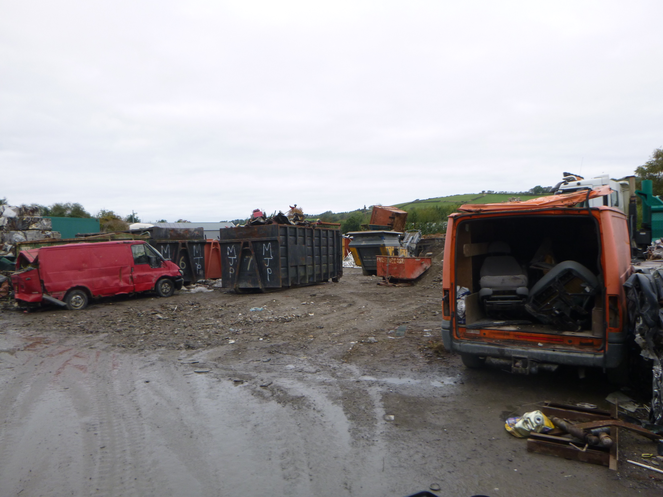
Scrap metal bins and ELVs on unmade yard area

Slide 9
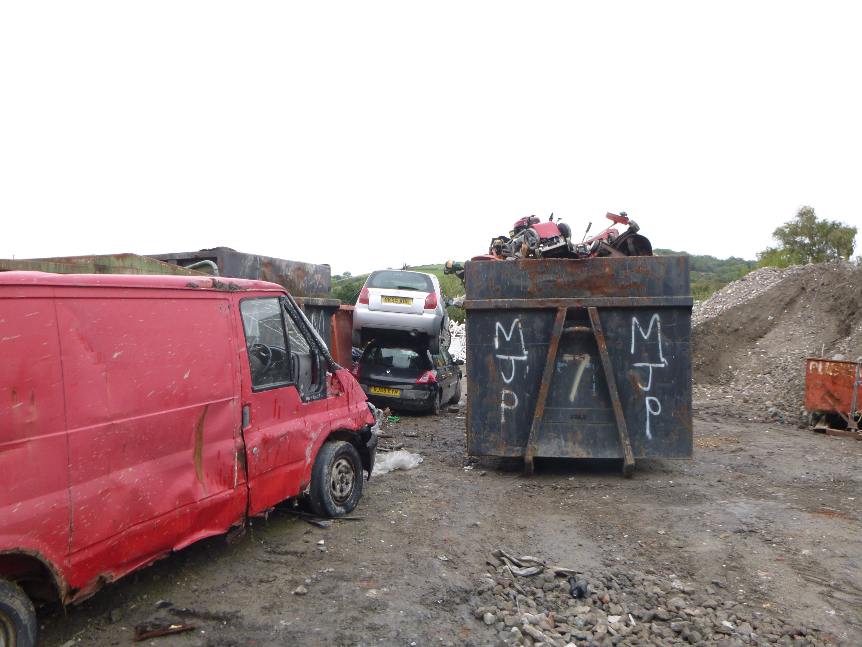
Three ELVs stored on hardstanding rather than impermeable pavement

Slide 10
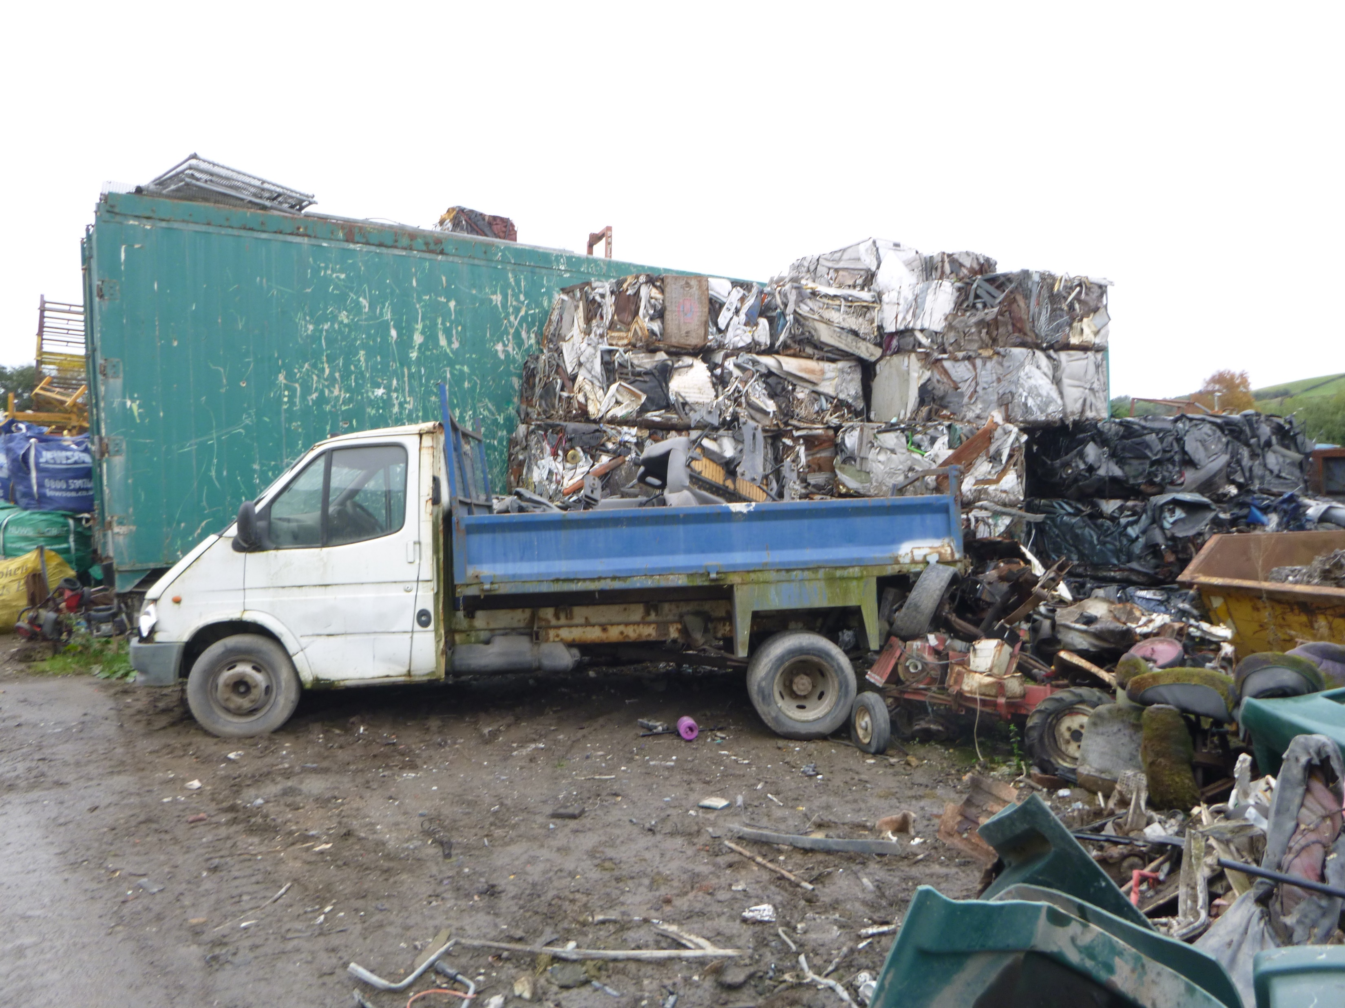
ELV and scrap metal stored on hardstanding

Slide 11
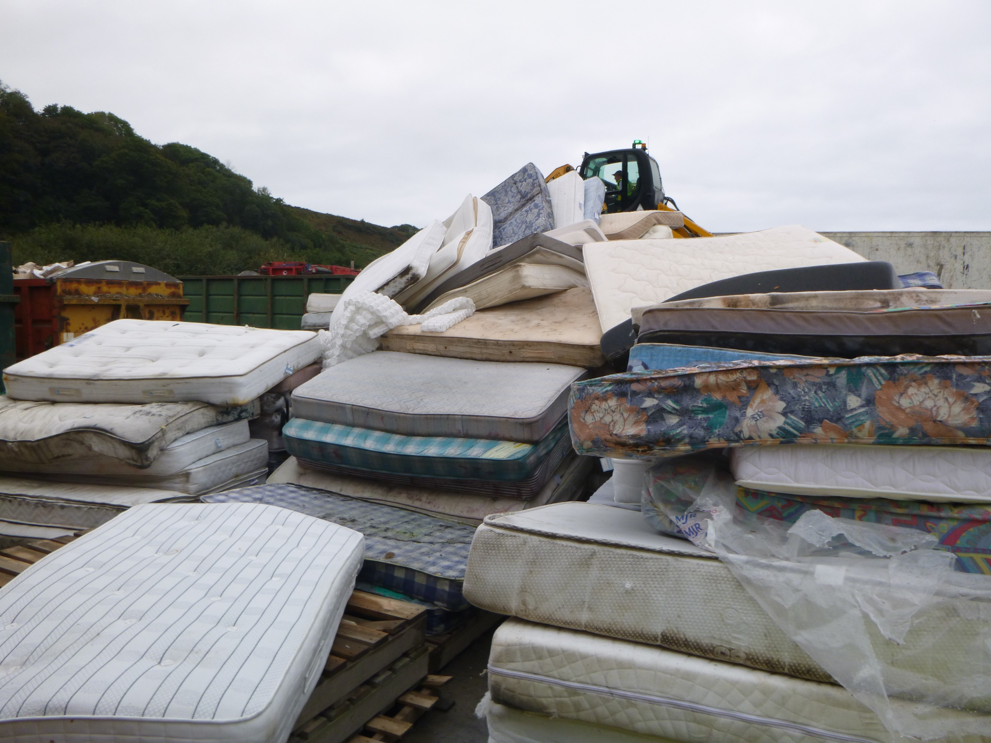
Waste mattresses awaiting drying

Slide 12
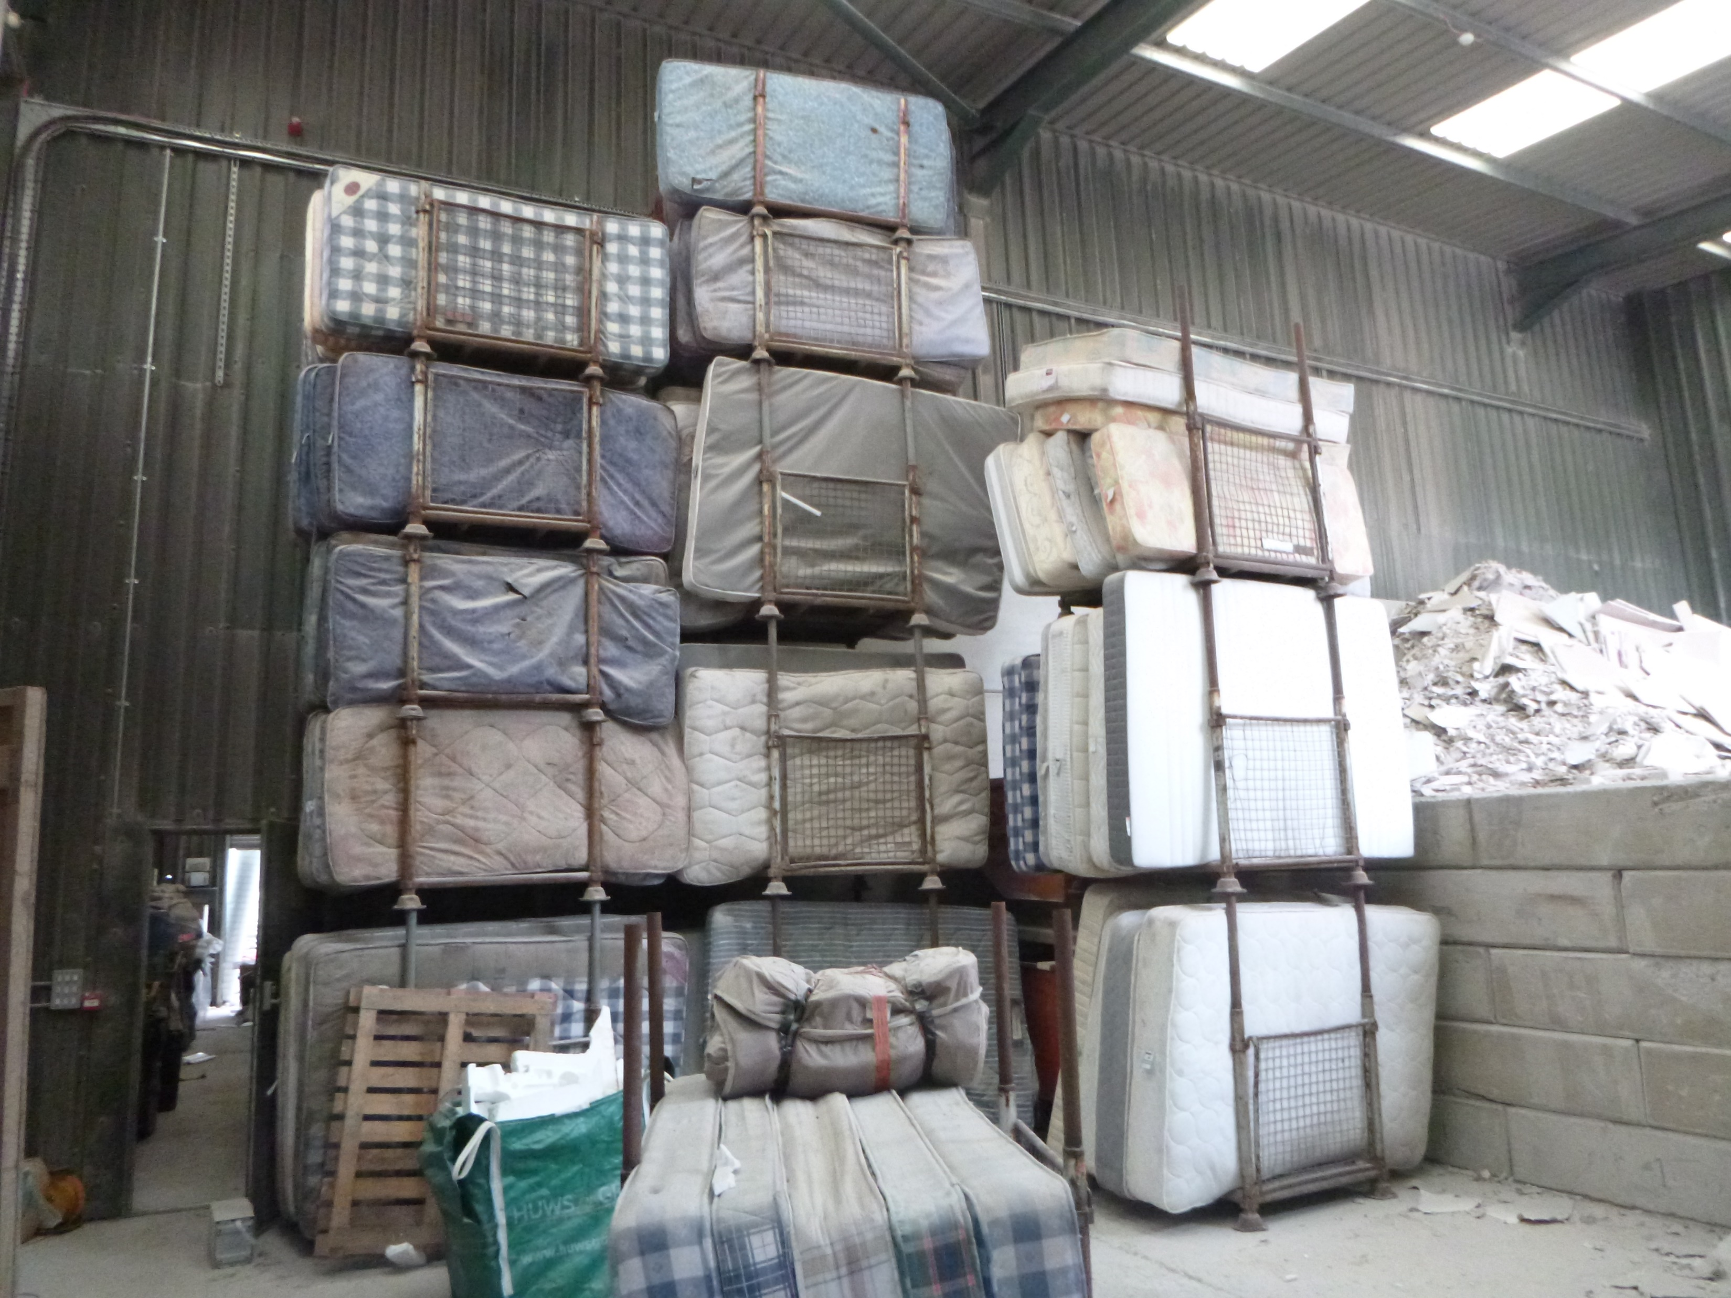
Waste mattresses (left) and gypsum/plasterboard (right) drying inside boiler room. Waste transfer is through door on the left

Slide 13
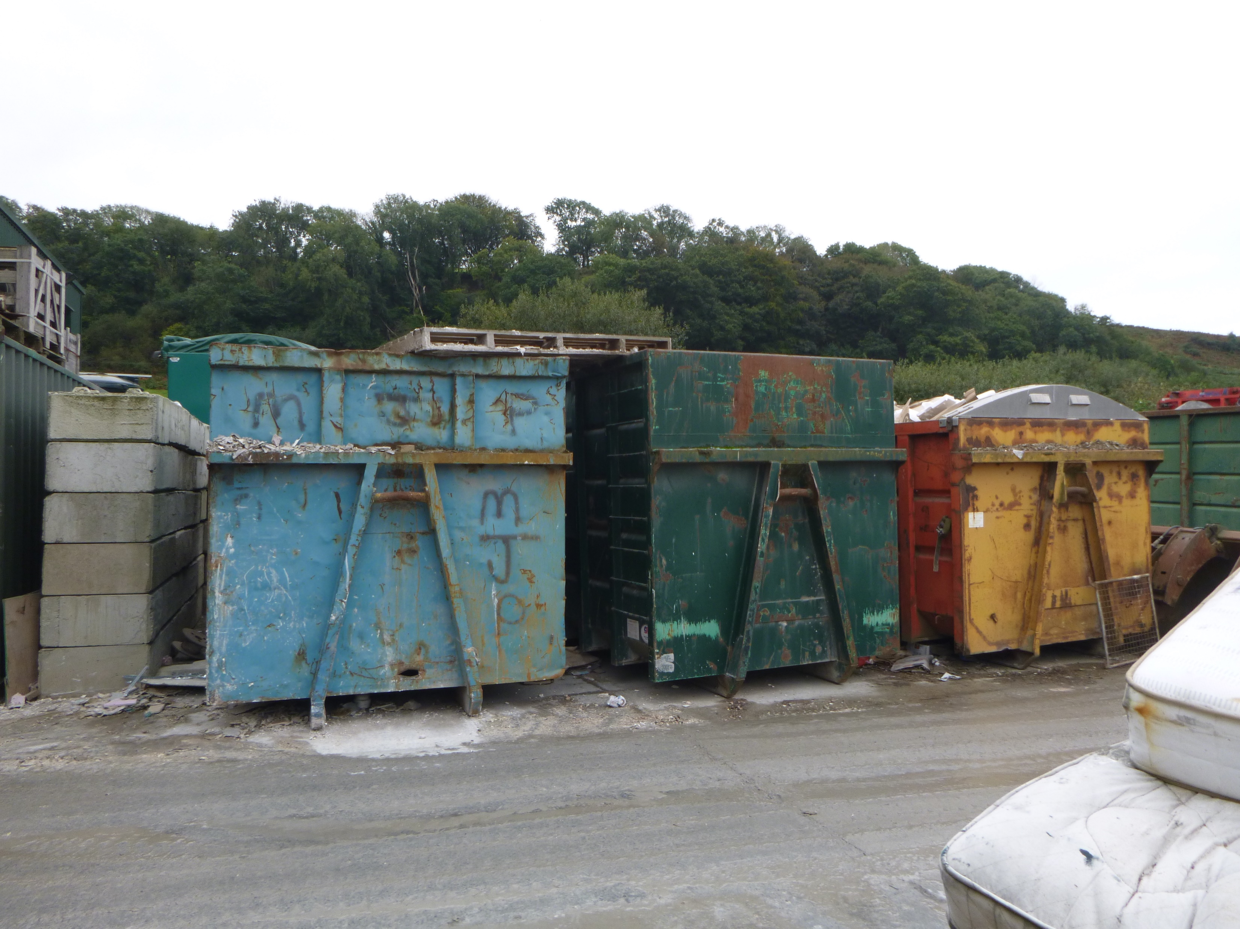
The three drying bins from the “front” or yard side with concrete blocks separating bins from waste transfer building

Slide 14
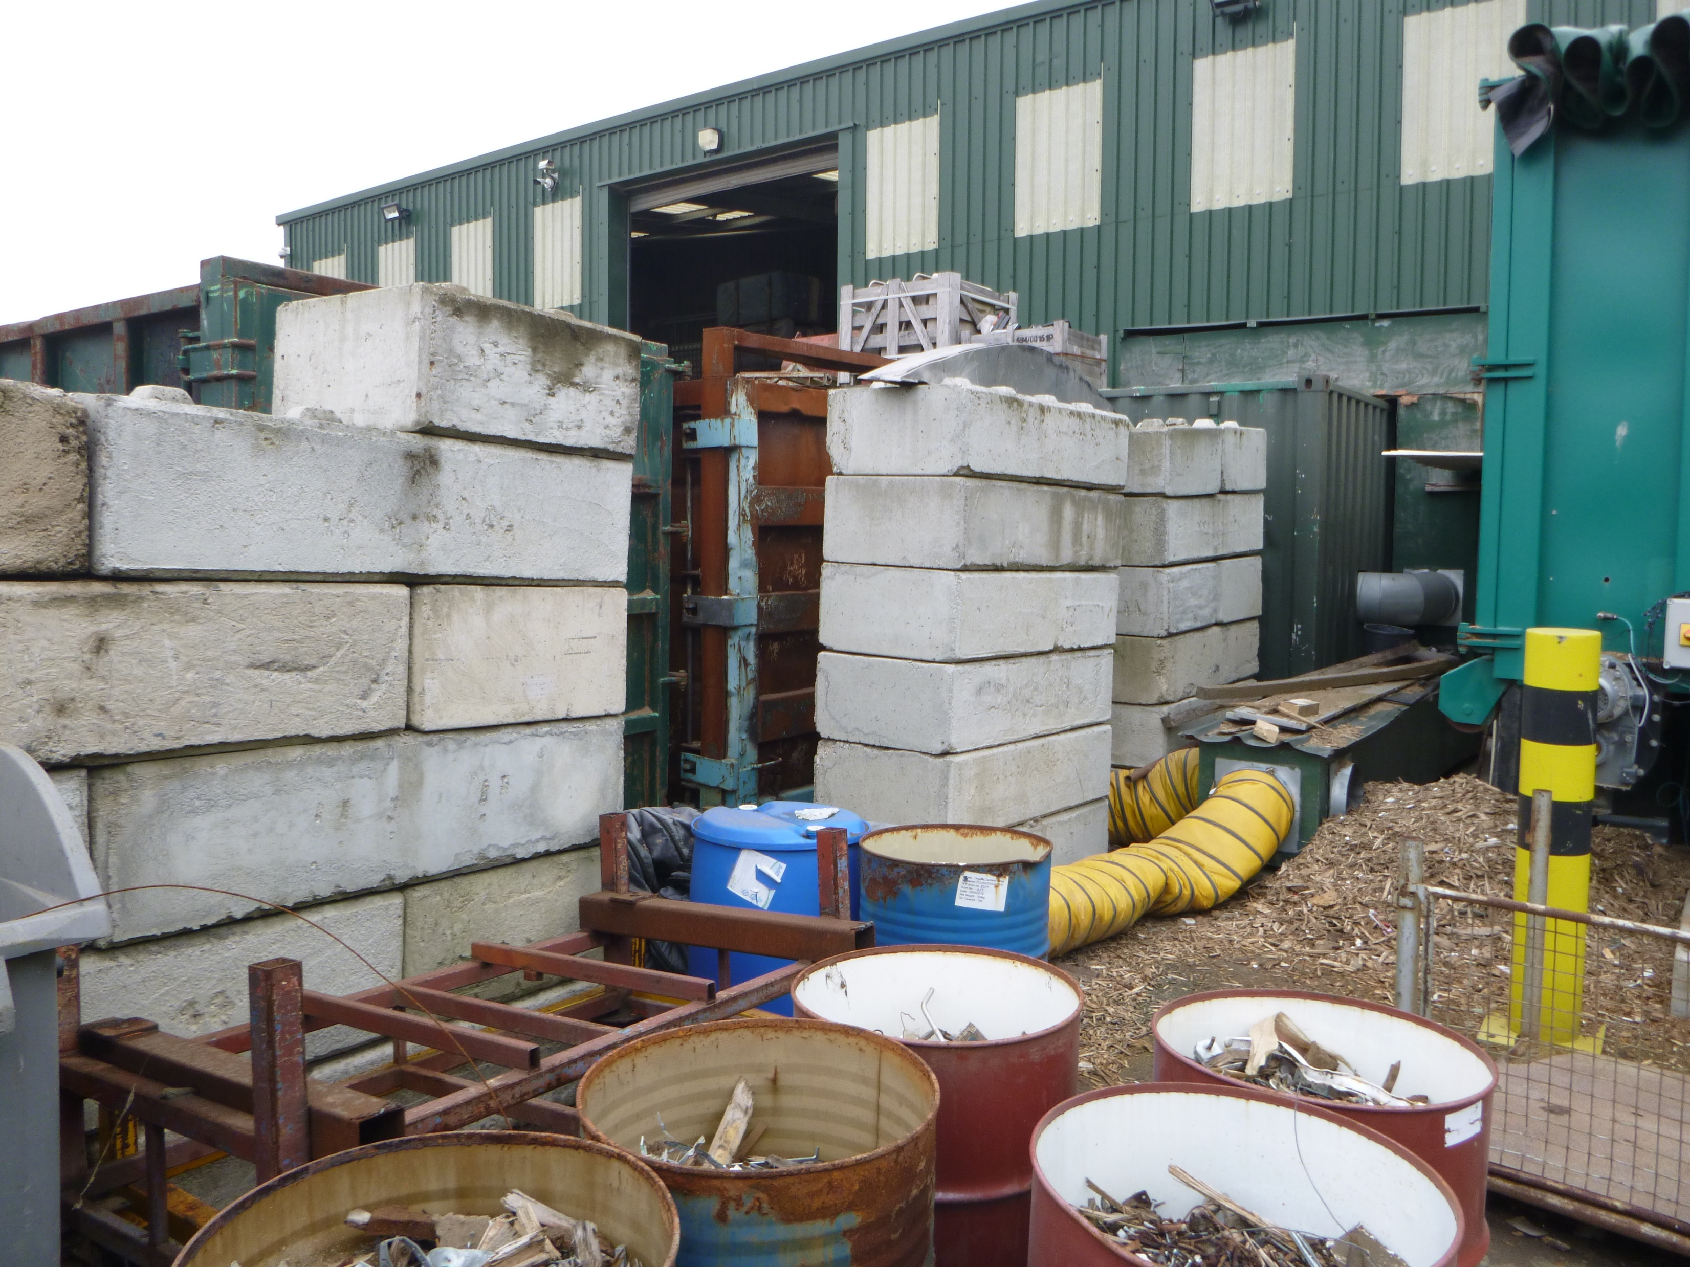
Drying bins separated from wood chip hopper by concrete blocks and showing yellow heating ducting

Slide 15
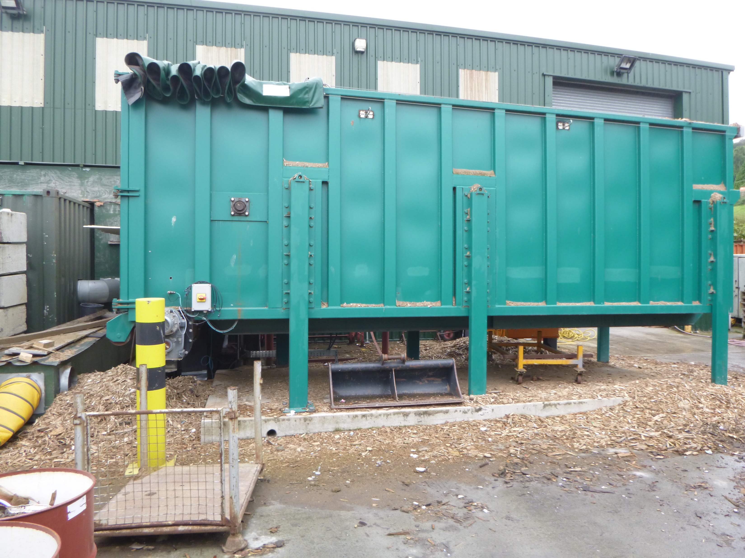
Sch.13 Permit Biomass Boiler hopper

Slide 16
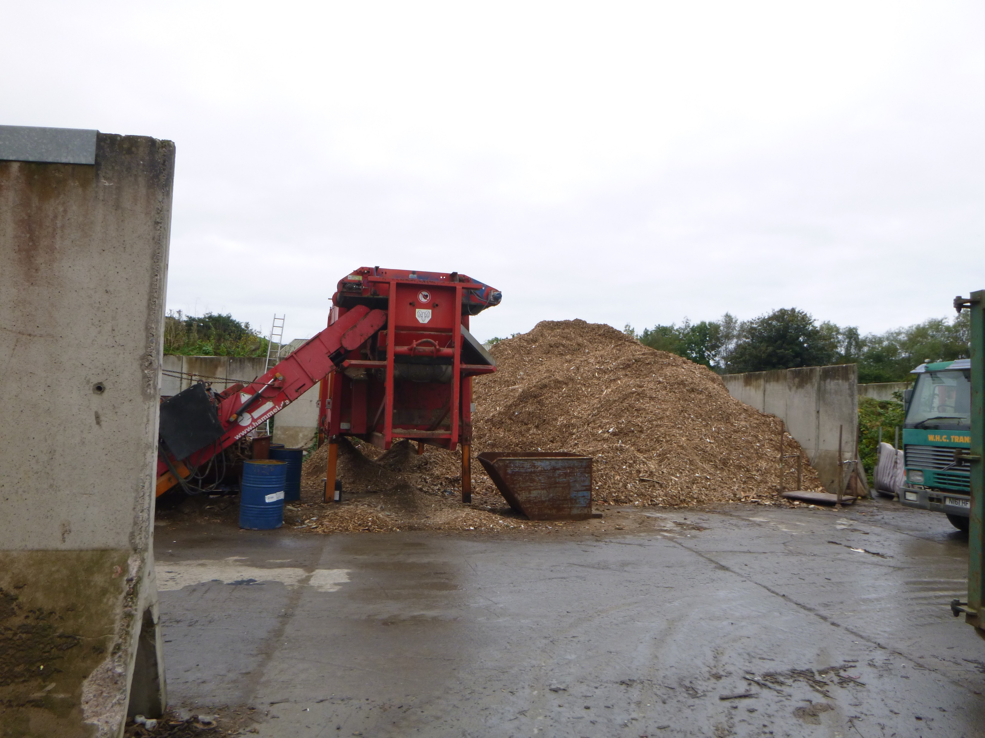
Wood shredding prior to “transfer” to Schedule 13 Permit Biomass Boiler

Slide 17
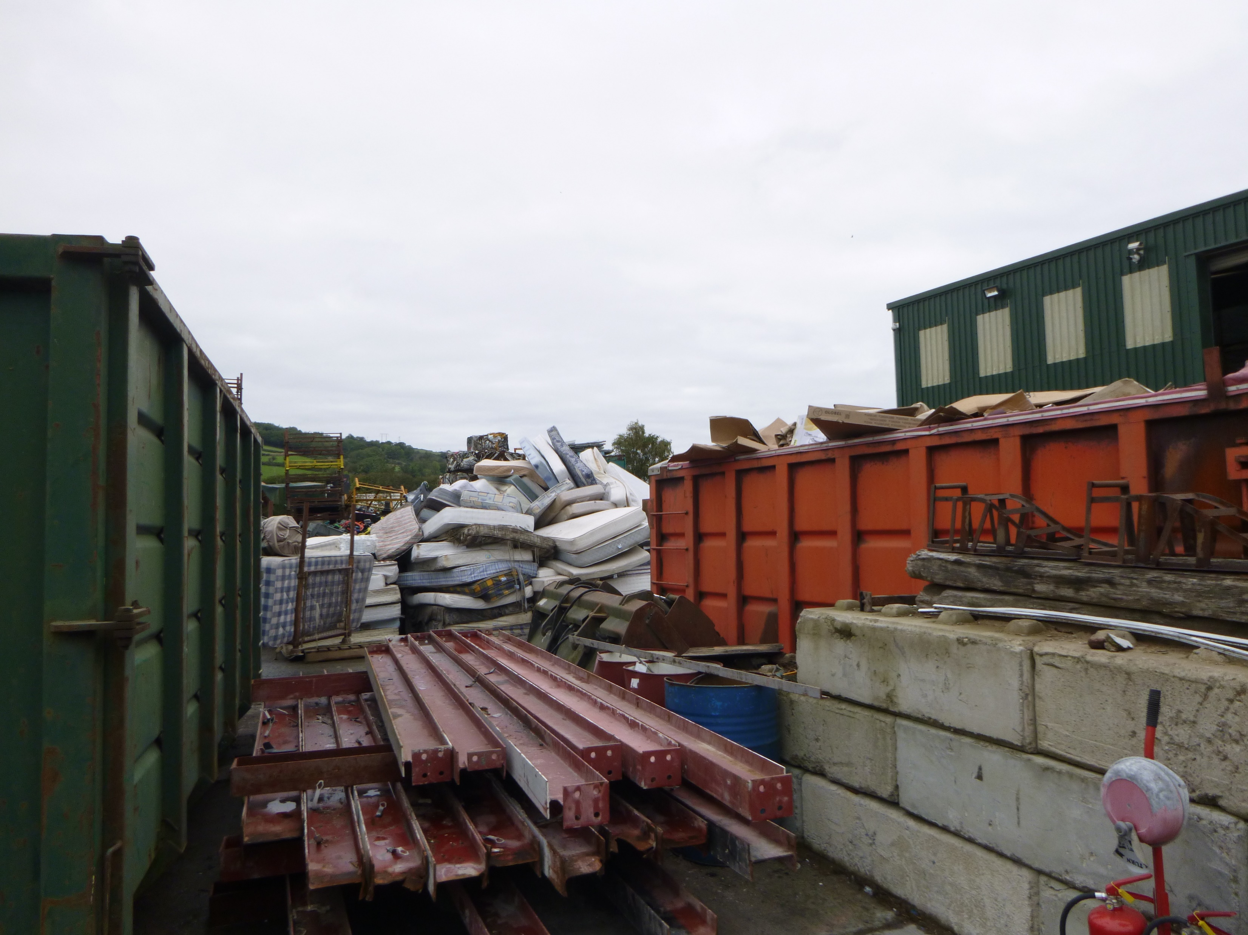
View of mattresses waiting to be dried from behind drying bins

Slide 18
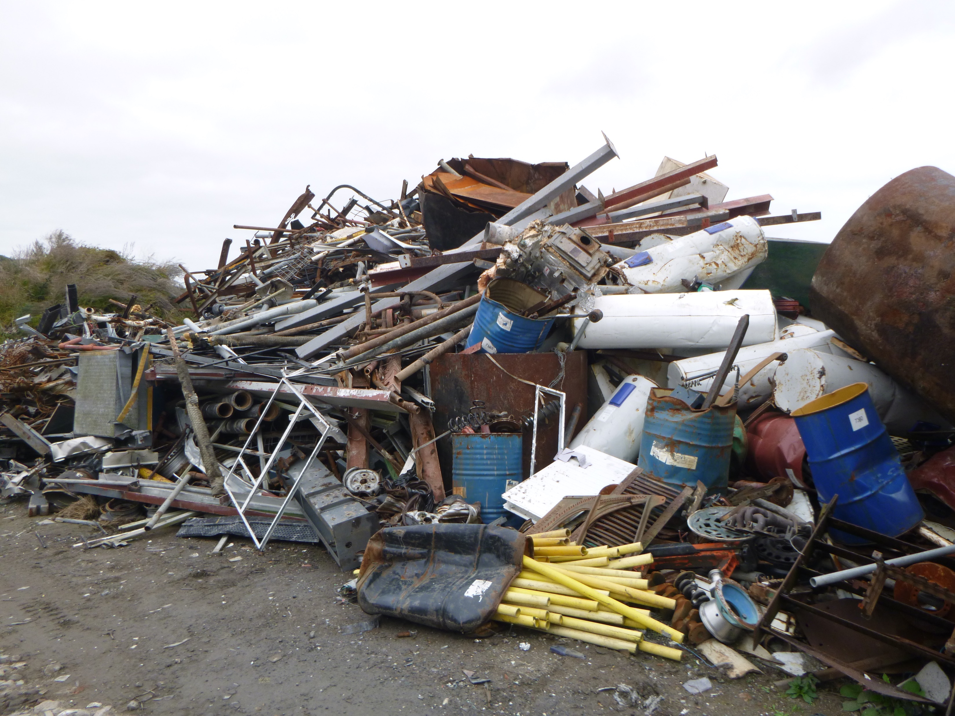
Scrap aluminium stockpile

