Slide 1
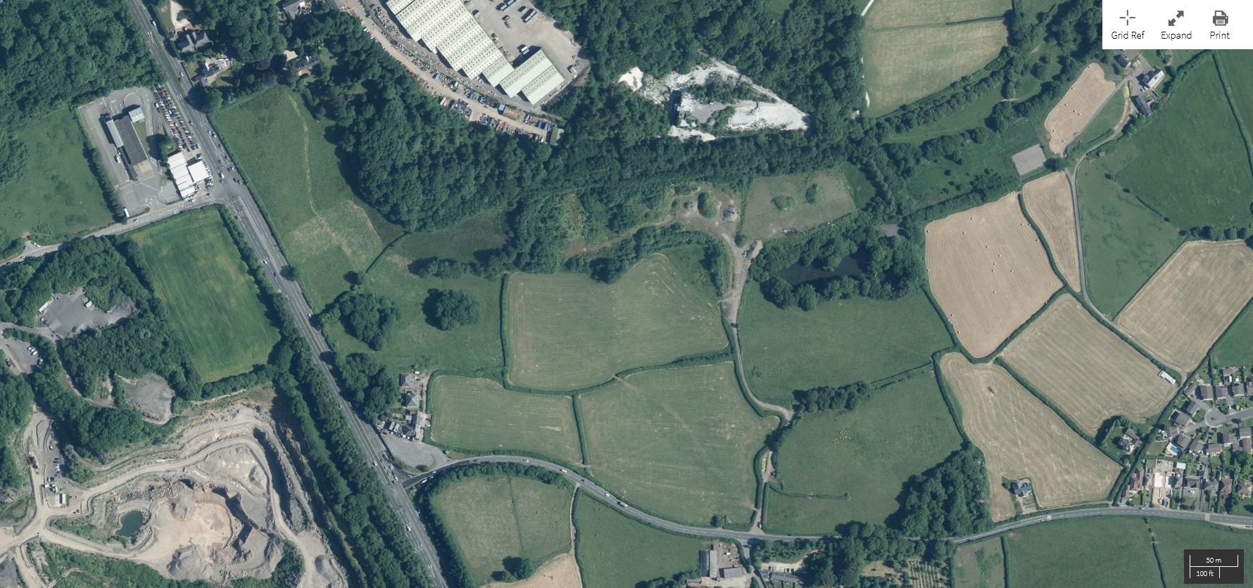
Current soil storage areas
Current aggregate storage
areas
Current treatment areas
Existing drainage channel
Proposed area
for concrete
Sealed sump for drainage

