Slide 1
NRW IED Review Meeting
Queensferry WwTW
23.10.20

Slide 2
Contents
Background and purpose
Basis of assessment
Method for data gathering
CIRIA 736 risk assessment approach
Inspection and Maintenance
Solution proposals

Slide 3
Background and purpose
Regulation 61 Notice Issued requiring DCWW to assess Queensferry, Afan, Cardiff and Eign and update existing waste installation permits.
Permit production to be aligned with the principals of best available techniques (BAT) for waste treatment under Directive 2010/75/EU of the European Parliament and of the Council (notified under document C(2018) 5070).
Main focus is BAT 19 – Emissions to water (secondary containment as per CIRIA 736, Design of containment systems for the prevention of pollution: secondary, tertiary and other measures for industrial and commercial purposes’ 2004.).

Slide 4
Queensferry WwTW

Slide 5
Information gathering
Information gathering exercise limited to desk top study due to Covid-19 restrictions.
Records from previous projects – CAD drawings of work done in 2018 (digesters) and 2002 (cake bays, thickener and centrifuge)
Consultation with previous operations supervisor (Michaella Thompson) for record information of the 1980 build.
Consultation with current site operator – to understand general operating procedures for the sludge treatment and storage assets
BGS logs – ground conditions to inform ground desk study.
LIDAR data and topographical survey information to model pathways.
Ecology – MAGIC maps, Local environmental records centre search to establish key receptors.

Slide 6
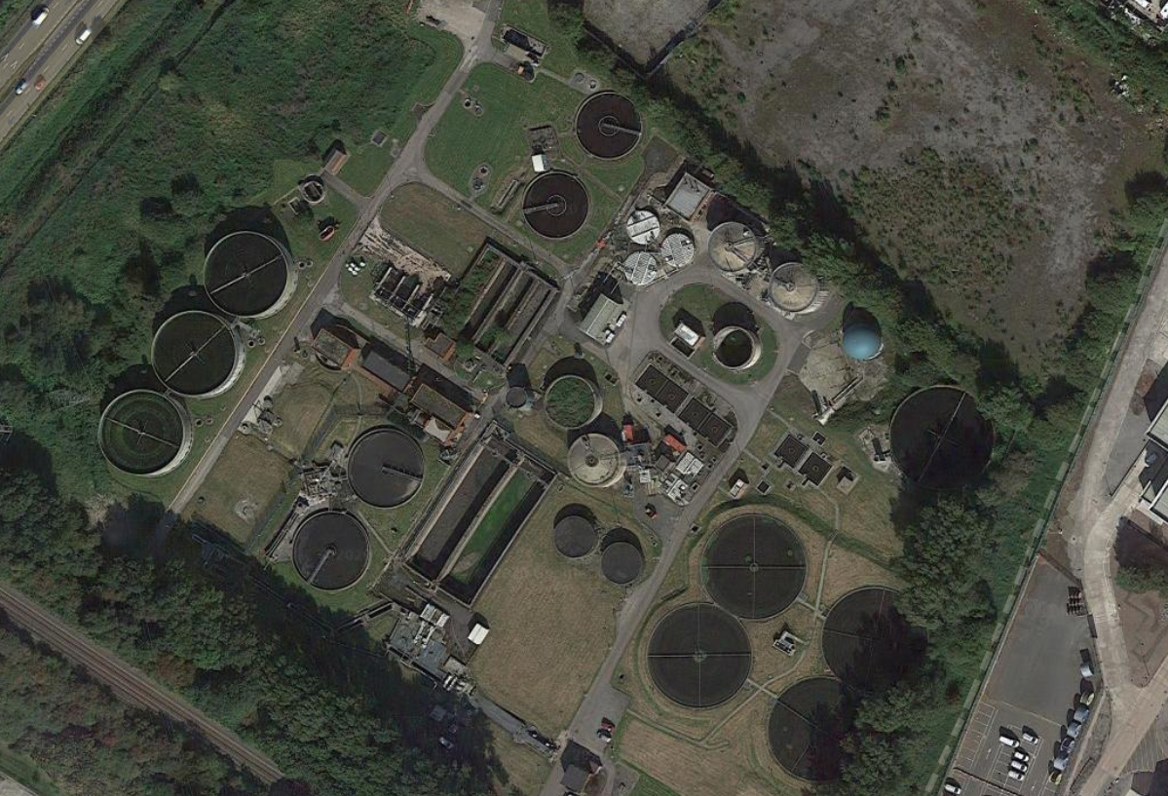
Queensferry WwTW

Slide 7
Queensferry - Schematic
Sludge from main works
Digesters
Imported sludge tank
Screened
Mixing/ consolidation tanks
Thickener
Thickened sludge tank
PS
Cake bays
Imported sludge >4% to bypass thickener
Digesters
Digested sludge
holding tanks
Centrifuge holding tank
PS
Centrifuge
De-Commissioned Tanks
PS

Slide 8
IED Zones
2 – Consolidation tanks
6 – Digested sludge holding tanks – formally aeration lanes
3 - Digesters
8 – Cake bays
7 – Centrifuge feed tank
5 – Concrete Digested sludge holding tanks:
Will be de-commissioned.
1 – Imported sludge tank
4 – GFS Digested sludge holding tanks:
Will be de-commissioned.

Slide 9
Solution Approach
Existing layout and gap analysis
Source Pathway Receptor Risk assessment
Failure modes (likelihood)
Mitigation measures without bunding (telemetry and vehicular barriers)
Catastrophic failure and pragmatic volume calculation for above ground volume
Civil 3D model –analysis to calculate bunding volume provision
Optioneering and solution

Slide 10
Risk assessment and solution approach spreadsheet overview
Digester example

Slide 11
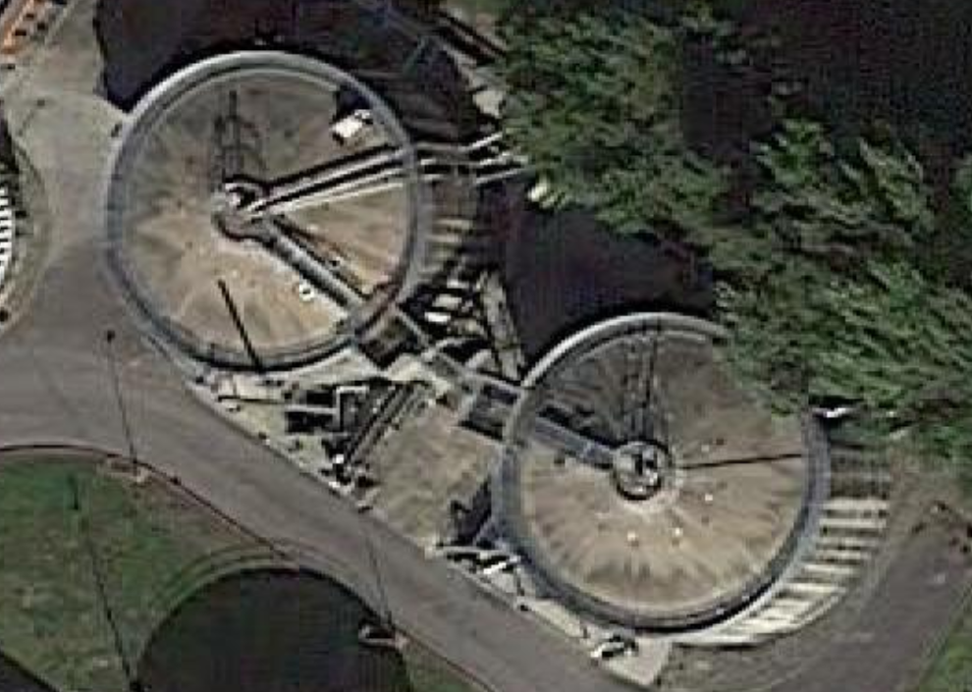
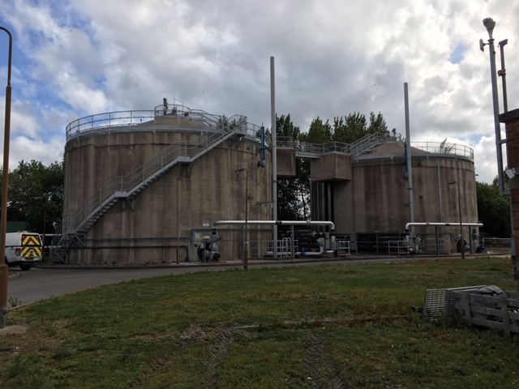
IED – Zone 3
Zone | Description
Zone 3 | Digester feed and return PS and Digesters (Original construction 1981). 2 above ground concrete tanks – 1600m³ concrete above ground tanks. Roofs refurbished in 2018 after statutory structural inspection. All above ground connecting pipework is thick-walled stainless steel. Surrounding external area is stone. Road south of tanks drains through gullies into two soakaways next to the old gas holder.

Slide 12
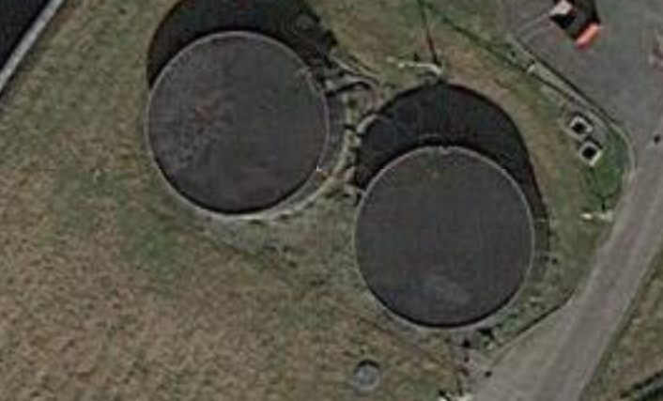
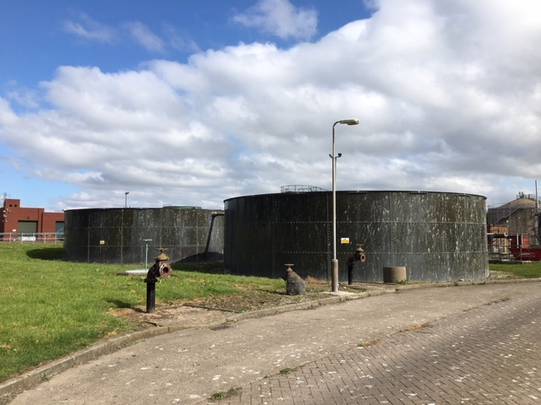
IED – Zone 4
Zone | Description
Zone 4 | GFS Digested sludge holding tanks 2 x 468m³ steel above ground tanks. Constructed in 2003. Connecting pipework appears to be ductile iron – above and below ground pipes. Surrounding external area is stone and grass.

Slide 13
Secondary containment volume required based on failure
Failure |  | Catastrophic | Pragmatic - no site presence | Pragmatic - site presence
Operational failure – tank All tanks | Overfilling Foaming Tanker spilling | 110% of volume above ground - Worst case | Filling and spilling of sludge treatment done with operational staff present. Spilling not a concern with site being not manned. Alarms would notify staff in case of foaming. Allow for foaming of volume between TWL and top of tank | Filling and spilling being done manually currently. Operational staff use levels sensors in tanks to check filling and spilling. Should allow for high level alarms which is currently not in place. Could also implement high level overflows to mitigate the overflow potential completely. In case of overflow of tanks, if staff is not present in area, allowance for 30min to 1hour before valve is shut off stopping overflow. Volume based on flow rate to tanks to be allowed for. Consolidation tanks, digesters and centrifuge feed tank have high level overflows - overfilling should not be an issue. Tanks to consider - Digested sludge holding tanks - being fed at 8l/s (2 digesters). To allow for 29m³ containment around each digested sludge holding tank. In the case of valve seizure (double jeopardy) - Allow for another half hour of volume loss. Could provide double valves to reduce volume. Alarms would notify staff in case of foaming. Allow for foaming of volume between TWL and top of tank

Slide 14
Secondary containment volume required based on failure
Failure |  | Catastrophic | Pragmatic - no site presence | Pragmatic - site presence
Structural failure - tank (GFS) Digested sludge holding tanks zone 4 and Centrifuge feed tank | Leaks Corrosion Sealant leak Sealant failure - loss through base | 110% of volume above ground - Worst case | Cracks and leaks - if significant DCWW would repair tanks and spot leaks in daily site inspection. Small leakage would be contained in concrete area around tank. In case the leaks are not spotted or catastrophic failure when site is manned: Alarms should notify staff when there is a significant drop in tank level based on ultrasonic level meter readings. Alarm for call out at 500mm drop in level - would notify at 100mm increments Allow for 1000mm volume loss until operational staff arrives during operating hours before tank is drained down. In the case of valve seizure (double jeopardy) - Allow for another 500mm of volume loss (1500mm in total). Could provide double valves to reduce volume. | Cracks and leaks - if significant DCWW would repair tanks and spot leaks in daily site inspection. Small leakage would be contained in concrete area around tank. In case the leaks are not spotted or catastrophic failure when site is manned: Alarms should notify staff when there is a significant drop in tank level based on ultrasonic level meter readings. Alarm for call out at 500mm drop in level - would notify at 100mm increments Allow for 1000mm volume loss until operational staff arrives during operating hours before tank is drained down. In the case of valve seizure (double jeopardy) - Allow for another 500mm of volume loss (1500mm in total). Could provide double valves to reduce volume.

Slide 15
Secondary containment volume required based on failure
Failure |  | Catastrophic | Pragmatic - no site presence | Pragmatic - site presence
Structural failure - tank (Concrete) Digested sludge holding tanks zone 5&6 and Digesters | Cracks Leaks Corrosion Pipe/mixer breaks off - orifice | 110% of volume above ground - Worst case | Cracks and leaks - if significant DCWW would repair tanks and spot leaks in daily site inspection. Small leakage would be contained in concrete area around tank. In case the leaks are not spotted or catastrophic failure when site is manned: Alarms should notify staff when there is a significant drop in tank level based on ultrasonic level meter readings. Alarm for call out at 500mm drop in level - would notify at 100mm increments Allow for 1000mm volume loss until operational staff arrives during operating hours before tank is drained down. In the case of valve seizure (double jeopardy) - Allow for another 500mm of volume loss (1500mm in total). Could provide double valves to reduce volume. | Cracks and leaks - if significant DCWW would repair tanks and spot leaks in daily site inspection. Small leakage would be contained in concrete area around tank. In case the leaks are not spotted or catastrophic failure when site is manned: Alarms should notify staff when there is a significant drop in tank level based on ultrasonic level meter readings. Alarm for call out at 500mm drop in level - would notify at 100mm increments Allow for 1000mm volume loss until operational staff arrives during operating hours before tank is drained down. In the case of valve seizure (double jeopardy) - Allow for another 500mm of volume loss (1500mm in total). Could provide double valves to reduce volume.

Slide 16
Secondary containment volume required based on failure
Failure |  | Catastrophic | Pragmatic - no site presence | Pragmatic - site presence
Structural failure - pipework | Leaks Corrosion Rising main breaks off - pumped volume escapes Valve seizure | 110% of volume above ground - Worst case - If loss in pressure, rising main failure, pressure sensors will be installed to shut off pumps - would be immediate. Allow for total volume of pipe section to be lost Underground pipe containment not considered. | Leaks in above ground pipework - if significant DCWW would repair leaks and spot leaks in daily site inspection. Small leakage would be contained in hardstanding area around pipe. In case they are not spotted - small leaks becoming larger leaks: If leaks become significant, pipe could lose all the contents within the pipe section. Allow for total volume of pipe section to be lost. | Leaks in above ground pipework - if significant DCWW would repair leaks and spot leaks in daily site inspection. Small leakage would be contained in hardstanding area around pipe. In case they are not spotted - small leaks becoming larger leaks: If leaks become significant, pipe could lose all the contents within the pipe section. Allow for total volume of pipe section to be lost.
Vehicular impact | Vehicular impact - significant cracks in concrete tank or failure of GFS tank | 110% of volume above ground - Worst case - Mitigated through vehicular barriers | Unlikely and not considered - Mitigated through vehicular barriers | Unlikely and not considered
Vandalism | Damage to tanks and pipework | Unlikely and not considered | Unlikely and not considered | Unlikely and not considered
Flooding | Damage to tanks and pipework - floodwater could get contaminated with inventory | Unlikely and not considered | Unlikely and not considered | Unlikely and not considered

Slide 17
Catastrophic failure vs.
Pragmatic volumes
Zone | Catastrophic failure volume | Pragmatic volume
1 | 33m³ | 3m³
2 | 82.5m³ | 0m³
3 | 1562m³ | 265m³
4 | 514.8m³ | 133m³
5 | 1586.2m³ | 216m³
6 | 30.8m³ | 28m³
7 | 157m³ | 35m³
8 | 15.6m³ | 15.6m³

Slide 18
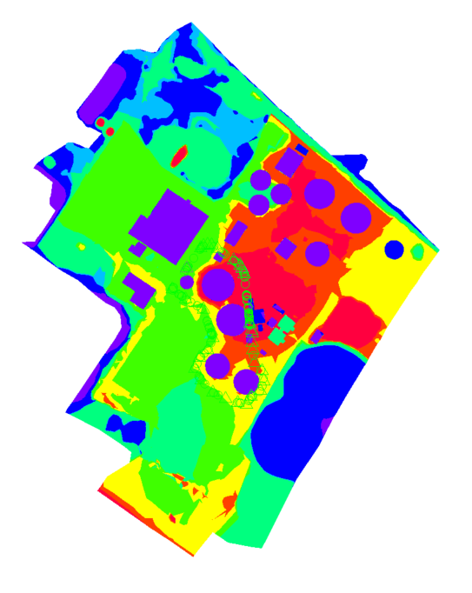
Civil 3D modelling
Lower lying areas
Higher lying areas

Slide 19
DCWW maintenance and operation

Slide 20
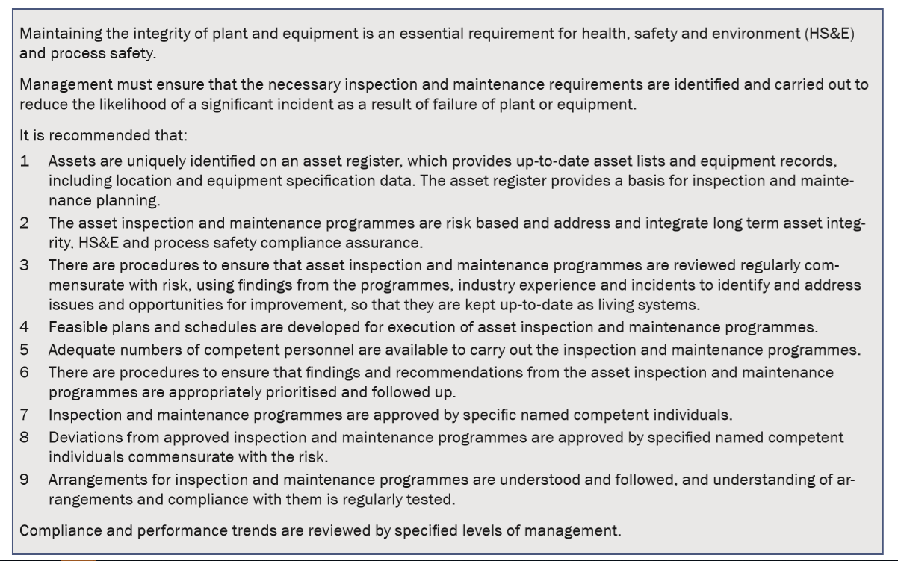
Maintenance and Operation

Slide 21
Solution

Slide 22
Solution Considerations
Ducting and underground services – potential pathways.
Provides secondary containment for sludge stored above ground.
Manhole and chamber volumes (above and below ground) not considered as part of volume.
Acknowledges need for new rainwater attenuation.
Freeboard - low flow and little wave action associated with credible cause of failure
Firefighting requirements (firewater allowance not significant for methane)
Notes:
Ducts and Underground Services – these can act as potential pathways and there are a lot of them within the permit boundary at Queensferry.
Acknowledgment that ducts aren’t normally specified to be leak proof for example. Therefore work would need to include sealing off of drawpits from surface run off, tracing and CCTV of pipelines to verify their condition and verify they don’t provide a pathway outside the intended bund area.
The bunding solution provides secondary containment for sludge stored above ground.
Rainfall, acknowledgement of increased hardstanding area and need for below ground attenuation volume to manage larger storm events.
Nature of credible failure modes such as overflow or foaming means loss of containment at low flow rates with little or no surge effects.
Firefighting water is insignificant when considering inventory (sludge). Methane is explosive under certain conditions but such an event is extremely unlikely and can be isolated and controlled very quickly.

