Slide 1
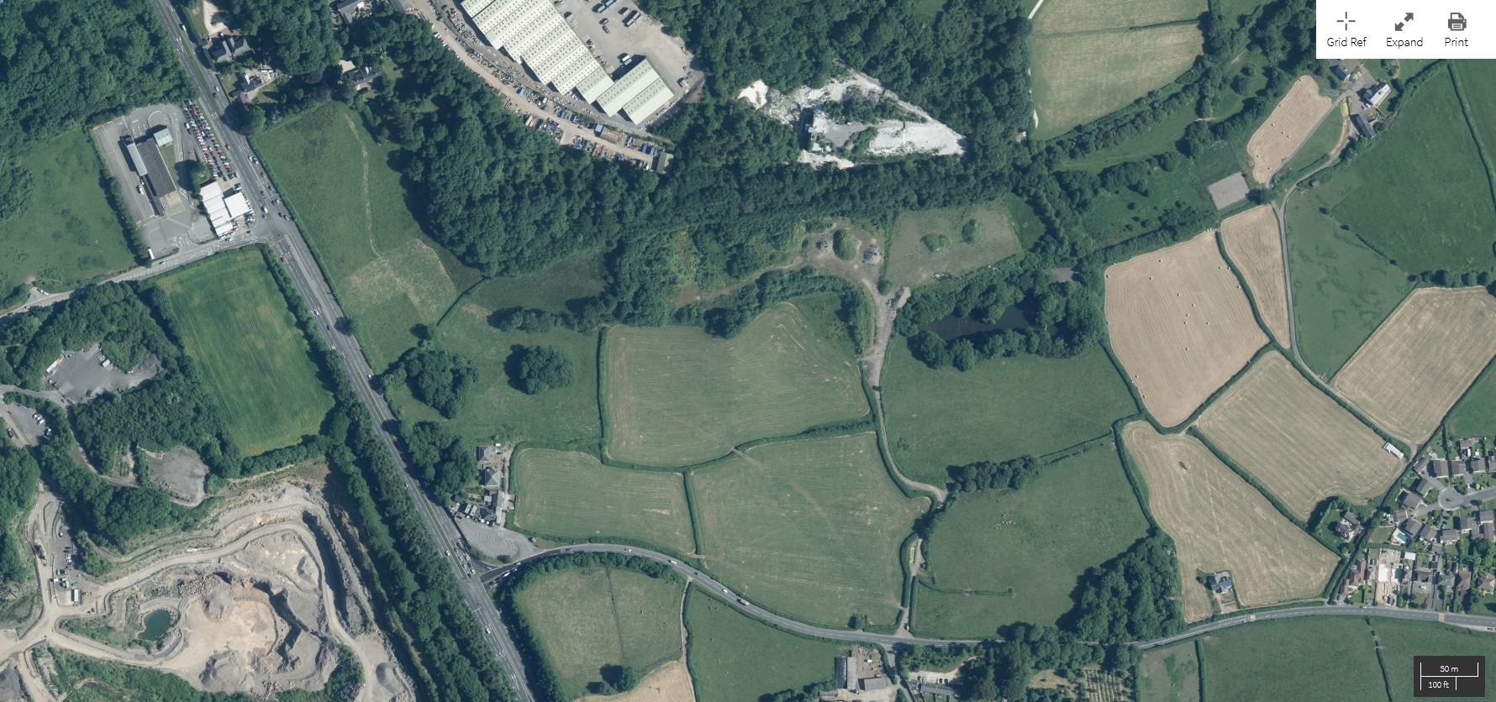
Current soil storage areas
Current aggregate storage
areas
Current treatment areas
Existing drainage channel
Proposed area
for extension
Proposed drainage
channel

